Slide 1
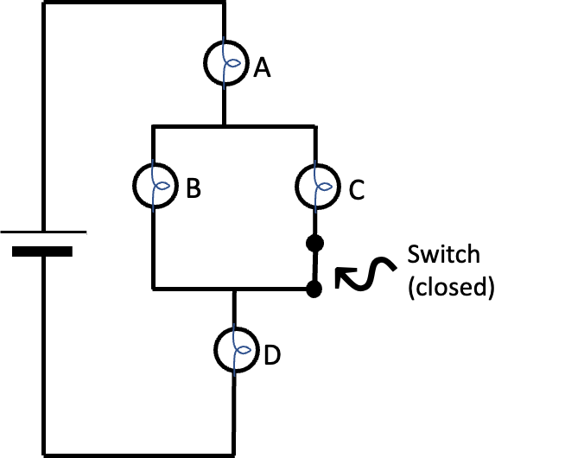


Rank the bulbs explain question
The switch in the circuit at right is
originally closed.
When the switch is closed, the
ranking of the brightness of the bulbs is
A = D > B = C. Explain why this ranking
is observed. (If this ranking doesn’t
make sense, say why not or
what you expected differently.)
When the switch is opened,
bulbs A and D get dimmer, bulb B
gets brighter, and bulb C goes out
(does not light). Explain why this is observed when the switch is opened. (Again, if it doesn’t make sense, please say so, and why not.)
ACORN Physics Tutorials
© Seattle Pacific University
Supported in part by
NSF Grant Nos. 1914603 & 1914572.

