Slide 1
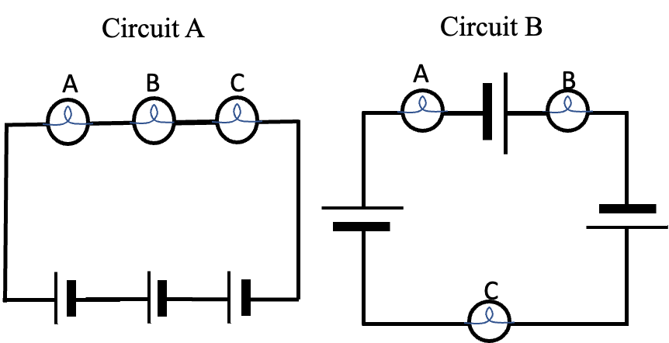


Order of elements explain question
A TA constructs two circuits
(shown at right). Each circuit
contains the same
3 bulbs and 3 batteries.
The only difference between the
two circuits is the order in which
the elements are placed.
The brightness of the bulbs in
circuit A and B are the same.
(i.e., all 6 bulbs shine equally bright).
Does this observation make sense to you? Explain how your understanding of circuits supports or opposes this observation.
ACORN Physics Tutorials
© Seattle Pacific University
Supported in part by
NSF Grant Nos. 1914603 & 1914572.

