Slide 1
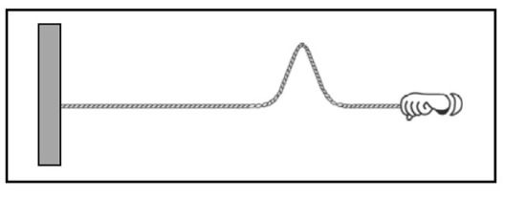


Tension pulse flick question
Consider the following
two scenarios: In scenario 1,
your Teaching Assistant (TA)
creates a pulse by flicking
the end of a spring, as in
the figure at right. In
scenario 2, your TA pulls the spring so that it is more taut (i.e., increases the tension in the spring) and then creates a pulse by flicking the end of the spring in the same way. The pulse in scenario 2 travels down the spring faster (i.e., has a larger speed) than the pulse in scenario 1.
Why would it make sense for a pulse to move faster on a higher-tension spring?
ACORN Physics Tutorials
© Seattle Pacific University
Supported in part by
NSF Grant Nos. 1914603 & 1914572.

