Slide 1
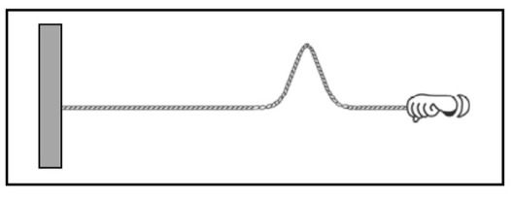


Mass density pulse flick question
Consider the following
two scenarios: In scenario 1,
your Teaching Assistant (TA)
creates a pulse by
flicking the end of a spring,
as in the figure at right.
In scenario 2, your TA uses a
heavier spring (i.e., increases the mass density of the spring) and then creates a pulse by flicking the end of the spring in the same way. The pulse in scenario 2 travels down the spring more slowly (i.e., has a lower speed) than the pulse in scenario 1.
Why would it make sense for a pulse to move more slowly on a heavier spring?
ACORN Physics Tutorials
© Seattle Pacific University
Supported in part by
NSF Grant Nos. 1914603 & 1914572.

