Slide 1


Ball/clay predict question
Imagine you want to shut a door quickly but can’t reach it. You have at your disposal a rubber bouncy ball and an equally massive piece of clay.
Which of these would you choose to throw at the door so that you have a higher chance to shut the door quickly and why?
ACORN Physics Tutorials
© Seattle Pacific University
Supported in part by
NSF Grant Nos. 1914603 & 1914572.

Slide 2
Desk chair momentum predict question
Two students are facing one another while sitting at rest in desk chairs with low-friction bearings. One of the students tosses a large, heavy ball to the other.
Does the student who catches the ball remain at rest?
Does the student who tosses the ball remain at rest?
Explain why your answers make sense to you.
ACORN Physics Tutorials
© Seattle Pacific University
Supported in part by
NSF Grant Nos. 1914603 & 1914572.

Slide 3
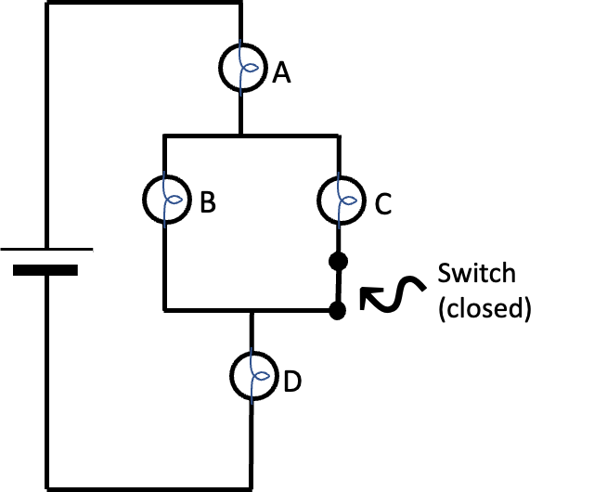
Rank the bulbs explain question
The switch in the circuit at right is
originally closed.
When the switch is closed, the
ranking of the brightness of the bulbs is
A = D > B = C. Explain why this ranking
is observed. (If this ranking doesn’t
make sense, say why not or
what you expected differently.)
When the switch is opened,
bulbs A and D get dimmer, bulb B
gets brighter, and bulb C goes out
(does not light). Explain why this is observed when the switch is opened. (Again, if it doesn’t make sense, please say so, and why not.)
ACORN Physics Tutorials
© Seattle Pacific University
Supported in part by
NSF Grant Nos. 1914603 & 1914572.

Slide 4
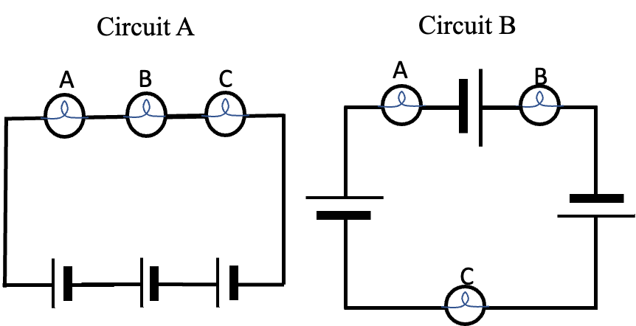
Order of elements explain question
A TA constructs two circuits
(shown at right). Each circuit
contains the same
3 bulbs and 3 batteries.
The only difference between the
two circuits is the order in which
the elements are placed.
The brightness of the bulbs in
circuit A and B are the same.
(i.e., all 6 bulbs shine equally bright).
Does this observation make sense to you? Explain how your understanding of circuits supports or opposes this observation.
ACORN Physics Tutorials
© Seattle Pacific University
Supported in part by
NSF Grant Nos. 1914603 & 1914572.

Slide 5
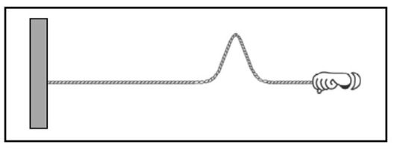
Tension pulse flick question
Consider the following
two scenarios: In scenario 1,
your Teaching Assistant (TA)
creates a pulse by flicking
the end of a spring, as in
the figure at right. In
scenario 2, your TA pulls the spring so that it is more taut (i.e., increases the tension in the spring) and then creates a pulse by flicking the end of the spring in the same way. The pulse in scenario 2 travels down the spring faster (i.e., has a larger speed) than the pulse in scenario 1.
Why would it make sense for a pulse to move faster on a higher-tension spring?
ACORN Physics Tutorials
© Seattle Pacific University
Supported in part by
NSF Grant Nos. 1914603 & 1914572.

Slide 6
Mass density pulse flick question
Consider the following
two scenarios: In scenario 1,
your Teaching Assistant (TA)
creates a pulse by
flicking the end of a spring,
as in the figure at right.
In scenario 2, your TA uses a
heavier spring (i.e., increases the mass density of the spring) and then creates a pulse by flicking the end of the spring in the same way. The pulse in scenario 2 travels down the spring more slowly (i.e., has a lower speed) than the pulse in scenario 1.
Why would it make sense for a pulse to move more slowly on a heavier spring?
ACORN Physics Tutorials
© Seattle Pacific University
Supported in part by
NSF Grant Nos. 1914603 & 1914572.

Slide 7
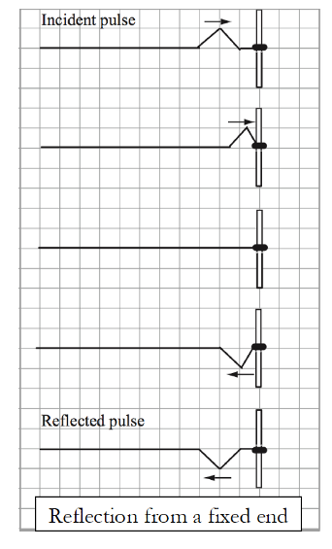
Fixed end reflection question
When wave pulses move through
fixed ends (e.g., when the string is
attached to the wall), they reflect on
the opposite side of the string, as in
the figure at right.
How do you make sense of
this phenomenon? In other words,
why do you think pulses reflect on the
opposite side of the string at fixed ends?
ACORN Physics Tutorials
© Seattle Pacific University
Supported in part by
NSF Grant Nos. 1914603 & 1914572.

Slide 8
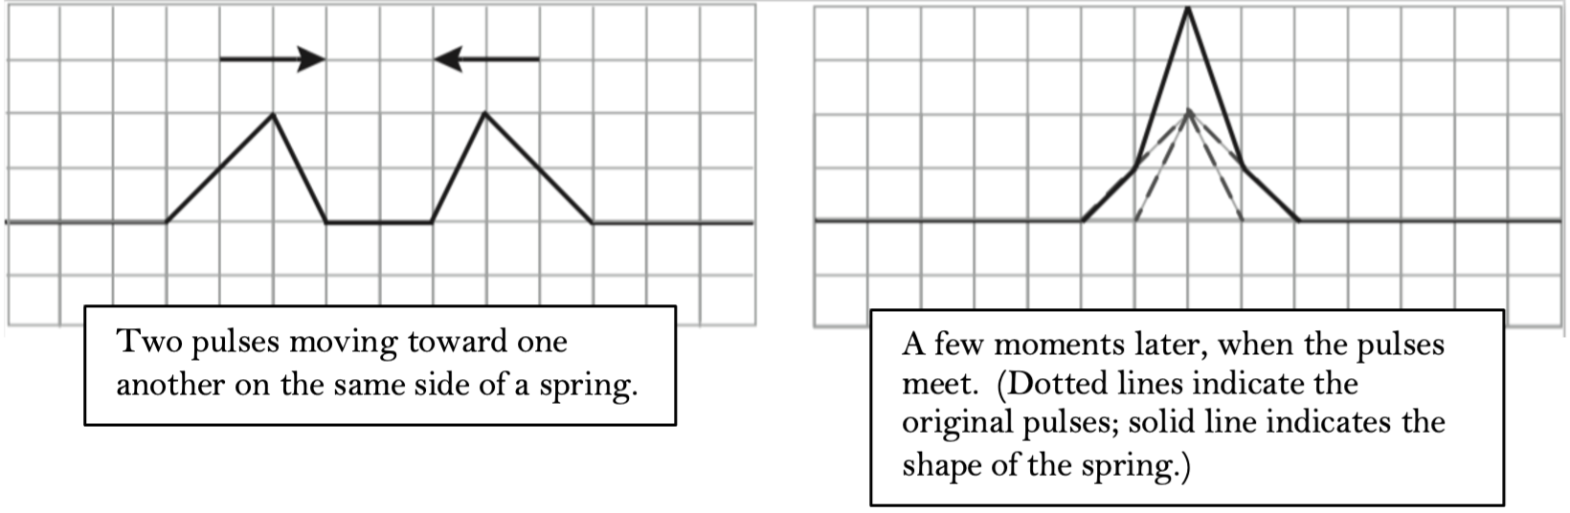
Superposition mechanism question
When two wave pulses
on the same side
of a spring meet,
they add, as in
the figure at right.
This is an example of superposition.
How do you make sense of this phenomenon? In other words, why do pulses add when they’re on the same side of the spring/why does the superposition principle work the way it does?
ACORN Physics Tutorials
© Seattle Pacific University
Supported in part by
NSF Grant Nos. 1914603 & 1914572.

Slide 9
Metal blocks question
Two metal blocks sitting on a table, one hot and one cold, are placed in contact with one another. Over the next several minutes, the blocks become the same temperature as one another, and eventually the same temperature as the room.
What is your mental model that helps you explain why this happens?
ACORN Physics Tutorials
© Seattle Pacific University
Supported in part by
NSF Grant Nos. 1914603 & 1914572.

Slide 10
Heat-transfers-from-hot-to-cold question
You may have heard that “heat” or “thermal energy” transfers from hot to cold objects, and not the other way around.
Why is that? How do you make sense of this?
ACORN Physics Tutorials
© Seattle Pacific University
Supported in part by
NSF Grant Nos. 1914603 & 1914572.

Slide 11
Cubes question
A scientist in a laboratory does a series of experiments with identical cubes. The cubes are the same mass, same material, and same shape, and all start at room temperature. In every experiment, the scientist drops the cubes into a pot of boiling water. The cubes stay in the water for five minutes and then are dumped onto a table, and the scientist measures their temperature.
In one of these experiments, the temperature of one of the cubes is much higher than the temperature of the other two. How do you make sense of this?
In another experiment, all three cubes have the same temperature. How do you make sense of this?
In yet another experiment, one of the three cubes has a temperature less than room temperature (i.e., the cube got colder in the water). How do you make sense of this?
ACORN Physics Tutorials
© Seattle Pacific University
Supported in part by
NSF Grant Nos. 1914603 & 1914572.

Slide 12
Particles question
Imagine it were possible for a scientist to track single gas particles in a sealed container and measure their speed at different moments. In a series of experiments, this scientist takes a sealed container of gas and identifies three identical gas particles, all moving with the same initial speed but in different (random) directions. Five minutes later, the scientist locates the same three particles and measures their speeds again.
In one of these experiments, the scientist finds that five minutes after the initial measurement, one of the three particles has a much higher speed than the other two particles. How do you make sense of this?
In another experiment, the scientist finds that five minutes after the initial measurement, the three particles have the same speed as one another. How do you make sense of this?
In yet another experiment, the scientist finds that five minutes after the initial measurement, one of the particles has a speed much lower than the initial particle speeds (i.e., the particle slowed down). How do you make sense of this?
ACORN Physics Tutorials
© Seattle Pacific University
Supported in part by
NSF Grant Nos. 1914603 & 1914572.

