Slide 1
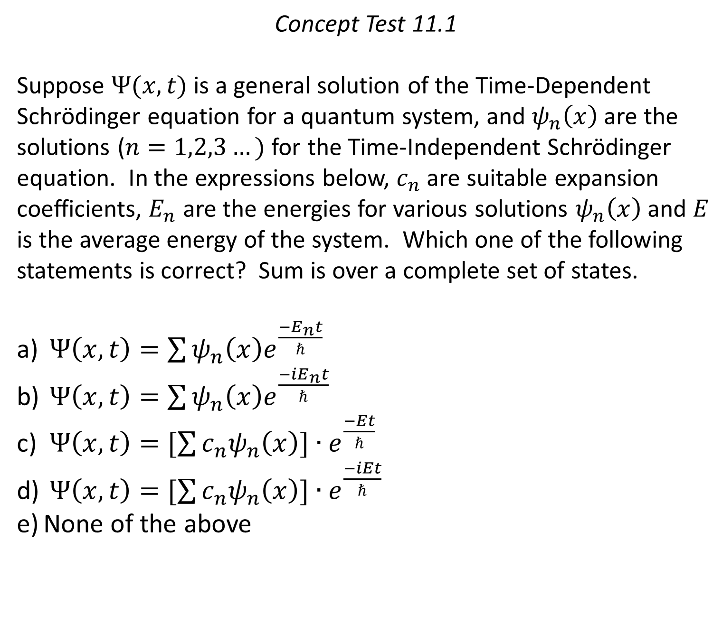
Concept Test 11.1
Suppose $Ψ(x,t)$ is a general solution of the Time-Dependent Schrödinger equation for a quantum system, and $ψ_{n}\left(x\right)$ are the solutions ($n=1,2,3…)$ for the Time-Independent Schrödinger equation. In the expressions below, $c_{n}$ are suitable expansion coefficients, $E_{n}$ are the energies for various solutions $ψ_{n}\left(x\right)$and $E$ is the average energy of the system. Which one of the following statements is correct? Sum is over a complete set of states.
$Ψ\left(x,t\right)=\sum{ψ_{n}\left(x\right)e^{\frac{−E_{n}t}{ℏ}}}$
$Ψ\left(x,t\right)=\sum{ψ_{n}\left(x\right)e^{\frac{−iE_{n}t}{ℏ}}}$
$Ψ\left(x,t\right)=[\sum{c_{n}ψ_{n}\left(x\right)]{∙e}^{\frac{−Et}{ℏ}}}$
$Ψ\left(x,t\right)=[\sum{c_{n}ψ_{n}\left(x\right)]∙e^{\frac{−iEt}{ℏ}}}$
None of the above

Slide 2
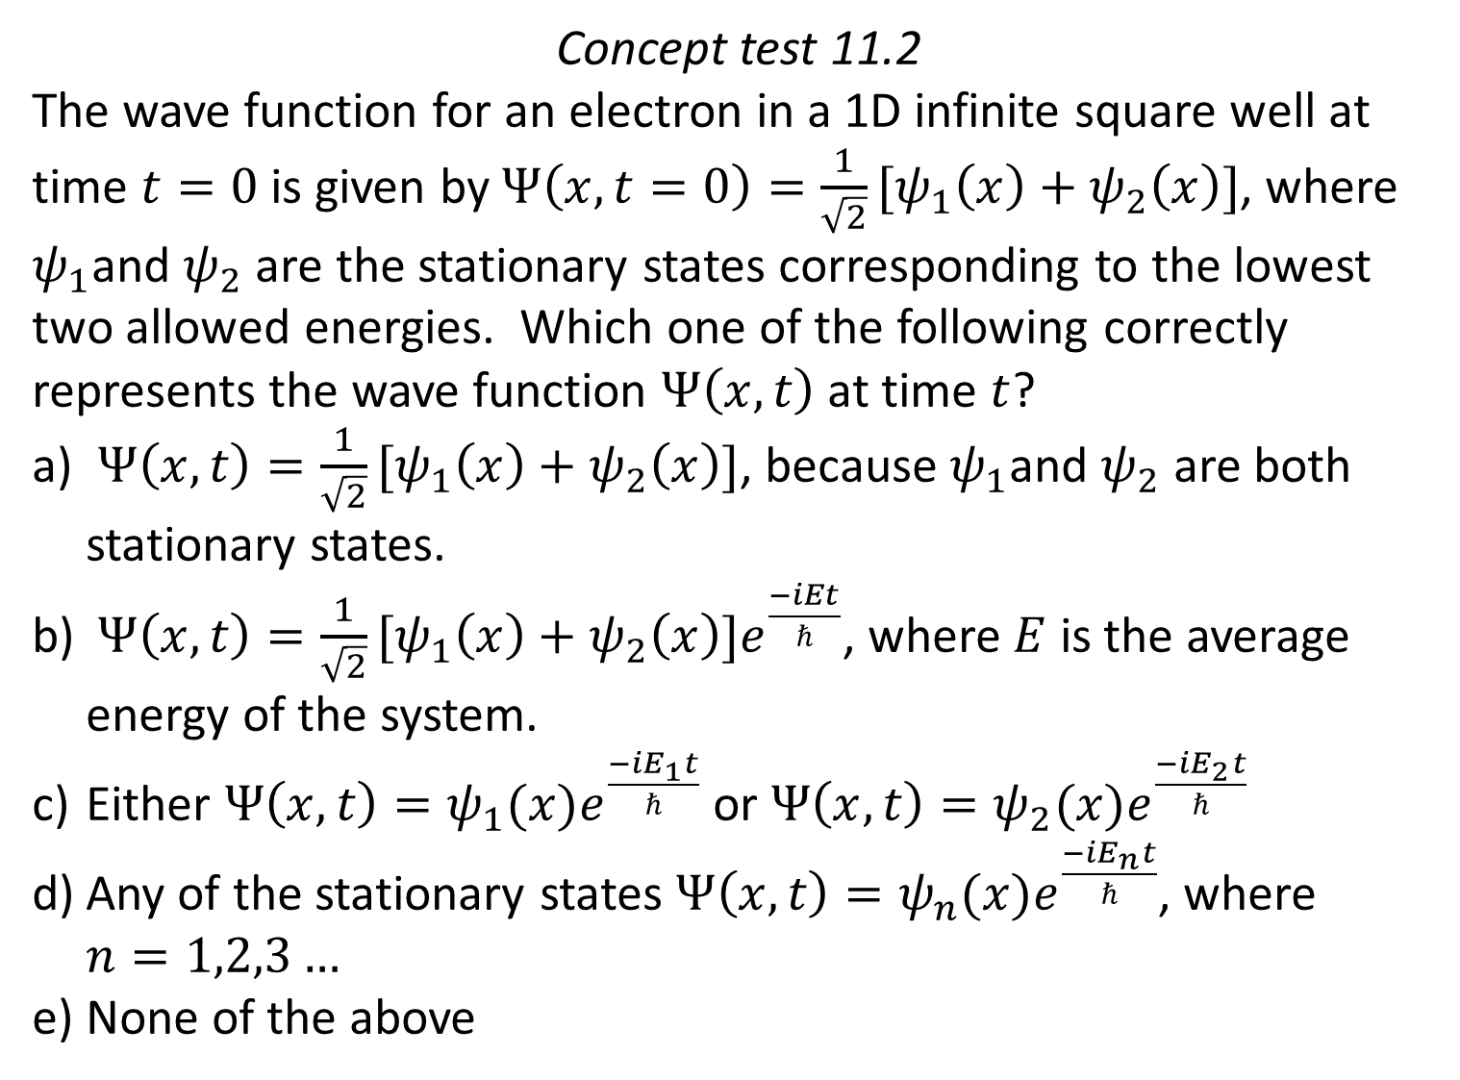
Concept test 11.2
The wave function for an electron in a 1D infinite square well at time $t=0$ is given by $Ψ\left(x, t=0\right)=\frac{1}{\sqrt{2}}[ψ_{1}\left(x\right)+ψ_{2}\left(x\right)]$, where $ψ_{1}$and $ψ_{2}$ are the stationary states corresponding to the lowest two allowed energies. Which one of the following correctly represents the wave function $Ψ\left(x, t\right)$ at time $t$?
$Ψ\left(x, t\right)=\frac{1}{\sqrt{2}}[ψ_{1}\left(x\right)+ψ_{2}\left(x\right)]$, because $ψ_{1}$and $ψ_{2}$ are both stationary states.
$Ψ\left(x, t\right)=\frac{1}{\sqrt{2}}[ψ_{1}\left(x\right)+ψ_{2}\left(x\right)]e^{\frac{−iEt}{ℏ}}$, where $E$ is the average energy of the system.
Either $Ψ\left(x, t\right)=ψ_{1}(x)e^{\frac{−iE_{1}t}{ℏ}}$ or $Ψ\left(x, t\right)=ψ_{2}(x)e^{\frac{−iE_{2}t}{ℏ}}$
Any of the stationary states $Ψ\left(x, t\right)=ψ_{n}(x)e^{\frac{−iE_{n}t}{ℏ}}$, where $n=1,2,3…$
None of the above

Slide 3
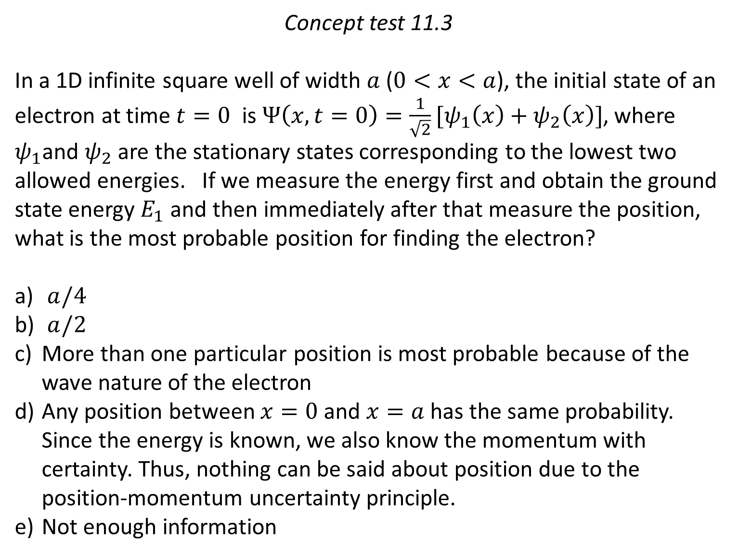
Concept test 11.3
In a 1D infinite square well of width $a$ ($0<x<a$), the initial state of an electron at time $t=0$ is $Ψ\left(x, t=0\right)=\frac{1}{\sqrt{2}}[ψ_{1}\left(x\right)+ψ_{2}\left(x\right)]$, where $ψ_{1}$and $ψ_{2}$ are the stationary states corresponding to the lowest two allowed energies. If we measure the energy first and obtain the ground state energy $E_{1}$ and then immediately after that measure the position, what is the most probable position for finding the electron?
$a/4$
$a/2$
More than one particular position is most probable because of the wave nature of the electron
Any position between $x=0$ and $x=a$ has the same probability. Since the energy is known, we also know the momentum with certainty. Thus, nothing can be said about position due to the position-momentum uncertainty principle.
Not enough information

Slide 4
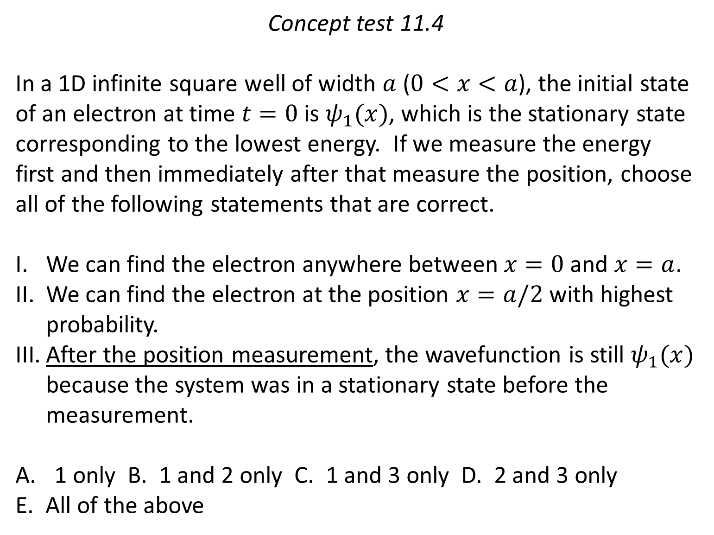
Concept test 11.4
In a 1D infinite square well of width $a$ ($0<x<a$), the initial state of an electron at time $t=0$ is $ψ_{1}(x)$, which is the stationary state corresponding to the lowest energy. If we measure the energy first and then immediately after that measure the position, choose all of the following statements that are correct.
We can find the electron anywhere between $x=0$ and $x=a$.
We can find the electron at the position $x=a/2$ with highest probability.
After the position measurement, the wavefunction is still $ψ_{1}(x)$ because the system was in a stationary state before the measurement.
1 only B. 1 and 2 only C. 1 and 3 only D. 2 and 3 only
E. All of the above

Slide 5
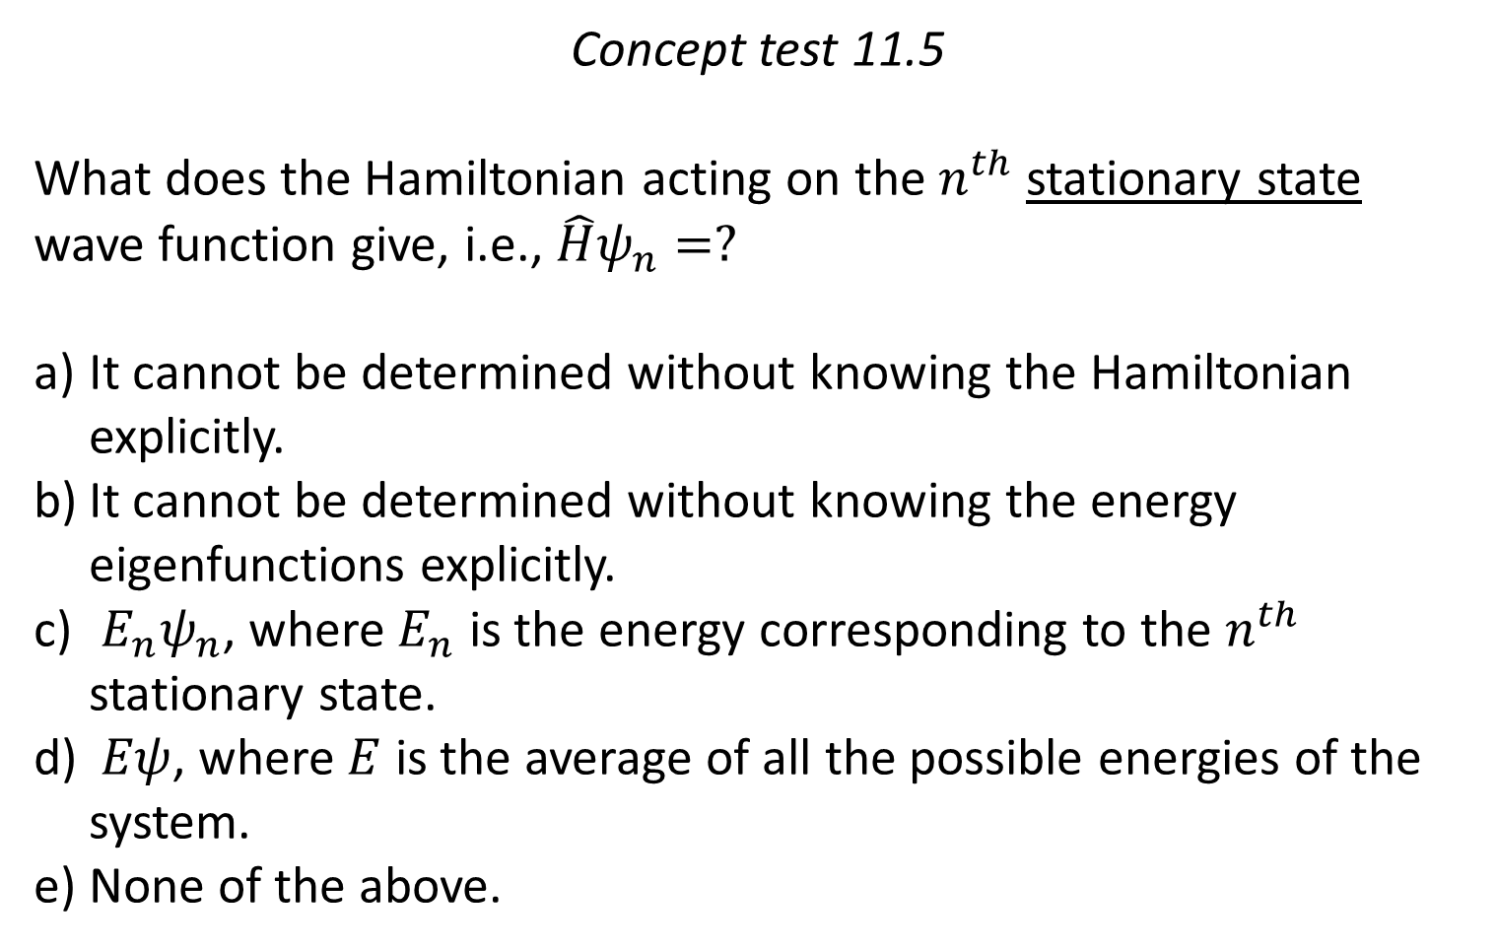
Concept test 11.5
What does the Hamiltonian acting on the $n^{th}$ stationary state wave function give, i.e., $\hat{H}ψ_{n}=?$
It cannot be determined without knowing the Hamiltonian explicitly.
It cannot be determined without knowing the energy eigenfunctions explicitly.
$E_{n}ψ_{n}$, where $E_{n}$ is the energy corresponding to the $n^{th}$ stationary state.
$Eψ$, where $E$ is the average of all the possible energies of the system.
None of the above.

Slide 6
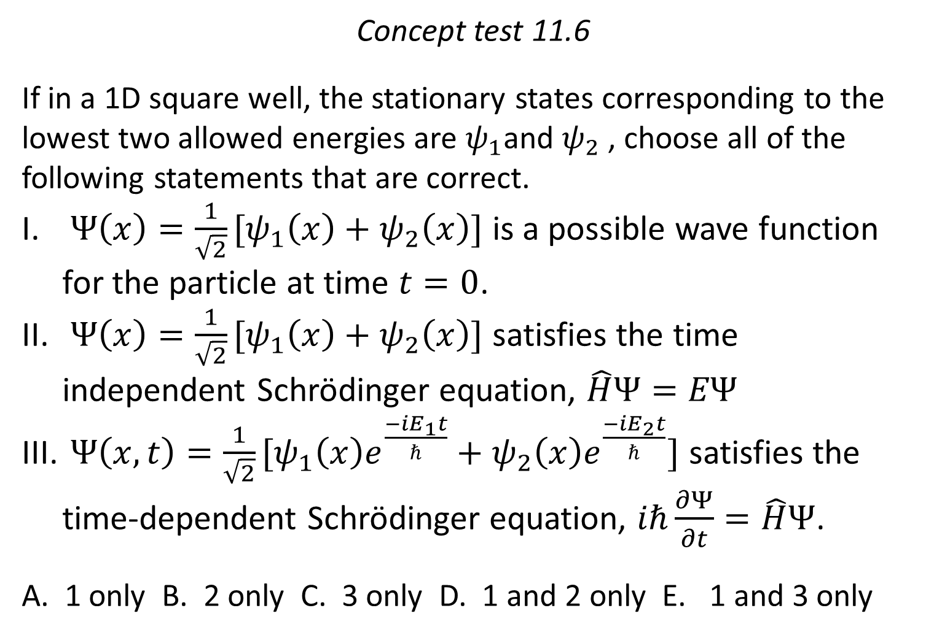
Concept test 11.6
If in a 1D square well, the stationary states corresponding to the lowest two allowed energies are $ψ_{1}$and $ψ_{2}$ , choose all of the following statements that are correct.
$Ψ\left(x\right)=\frac{1}{\sqrt{2}}[ψ_{1}\left(x\right)+ψ_{2}\left(x\right)]$ is a possible wave function for the particle at time $t=0$.
$Ψ\left(x\right)=\frac{1}{\sqrt{2}}[ψ_{1}\left(x\right)+ψ_{2}\left(x\right)]$ satisfies the time independent Schrödinger equation, $\hat{H}Ψ=EΨ$
$Ψ\left(x, t\right)=\frac{1}{\sqrt{2}}[ψ_{1}\left(x\right)e^{\frac{−iE_{1}t}{ℏ}}+ψ_{2}\left(x\right)e^{\frac{−iE_{2}t}{ℏ}}]$ satisfies the time-dependent Schrödinger equation, $iℏ\frac{∂Ψ}{∂t}=\hat{H}Ψ$.
A. 1 only B. 2 only C. 3 only D. 1 and 2 only E. 1 and 3 only

Slide 7
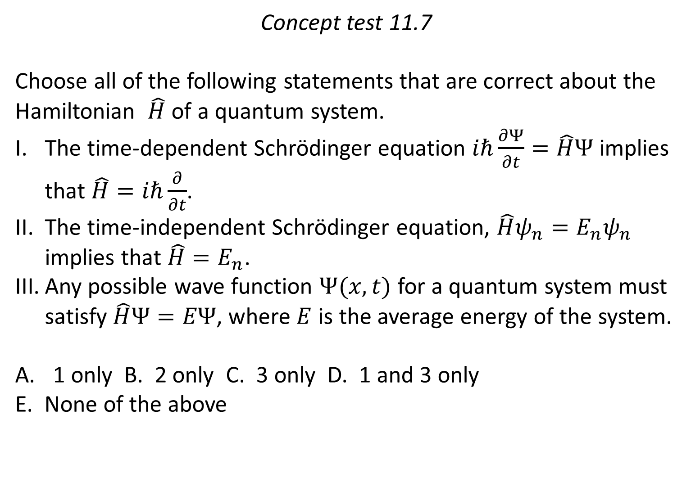
Concept test 11.7
Choose all of the following statements that are correct about the Hamiltonian $\hat{H}$ of a quantum system.
The time-dependent Schrödinger equation $iℏ\frac{∂Ψ}{∂t}=\hat{H}Ψ$ implies that $\hat{H}=iℏ\frac{∂}{∂t}$.
The time-independent Schrödinger equation, $\hat{H}ψ_{n}=E_{n}ψ_{n}$ implies that $\hat{H}=E_{n}$.
Any possible wave function $Ψ(x, t)$ for a quantum system must satisfy $\hat{H}Ψ=EΨ$, where $E$ is the average energy of the system.
1 only B. 2 only C. 3 only D. 1 and 3 only
E. None of the above

