Slide 1
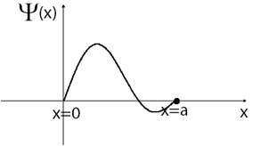
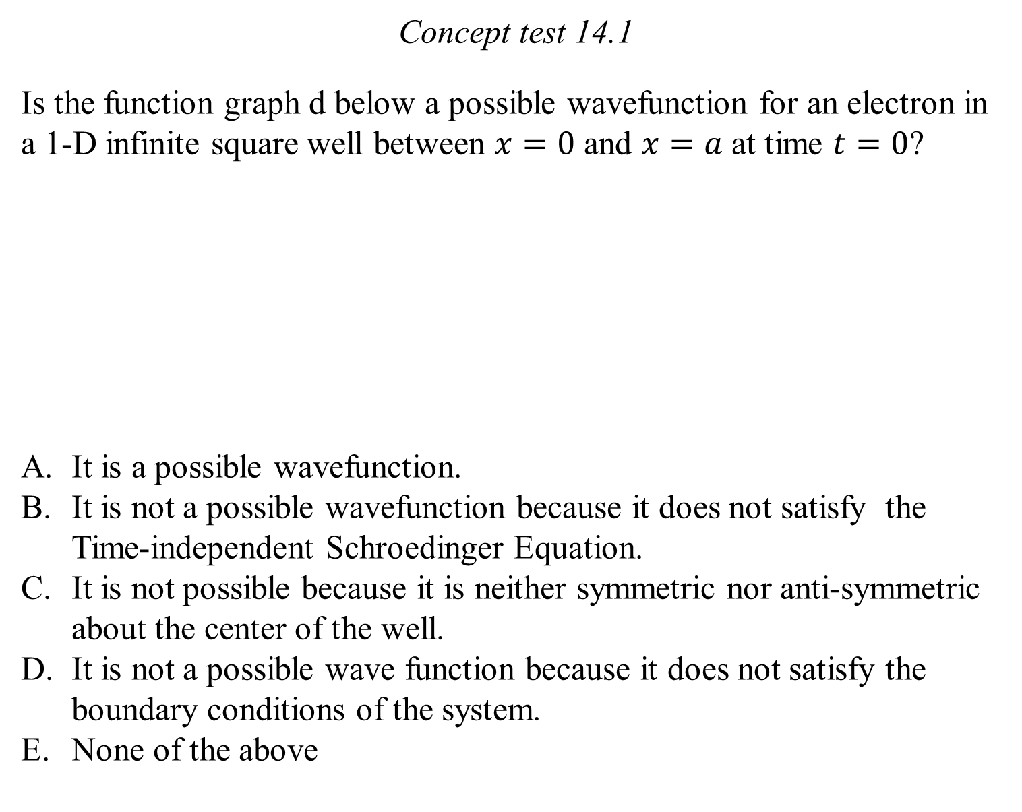
Concept test 14.1
Is the function graph d below a possible wavefunction for an electron in a 1-D infinite square well between $x=0$ and $x=a$ at time $t=0$?
It is a possible wavefunction.
It is not a possible wavefunction because it does not satisfy the Time-independent Schroedinger Equation.
It is not possible because it is neither symmetric nor anti-symmetric about the center of the well.
It is not a possible wave function because it does not satisfy the boundary conditions of the system.
None of the above

Slide 2
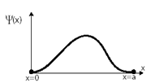
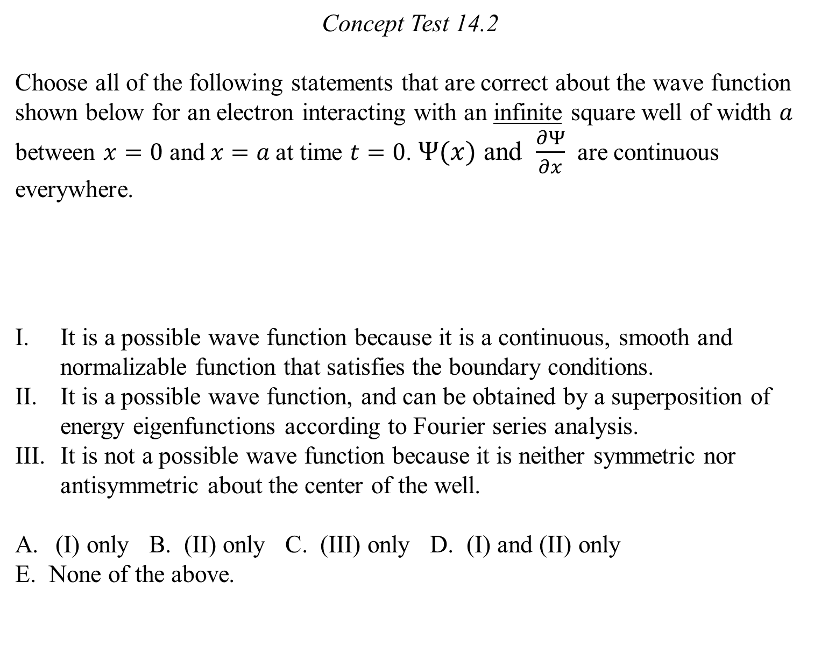
Concept Test 14.2
Choose all of the following statements that are correct about the wave function shown below for an electron interacting with an infinite square well of width $a$ between $x=0$ and$x=a$at time $t=0$. $Ψ(x)$ and $\frac{∂Ψ}{∂x}$ are continuous everywhere.
It is a possible wave function because it is a continuous, smooth and normalizable function that satisfies the boundary conditions.
It is a possible wave function, and can be obtained by a superposition of energy eigenfunctions according to Fourier series analysis.
It is not a possible wave function because it is neither symmetric nor antisymmetric about the center of the well.
(I) only B. (II) only C. (III) only D. (I) and (II) only
E. None of the above.

Slide 3
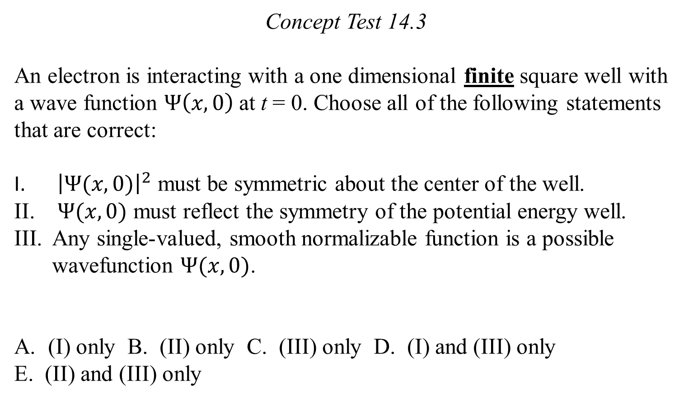
Concept Test 14.3
An electron is interacting with a one dimensional finite square well with a wave function $Ψ\left(x,0\right)$at t = 0. Choose all of the following statements that are correct:
${\left|Ψ(x,0)\right|}^{2}$ must be symmetric about the center of the well.
$Ψ(x,0)$ must reflect the symmetry of the potential energy well.
Any single-valued, smooth normalizable function is a possible wavefunction $Ψ(x,0)$.
(I) only B. (II) only C. (III) only D. (I) and (III) only
E. (II) and (III) only

Slide 4
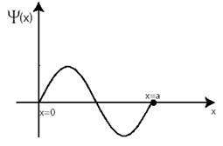
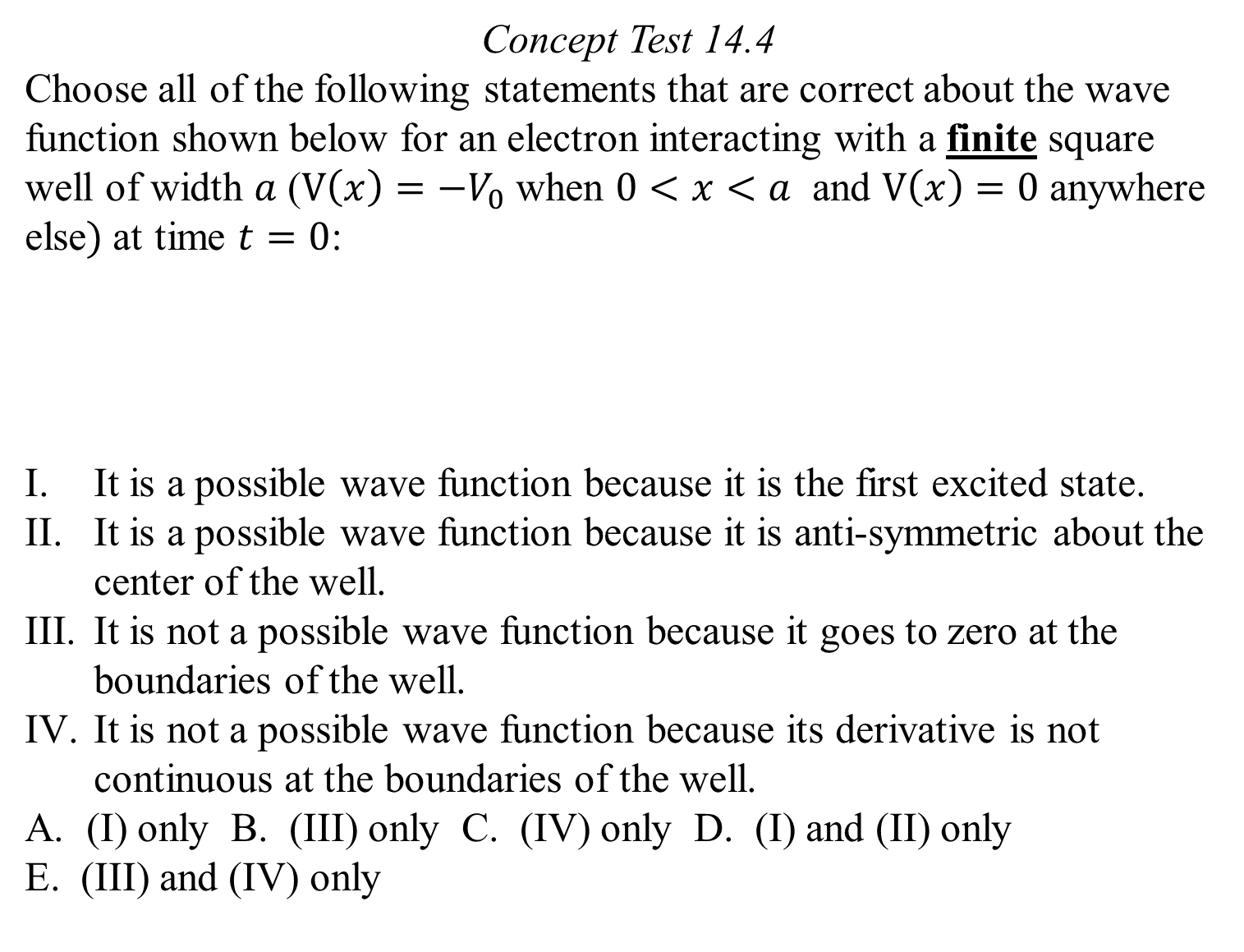
Concept Test 14.4
Choose all of the following statements that are correct about the wave function shown below for an electron interacting with a finite square well of width $a$ ($V\left(x\right)=−V_{0}$when $0<x<a$ and $V\left(x\right)=0$ anywhere else$)$at time $t=0$:
It is a possible wave function because it is the first excited state.
It is a possible wave function because it is anti-symmetric about the center of the well.
It is not a possible wave function because it goes to zero at the boundaries of the well.
It is not a possible wave function because its derivative is not continuous at the boundaries of the well.
(I) only B. (III) only C. (IV) only D. (I) and (II) only
E. (III) and (IV) only

Slide 5
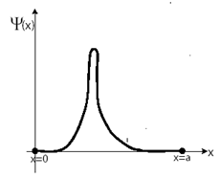
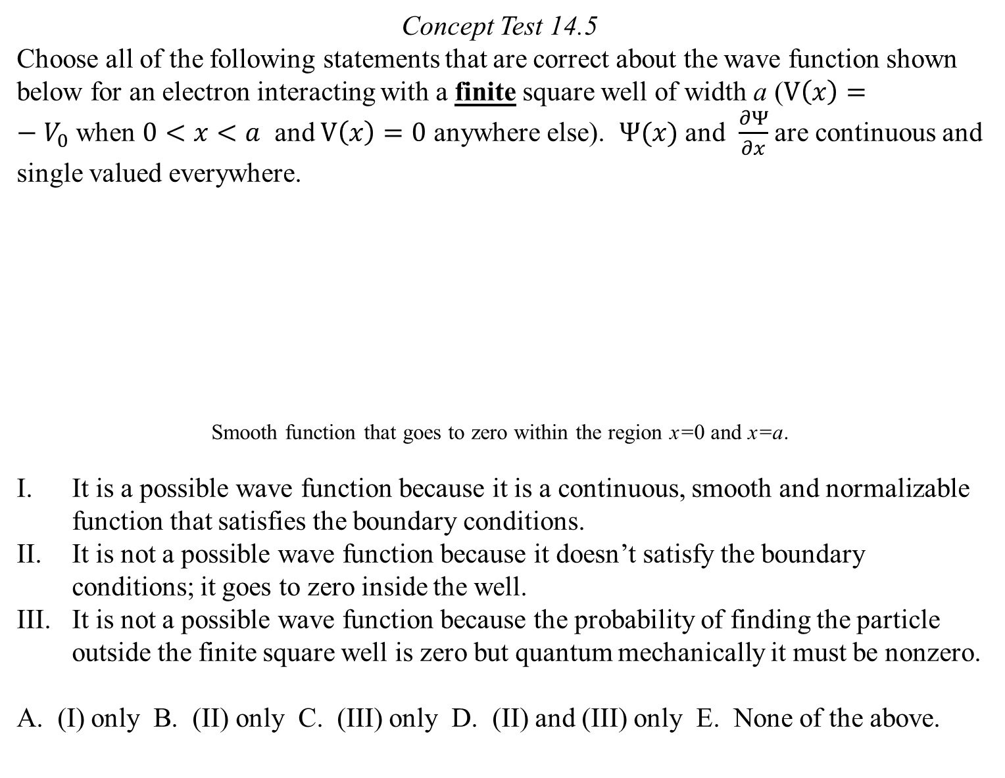
Concept Test 14.5
Choose all of the following statements that are correct about the wave function shown below for an electron interacting with a finite square well of width a ($V\left(x\right)=−V_{0}$when $0<x<a$ and $V\left(x\right)=0$ anywhere else). $Ψ(x)$ and $\frac{∂Ψ}{∂x}$ are continuous and single valued everywhere.
Smooth function that goes to zero within the region x=0 and x=a.
It is a possible wave function because it is a continuous, smooth and normalizable function that satisfies the boundary conditions.
It is not a possible wave function because it doesn’t satisfy the boundary conditions; it goes to zero inside the well.
It is not a possible wave function because the probability of finding the particle outside the finite square well is zero but quantum mechanically it must be nonzero.
A. (I) only B. (II) only C. (III) only D. (II) and (III) only E. None of the above.

Slide 6
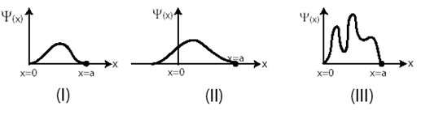
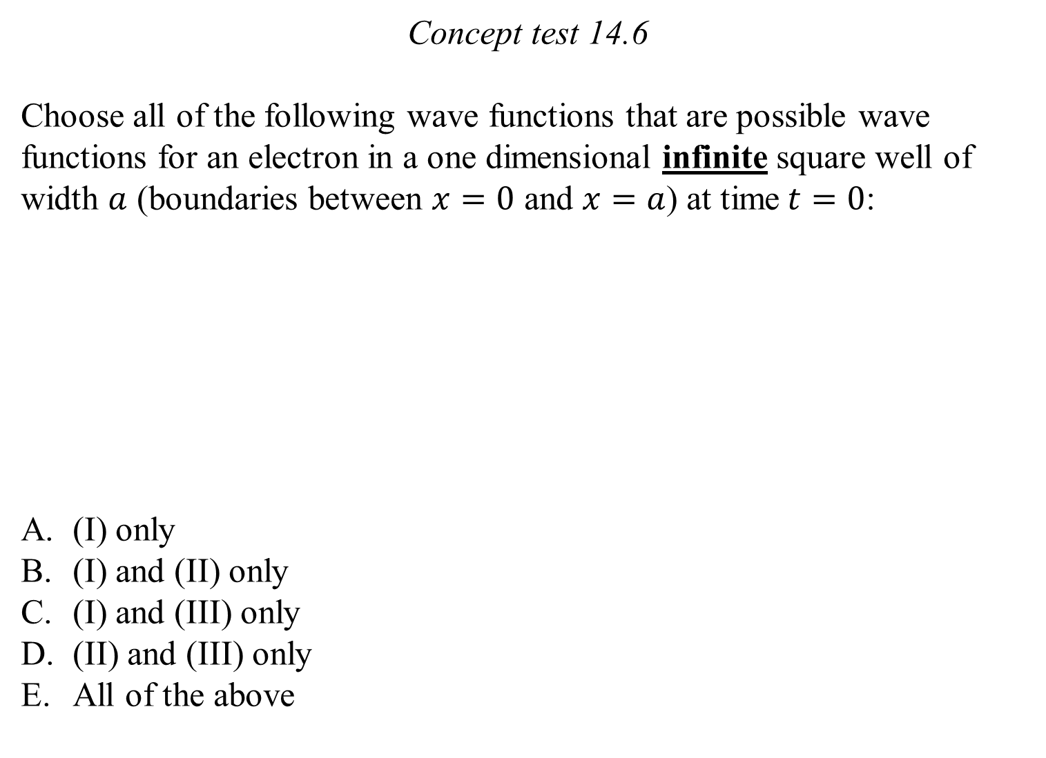
Concept test 14.6
Choose all of the following wave functions that are possible wave functions for an electron in a one dimensional infinite square well of width $a$ (boundaries between $x=0$ and $x=a$) at time$t=0$:
(I) only
(I) and (II) only
(I) and (III) only
(II) and (III) only
All of the above

Slide 7
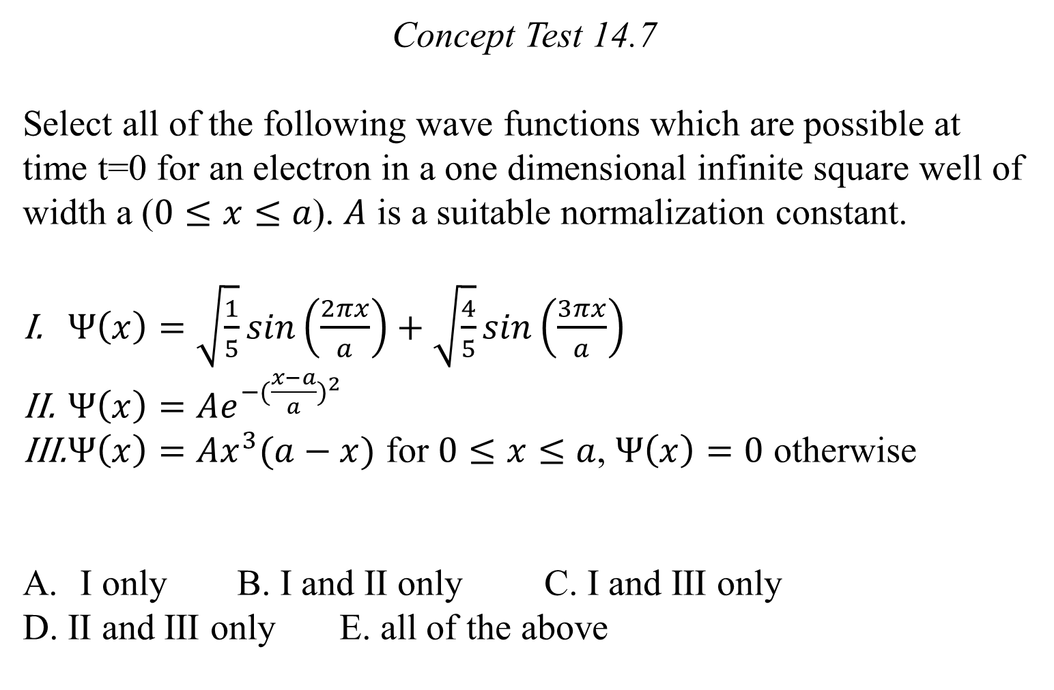
Concept Test 14.7
Select all of the following wave functions which are possible at time t=0 for an electron in a one dimensional infinite square well of width a ($0≤x≤a$). $A$ is a suitable normalization constant.
$Ψ\left(x\right)=\sqrt{\frac{1}{5}}sin\left(\frac{2πx}{a}\right)+\sqrt{\frac{4}{5}}sin\left(\frac{3πx}{a}\right)$
$Ψ\left(x\right)=Ae^{−{(\frac{x−a}{a})}^{2}}$
$Ψ\left(x\right)=Ax^{3}(a−x)$ for $0≤x≤a$, $Ψ\left(x\right)=0$ otherwise
I only B. I and II only C. I and III only
D. II and III only E. all of the above

