Slide 1
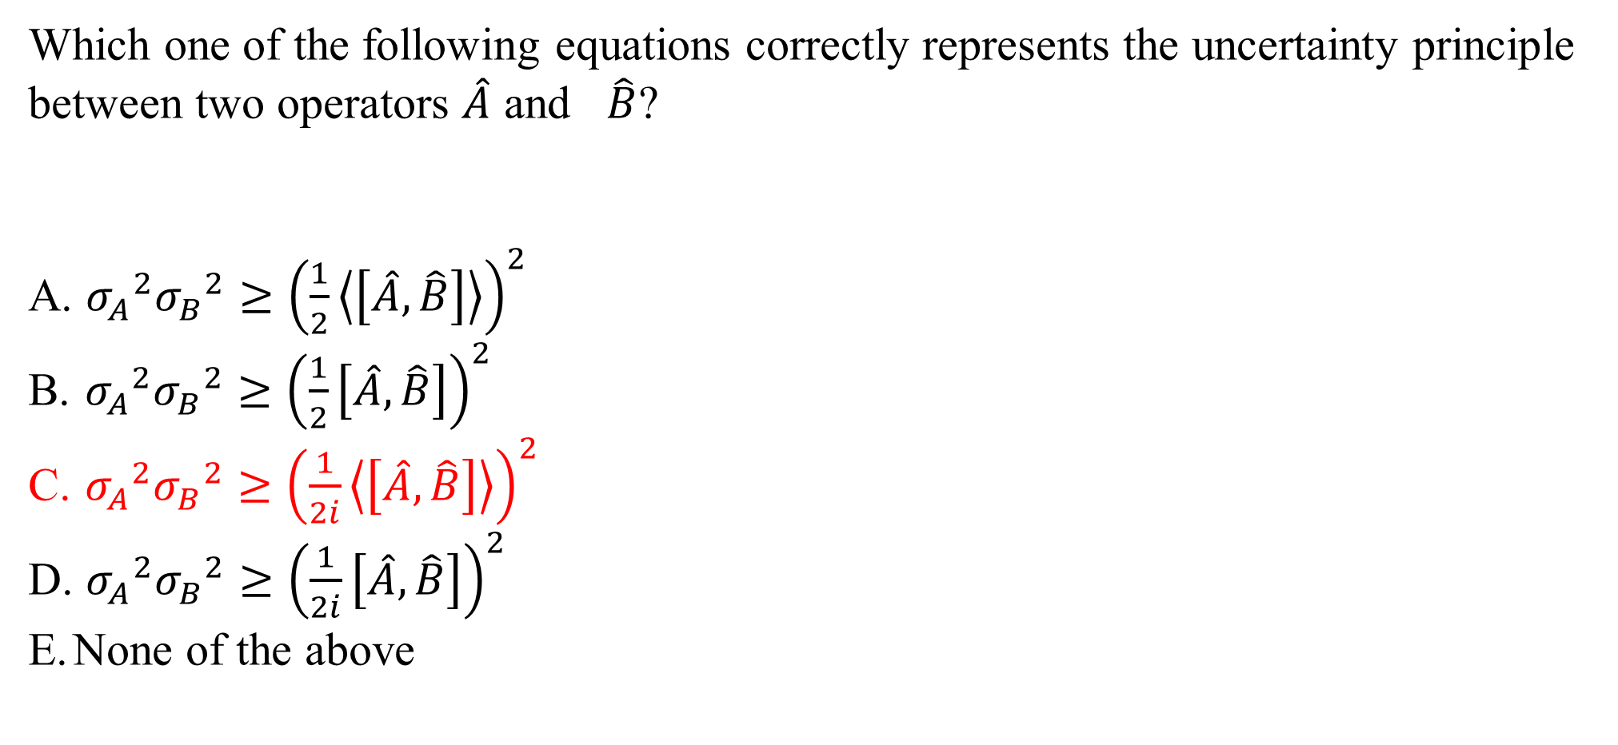
Which one of the following equations correctly represents the uncertainty principle between two operators $\hat{A}$ and $\hat{B}$?
${σ_{A}}^{2}{σ_{B}}^{2}≥{\left(\frac{1}{2}\left\langle \left[\hat{A},\hat{B}\right]\right\rangle \right)}^{2}$
${σ_{A}}^{2}{σ_{B}}^{2}≥{\left(\frac{1}{2}\left[\hat{A},\hat{B}\right]\right)}^{2}$
${σ_{A}}^{2}{σ_{B}}^{2}≥{\left(\frac{1}{2i}\left\langle \left[\hat{A},\hat{B}\right]\right\rangle \right)}^{2}$
${σ_{A}}^{2}{σ_{B}}^{2}≥{\left(\frac{1}{2i}\left[\hat{A},\hat{B}\right]\right)}^{2}$
None of the above

Slide 2
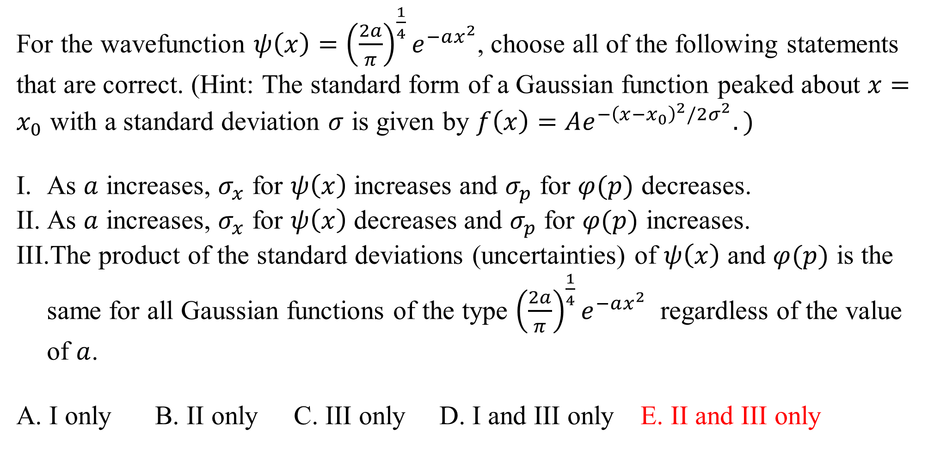
For the wavefunction $ψ\left(x\right)={\left(\frac{2a}{π}\right)}^{\frac{1}{4}}e^{−ax^{2}}$, choose all of the following statements that are correct. (Hint: The standard form of a Gaussian function peaked about $x=x_{0}$ with a standard deviation $σ$ is given by $f\left(x\right)=Ae^{−{\left(x−x_{0}\right)}^{2}/2σ^{2}}.)$
As $a$ increases, $σ_{x}$ for $ψ\left(x\right)$ increases and $σ_{p}$ for $φ(p)$ decreases.
As $a$ increases, $σ_{x}$ for $ψ\left(x\right)$ decreases and $σ_{p}$ for $φ(p)$ increases.
The product of the standard deviations (uncertainties) of $ψ\left(x\right)$ and $φ(p)$ is the same for all Gaussian functions of the type ${\left(\frac{2a}{π}\right)}^{\frac{1}{4}}e^{−ax^{2}}$ regardless of the value of $a$.
A. I only B. II only C. III only D. I and III only E. II and III only

Slide 3
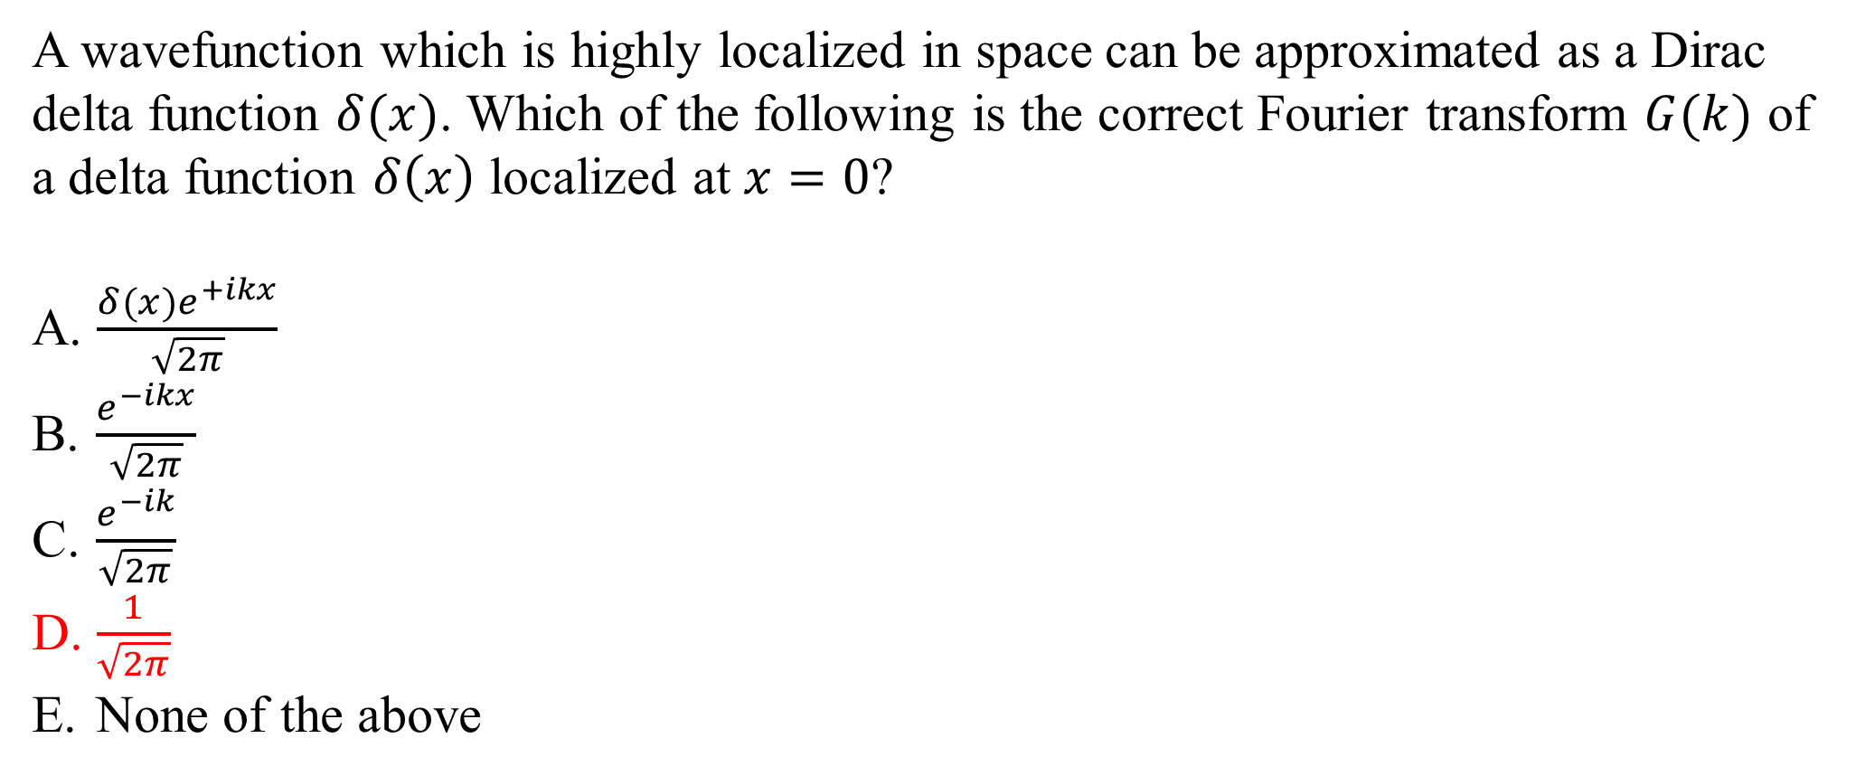
A wavefunction which is highly localized in space can be approximated as a Dirac delta function $δ(x)$. Which of the following is the correct Fourier transform $G(k)$ of a delta function $δ\left(x\right)$ localized at $x=0$?
$\frac{δ(x)e^{+ikx}}{\sqrt{2π}}$
$\frac{e^{−ikx}}{\sqrt{2π}}$
$\frac{e^{−ik}}{\sqrt{2π}}$
$\frac{1}{\sqrt{2π}}$
None of the above

Slide 4
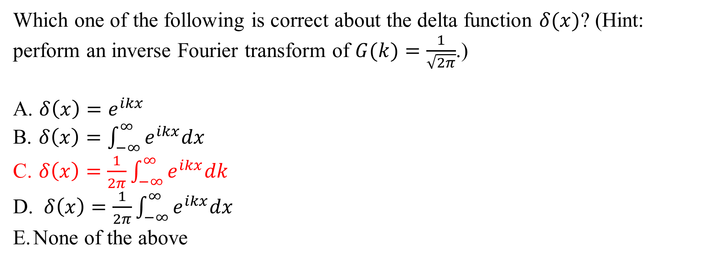
Which one of the following is correct about the delta function $δ(x)$? (Hint: perform an inverse Fourier transform of $G(k)=\frac{1}{\sqrt{2π}}$.)
$δ\left(x\right)=e^{ikx}$
$δ\left(x\right)=\int_{−∞}^{∞}{e^{ikx}dx}$
$δ\left(x\right)=\frac{1}{2π}\int_{−∞}^{∞}{e^{ikx}dk}$
$δ\left(x\right)=\frac{1}{2π}\int_{−∞}^{∞}{e^{ikx}dx}$
None of the above

Slide 5
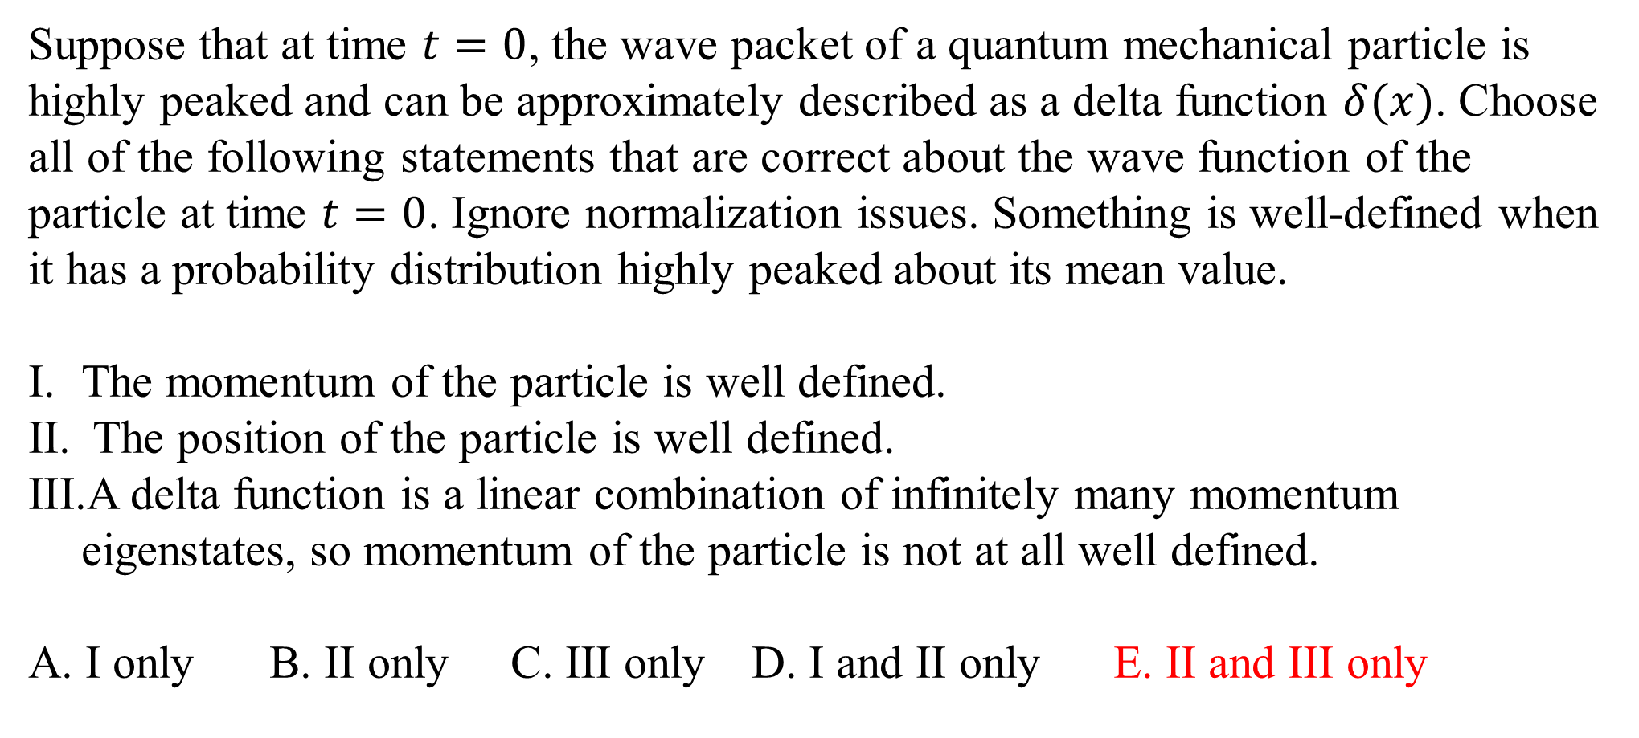
Suppose that at time $t=0$, the wave packet of a quantum mechanical particle is highly peaked and can be approximately described as a delta function $δ(x)$. Choose all of the following statements that are correct about the wave function of the particle at time $t=0$. Ignore normalization issues. Something is well-defined when it has a probability distribution highly peaked about its mean value.
The momentum of the particle is well defined.
The position of the particle is well defined.
A delta function is a linear combination of infinitely many momentum eigenstates, so momentum of the particle is not at all well defined.
A. I only B. II only C. III only D. I and II only E. II and III only

Slide 6
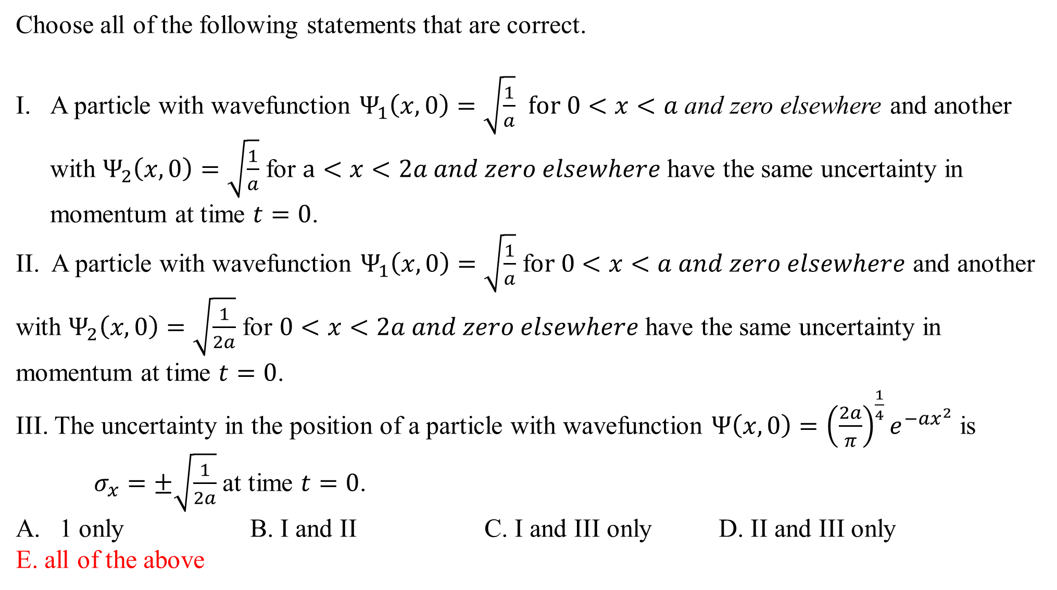
Choose all of the following statements that are correct.
A particle with wavefunction $Ψ_{1}\left(x,0\right)=\sqrt{\frac{1}{a}}$ $for 0<x<a$ and zero elsewhere and another with $Ψ_{2}\left(x,0\right)=\sqrt{\frac{1}{a}}$ for $a<x<2a and zero elsewhere$ have the same uncertainty in momentum at time $t=0$.
II. A particle with wavefunction $Ψ_{1}\left(x,0\right)=\sqrt{\frac{1}{a}}$ f$or 0<x<a and zero elsewhere$ and another with $Ψ_{2}\left(x,0\right)=\sqrt{\frac{1}{2a}}$ for $0<x<2a and zero elsewhere$ have the same uncertainty in momentum at time $t=0$.
III. The uncertainty in the position of a particle with wavefunction $Ψ\left(x,0\right)={\left(\frac{2a}{π}\right)}^{\frac{1}{4}}e^{−ax^{2}}$ is $σ_{x}=±\sqrt{\frac{1}{2a}}$ at time $t=0$.
1 only B. I and II C. I and III only D. II and III only
E. all of the above

Slide 7
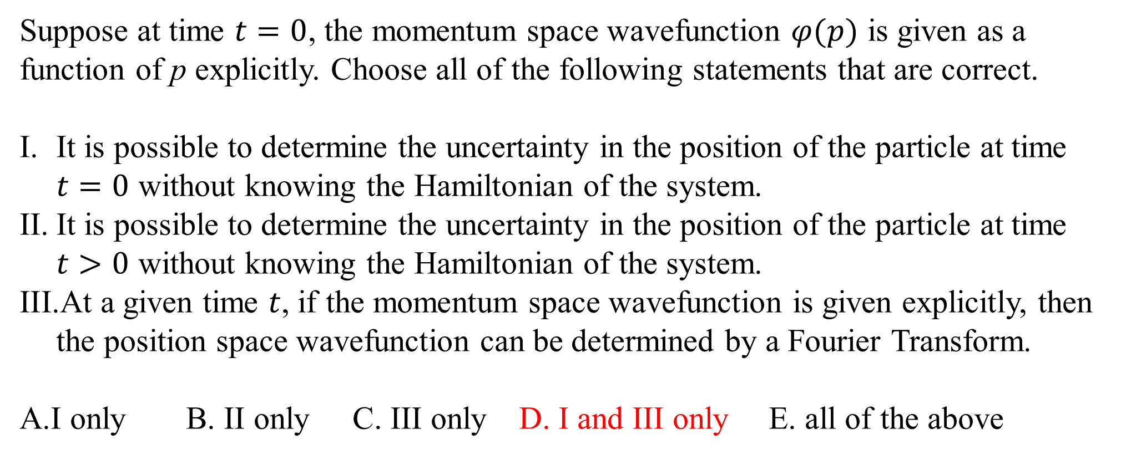
Suppose at time $t=0$, the momentum space wavefunction $φ(p)$ is given as a function of p explicitly. Choose all of the following statements that are correct.
It is possible to determine the uncertainty in the position of the particle at time $t=0$ without knowing the Hamiltonian of the system.
It is possible to determine the uncertainty in the position of the particle at time $t>0$ without knowing the Hamiltonian of the system.
At a given time $t$, if the momentum space wavefunction is given explicitly, then the position space wavefunction can be determined by a Fourier Transform.
A.I only B. II only C. III only D. I and III only E. all of the above

Slide 8
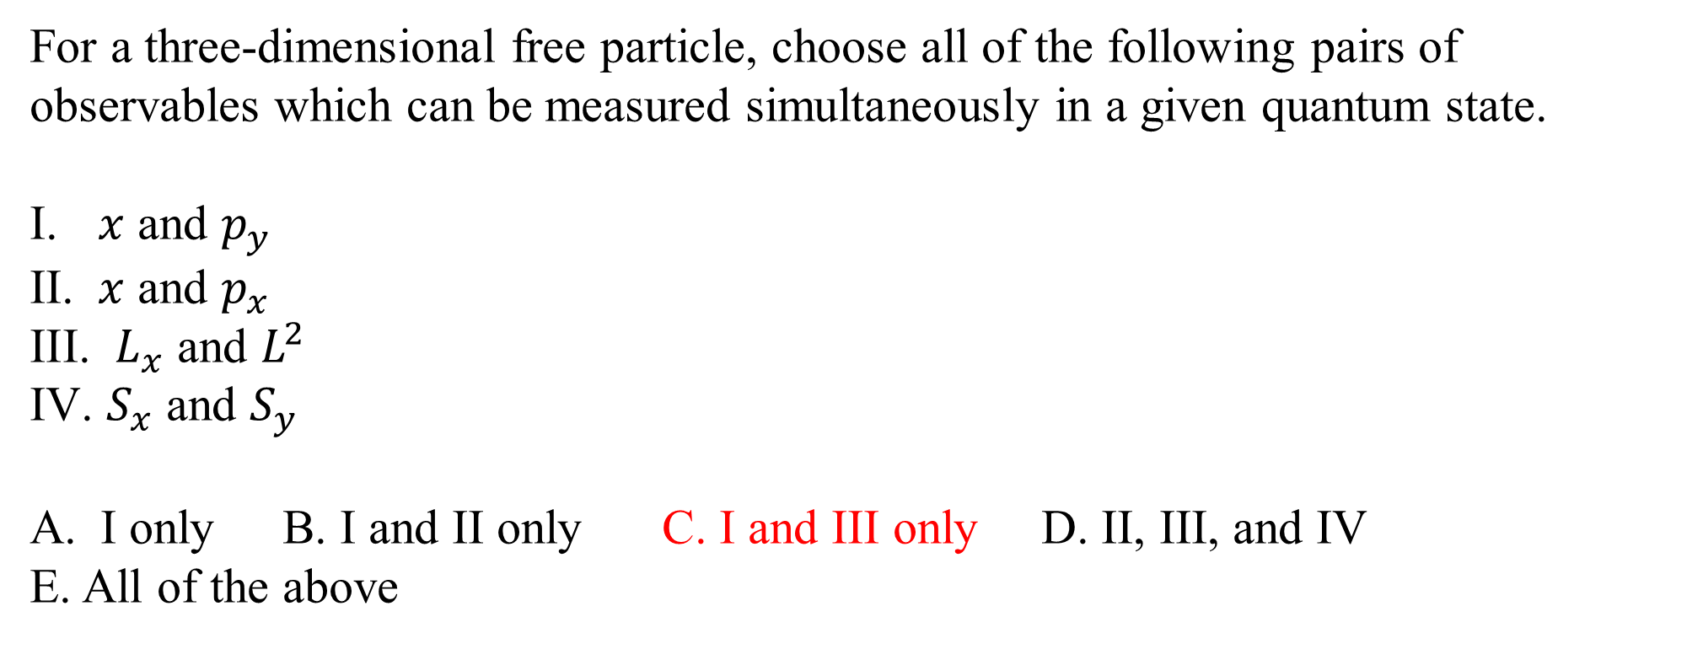
For a three-dimensional free particle, choose all of the following pairs of observables which can be measured simultaneously in a given quantum state.
$x$ and $p_{y}$
$x$ and $p_{x}$
$L_{x}$ and $L^{2}$
$S_{x}$ and $S_{y}$
I only B. I and II only C. I and III only D. II, III, and IV
E. All of the above

Slide 9
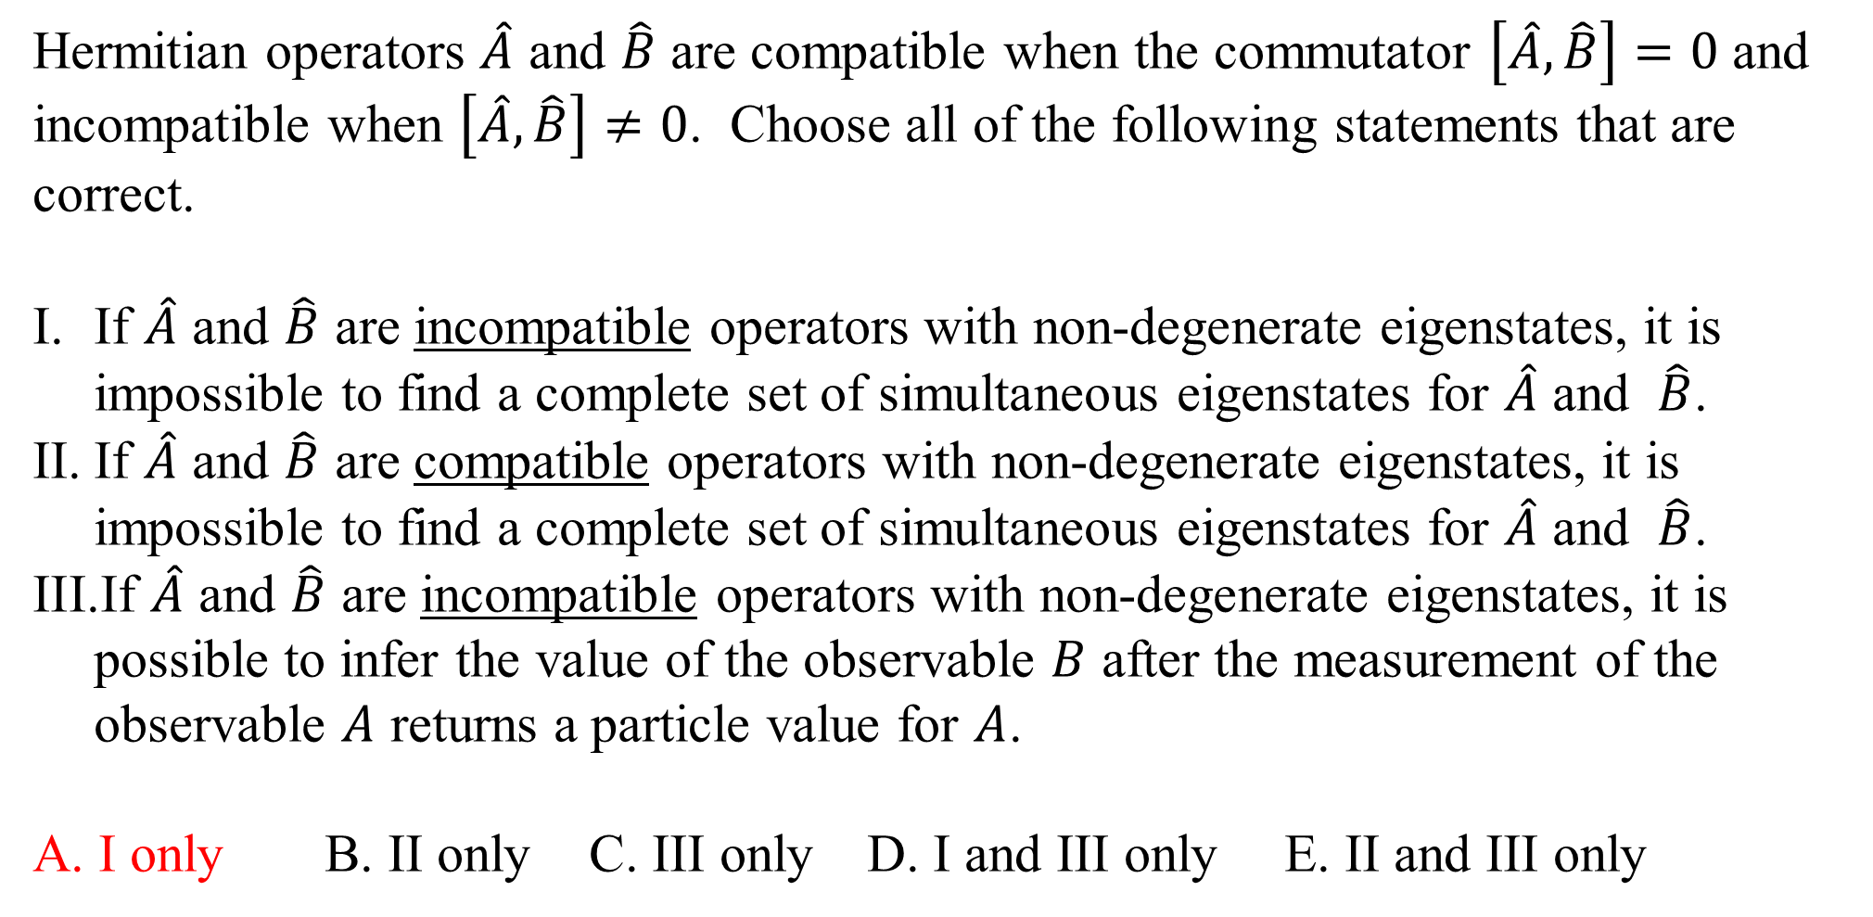
Hermitian operators $\hat{A}$ and $\hat{B}$ are compatible when the commutator $\left[\hat{A},\hat{B}\right]=0$ and incompatible when $\left[\hat{A},\hat{B}\right]≠0$. Choose all of the following statements that are correct.
If $\hat{A}$ and $\hat{B}$ are incompatible operators with non-degenerate eigenstates, it is impossible to find a complete set of simultaneous eigenstates for $\hat{A}$ and $\hat{B}$.
If $\hat{A}$ and $\hat{B}$ are compatible operators with non-degenerate eigenstates, it is impossible to find a complete set of simultaneous eigenstates for $\hat{A}$ and $\hat{B}$.
If $\hat{A}$ and $\hat{B}$ are incompatible operators with non-degenerate eigenstates, it is possible to infer the value of the observable $B$ after the measurement of the observable $A$ returns a particle value for $A$.
A. I only B. II only C. III only D. I and III only E. II and III only

Slide 10
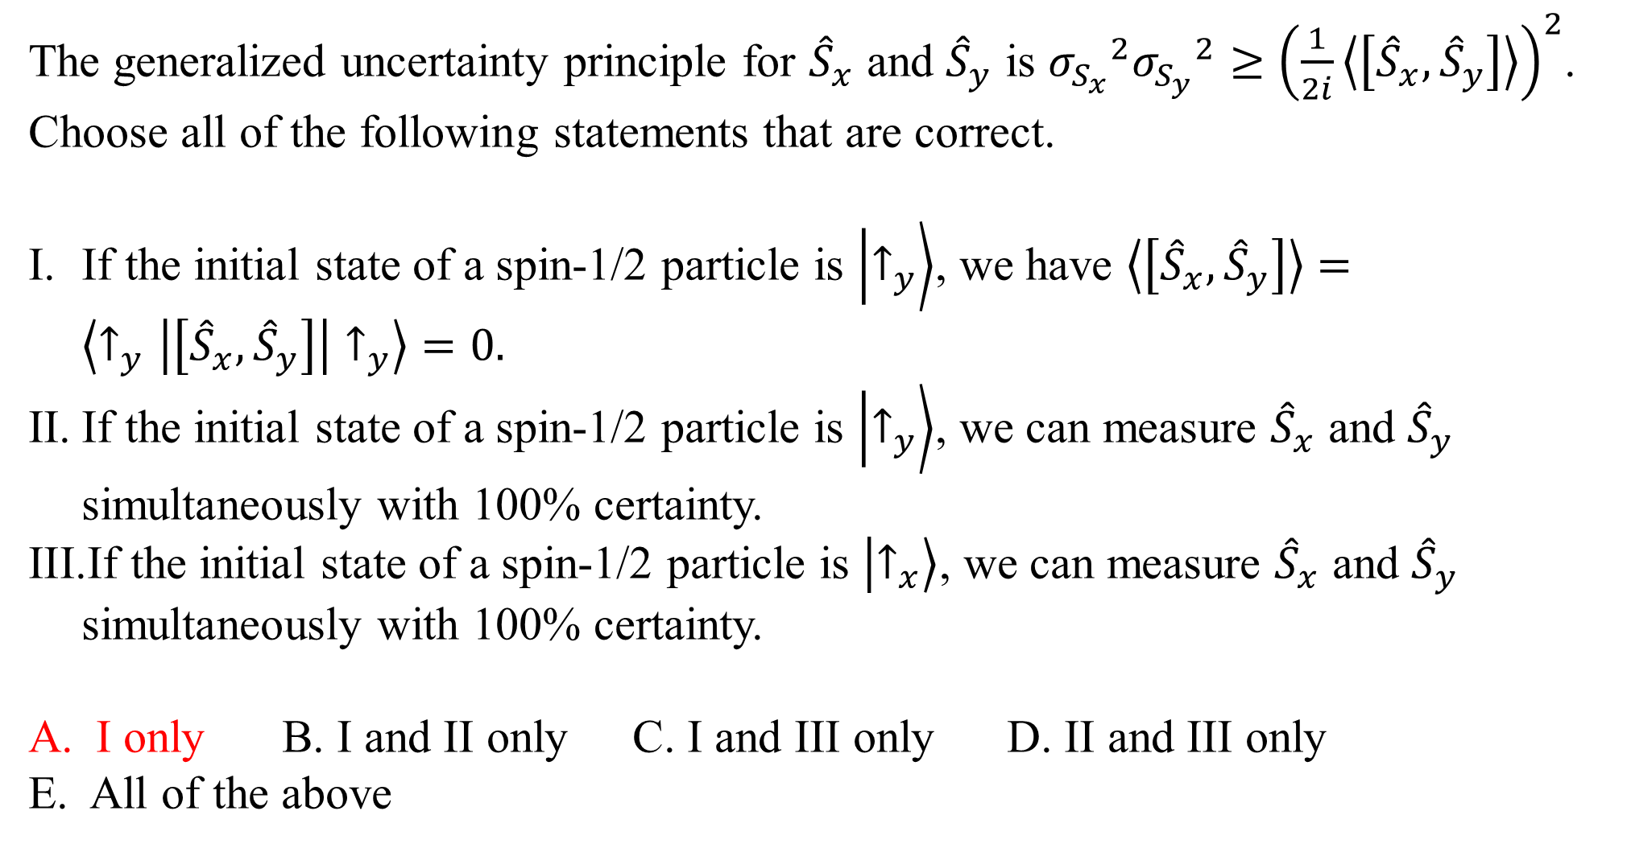
The generalized uncertainty principle for ${\hat{S}}_{x}$ and ${\hat{S}}_{y}$ is ${σ_{S_{x}}}^{2}{σ_{S_{y}}}^{2}≥{\left(\frac{1}{2i}\left\langle \left[{\hat{S}}_{x},{\hat{S}}_{y}\right]\right\rangle \right)}^{2}$. Choose all of the following statements that are correct.
If the initial state of a spin-1/2 particle is $\left.\left|↑_{y}\right.\right\rangle$, we have $\left\langle \left[{\hat{S}}_{x},{\hat{S}}_{y}\right]\right\rangle =\left\langle ↑_{y} | \left[{\hat{S}}_{x},{\hat{S}}_{y}\right] | ↑_{y}\right\rangle =0.$
If the initial state of a spin-1/2 particle is $\left.\left|↑_{y}\right.\right\rangle$, we can measure ${\hat{S}}_{x}$ and ${\hat{S}}_{y}$ simultaneously with 100% certainty.
If the initial state of a spin-1/2 particle is $\left.\left|↑_{x}\right.\right\rangle$, we can measure ${\hat{S}}_{x}$ and ${\hat{S}}_{y}$ simultaneously with 100% certainty.
I only B. I and II only C. I and III only D. II and III only
E. All of the above

Slide 11
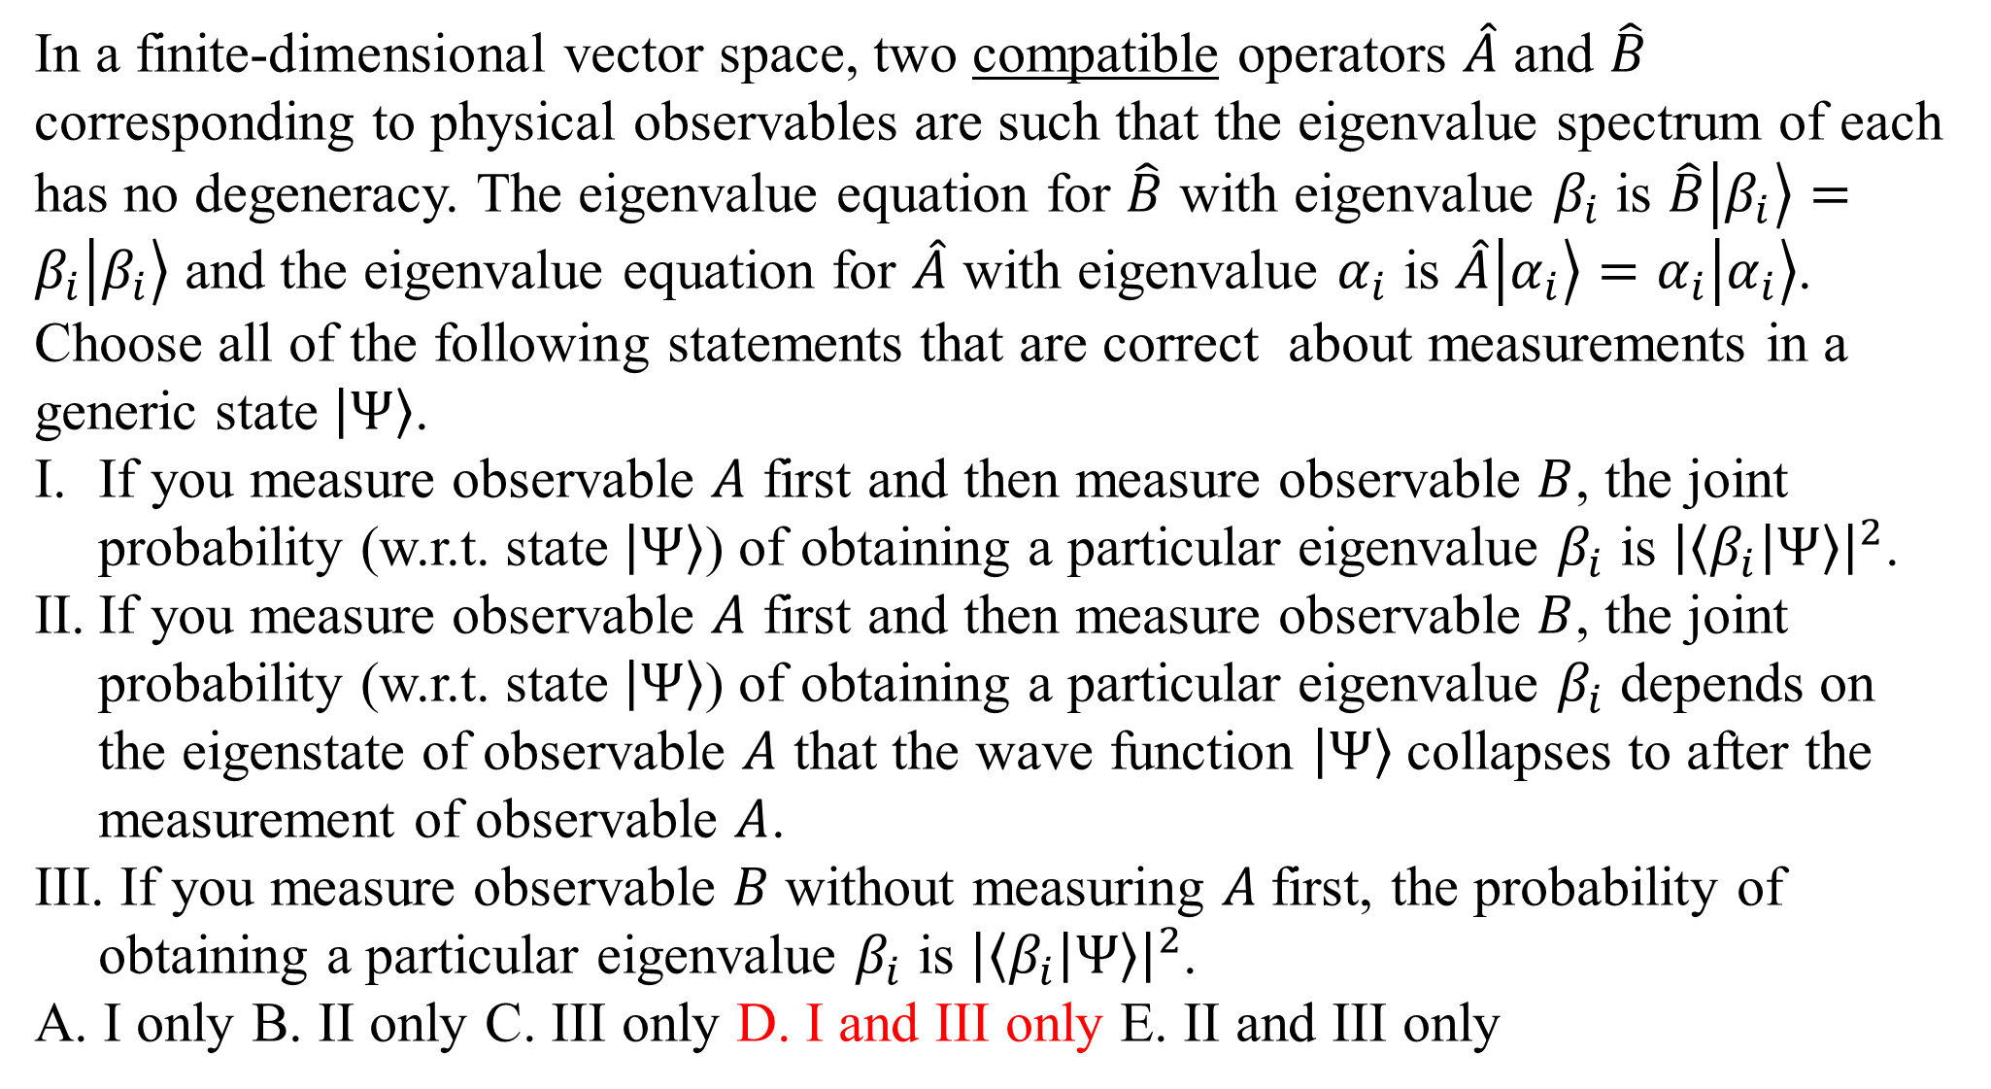
In a finite-dimensional vector space, two compatible operators $\hat{A}$ and $\hat{B}$ corresponding to physical observables are such that the eigenvalue spectrum of each has no degeneracy. The eigenvalue equation for $\hat{B}$ with eigenvalue $β_{i}$ is $\hat{B}\left.\left|β_{i}\right.\right\rangle =β_{i}\left.\left|β_{i}\right.\right\rangle$ and the eigenvalue equation for $\hat{A}$ with eigenvalue $α_{i}$ is $\hat{A}\left.\left|α_{i}\right.\right\rangle =α_{i}\left.\left|α_{i}\right.\right\rangle$. Choose all of the following statements that are correct about measurements in a generic state $\left.\left|Ψ\right.\right\rangle$.
If you measure observable $A$ first and then measure observable $B$, the joint probability (w.r.t. state $\left.\left|Ψ\right.\right\rangle$) of obtaining a particular eigenvalue $β_{i}$ is ${\left|\left\langle β_{i} | Ψ\right\rangle \right|}^{2}$.
If you measure observable $A$ first and then measure observable $B$, the joint probability (w.r.t. state $\left.\left|Ψ\right.\right\rangle$) of obtaining a particular eigenvalue $β_{i}$ depends on the eigenstate of observable $A$ that the wave function $\left.\left|Ψ\right.\right\rangle$collapses to after the measurement of observable $A$.
If you measure observable $B$ without measuring $A$first, the probability of obtaining a particular eigenvalue $β_{i}$ is ${\left|\left\langle β_{i} | Ψ\right\rangle \right|}^{2}$.
A. I only B. II only C. III only D. I and III only E. II and III only

Slide 12
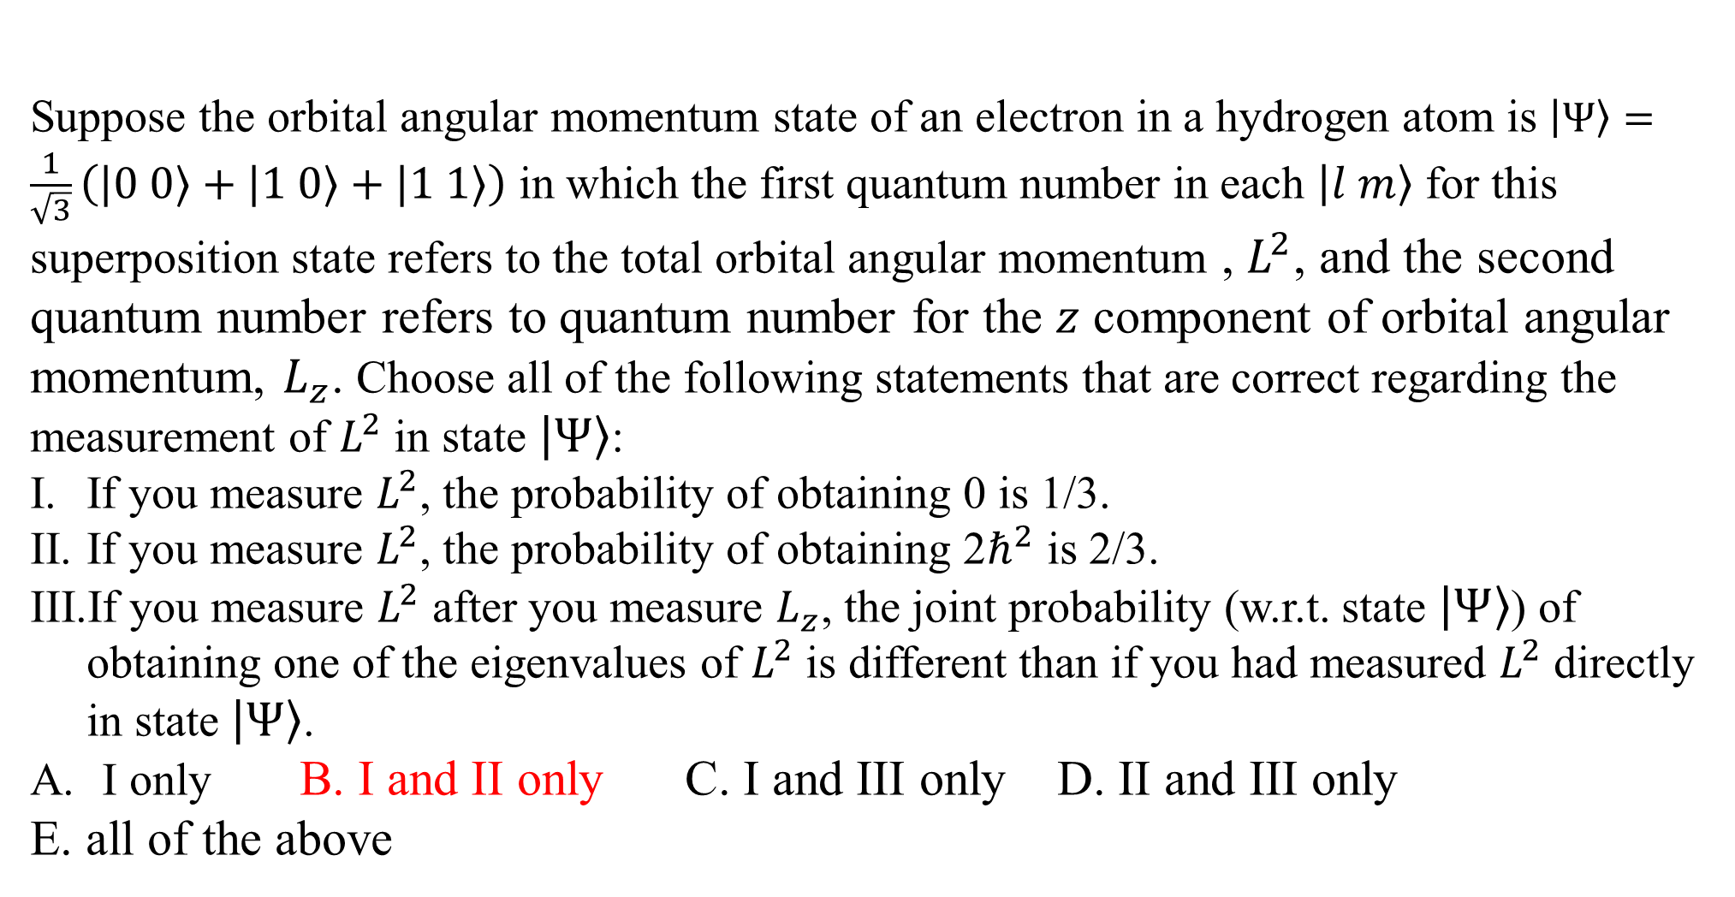
Suppose the orbital angular momentum state of an electron in a hydrogen atom is $\left.\left|Ψ\right.\right\rangle =\frac{1}{\sqrt{3}}\left(\left.\left|0 0\right.\right\rangle +\left.\left|1 0\right.\right\rangle +\left.\left|1 1\right.\right\rangle \right)$ in which the first quantum number in each $\left.\left|l m\right.\right\rangle$ for this superposition state refers to the total orbital angular momentum , $L^{2}$, and the second quantum number refers to quantum number for the $z$ component of orbital angular momentum, $L_{z}$. Choose all of the following statements that are correct regarding the measurement of $L^{2}$ in state $\left.\left|Ψ\right.\right\rangle$:
If you measure $L^{2}$, the probability of obtaining 0 is 1/3.
If you measure $L^{2}$, the probability of obtaining 2$ℏ^{2}$ is 2/3.
If you measure $L^{2}$ after you measure $L_{z}$, the joint probability (w.r.t. state $\left.\left|Ψ\right.\right\rangle$) of obtaining one of the eigenvalues of $L^{2}$ is different than if you had measured $L^{2}$ directly in state $\left.\left|Ψ\right.\right\rangle$.
I only B. I and II only C. I and III only D. II and III only
E. all of the above

Slide 13
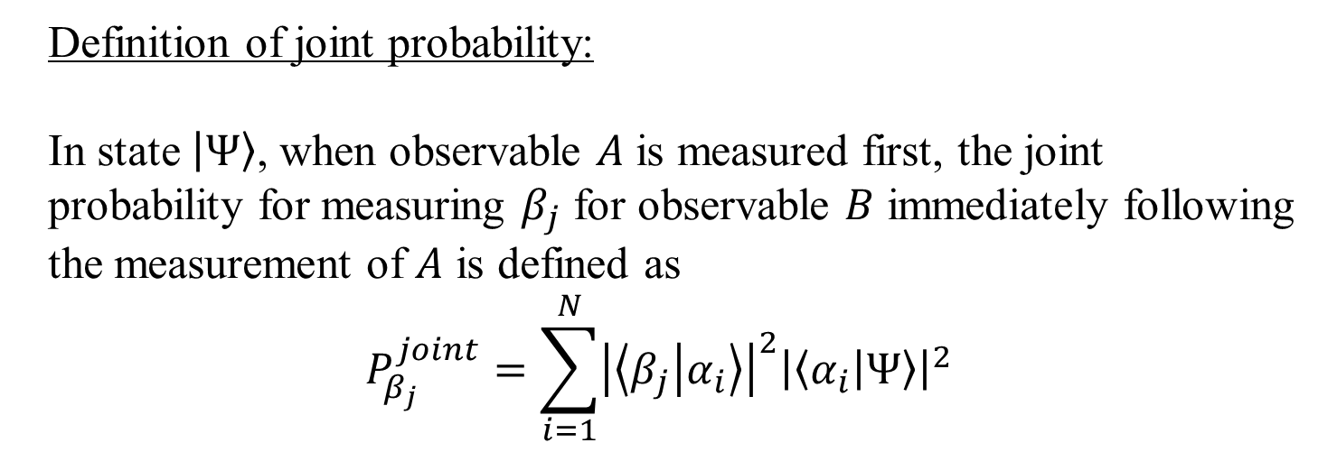
Definition of joint probability:
In state $\left.\left|Ψ\right.\right\rangle$, when observable $A$ is measured first, the joint probability for measuring $β_{j}$ for observable $B$ immediately following the measurement of $A$ is defined as
$$P_{β_{j}}^{joint}=\sum_{i=1}^{N}{{\left|\left\langle β_{j} | α_{i}\right\rangle \right|}^{2}{\left|\left\langle α_{i} | Ψ\right\rangle \right|}^{2}}$$

Slide 14
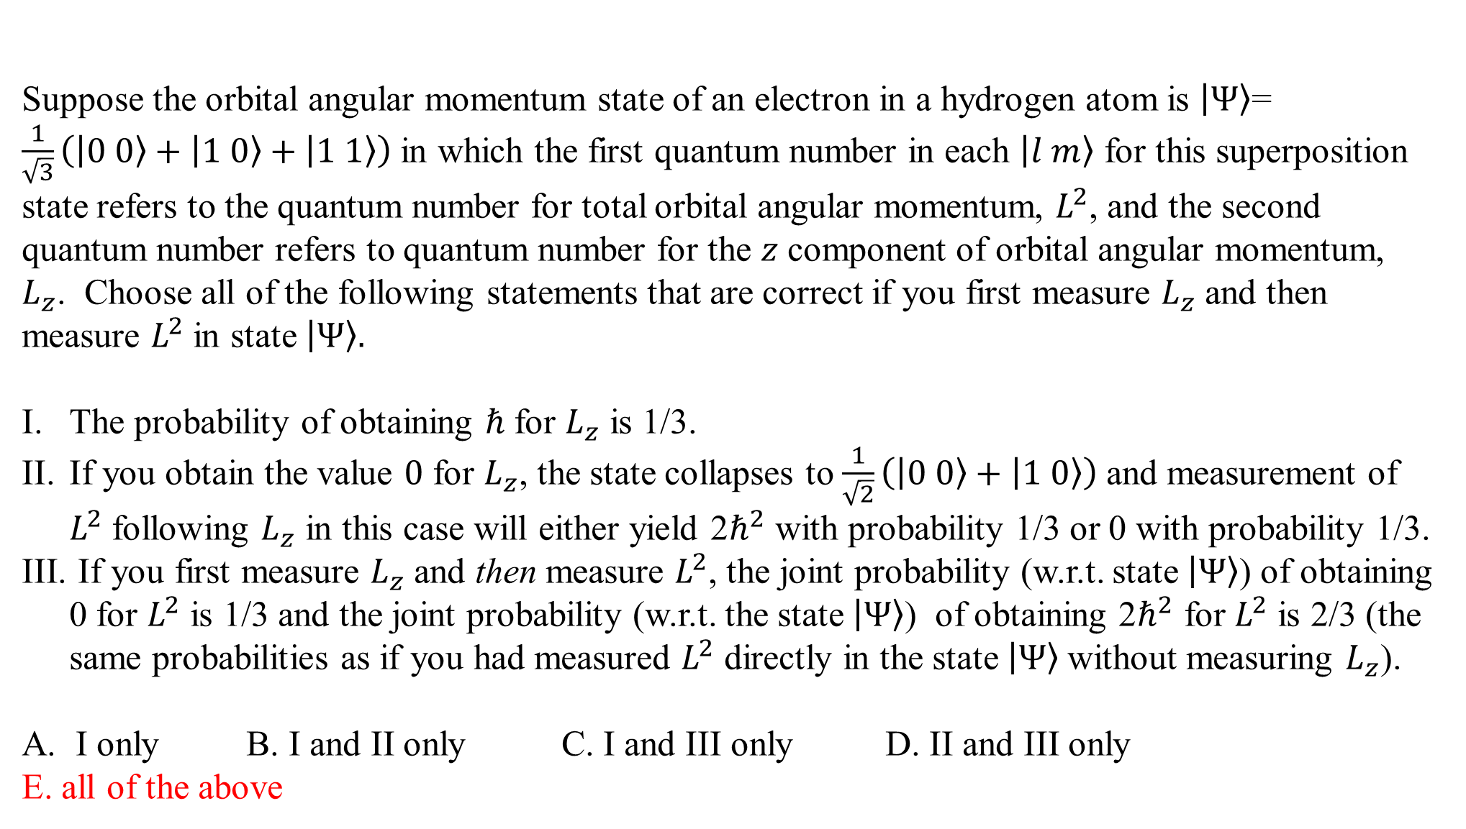
Suppose the orbital angular momentum state of an electron in a hydrogen atom is $\left.\left|Ψ\right.\right\rangle$= $\frac{1}{\sqrt{3}}\left(\left.\left|0 0\right.\right\rangle +\left.\left|1 0\right.\right\rangle +\left.\left|1 1\right.\right\rangle \right)$ in which the first quantum number in each $\left.\left|l m\right.\right\rangle$ for this superposition state refers to the quantum number for total orbital angular momentum, $L^{2}$, and the second quantum number refers to quantum number for the $z$ component of orbital angular momentum, $L_{z}$. Choose all of the following statements that are correct if you first measure $L_{z}$ and then measure $L^{2}$ in state $\left.\left|Ψ\right.\right\rangle .$
The probability of obtaining $ℏ$ for $L_{z}$ is 1/3.
If you obtain the value $0$ for $L_{z}$, the state collapses to $\frac{1}{\sqrt{2}}\left(\left.\left|0 0\right.\right\rangle +\left.\left|1 0\right.\right\rangle \right)$ and measurement of $L^{2}$ following $L_{z}$ in this case will either yield 2$ℏ^{2}$ with probability 1/3 or 0 with probability 1/3.
If you first measure $L_{z}$ and then measure $L^{2}$, the joint probability (w.r.t. state $\left.\left|Ψ\right.\right\rangle$) of obtaining 0 for $L^{2}$ is 1/3 and the joint probability (w.r.t. the state $\left.\left|Ψ\right.\right\rangle$) of obtaining 2$ℏ^{2}$ for $L^{2}$ is 2/3 (the same probabilities as if you had measured $L^{2}$ directly in the state $\left.\left|Ψ\right.\right\rangle$without measuring $L_{z}$).
I only B. I and II only C. I and III only D. II and III only
E. all of the above

Slide 15
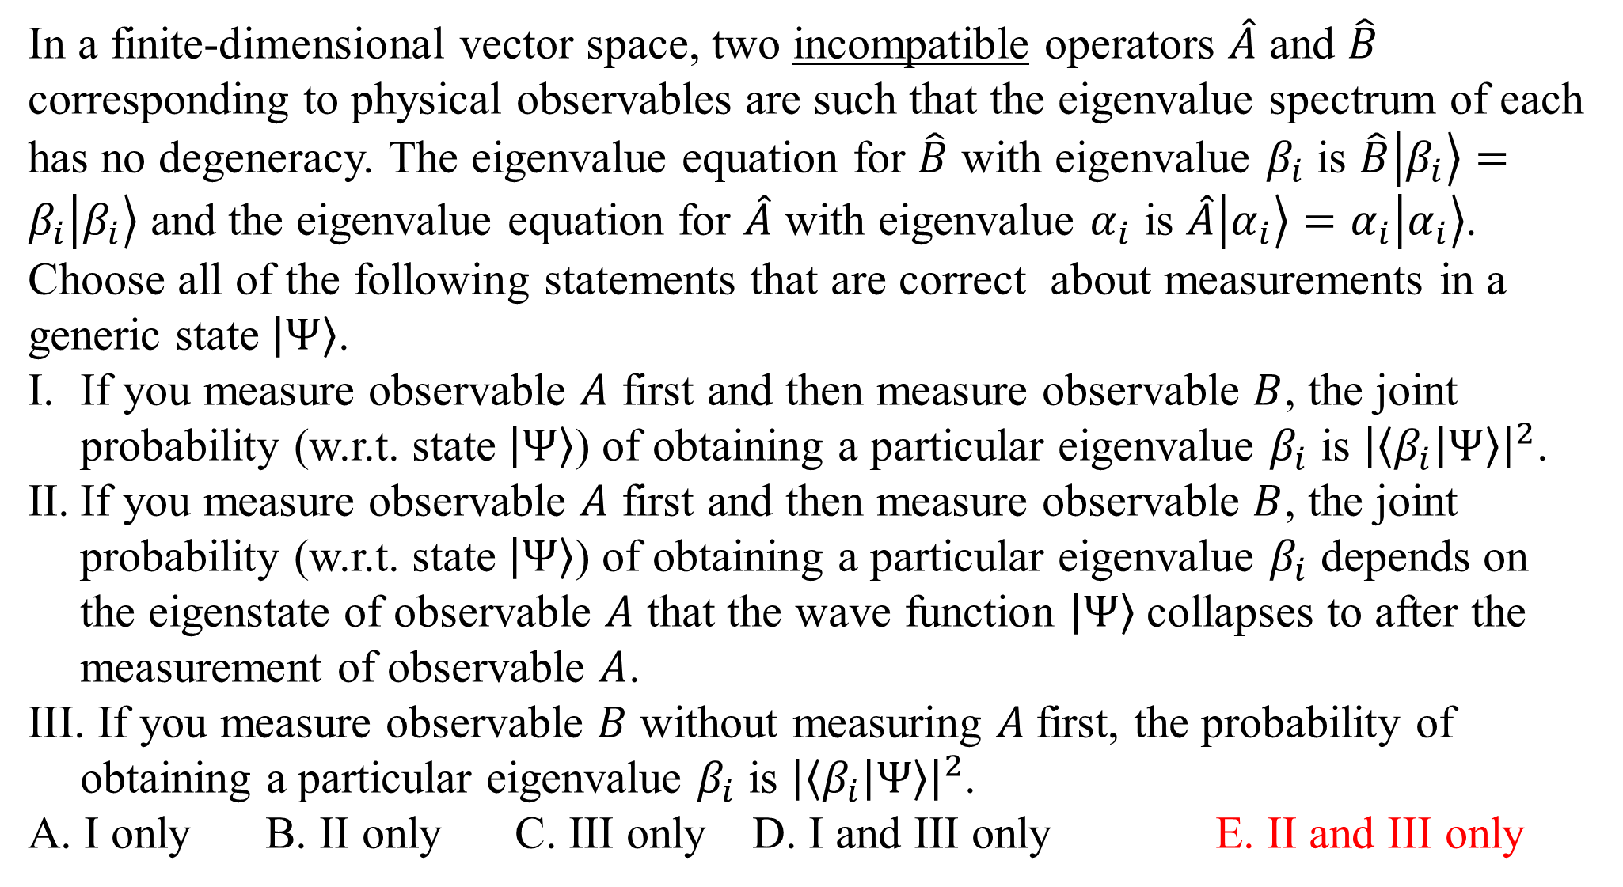
In a finite-dimensional vector space, two incompatible operators $\hat{A}$ and $\hat{B}$ corresponding to physical observables are such that the eigenvalue spectrum of each has no degeneracy. The eigenvalue equation for $\hat{B}$ with eigenvalue $β_{i}$ is $\hat{B}\left.\left|β_{i}\right.\right\rangle =β_{i}\left.\left|β_{i}\right.\right\rangle$ and the eigenvalue equation for $\hat{A}$ with eigenvalue $α_{i}$ is $\hat{A}\left.\left|α_{i}\right.\right\rangle =α_{i}\left.\left|α_{i}\right.\right\rangle$. Choose all of the following statements that are correct about measurements in a generic state $\left.\left|Ψ\right.\right\rangle$.
If you measure observable $A$ first and then measure observable $B$, the joint probability (w.r.t. state $\left.\left|Ψ\right.\right\rangle$) of obtaining a particular eigenvalue $β_{i}$ is ${\left|\left\langle β_{i} | Ψ\right\rangle \right|}^{2}$.
If you measure observable $A$ first and then measure observable $B$, the joint probability (w.r.t. state $\left.\left|Ψ\right.\right\rangle$) of obtaining a particular eigenvalue $β_{i}$ depends on the eigenstate of observable $A$ that the wave function $\left.\left|Ψ\right.\right\rangle$collapses to after the measurement of observable $A$.
If you measure observable $B$ without measuring $A$first, the probability of obtaining a particular eigenvalue $β_{i}$ is ${\left|\left\langle β_{i} | Ψ\right\rangle \right|}^{2}$.
A. I only B. II only C. III only D. I and III only E. II and III only

