Slide 1
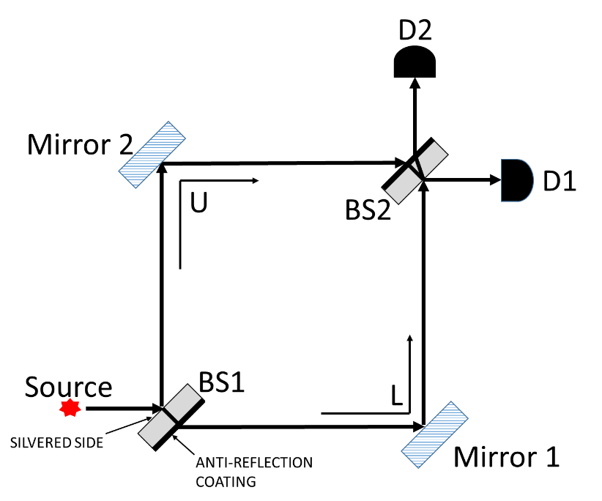
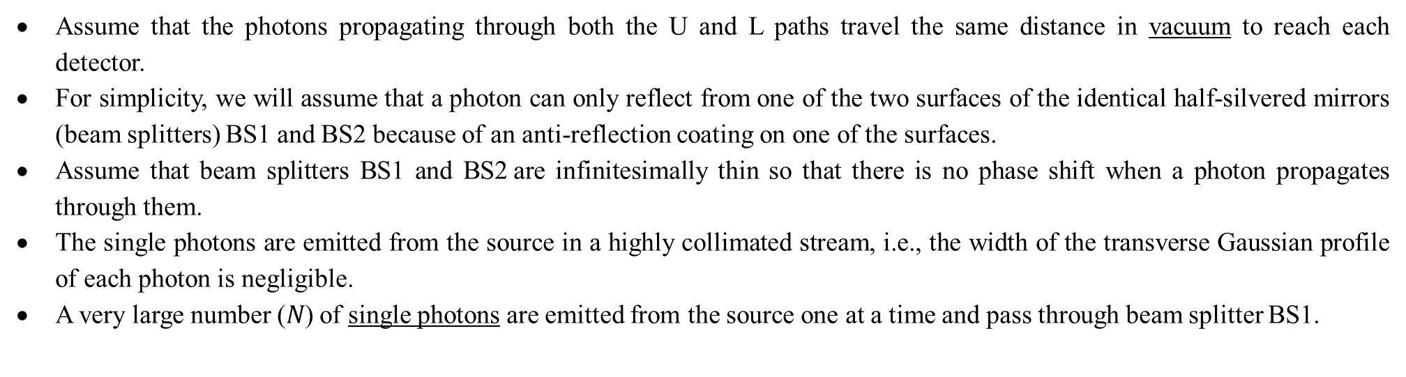
Assume that the photons propagating through both the U and L paths travel the same distance in vacuum to reach each detector.
For simplicity, we will assume that a photon can only reflect from one of the two surfaces of the identical half-silvered mirrors (beam splitters) BS1 and BS2 because of an anti-reflection coating on one of the surfaces.
Assume that beam splitters BS1 and BS2 are infinitesimally thin so that there is no phase shift when a photon propagates through them.
The single photons are emitted from the source in a highly collimated stream, i.e., the width of the transverse Gaussian profile of each photon is negligible.
A very large number ($N$) of single photons are emitted from the source one at a time and pass through beam splitter BS1.

Slide 2
Summary of phase shifts
Glass has a higher index of refraction than vacuum.
 | Initially in medium with lower n | Initially in medium with higher n
Reflection at interface | Phase shift of π | No phase shift
Transmission at interface | No phase shift | No phase shift
Propagation through a medium | Phase shift φ depends on thickness and refractive index n of the medium

Slide 3
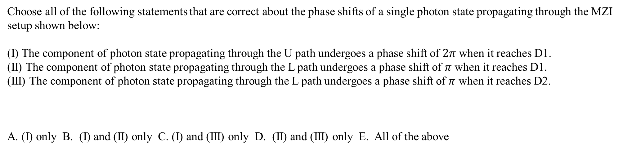
Choose all of the following statements that are correct about the phase shifts of a single photon state propagating through the MZI setup shown below:
(I) The component of photon state propagating through the U path undergoes a phase shift of $2π$ when it reaches D1.
(II) The component of photon state propagating through the L path undergoes a phase shift of $π$ when it reaches D1.
(III) The component of photon state propagating through the L path undergoes a phase shift of $π$ when it reaches D2.
A. (I) only B. (I) and (II) only C. (I) and (III) only D. (II) and (III) only E. All of the above

Slide 4
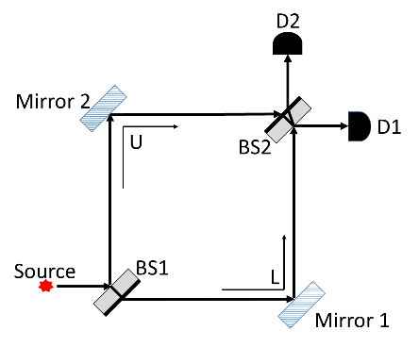

In the setup shown below, a beam of light of intensity $I$ is sent through the MZI. Choose all of the following statements that are correct about the intensity of light at the detectors D1 and D2:
The intensity of light reaching detector D1 is $I/2$.
The intensity of light reaching detector D1 is $I$.
The intensity of light reaching detector D2 is $I/2$.
The intensity of light reaching detector D2 is 0.
A. I only B. II only C. I and III only D. I and IV only E. II and IV only

Slide 5
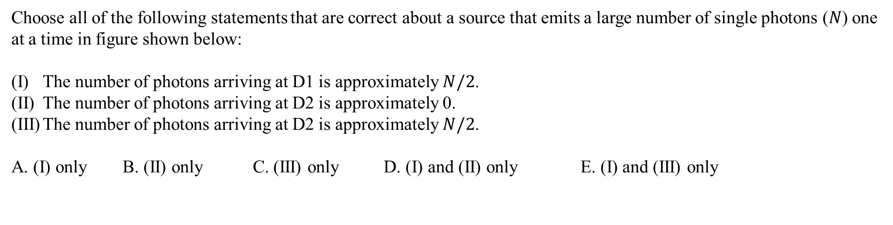
Choose all of the following statements that are correct about a source that emits a large number of single photons ($N$) one at a time in figure shown below:
The number of photons arriving at D1 is approximately $N/2$.
The number of photons arriving at D2 is approximately 0.
The number of photons arriving at D2 is approximately $N/2$.
A. (I) only B. (II) only C. (III) only D. (I) and (II) only E. (I) and (III) only

Slide 6
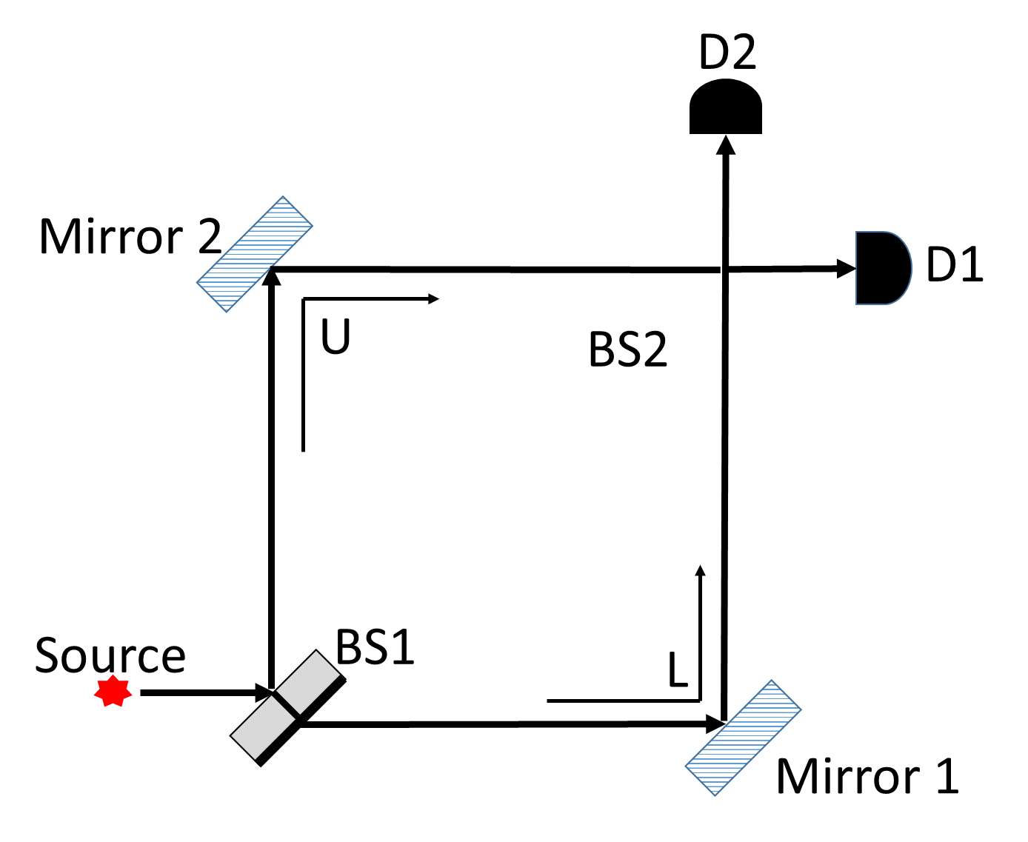
Choose all of the following statements that are correct about the setup in which BS2 is suddenly removed after the photon has already passed through BS1 (but has not arrived at the location of BS2) :
D1 and D2 each have a 50% probability of registering the photon.
Instantaneously after BS2 is removed, the photon state collapses to either the U or L path state.
After BS2 is removed, the photon state remains in a superposition state of the U and L path states until the photon is detected at one of the detectors.
A. (I) only B. (II) only C. (III) only D. (I) and (II) only E. (I) and (III) only

Slide 7
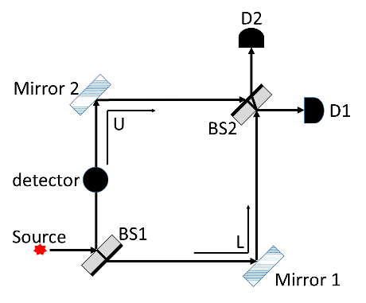
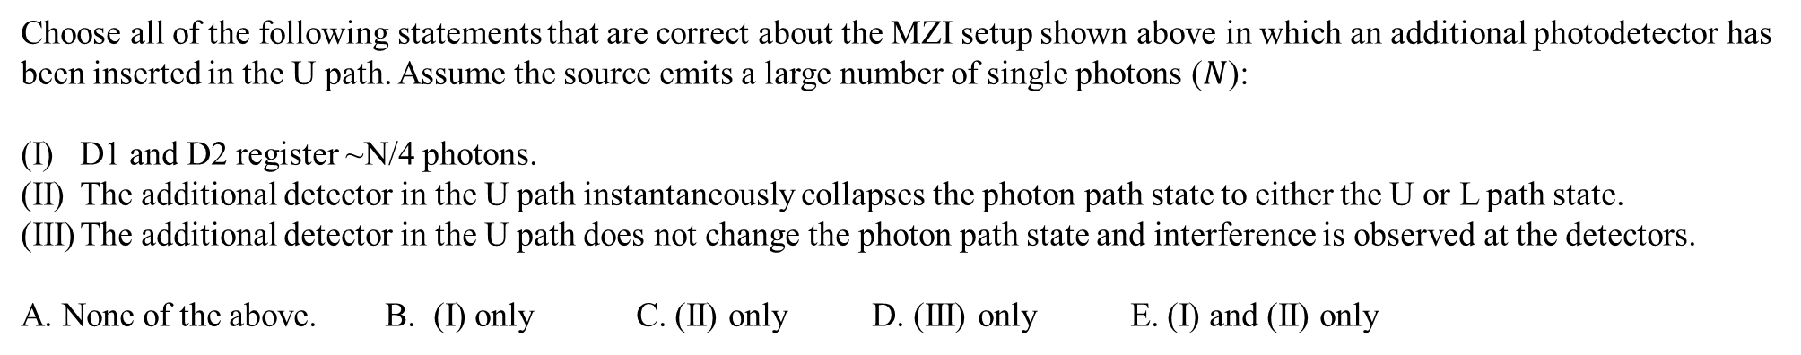
Choose all of the following statements that are correct about the MZI setup shown above in which an additional photodetector has been inserted in the U path. Assume the source emits a large number of single photons ($N$):
D1 and D2 register ~N/4 photons.
The additional detector in the U path instantaneously collapses the photon path state to either the U or L path state.
The additional detector in the U path does not change the photon path state and interference is observed at the detectors.
A. None of the above. B. (I) only C. (II) only D. (III) only E. (I) and (II) only

Slide 8
For all of the following questions involving polarizers, assume that you place a polarizer in front of each photodetector to measure BOTH the path state and polarization state of the photon.
A convenient basis is chosen for the polarizers placed in front of the detectors, e.g., polarizers with horizontal and vertical polarization axes or +45° and - 45° polarization axes.

Slide 9
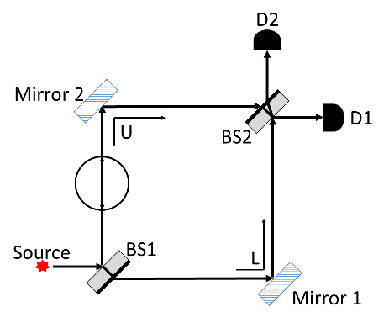
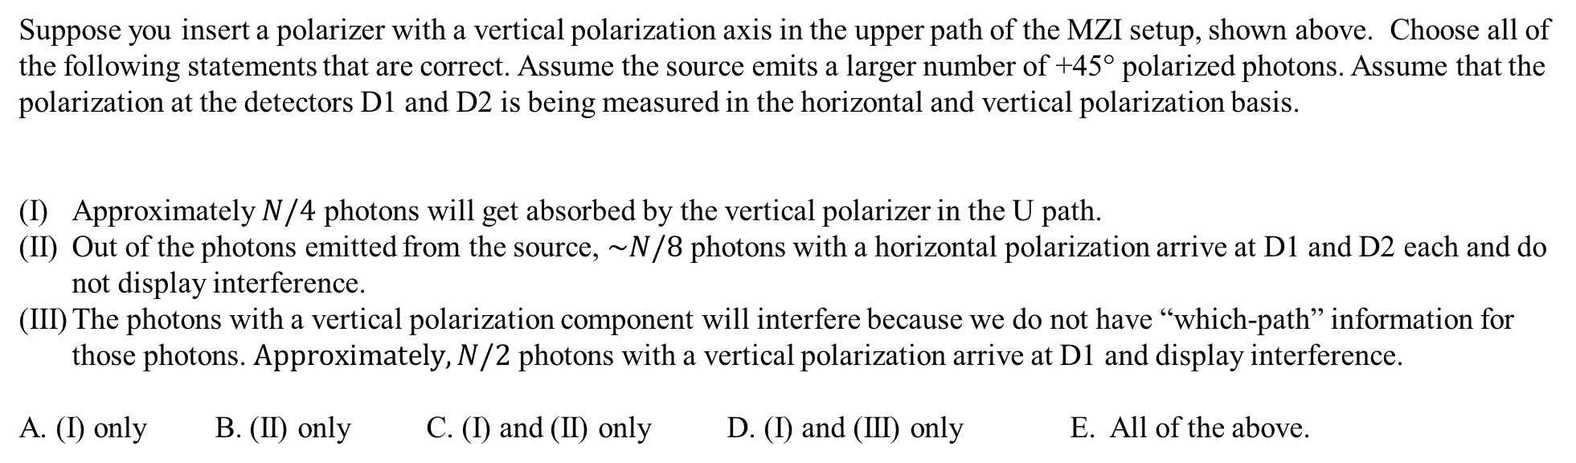
Suppose you insert a polarizer with a vertical polarization axis in the upper path of the MZI setup, shown above. Choose all of the following statements that are correct. Assume the source emits a larger number of +45° polarized photons. Assume that the polarization at the detectors D1 and D2 is being measured in the horizontal and vertical polarization basis.
Approximately $N/4$ photons will get absorbed by the vertical polarizer in the U path.
Out of the photons emitted from the source, $\sim N/8$ photons with a horizontal polarization arrive at D1 and D2 each and do not display interference.
The photons with a vertical polarization component will interfere because we do not have “which-path” information for those photons. $Approximately, N/2$ photons with a vertical polarization arrive at D1 and display interference.
A. (I) only B. (II) only C. (I) and (II) only D. (I) and (III) only E. All of the above.

Slide 10
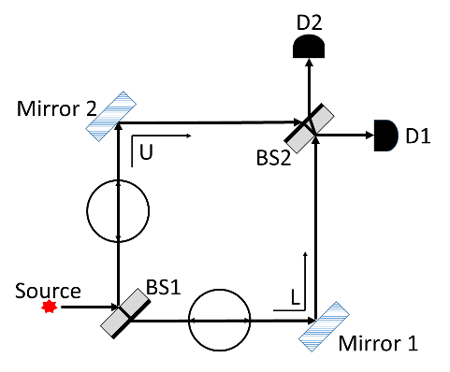
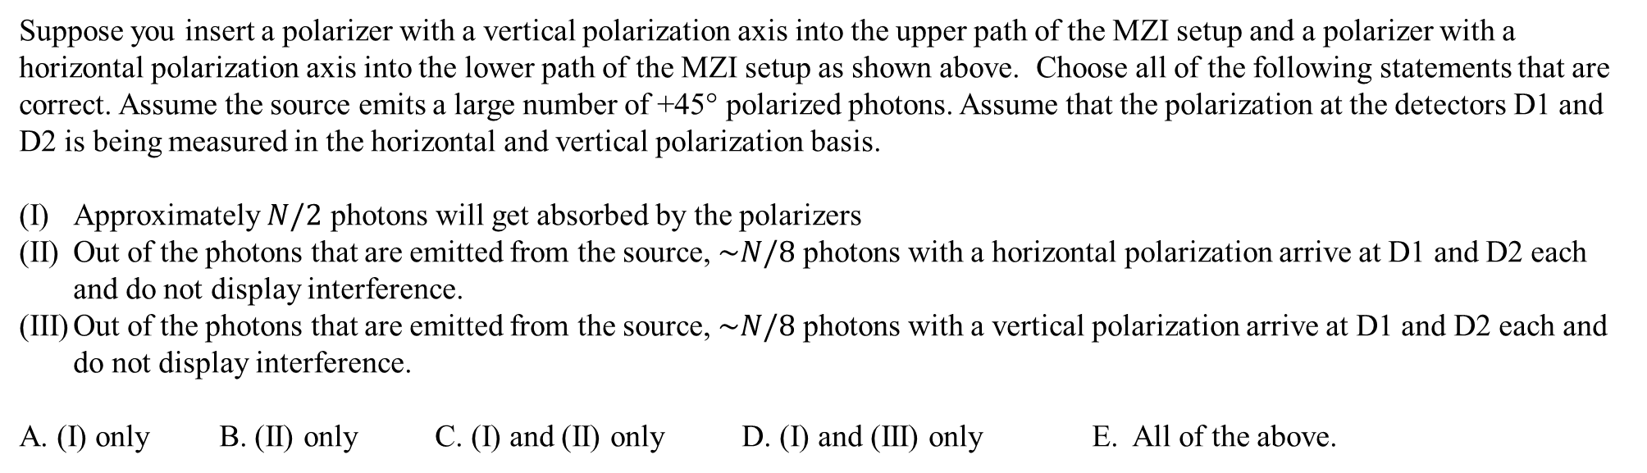
Suppose you insert a polarizer with a vertical polarization axis into the upper path of the MZI setup and a polarizer with a horizontal polarization axis into the lower path of the MZI setup as shown above. Choose all of the following statements that are correct. Assume the source emits a large number of +45° polarized photons. Assume that the polarization at the detectors D1 and D2 is being measured in the horizontal and vertical polarization basis.
Approximately $N/2$ photons will get absorbed by the polarizers
Out of the photons that are emitted from the source, $\sim N/8$ photons with a horizontal polarization arrive at D1 and D2 each and do not display interference.
Out of the photons that are emitted from the source, $\sim N/8$ photons with a vertical polarization arrive at D1 and D2 each and do not display interference.
A. (I) only B. (II) only C. (I) and (II) only D. (I) and (III) only E. All of the above.

Slide 11

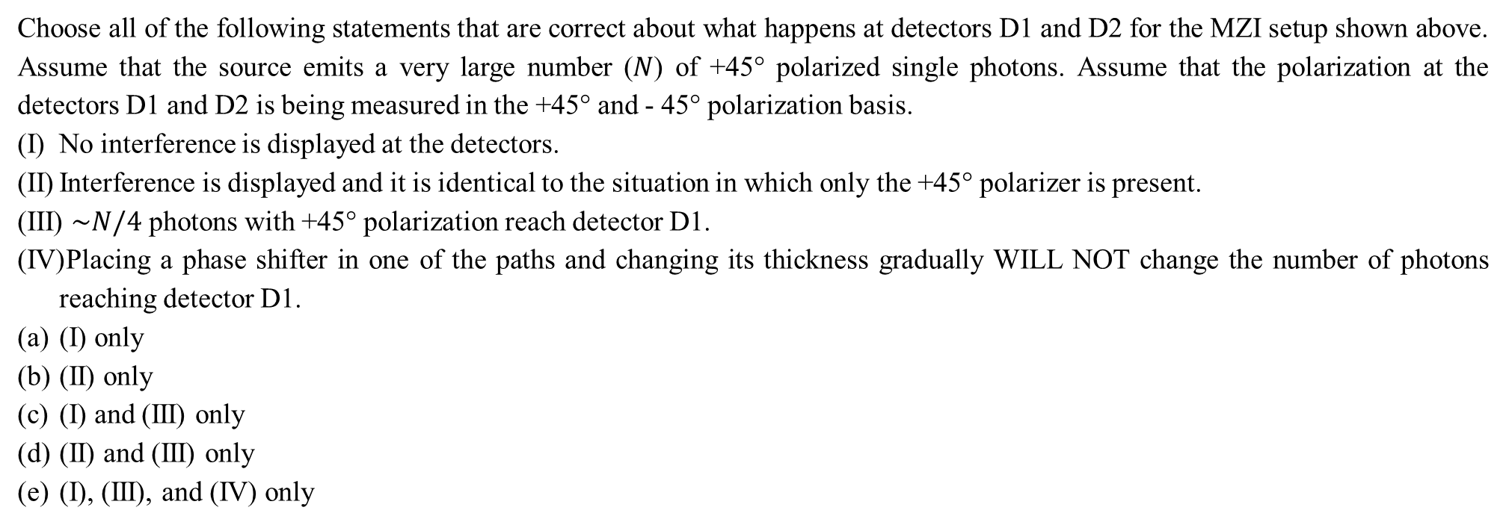
Choose all of the following statements that are correct about what happens at detectors D1 and D2 for the MZI setup shown above. Assume that the source emits a very large number ($N$) of +45° polarized single photons. Assume that the polarization at the detectors D1 and D2 is being measured in the +45° and - 45° polarization basis.
No interference is displayed at the detectors.
Interference is displayed and it is identical to the situation in which only the +45° polarizer is present.
$\sim N/4$ photons with +45° polarization reach detector D1.
Placing a phase shifter in one of the paths and changing its thickness gradually WILL NOT change the number of photons reaching detector D1.
(I) only
(II) only
(I) and (III) only
(II) and (III) only
(I), (III), and (IV) only

Slide 12
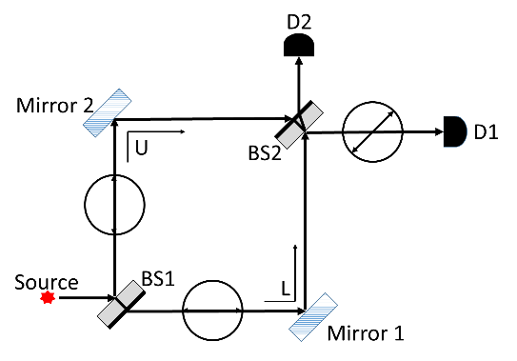
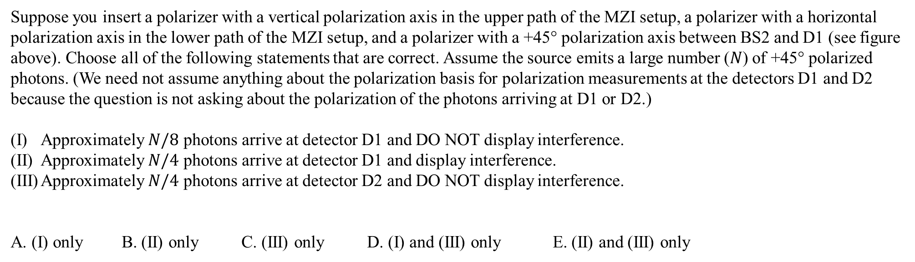
Suppose you insert a polarizer with a vertical polarization axis in the upper path of the MZI setup, a polarizer with a horizontal polarization axis in the lower path of the MZI setup, and a polarizer with a +45° polarization axis between BS2 and D1 (see figure above). Choose all of the following statements that are correct. Assume the source emits a large number ($N$) of +45° polarized photons. (We need not assume anything about the polarization basis for polarization measurements at the detectors D1 and D2 because the question is not asking about the polarization of the photons arriving at D1 or D2.)
Approximately $N/8$ photons arrive at detector D1 and DO NOT display interference.
Approximately $N/4$ photons arrive at detector D1 and display interference.
Approximately $N/4$ photons arrive at detector D2 and DO NOT display interference.
A. (I) only B. (II) only C. (III) only D. (I) and (III) only E. (II) and (III) only

Slide 13
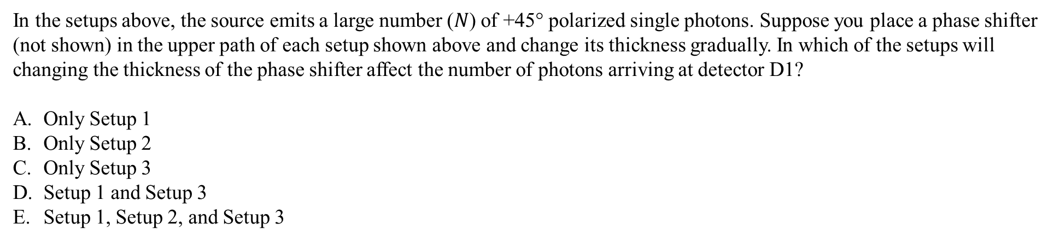
Setup 1
Setup 2
Setup 3
In the setups above, the source emits a large number ($N$) of +45° polarized single photons. Suppose you place a phase shifter (not shown) in the upper path of each setup shown above and change its thickness gradually. In which of the setups will changing the thickness of the phase shifter affect the number of photons arriving at detector D1?
Only Setup 1
Only Setup 2
Only Setup 3
Setup 1 and Setup 3
Setup 1, Setup 2, and Setup 3

Slide 14
Which of the following MZI setups does not distinguish between a source emitting a large number of +45° polarized single photons and a source emitting a large number of unpolarized single photons, e.g., a mixture of horizontally and vertically polarized photons with regard to what happens at D1 and D2?
I
II
III
I only
II only
III only
I and II only
All of the above

Slide 15
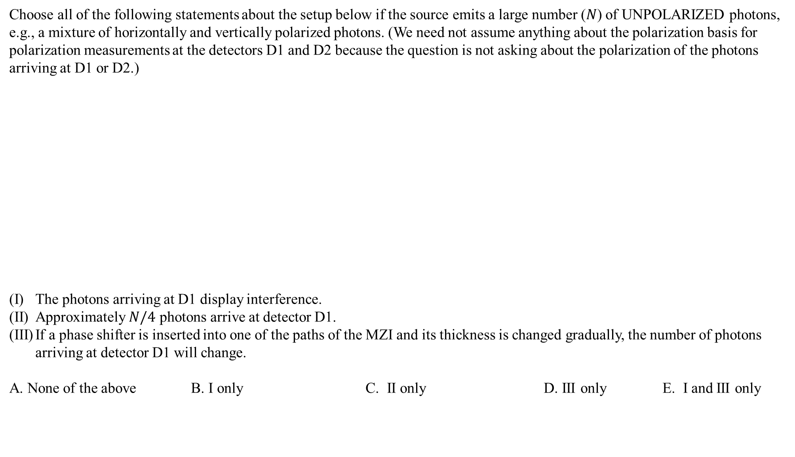
Choose all of the following statements about the setup below if the source emits a large number ($N$) of UNPOLARIZED photons, e.g., a mixture of horizontally and vertically polarized photons. (We need not assume anything about the polarization basis for polarization measurements at the detectors D1 and D2 because the question is not asking about the polarization of the photons arriving at D1 or D2.)
The photons arriving at D1 display interference.
Approximately $N/4$ photons arrive at detector D1.
If a phase shifter is inserted into one of the paths of the MZI and its thickness is changed gradually, the number of photons arriving at detector D1 will change.
A. None of the above B. I only C. II only D. III only E. I and III only

Slide 16
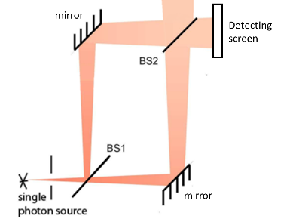
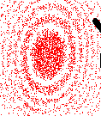
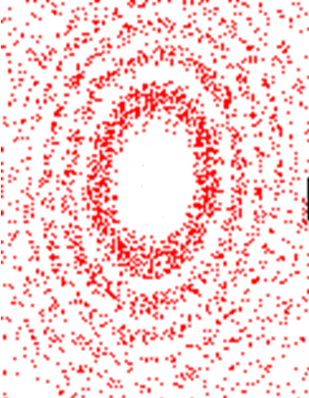
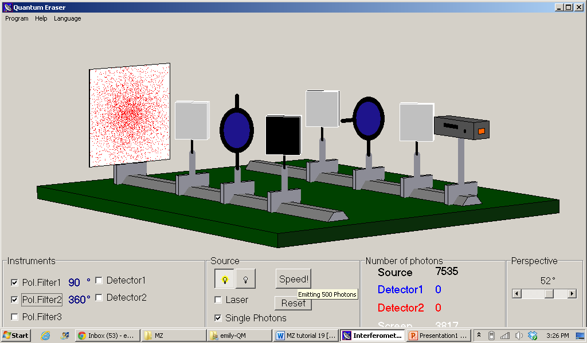
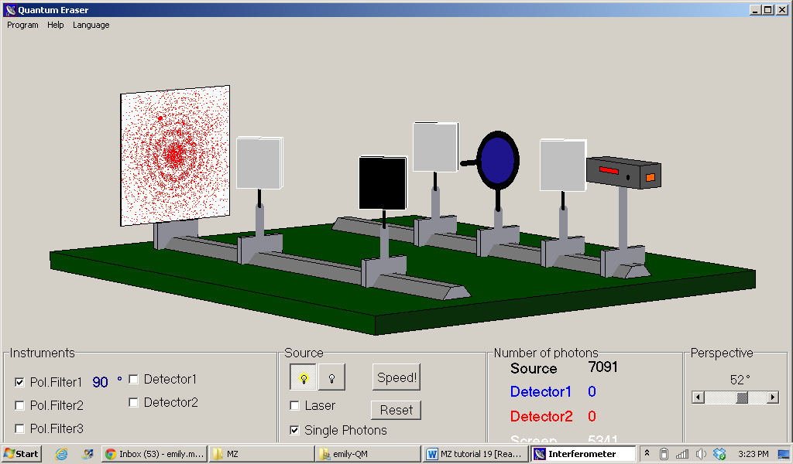

Suppose that the source emits +45$°$ polarized photons with a transverse Gaussian profile instead of a highly collimated beam of photons. The MZI setup shown below is altered such that detector D1 is replaced by a screen, as shown below.
Which one of the following pictures qualitatively represents the pattern displayed on the detecting screen after a large number of photons (red) emitted from the source arrive at the screen?
A. B. C. D. E. none of the above
(combination of A and C)

Slide 17
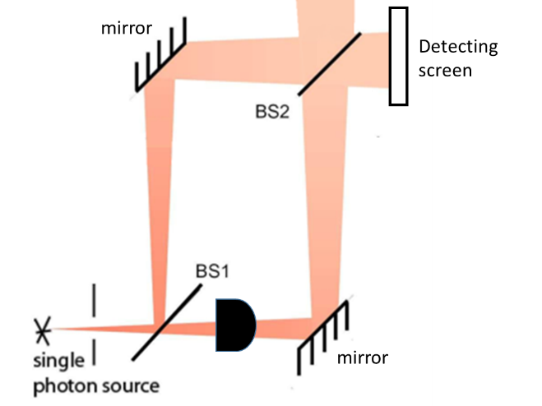

Suppose that the source emits +45$°$ polarized photons with a transverse Gaussian profile instead of a highly collimated beam of photons. The MZI setup shown below is altered such that detector D1 is replaced by a screen, as shown below.
Which one of the following pictures represents the pattern displayed on the detecting screen after a large number of photons are emitted from the source?
A. B. C. D. E. none of the above
(combination of A and C)

Slide 18
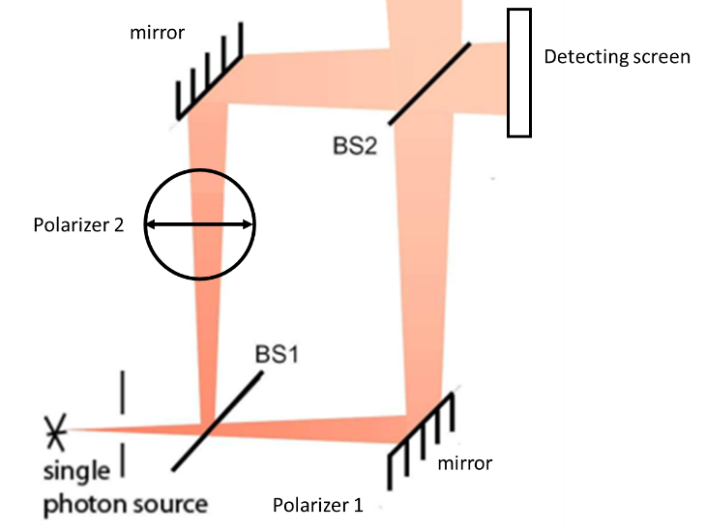
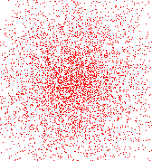

Suppose that the source emits +45$°$ polarized photons with a transverse Gaussian profile instead of a highly collimated beam of photons. The MZI setup shown below is altered such that detector D1 is replaced by a screen, as shown below.
Which one of the following pictures represents the pattern displayed on the detecting screen after a large number of photons are emitted from the source?
A. B. C. D. E. none of the above
(combination of A and C)

Slide 19
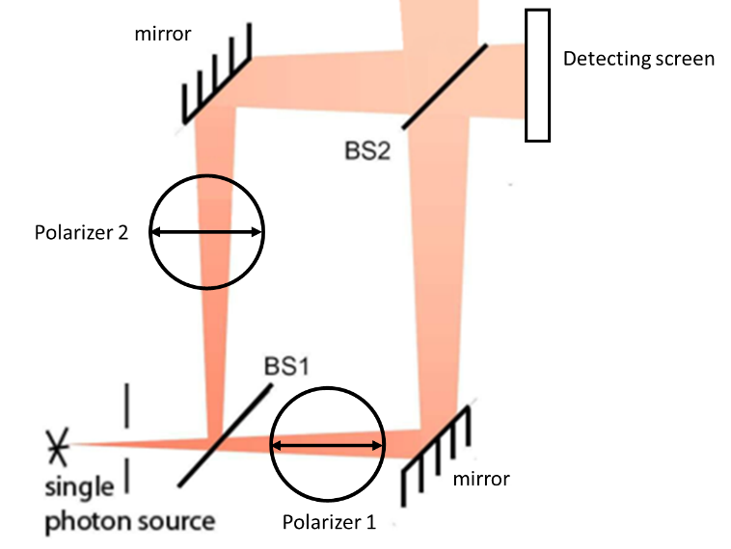

Suppose that the source emits +45$°$ polarized photons with a transverse Gaussian profile instead of a highly collimated beam of photons. The MZI setup shown below is altered such that detector D1 is replaced by a screen, as shown below.
Which one of the following pictures represents the pattern displayed on the detecting screen after a large number of photons are emitted from the source?
A. B. C. D. E. none of the above
(combination of A and C)

Slide 20


Suppose that the source emits +45$°$ polarized photons with a transverse Gaussian profile instead of a highly collimated beam of photons. The MZI setup shown below is altered such that detector D1 is replaced by a screen, as shown below.
Which one of the following pictures represents the pattern displayed on the detecting screen after a large number of photons are emitted from the source?
A. B. C. D. E. none of the above
(combination of A and C)

Slide 21
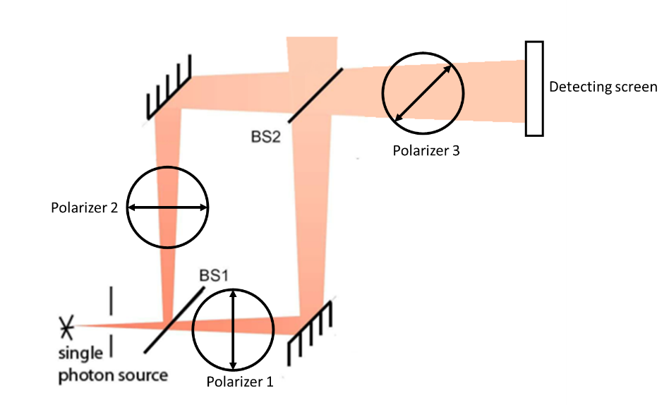

Suppose that the source emits +45$°$ polarized photons with a transverse Gaussian profile instead of a highly collimated beam of photons. The MZI setup shown below is altered such that detector D1 is replaced by a screen, as shown below.
Which one of the following pictures represents the pattern displayed on the detecting screen after a large number of photons are emitted from the source?
A. B. C. D. E. none of the above
(combination of A and C)

Slide 22
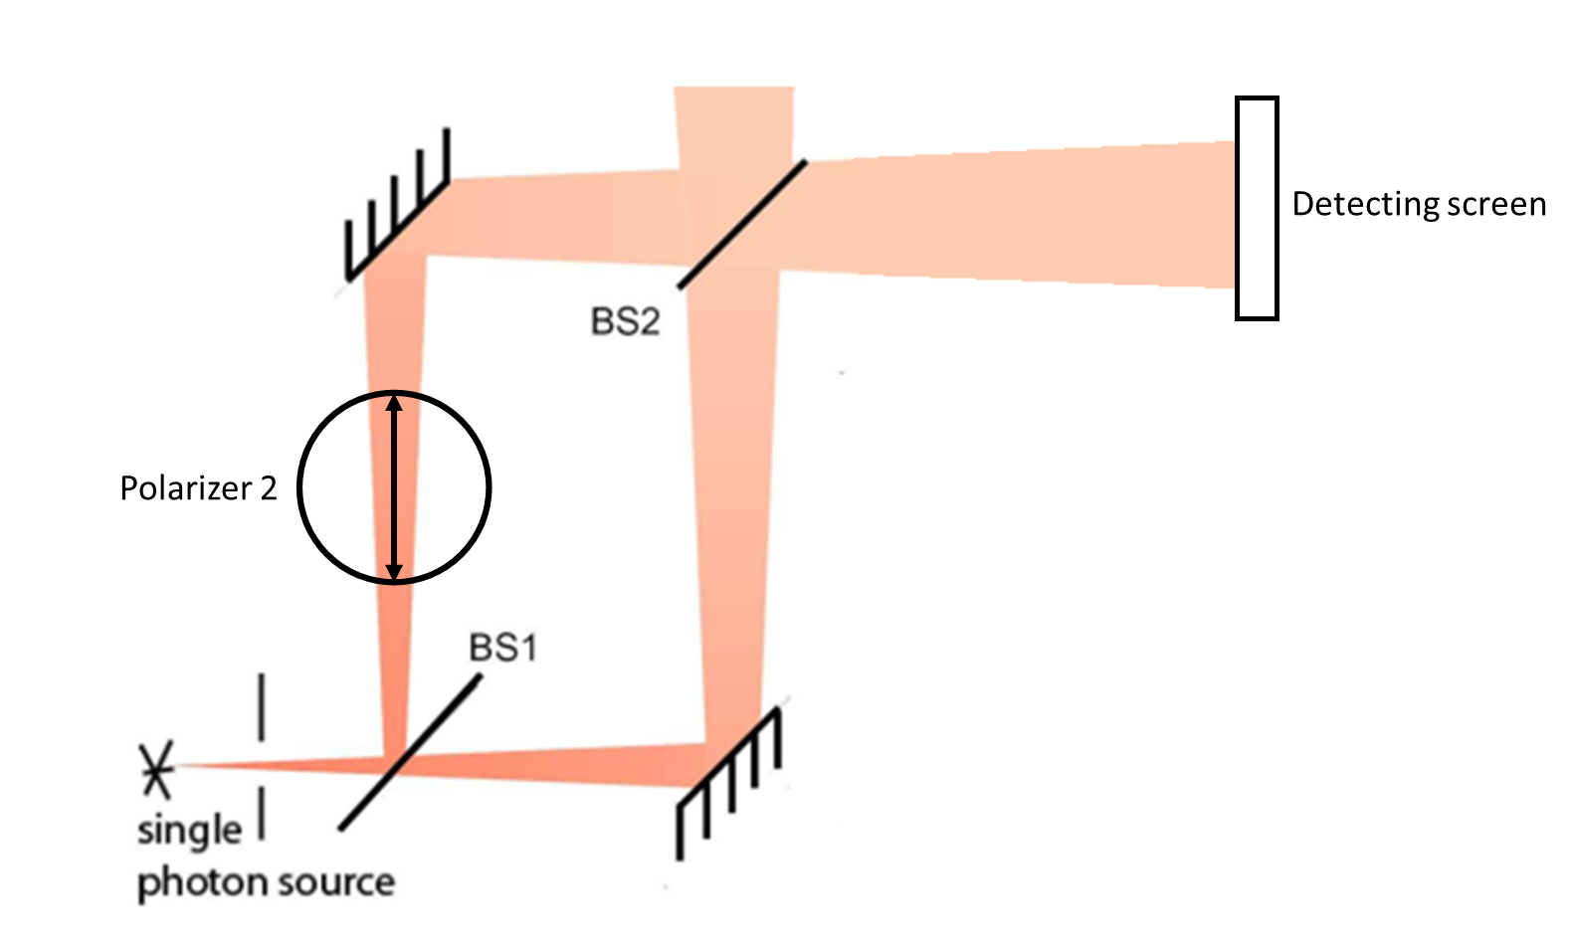

Suppose that the source emits VERTICALLY polarized photons with a transverse Gaussian profile instead of a highly collimated beam of photons. Choose all of the following MZI setups that would display an interference pattern on the detecting screen after a large number of photons are emitted from the source.
I only
I and IV only
II and IV only
II, III, and IV only
All of the above
I
II
III
IV

