Slide 1
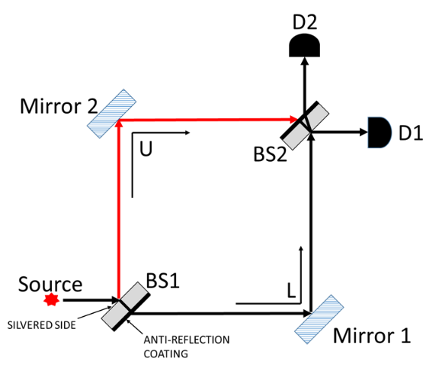
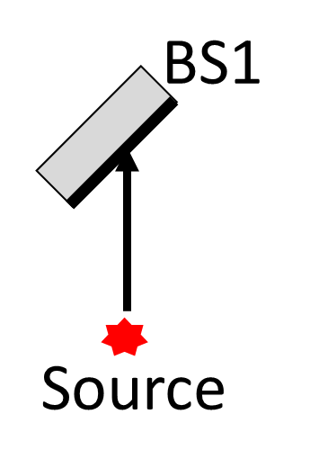

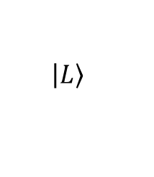
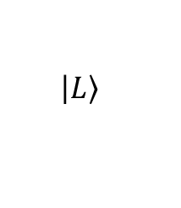
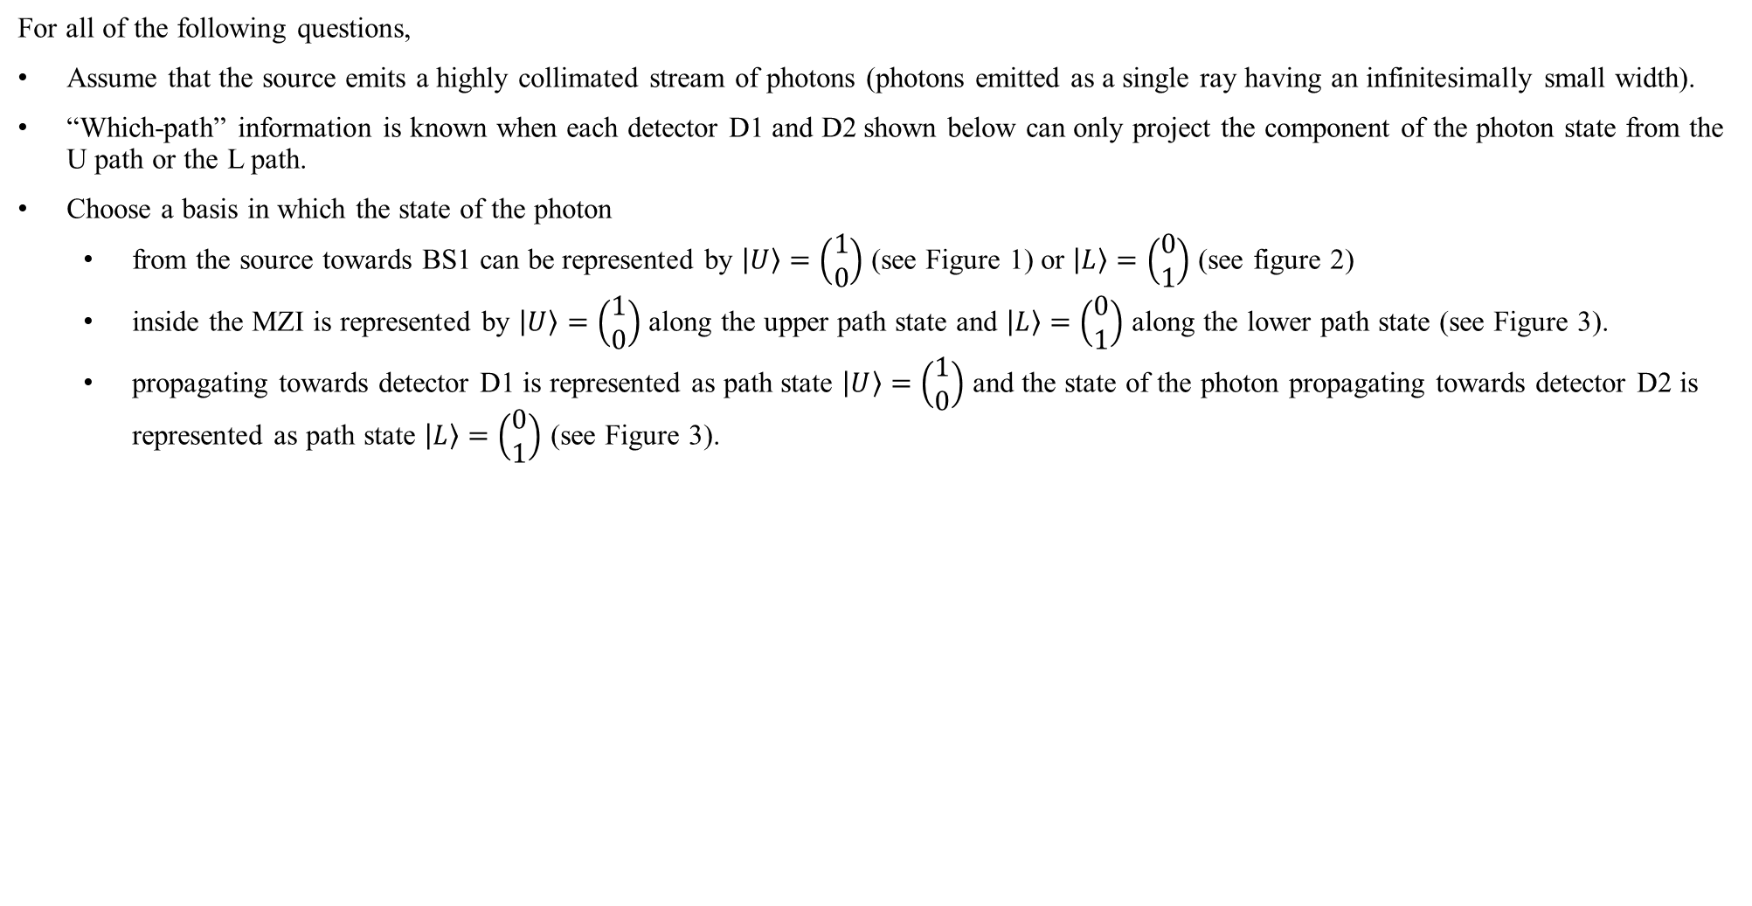

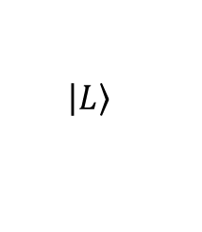


For all of the following questions,
Assume that the source emits a highly collimated stream of photons (photons emitted as a single ray having an infinitesimally small width).
“Which-path” information is known when each detector D1 and D2 shown below can only project the component of the photon state from the U path or the L path.
Choose a basis in which the state of the photon
  from the source towards BS1 can be represented by $\left|U\right.〉=\left(\begin{matrix}1 \\ 0\end{matrix}\right)$ (see Figure 1) or $\left|L\right.〉=\left(\begin{matrix}0 \\ 1\end{matrix}\right)$ (see figure 2)
  inside the MZI is represented by $\left|U\right.〉=\left(\begin{matrix}1 \\ 0\end{matrix}\right)$ along the upper path state and $\left|L\right.〉=\left(\begin{matrix}0 \\ 1\end{matrix}\right)$ along the lower path state (see Figure 3).
  propagating towards detector D1 is represented as path state $\left|U\right.〉=\left(\begin{matrix}1 \\ 0\end{matrix}\right)$ and the state of the photon propagating towards detector D2 is represented as path state $\left|L\right.〉=\left(\begin{matrix}0 \\ 1\end{matrix}\right)$ (see Figure 3).
$$\left.\left|L\right.\right\rangle$$
$$\left.\left|U\right.\right\rangle$$
$$\left.\left|L\right.\right\rangle$$
$$\left.\left|U\right.\right\rangle$$
$$\left.\left|L\right.\right\rangle$$
$$\left.\left|U\right.\right\rangle$$
Figure 1
Figure 2
Figure 3

Slide 2
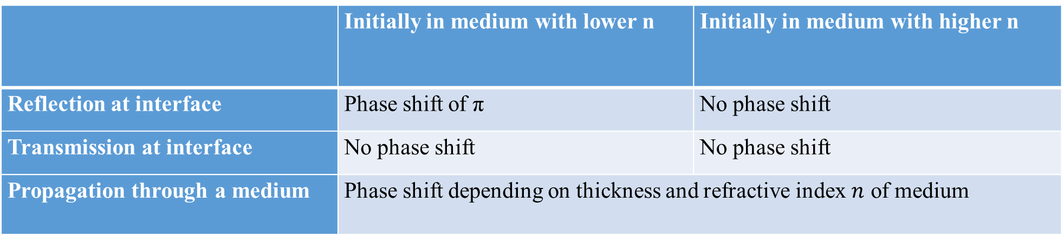
Summary of phase shifts
 | Initially in medium with lower n | Initially in medium with higher n
Reflection at interface | Phase shift of π | No phase shift
Transmission at interface | No phase shift | No phase shift
Propagation through a medium | Phase shift depending on thickness and refractive index $n$ of medium

Slide 3
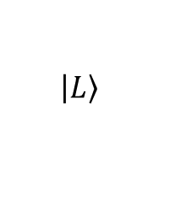
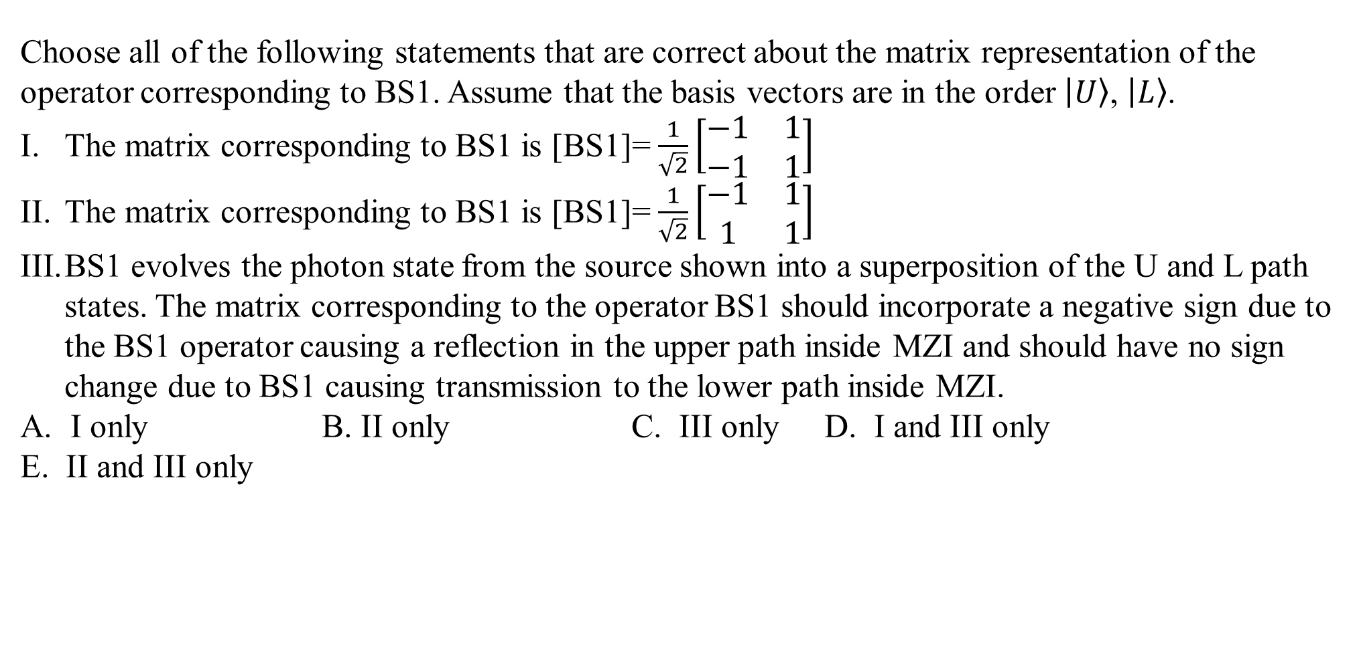


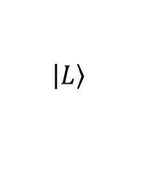
Choose all of the following statements that are correct about the matrix representation of the operator corresponding to BS1. Assume that the basis vectors are in the order $\left|U\right.〉$, $\left|L\right.〉$.
The matrix corresponding to BS1 is [BS1]=$\frac{1}{\sqrt{2}}\left[\begin{matrix}−1 & 1 \\ −1 & 1\end{matrix}\right]$
The matrix corresponding to BS1 is [BS1]=$\frac{1}{\sqrt{2}}\left[\begin{matrix}−1 & 1 \\ 1 & 1\end{matrix}\right]$
BS1 evolves the photon state from the source shown into a superposition of the U and L path states. The matrix corresponding to the operator BS1 should incorporate a negative sign due to the BS1 operator causing a reflection in the upper path inside MZI and should have no sign change due to BS1 causing transmission to the lower path inside MZI.
I only B. II only C. III only D. I and III only
E. II and III only
$$\left.\left|L\right.\right\rangle$$
$$\left.\left|U\right.\right\rangle$$
$$\left.\left|U\right.\right\rangle$$
$$\left.\left|L\right.\right\rangle$$

Slide 4
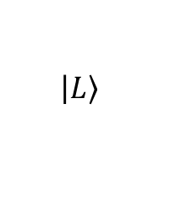
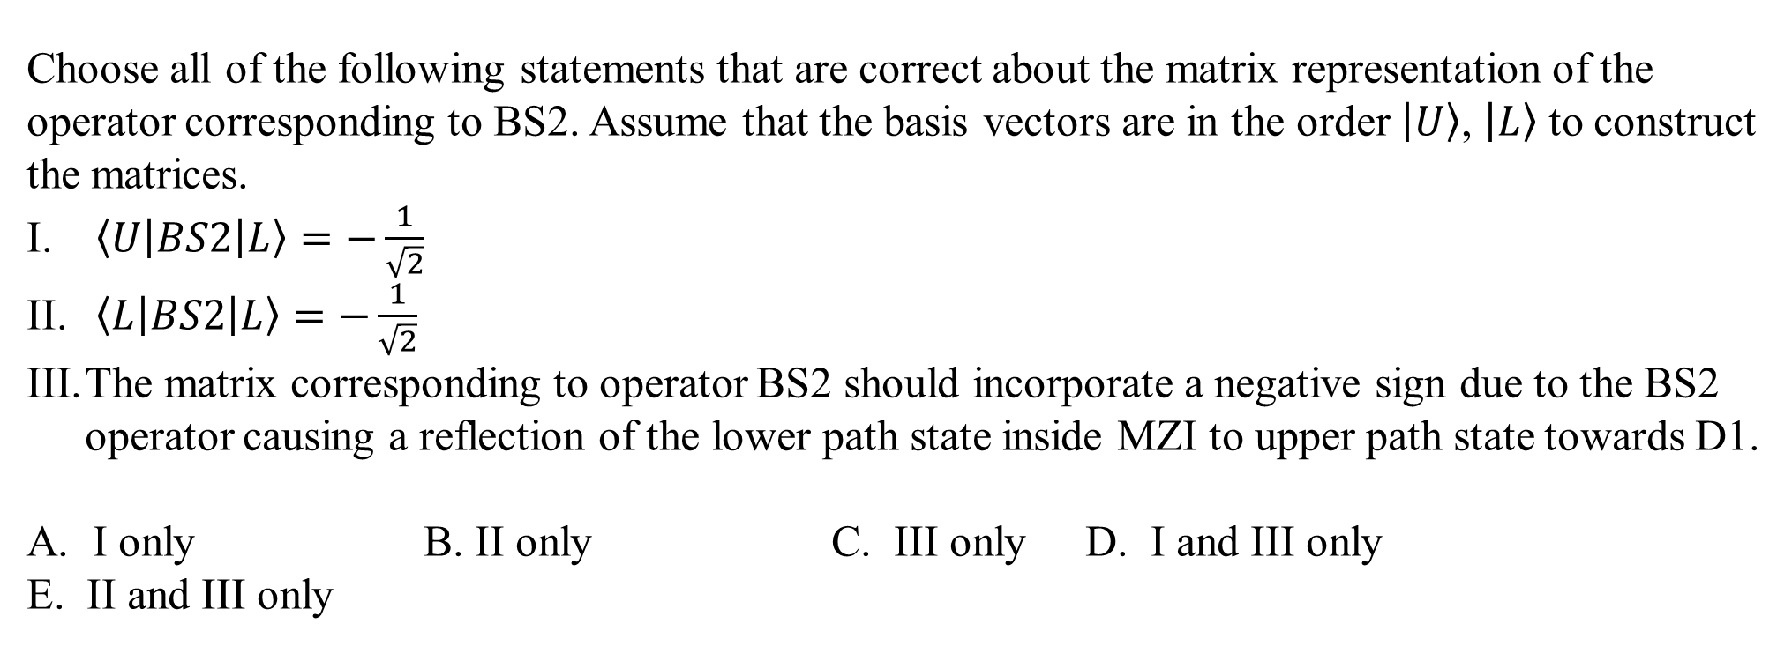


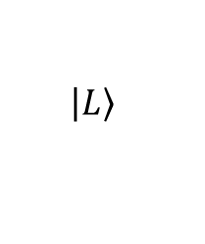
Choose all of the following statements that are correct about the matrix representation of the operator corresponding to BS2. Assume that the basis vectors are in the order $\left|U\right.〉$, $\left|L\right.〉$ to construct the matrices.
$\left\langle U | BS2 | L\right\rangle =−\frac{1}{\sqrt{2}}$
$\left\langle L | BS2 | L\right\rangle =−\frac{1}{\sqrt{2}}$
The matrix corresponding to operator BS2 should incorporate a negative sign due to the BS2 operator causing a reflection of the lower path state inside MZI to upper path state towards D1.
I only B. II only C. III only D. I and III only
E. II and III only
$$\left.\left|L\right.\right\rangle$$
$$\left.\left|U\right.\right\rangle$$
$$\left.\left|U\right.\right\rangle$$
$$\left.\left|L\right.\right\rangle$$

Slide 5
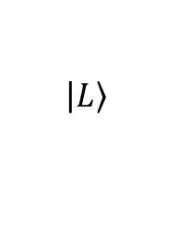
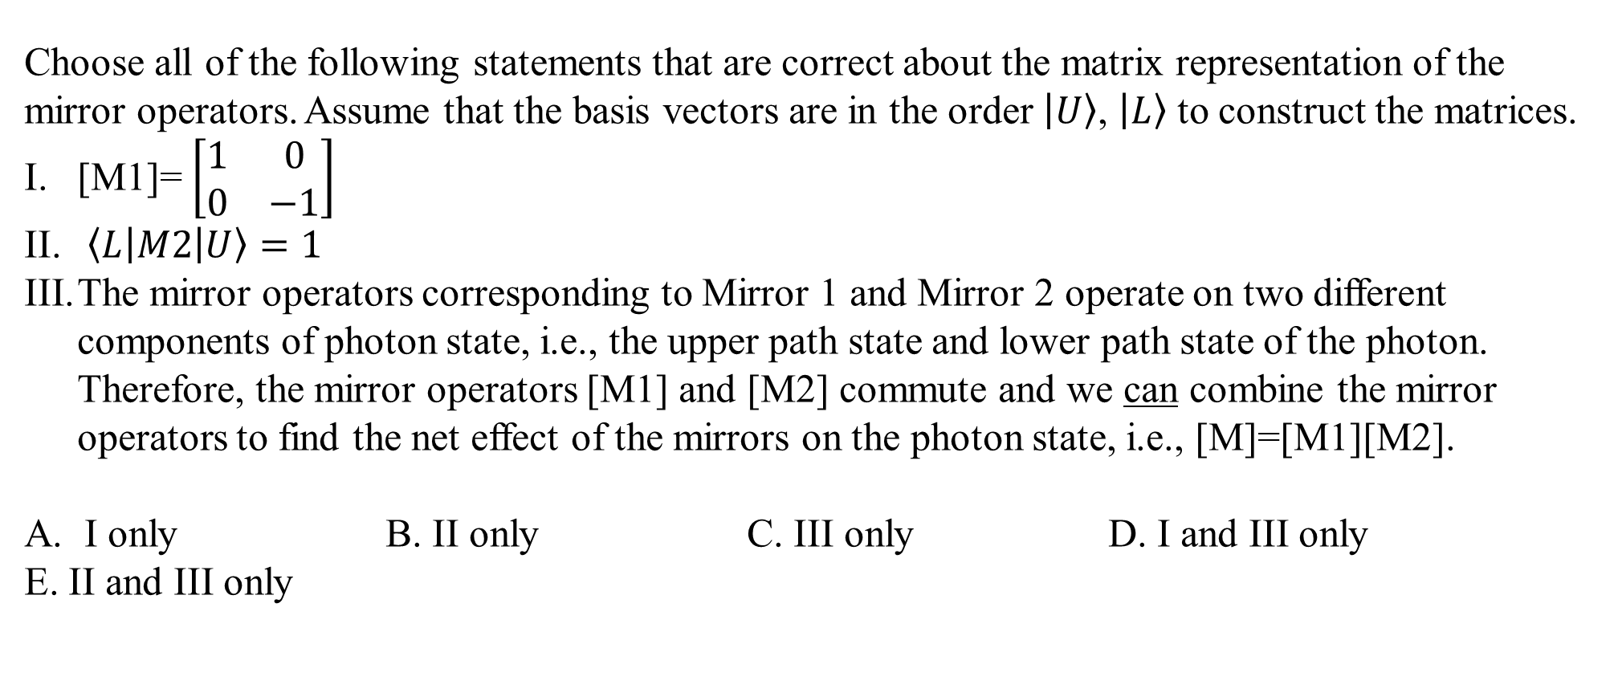


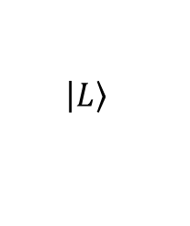
Choose all of the following statements that are correct about the matrix representation of the mirror operators. Assume that the basis vectors are in the order $\left|U\right.〉$, $\left|L\right.〉$ to construct the matrices.
[M1]=$\left[\begin{matrix}1 & 0 \\ 0 & −1\end{matrix}\right]$
$\left\langle L | M2 | U\right\rangle =1$
The mirror operators corresponding to Mirror 1 and Mirror 2 operate on two different components of photon state, i.e., the upper path state and lower path state of the photon. Therefore, the mirror operators [M1] and [M2] commute and we can combine the mirror operators to find the net effect of the mirrors on the photon state, i.e., [M]=[M1][M2].
I only B. II only C. III only D. I and III only
E. II and III only
$$\left.\left|L\right.\right\rangle$$
$$\left.\left|U\right.\right\rangle$$
$$\left.\left|U\right.\right\rangle$$
$$\left.\left|L\right.\right\rangle$$

Slide 6
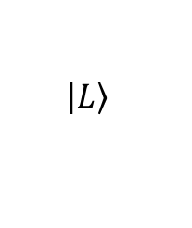
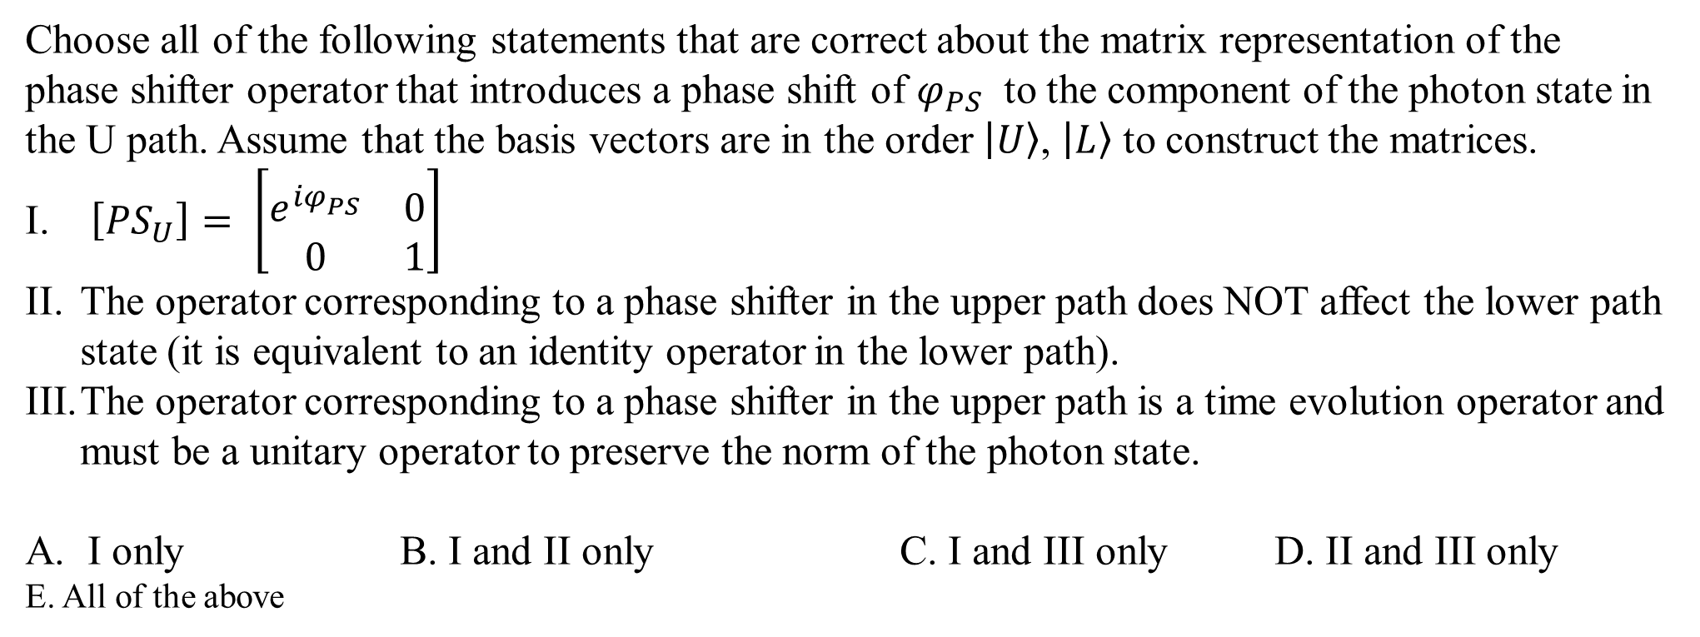


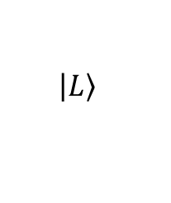
Choose all of the following statements that are correct about the matrix representation of the phase shifter operator that introduces a phase shift of $φ_{PS}$ to the component of the photon state in the U path. Assume that the basis vectors are in the order $\left|U\right.〉$, $\left|L\right.〉$ to construct the matrices.
$\left[{PS}_{U}\right]= \left[\begin{matrix}e^{{iφ}_{PS}^{}} & 0 \\ 0 & 1\end{matrix}\right]$
The operator corresponding to a phase shifter in the upper path does NOT affect the lower path state (it is equivalent to an identity operator in the lower path).
The operator corresponding to a phase shifter in the upper path is a time evolution operator and must be a unitary operator to preserve the norm of the photon state.
I only B. I and II only C. I and III only D. II and III only
E. All of the above
Phase shifter
$$\left.\left|L\right.\right\rangle$$
$$\left.\left|U\right.\right\rangle$$
$$\left.\left|U\right.\right\rangle$$
$$\left.\left|L\right.\right\rangle$$

Slide 7
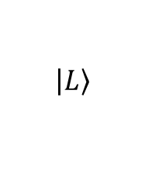
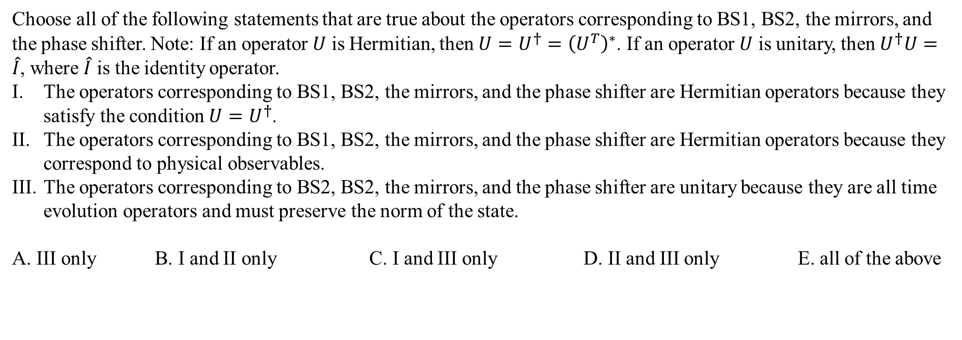


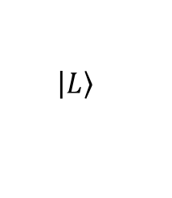
Choose all of the following statements that are true about the operators corresponding to BS1, BS2, the mirrors, and the phase shifter. Note: If an operator $U$ is Hermitian, then $U=U^{†}={\left(U^{T}\right)}^{∗}$. If an operator $U$ is unitary, then $U^{†}U=\hat{I}$, where $\hat{I}$ is the identity operator.
The operators corresponding to BS1, BS2, the mirrors, and the phase shifter are Hermitian operators because they satisfy the condition $U=U^{†}$.
The operators corresponding to BS1, BS2, the mirrors, and the phase shifter are Hermitian operators because they correspond to physical observables.
The operators corresponding to BS2, BS2, the mirrors, and the phase shifter are unitary because they are all time evolution operators and must preserve the norm of the state.
A. III only B. I and II only C. I and III only D. II and III only E. all of the above
$$\left.\left|L\right.\right\rangle$$
$$\left.\left|U\right.\right\rangle$$
$$\left.\left|U\right.\right\rangle$$
$$\left.\left|L\right.\right\rangle$$

Slide 8
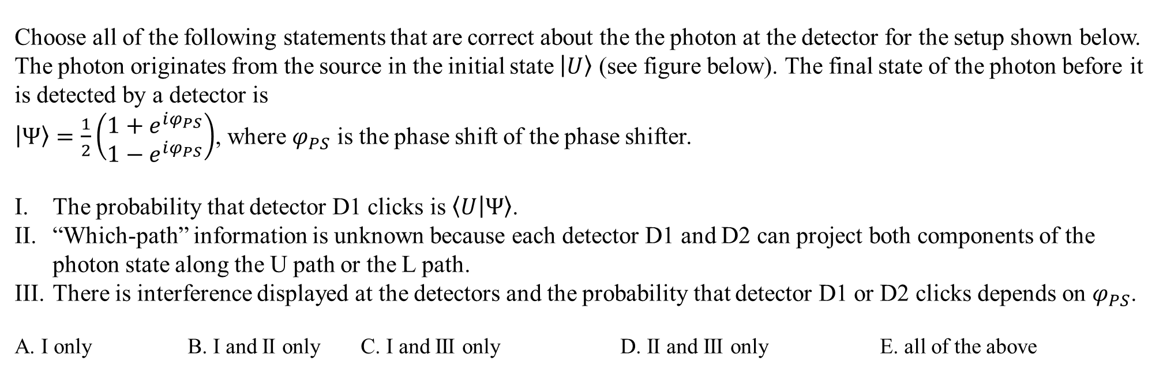
Choose all of the following statements that are correct about the the photon at the detector for the setup shown below. The photon originates from the source in the initial state $\left.\left|U\right.\right\rangle$ (see figure below). The final state of the photon before it is detected by a detector is
$\left.\left|Ψ\right.\right\rangle =\frac{1}{2}\left(\begin{matrix}1+e^{iφ_{PS}} \\ 1−e^{iφ_{PS}}\end{matrix}\right)$, where $φ_{PS}$ is the phase shift of the phase shifter.
The probability that detector D1 clicks is $\left\langle U | Ψ\right\rangle$.
“Which-path” information is unknown because each detector D1 and D2 can project both components of the photon state along the U path or the L path.
There is interference displayed at the detectors and the probability that detector D1 or D2 clicks depends on $φ_{PS}$.
A. I only B. I and II only C. I and III only D. II and III only E. all of the above
$$\left.\left|L\right.\right\rangle$$
$$\left.\left|U\right.\right\rangle$$
$$\left.\left|U\right.\right\rangle$$
$$\left.\left|L\right.\right\rangle$$

Slide 9
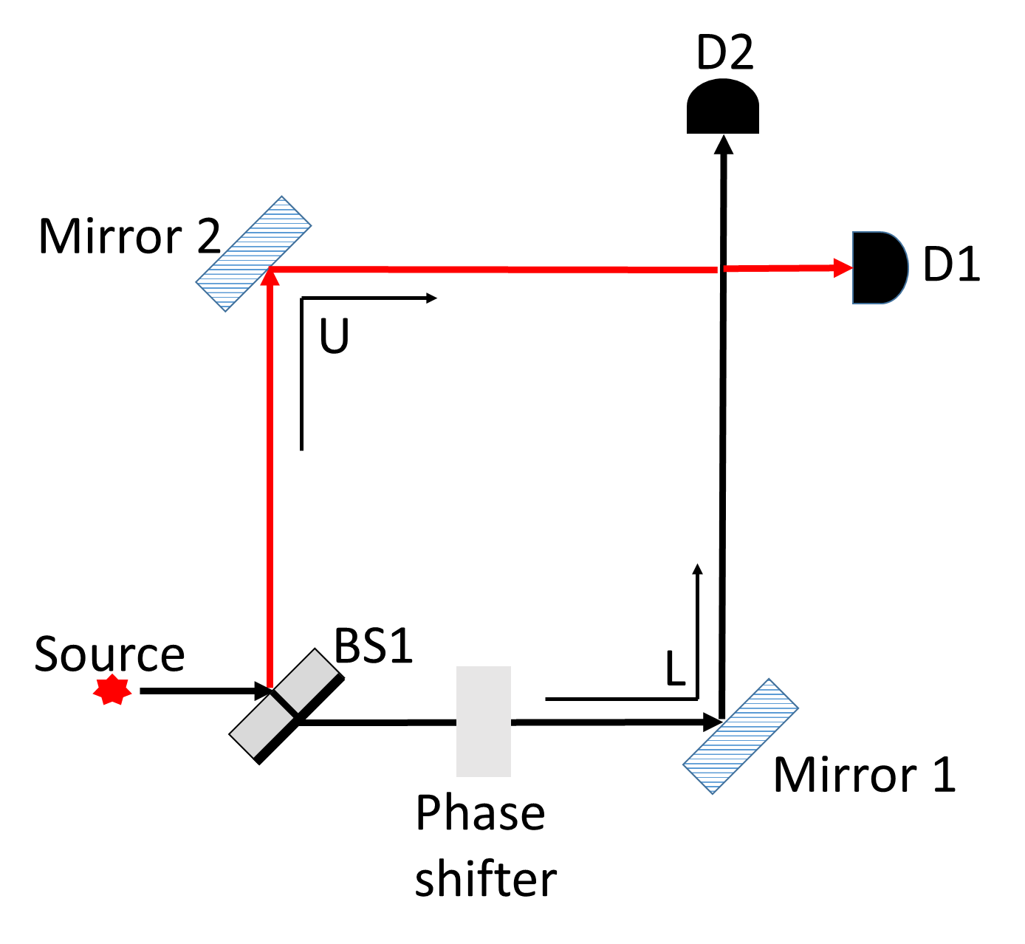
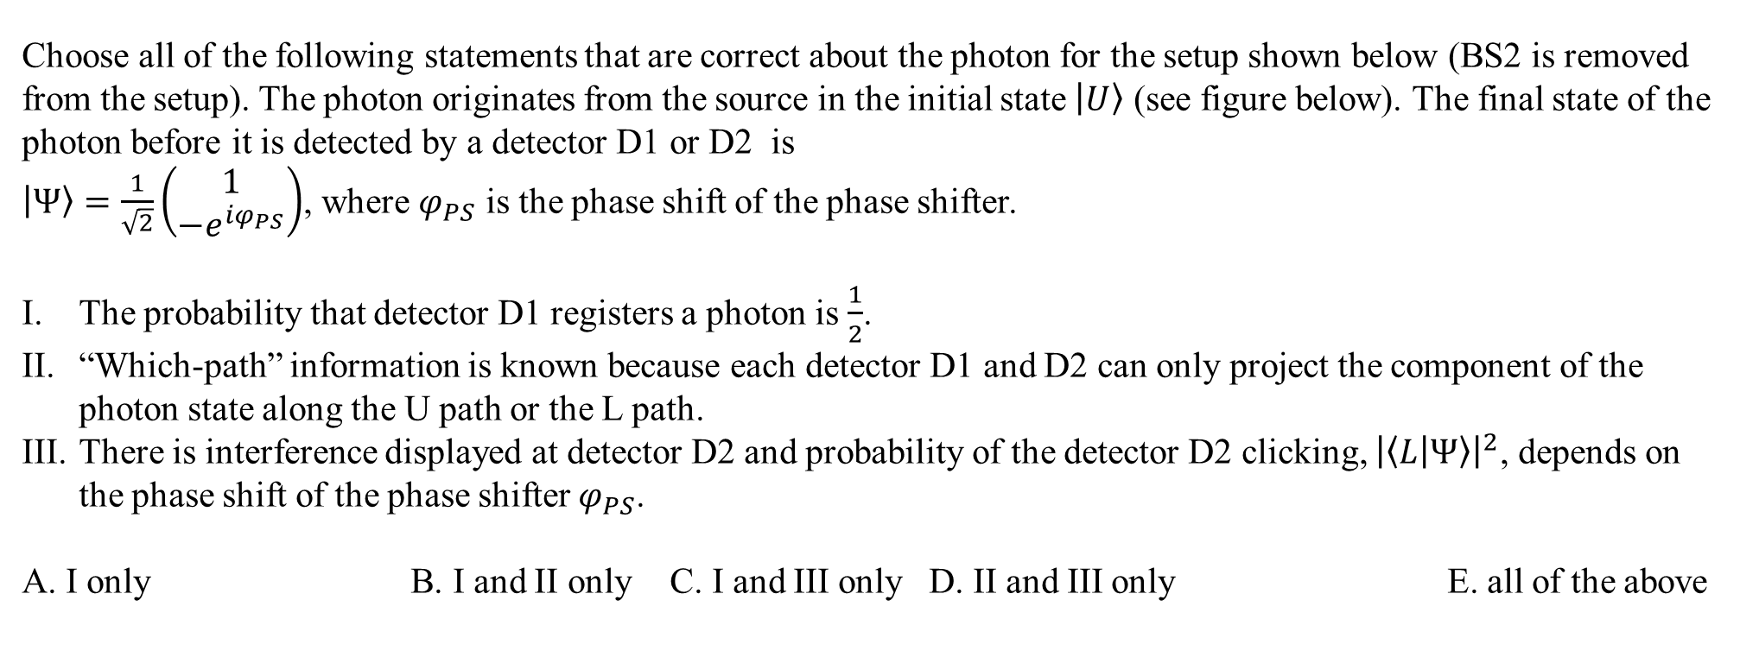
Choose all of the following statements that are correct about the photon for the setup shown below (BS2 is removed from the setup). The photon originates from the source in the initial state $\left.\left|U\right.\right\rangle$ (see figure below). The final state of the photon before it is detected by a detector D1 or D2 is
$\left.\left|Ψ\right.\right\rangle =\frac{1}{\sqrt{2}}\left(\begin{matrix}1 \\ {−e}^{iφ_{PS}}\end{matrix}\right)$, where $φ_{PS}$ is the phase shift of the phase shifter.
The probability that detector D1 registers a photon is $\frac{1}{2}$.
“Which-path” information is known because each detector D1 and D2 can only project the component of the photon state along the U path or the L path.
There is interference displayed at detector D2 and probability of the detector D2 clicking, ${\left|\left\langle L | Ψ\right\rangle \right|}^{2}$, depends on the phase shift of the phase shifter $φ_{PS}$.
A. I only B. I and II only C. I and III only D. II and III only E. all of the above

Slide 10
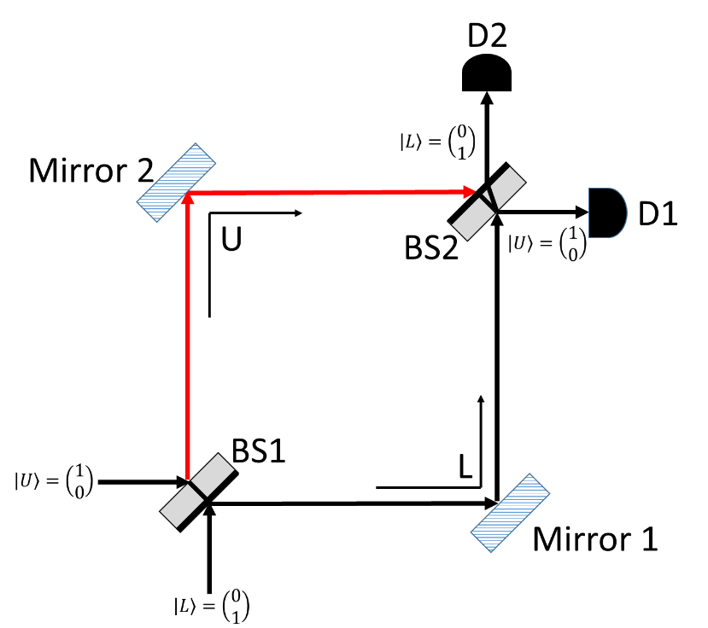
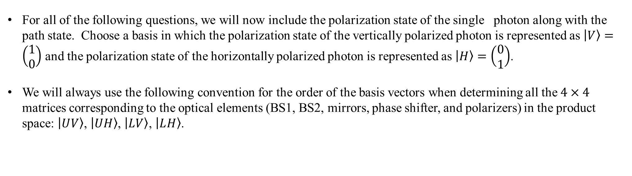
For all of the following questions, we will now include the polarization state of the single photon along with the path state. Choose a basis in which the polarization state of the vertically polarized photon is represented as $\left|V\right.〉=\left(\begin{matrix}1 \\ 0\end{matrix}\right)$ and the polarization state of the horizontally polarized photon is represented as $\left|H\right.〉=\left(\begin{matrix}0 \\ 1\end{matrix}\right)$.
We will always use the following convention for the order of the basis vectors when determining all the $4×4$ matrices corresponding to the optical elements (BS1, BS2, mirrors, phase shifter, and polarizers) in the product space: $\left|U\right.V〉$, $\left|UH\right.〉$, $\left|L\right.V〉$, $\left|L\right.H〉$.

Slide 11
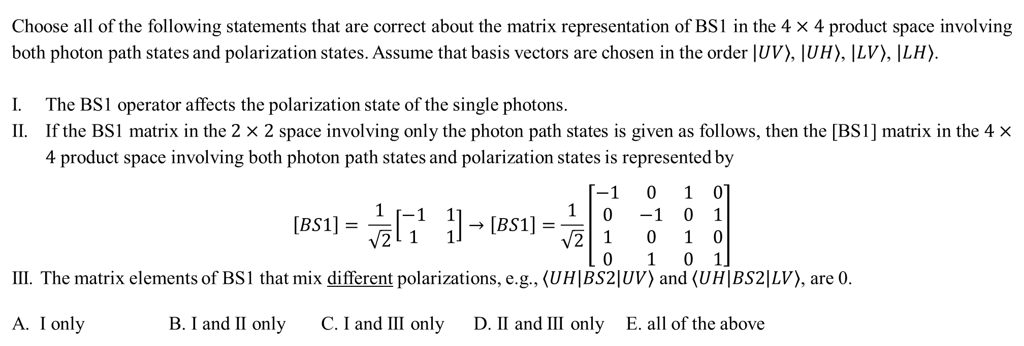
Choose all of the following statements that are correct about the matrix representation of BS1 in the $4×4$ product space involving both photon path states and polarization states. Assume that basis vectors are chosen in the order $\left|U\right.V〉$, $\left|UH\right.〉$, $\left|L\right.V〉$, $\left|L\right.H〉$.
The BS1 operator affects the polarization state of the single photons.
If the BS1 matrix in the $2×2$ space involving only the photon path states is given as follows, then the [BS1] matrix in the $4×4$ product space involving both photon path states and polarization states is represented by
$$\left[BS1\right]= \frac{1}{\sqrt{2}}\left[\begin{matrix}−1 & 1 \\ 1 & 1\end{matrix}\right]→\left[BS1\right]=\frac{1}{\sqrt{2}}\left[\begin{matrix}−1 & 0 & 1 & 0 \\ 0 & −1 & 0 & 1 \\ 1 & 0 & 1 & 0 \\ 0 & 1 & 0 & 1\end{matrix}\right]$$
III. The matrix elements of BS1 that mix different polarizations, e.g., $\left\langle UH | BS2 | UV\right\rangle$ and $\left\langle UH | BS2 | LV\right\rangle$, are 0.
A. I only B. I and II only C. I and III only D. II and III only E. all of the above

Slide 12



Which one of the following matrices is the correct matrix representation of BS2 in the $4×4$ product space involving both single photon path states and polarization states? Assume that basis vectors are chosen in the order $\left|U\right.V〉$, $\left|UH\right.〉$, $\left|L\right.V〉$, $\left|L\right.H〉$. Hint: The matrix representation of BS2 in the $2×2$ space involving only the single photon path states is [BS2]=$\frac{1}{\sqrt{2}}\left[\begin{matrix}1 & −1 \\ 1 & 1\end{matrix}\right]$.
$\left[BS2\right]=\frac{1}{\sqrt{2}}\left[\begin{matrix}1 & 0 & −1 & 0 \\ 0 & 1 & 0 & 1 \\ 1 & 0 & 1 & 0 \\ 0 & 1 & 0 & 1\end{matrix}\right]$
$\left[BS2\right]=\frac{1}{\sqrt{2}}\left[\begin{matrix}1 & 0 & 1 & 0 \\ 0 & 1 & 0 & 1 \\ 1 & 0 & −1 & 0 \\ 0 & 1 & 0 & −1\end{matrix}\right]$
$\left[BS2\right]=\frac{1}{\sqrt{2}}\left[\begin{matrix}1 & 0 & −1 & 0 \\ 0 & 1 & 0 & −1 \\ 1 & 0 & 1 & 0 \\ 0 & 1 & 0 & 1\end{matrix}\right]$
D. $\left[BS2\right]=\frac{1}{\sqrt{2}}\left[\begin{matrix}1 & 0 & 1 & 0 \\ 0 & 1 & 0 & −1 \\ 1 & 0 & 1 & 0 \\ 0 & 1 & 0 & 1\end{matrix}\right]$
E. $\left[BS2\right]=\frac{1}{\sqrt{2}}\left[\begin{matrix}1 & 0 & 1 & 0 \\ 0 & 1 & 0 & 1 \\ 1 & 0 & 1 & 0 \\ 0 & 1 & 0 & 1\end{matrix}\right]$

Slide 13
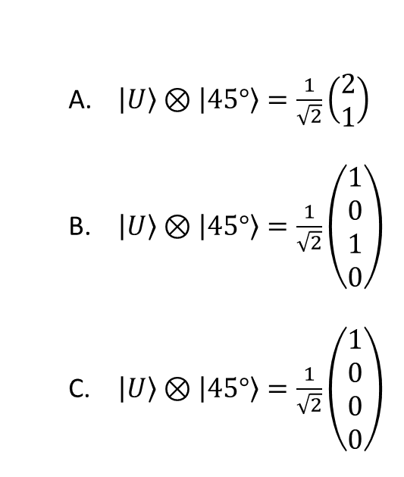
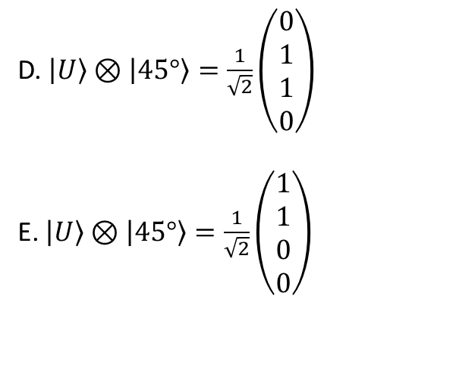
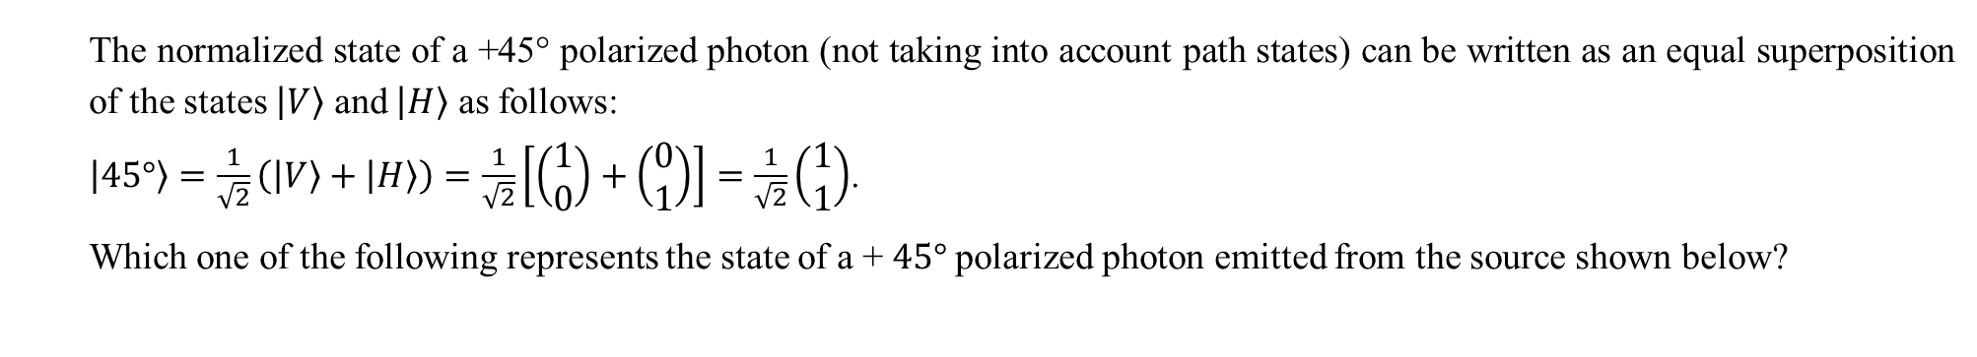
The normalized state of a +45° polarized photon (not taking into account path states) can be written as an equal superposition of the states $\left|V\right.〉$ and $\left|H\right.〉$ as follows:
$\left|45°\right.〉=\frac{1}{\sqrt{2}}\left(\left|V\right.〉+\left|H\right.〉\right)=\frac{1}{\sqrt{2}}\left[\left(\begin{matrix}1 \\ 0\end{matrix}\right)+\left(\begin{matrix}0 \\ 1\end{matrix}\right)\right]=\frac{1}{\sqrt{2}}\left(\begin{matrix}1 \\ 1\end{matrix}\right)$.
Which one of the following represents the state of a + $45°$polarized photon emitted from the source shown below?
$\left|U\right.〉⊗\left|45°\right.〉=\frac{1}{\sqrt{2}}\left(\begin{matrix}2 \\ 1\end{matrix}\right)$
$\left|U\right.〉⊗\left|45°\right.〉=\frac{1}{\sqrt{2}}\left(\begin{matrix}1 \\ 0 \\ 1 \\ 0\end{matrix}\right)$
$\left|U\right.〉⊗\left|45°\right.〉=\frac{1}{\sqrt{2}}\left(\begin{matrix}1 \\ 0 \\ 0 \\ 0\end{matrix}\right)$
D. $\left|U\right.〉⊗\left|45°\right.〉=\frac{1}{\sqrt{2}}\left(\begin{matrix}0 \\ 1 \\ 1 \\ 0\end{matrix}\right)$
E. $\left|U\right.〉⊗\left|45°\right.〉=\frac{1}{\sqrt{2}}\left(\begin{matrix}1 \\ 1 \\ 0 \\ 0\end{matrix}\right)$
source

