Slide 1
QM1 Concept test 1.1
Consider an ensemble of hydrogen atoms all in the ground state. Choose all of the following statements that are correct.
If you make measurements of the distance of the electron from the nucleus, you will find all electrons at the same distance from the nucleus.
If you make measurements of the magnitude of the orbital angular momentum of the electrons, you will obtain the same value for all electrons.
If you make measurements of z-component of the orbital angular momentum of the electrons, you will obtain the same value for all electrons.
A. 1 only B. 2 only C. 1 and 3 only D. 2 and 3 only
E. all of the above

Slide 2
QM1 Concept test 1.2
Consider an ensemble of hydrogen atoms all in the first excited state. Choose all of the following statements that are correct.
If you make measurements of the distance of the electron from the nucleus, you must find all electrons at a larger distance than what you can find in the ground state.
If you make measurements of the magnitude of the orbital angular momentum of the electrons, you will obtain the same value for all electrons.
If you make measurements of z-component of the orbital angular momentum of the electrons, you will obtain the same value for all electrons.
A. 1 only B. 2 only C. 3 only D. 2 and 3 only
E. none of the above

Slide 3
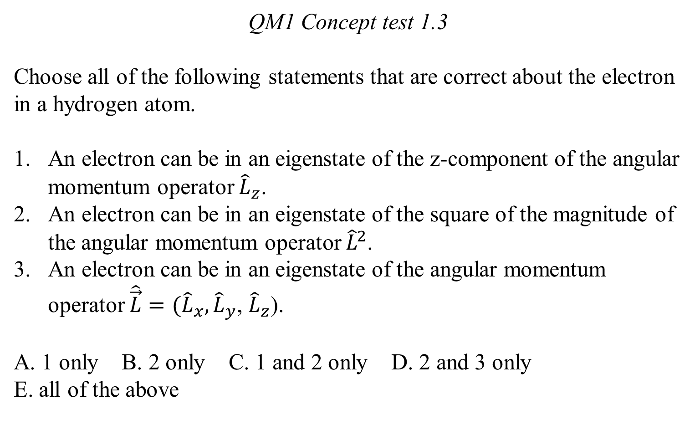
QM1 Concept test 1.3
Choose all of the following statements that are correct about the electron in a hydrogen atom.
An electron can be in an eigenstate of the z-component of the angular momentum operator ${\hat{L}}_{z}$.
An electron can be in an eigenstate of the square of the magnitude of the angular momentum operator ${\hat{L}}^{2}$.
An electron can be in an eigenstate of the angular momentum operator $\hat{\vec{L}}=({\hat{L}}_{x},{\hat{L}}_{y}$, ${\hat{L}}_{z}$).
A. 1 only B. 2 only C. 1 and 2 only D. 2 and 3 only
E. all of the above

Slide 4
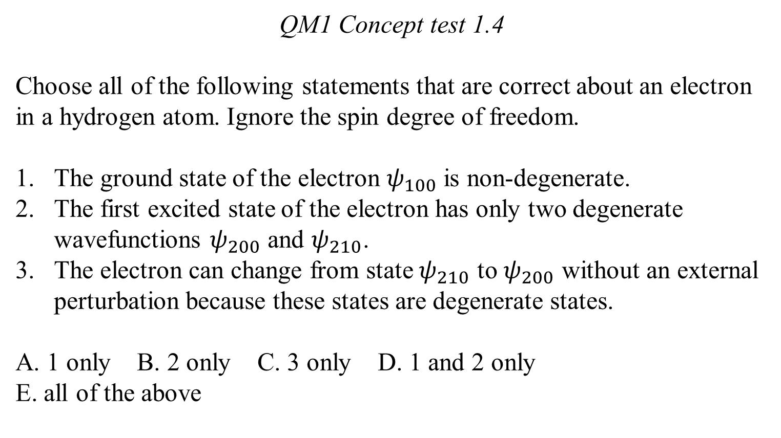
QM1 Concept test 1.4
Choose all of the following statements that are correct about an electron in a hydrogen atom. Ignore the spin degree of freedom.
The ground state of the electron $ψ_{100}$ is non-degenerate.
The first excited state of the electron has only two degenerate wavefunctions $ψ_{200}$ and $ψ_{210}$.
The electron can change from state $ψ_{210}$ to $ψ_{200}$ without an external perturbation because these states are degenerate states.
A. 1 only B. 2 only C. 3 only D. 1 and 2 only
E. all of the above

Slide 5
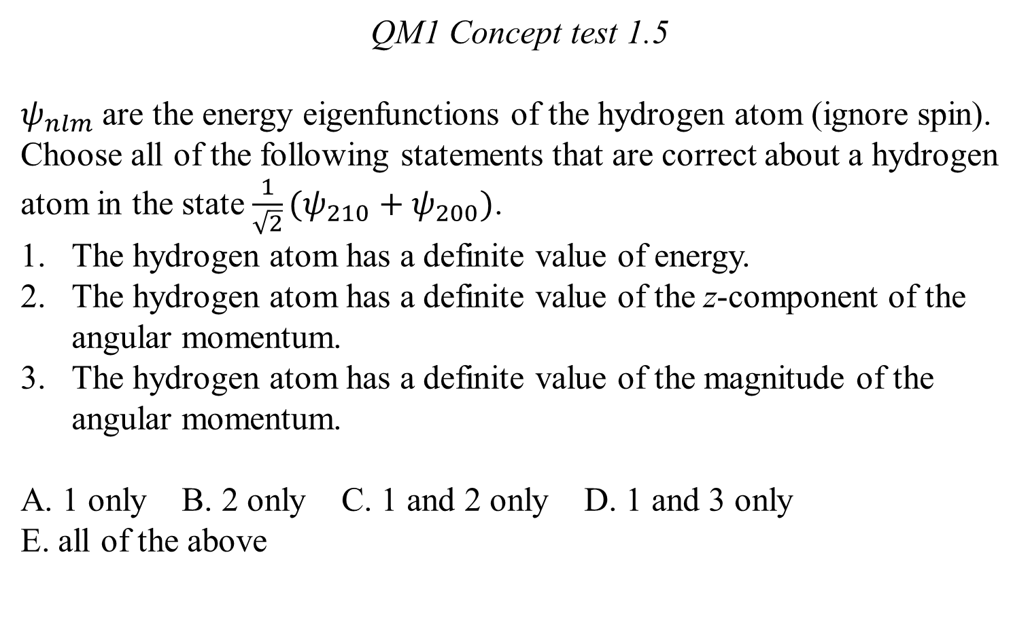
QM1 Concept test 1.5
$ψ_{nlm}$ are the energy eigenfunctions of the hydrogen atom (ignore spin). Choose all of the following statements that are correct about a hydrogen atom in the state $\frac{1}{\sqrt{2}}(ψ_{210}+ψ_{200})$.
The hydrogen atom has a definite value of energy.
The hydrogen atom has a definite value of the z-component of the angular momentum.
The hydrogen atom has a definite value of the magnitude of the angular momentum.
A. 1 only B. 2 only C. 1 and 2 only D. 1 and 3 only
E. all of the above

Slide 6
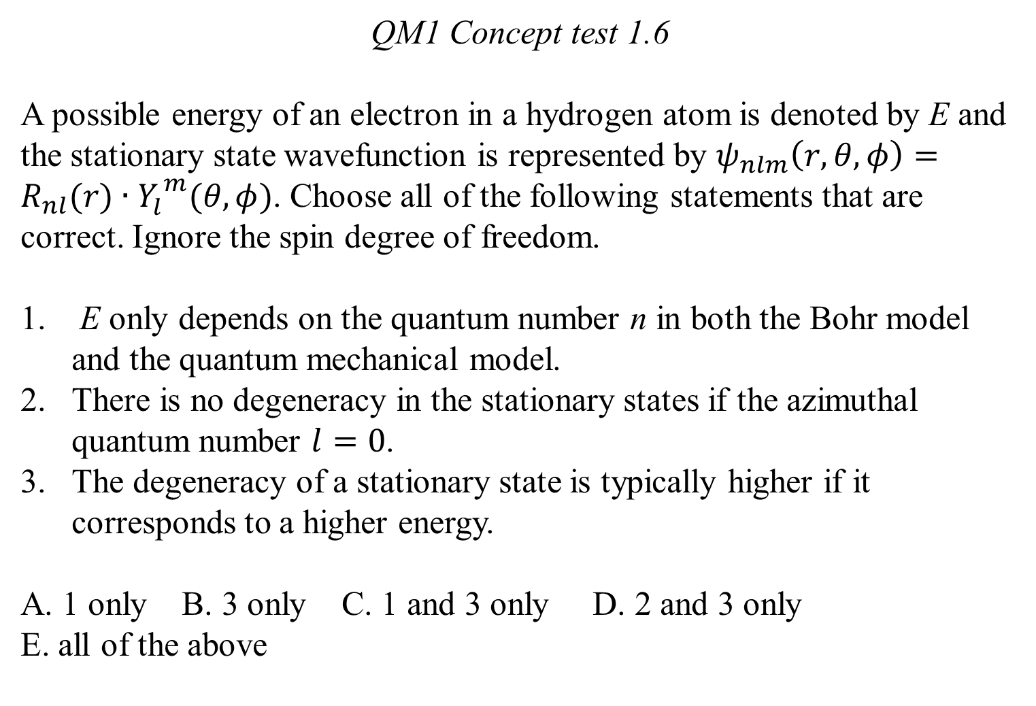
QM1 Concept test 1.6
A possible energy of an electron in a hydrogen atom is denoted by E and the stationary state wavefunction is represented by $ψ_{nlm}\left(r, θ, φ\right)=R_{nl}(r)∙{Y_{l}^{}}^{m}(θ,φ)$. Choose all of the following statements that are correct. Ignore the spin degree of freedom.
E only depends on the quantum number n in both the Bohr model and the quantum mechanical model.
There is no degeneracy in the stationary states if the azimuthal quantum number $l=0$.
The degeneracy of a stationary state is typically higher if it corresponds to a higher energy.
A. 1 only B. 3 only C. 1 and 3 only D. 2 and 3 only
E. all of the above

Slide 7
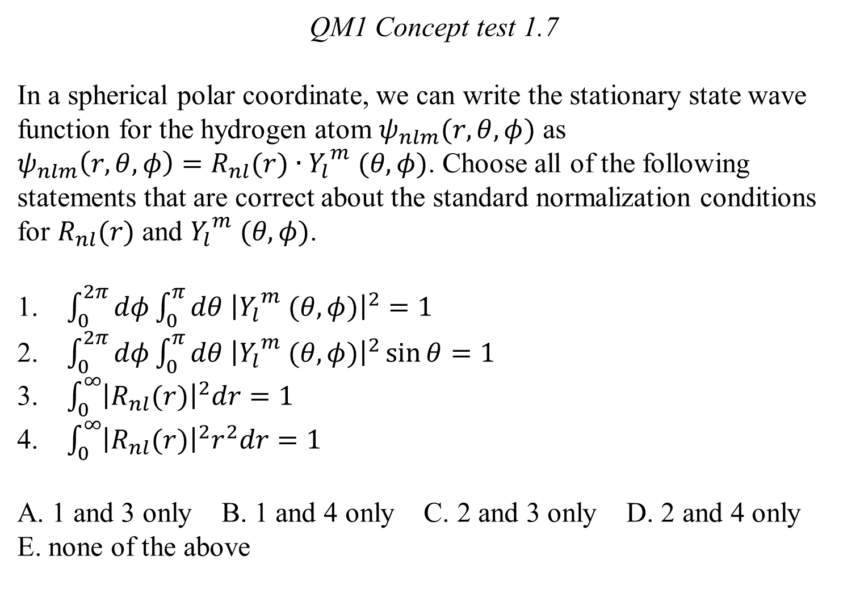
QM1 Concept test 1.7
In a spherical polar coordinate, we can write the stationary state wave function for the hydrogen atom $ψ_{nlm}(r, θ, φ)$ as
$ψ_{nlm}\left(r, θ, φ\right)=R_{nl}(r)∙{Y_{l}}^{m} (θ,φ)$. Choose all of the following statements that are correct about the standard normalization conditions for $R_{nl}(r)$ and ${Y_{l}}^{m} (θ,φ)$.
$\int_{0}^{2π}{dφ\int_{0}^{π}{dθ {\left|{Y_{l}}^{m} (θ,φ)\right|}^{2}}}=1$
$\int_{0}^{2π}{dφ\int_{0}^{π}{dθ {\left|{Y_{l}}^{m} (θ,φ)\right|}^{2}\sin{θ}}}=1$
$\int_{0}^{∞}{{\left|R_{nl}(r)\right|}^{2}dr=1}$
$\int_{0}^{∞}{{\left|R_{nl}(r)\right|}^{2}r^{2}dr=1}$
A. 1 and 3 only B. 1 and 4 only C. 2 and 3 only D. 2 and 4 only
E. none of the above

Slide 8
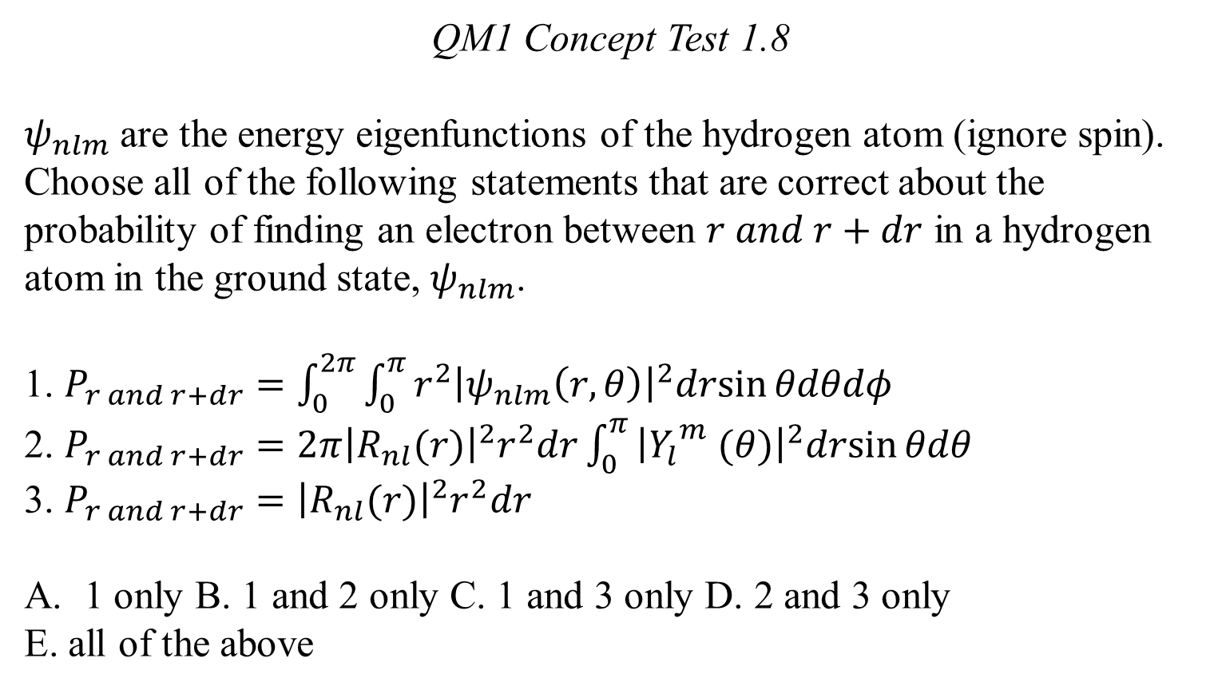
QM1 Concept Test 1.8
$ψ_{nlm}$ are the energy eigenfunctions of the hydrogen atom (ignore spin). Choose all of the following statements that are correct about the probability of finding an electron between $r and r+dr$ in a hydrogen atom in the ground state, $ψ_{nlm}$.
1. $P_{r and r+dr}=\int_{0}^{2π}{\int_{0}^{π}{r^{2}{\left|ψ_{nlm}\left(r,θ\right)\right|}^{2}drsin{θdθdφ}}}$
2. $P_{r and r+dr}=2π{\left|R_{nl}(r)\right|}^{2}r^{2}dr\int_{0}^{π}{{\left|{Y_{l}}^{m} (θ)\right|}^{2}drsin{θdθ}}$
3. $P_{r and r+dr}={\left|R_{nl}(r)\right|}^{2}r^{2}dr$
1 only B. 1 and 2 only C. 1 and 3 only D. 2 and 3 only
E. all of the above

Slide 9
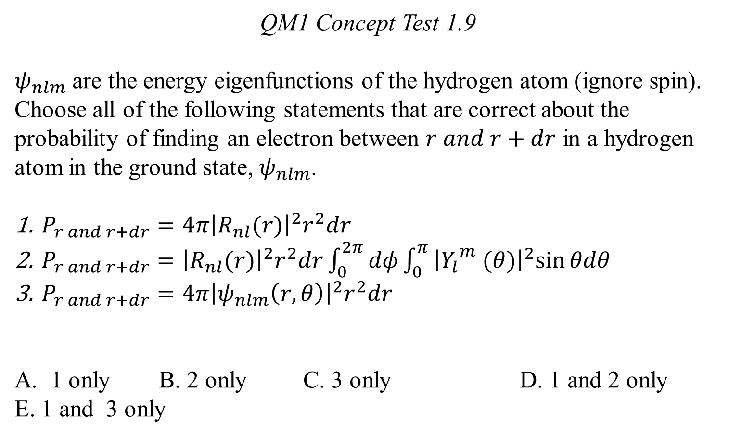
QM1 Concept Test 1.9
$ψ_{nlm}$ are the energy eigenfunctions of the hydrogen atom (ignore spin). Choose all of the following statements that are correct about the probability of finding an electron between $r and r+dr$ in a hydrogen atom in the ground state, $ψ_{nlm}$.
$P_{r and r+dr}={4π\left|R_{nl}(r)\right|}^{2}r^{2}dr$
$P_{r and r+dr}={\left|R_{nl}(r)\right|}^{2}r^{2}dr\int_{0}^{2π}{dφ\int_{0}^{π}{{\left|{Y_{l}}^{m} (θ)\right|}^{2}sin{θdθ}}}$
$P_{r and r+dr}=4π{\left|ψ_{nlm}\left(r,θ\right)\right|}^{2}r^{2}dr$
1 only B. 2 only C. 3 only D. 1 and 2 only
E. 1 and 3 only

Slide 10
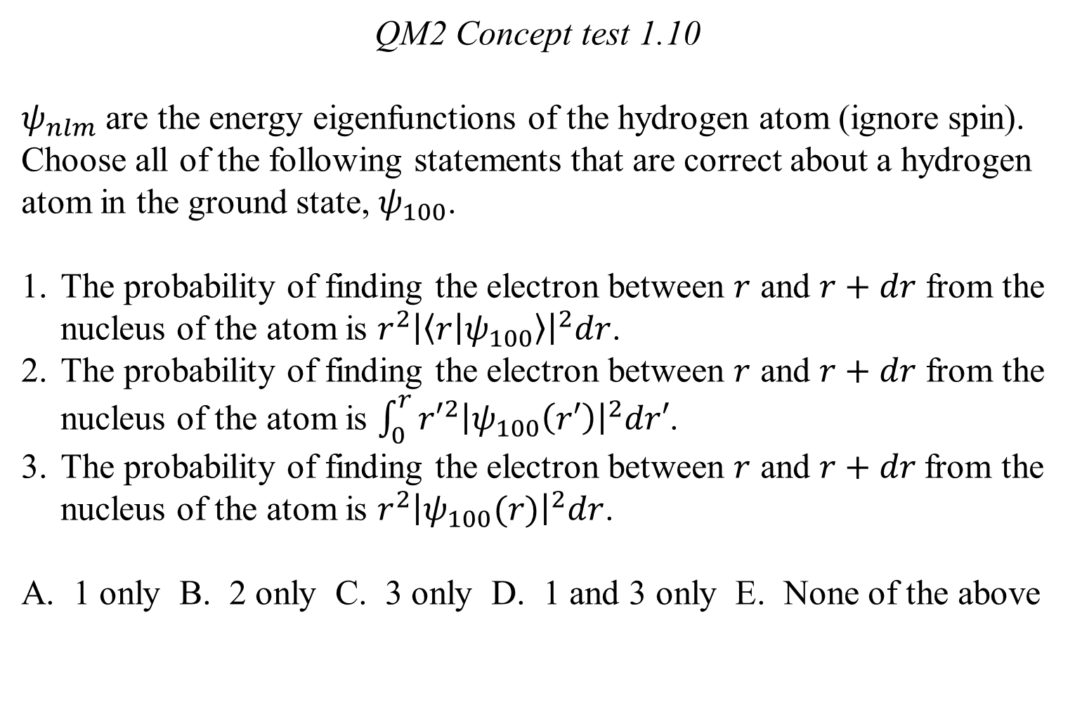
QM2 Concept test 1.10
$ψ_{nlm}$ are the energy eigenfunctions of the hydrogen atom (ignore spin). Choose all of the following statements that are correct about a hydrogen atom in the ground state, $ψ_{100}$.
The probability of finding the electron between $r$ and $r+dr$ from the nucleus of the atom is ${r^{2}\left|\left\langle r | ψ_{100}\right\rangle \right|}^{2}dr$.
The probability of finding the electron between $r$ and $r+dr$ from the nucleus of the atom is $\int_{0}^{r}{{r′}^{2}{\left|ψ_{100}\left(r′\right)\right|}^{2}dr′}$.
The probability of finding the electron between $r$ and $r+dr$from the nucleus of the atom is $r^{2}{\left|ψ_{100}(r)\right|}^{2}dr$.
A. 1 only B. 2 only C. 3 only D. 1 and 3 only E. None of the above

Slide 11
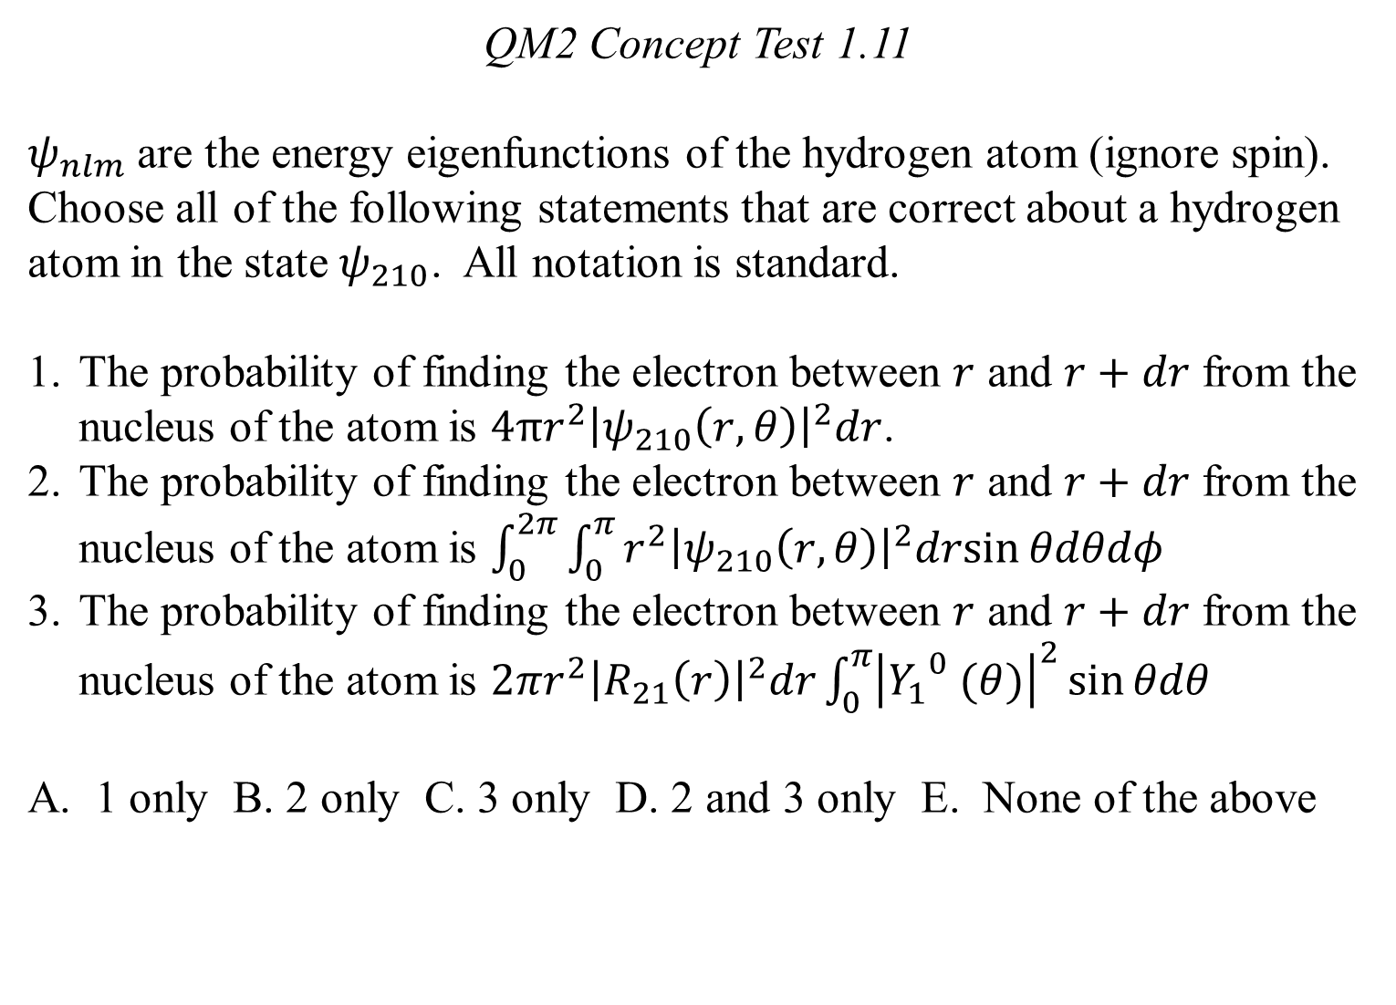
QM2 Concept Test 1.11
$ψ_{nlm}$ are the energy eigenfunctions of the hydrogen atom (ignore spin). Choose all of the following statements that are correct about a hydrogen atom in the state $ψ_{210}$. All notation is standard.
The probability of finding the electron between $r$ and $r+dr$ from the nucleus of the atom is $4πr^{2}{\left|ψ_{210}\left(r, θ\right)\right|}^{2}dr$.
The probability of finding the electron between $r$ and $r+dr$ from the nucleus of the atom is $\int_{0}^{2π}{\int_{0}^{π}{r^{2}{\left|ψ_{210}\left(r,θ\right)\right|}^{2}drsin{θdθdφ}}}$
The probability of finding the electron between $r$ and $r+dr$ from the nucleus of the atom is $2πr^{2}{\left|R_{21}\left(r\right)\right|}^{2}dr\int_{0}^{π}{{\left|{Y_{1}}^{0} (θ)\right|}^{2}\sin{θdθ}}$
A. 1 only B. 2 only C. 3 only D. 2 and 3 only E. None of the above

Slide 12
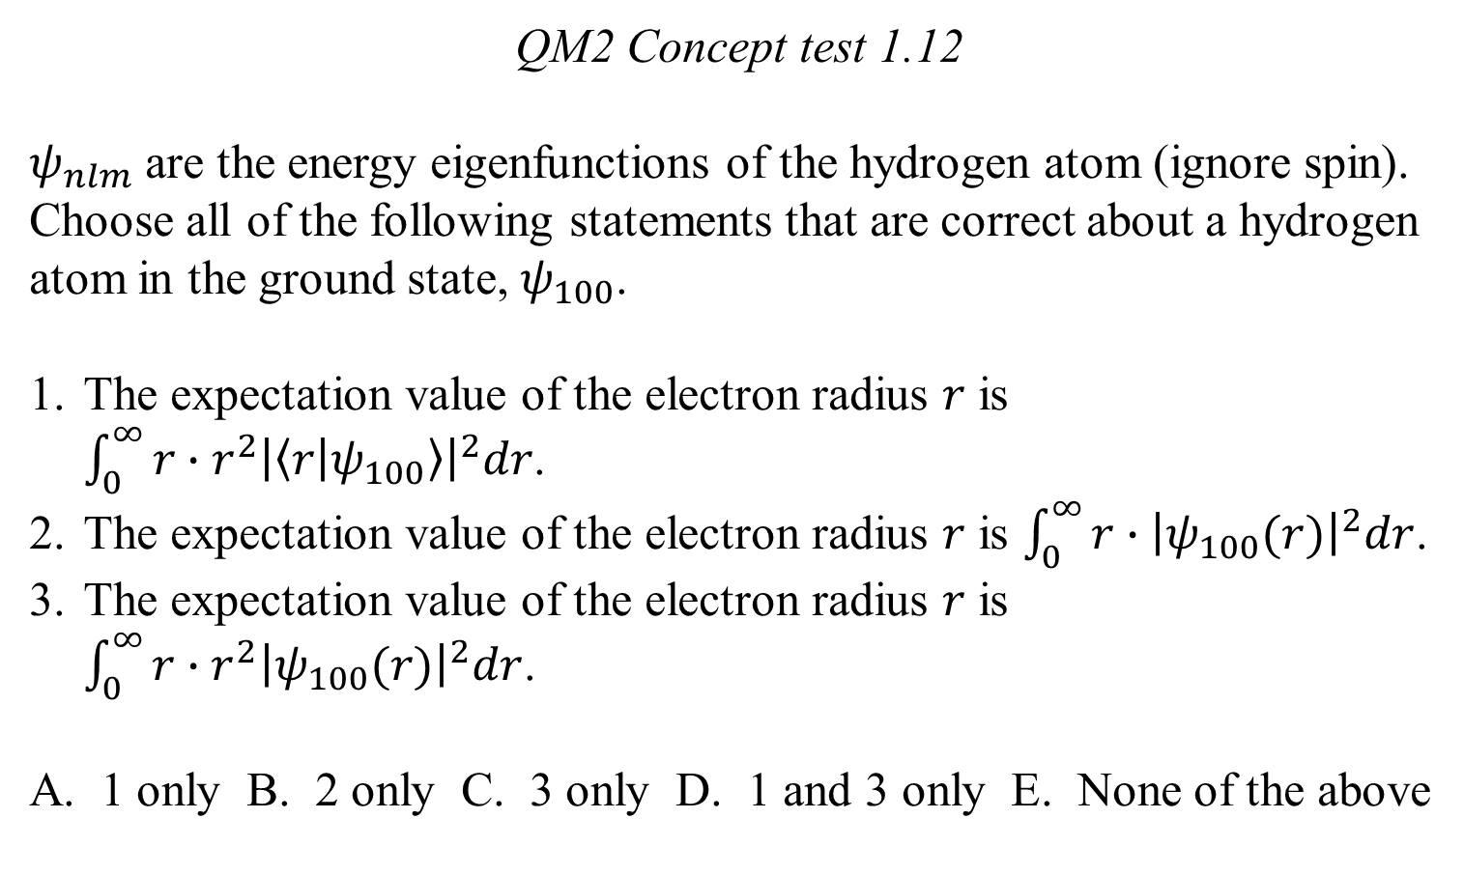
QM2 Concept test 1.12
$ψ_{nlm}$ are the energy eigenfunctions of the hydrogen atom (ignore spin). Choose all of the following statements that are correct about a hydrogen atom in the ground state, $ψ_{100}$.
The expectation value of the electron radius $r$ is $\int_{0}^{∞}{{r∙r^{2}\left|\left\langle r | ψ_{100}\right\rangle \right|}^{2}dr}$.
The expectation value of the electron radius $r$ is $\int_{0}^{∞}{r∙{\left|ψ_{100}(r)\right|}^{2}dr}$.
The expectation value of the electron radius $r$ is
$\int_{0}^{∞}{r∙r^{2}{\left|ψ_{100}(r)\right|}^{2}dr}$.
A. 1 only B. 2 only C. 3 only D. 1 and 3 only E. None of the above

Slide 13
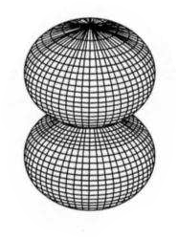
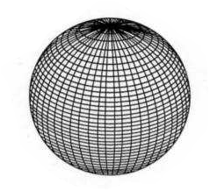
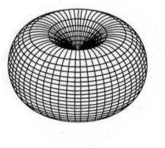
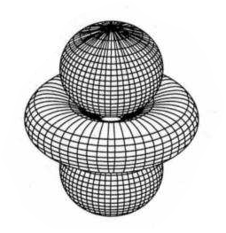
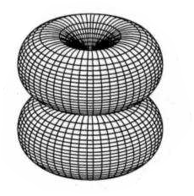

QM2 Concept test 1.13
Which one of the following pictures represents the surface of constant ${\left|ψ\right|}^{2}$ for $ψ_{200}$?
A. B. C.
D. E.

