Slide 1
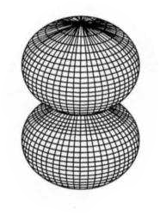
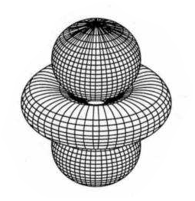
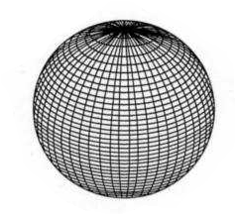
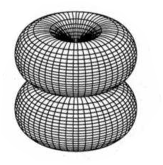
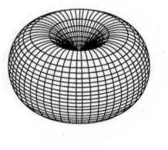
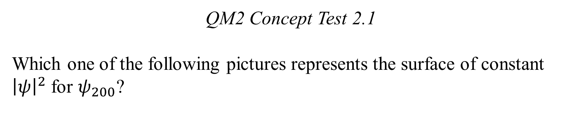
QM2 Concept Test 2.1
Which one of the following pictures represents the surface of constant ${\left|ψ\right|}^{2}$ for $ψ_{200}$?
A.
B.
C.
D.
E.

Slide 2
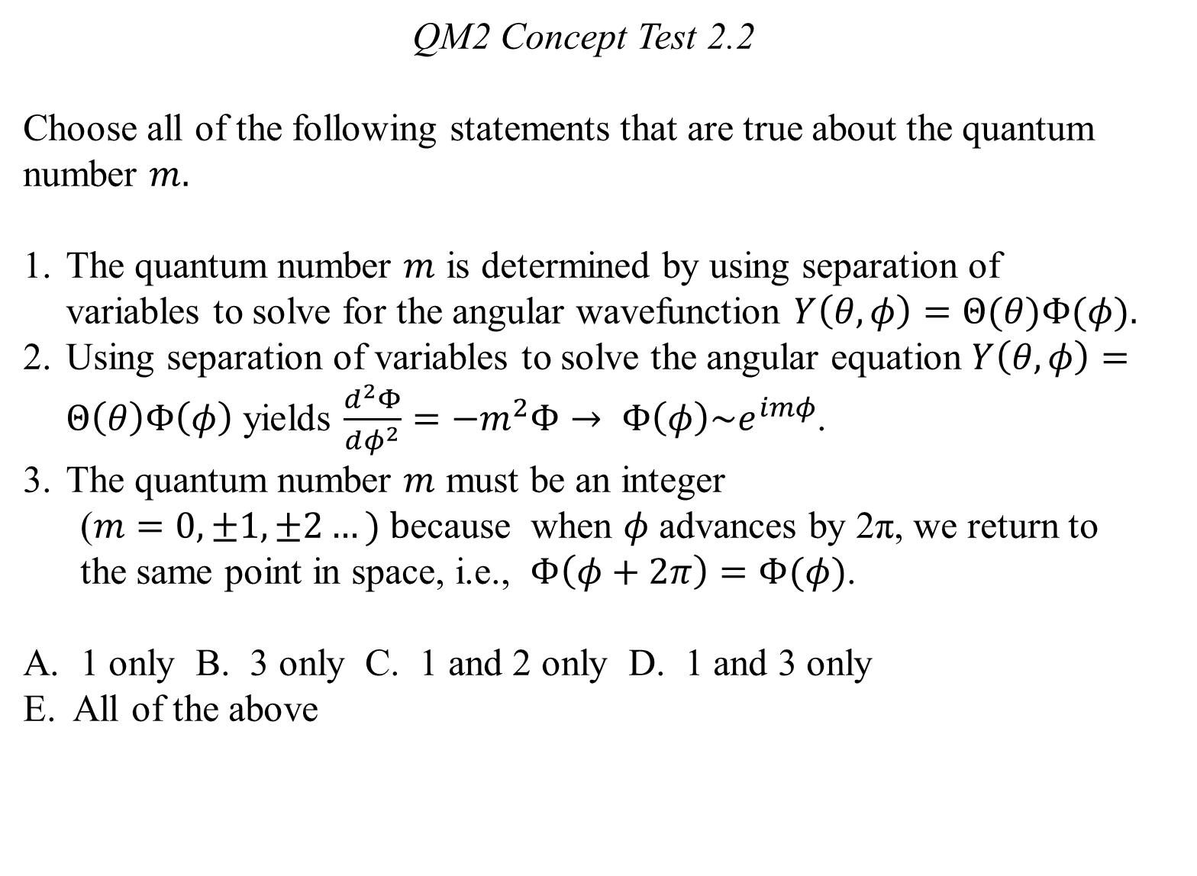
QM2 Concept Test 2.2
Choose all of the following statements that are true about the quantum number $m.$
The quantum number $m$ is determined by using separation of variables to solve for the angular wavefunction $Y\left(θ,φ\right)=Θ(θ)Φ(φ).$
Using separation of variables to solve the angular equation $Y\left(θ,φ\right)=Θ\left(θ\right)Φ\left(φ\right)$ yields $\frac{d^{2}Φ}{dφ^{2}}=−m^{2}Φ→ Φ\left(φ\right)\sim e^{imφ}$.
The quantum number $m$ must be an integer
  ($m=0, ±1, ±2…) b$ecause when $φ$ advances by 2π, we return to the same point in space, i.e., $Φ\left(φ+2π\right)=Φ(φ)$.
1 only B. 3 only C. 1 and 2 only D. 1 and 3 only
E. All of the above

Slide 3
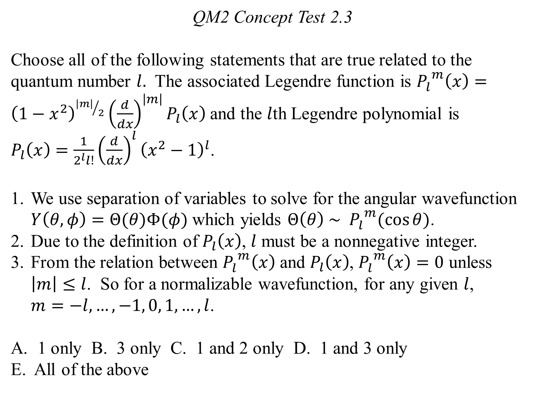
QM2 Concept Test 2.3
Choose all of the following statements that are true related to the quantum number $l.$ The associated Legendre function is ${P_{l}^{}}^{m}\left(x\right)={\left(1−x^{2}\right)}^{{\left|m\right|}/2}{\left(\frac{d}{dx}\right)}^{\left|m\right|}P_{l}\left(x\right)$ and the $l$th Legendre polynomial is $P_{l}\left(x\right)=\frac{1}{2^{l}l!}{\left(\frac{d}{dx}\right)}^{l}{\left(x^{2}−1\right)}^{l}$.
We use separation of variables to solve for the angular wavefunction $Y\left(θ,φ\right)=Θ(θ)Φ(φ)$ which yields $Θ\left(θ\right) \sim {{ P}_{l}^{}}^{m}(\cos{θ)}$.
Due to the definition of $P_{l}\left(x\right)$, $l$ must be a nonnegative integer.
From the relation between ${P_{l}^{}}^{m}\left(x\right)$ and $P_{l}\left(x\right)$, ${P_{l}^{}}^{m}\left(x\right)=0$ unless $\left|m\right|≤l$. So for a normalizable wavefunction, for any given $l$, $m=−l, …,−1, 0, 1, …,l$.
1 only B. 3 only C. 1 and 2 only D. 1 and 3 only
E. All of the above

Slide 4
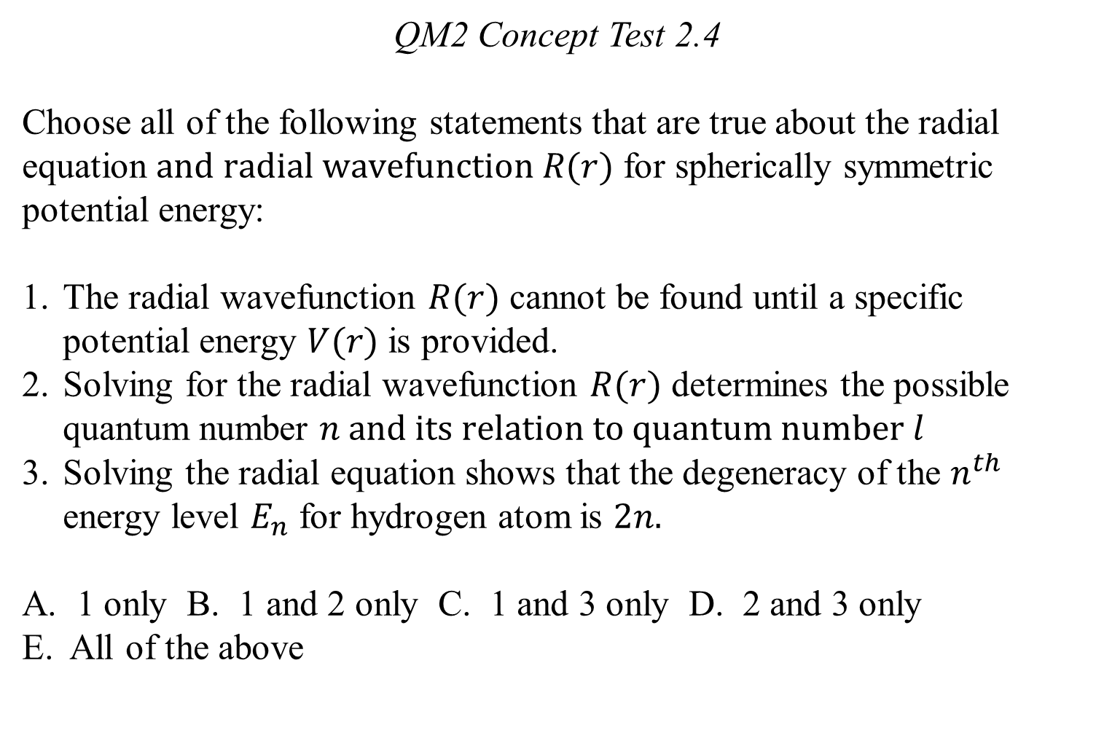
QM2 Concept Test 2.4
Choose all of the following statements that are true about the radial equation $and radial wavefunction R(r)$ for spherically symmetric potential energy:
The radial wavefunction $R(r)$ cannot be found until a specific potential energy $V(r)$ is provided.
Solving for the radial wavefunction $R(r)$ determines the possible quantum number $n and its relation to quantum number l$
Solving the radial equation shows that the degeneracy of the $n^{th}$ energy level $E_{n}$ for hydrogen atom is $2n.$
1 only B. 1 and 2 only C. 1 and 3 only D. 2 and 3 only
E. All of the above

Slide 5
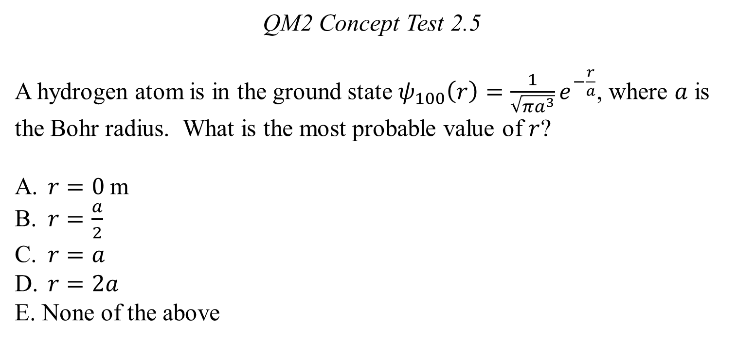
QM2 Concept Test 2.5
A hydrogen atom is in the ground state $ψ_{100}\left(r\right)=\frac{1}{\sqrt{πa^{3}}}e^{−\frac{r}{a}}$, where $a$ is the Bohr radius. What is the most probable value of $r$?
$r=0$m
$r=\frac{a}{2}$
$r=a$
$r=2a$
None of the above

Slide 6
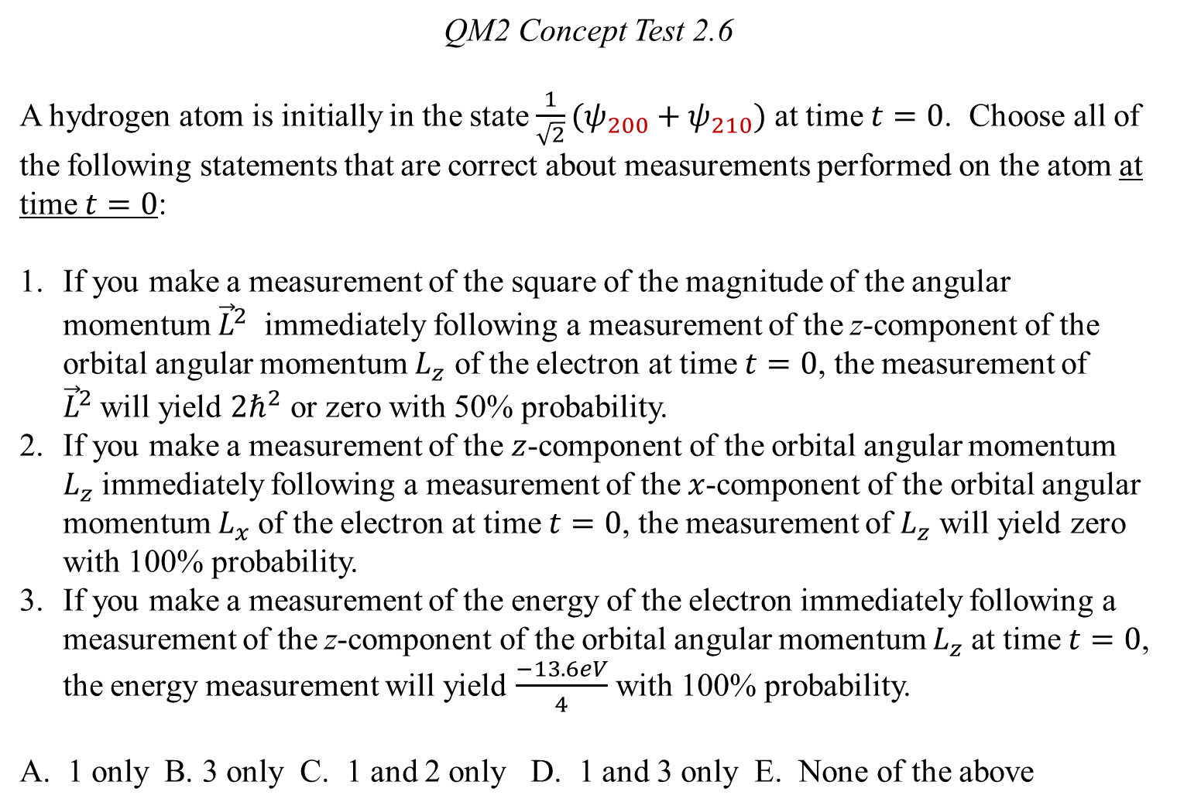
QM2 Concept Test 2.6
A hydrogen atom is initially in the state $\frac{1}{\sqrt{2}}(ψ_{200}+ψ_{210})$ at time $t=0$. Choose all of the following statements that are correct about measurements performed on the atom at time $t=0$:
If you make a measurement of the square of the magnitude of the angular momentum ${\vec{L}}^{2}$ immediately following a measurement of the z-component of the orbital angular momentum $L_{z}$ of the electron at time $t=0$, the measurement of ${\vec{L}}^{2}$will yield $2ℏ^{2}$ or zero with 50% probability.
If you make a measurement of the $z$-component of the orbital angular momentum $L_{z}$immediately following a measurement of the $x$-component of the orbital angular momentum $L_{x}$of the electron at time $t=0$, the measurement of $L_{z}$ will yield zero with 100% probability.
If you make a measurement of the energy of the electron immediately following a measurement of the z-component of the orbital angular momentum $L_{z}$at time $t=0$, the energy measurement will yield $\frac{−13.6eV}{4}$ with 100% probability.
A. 1 only B. 3 only C. 1 and 2 only D. 1 and 3 only E. None of the above

Slide 7
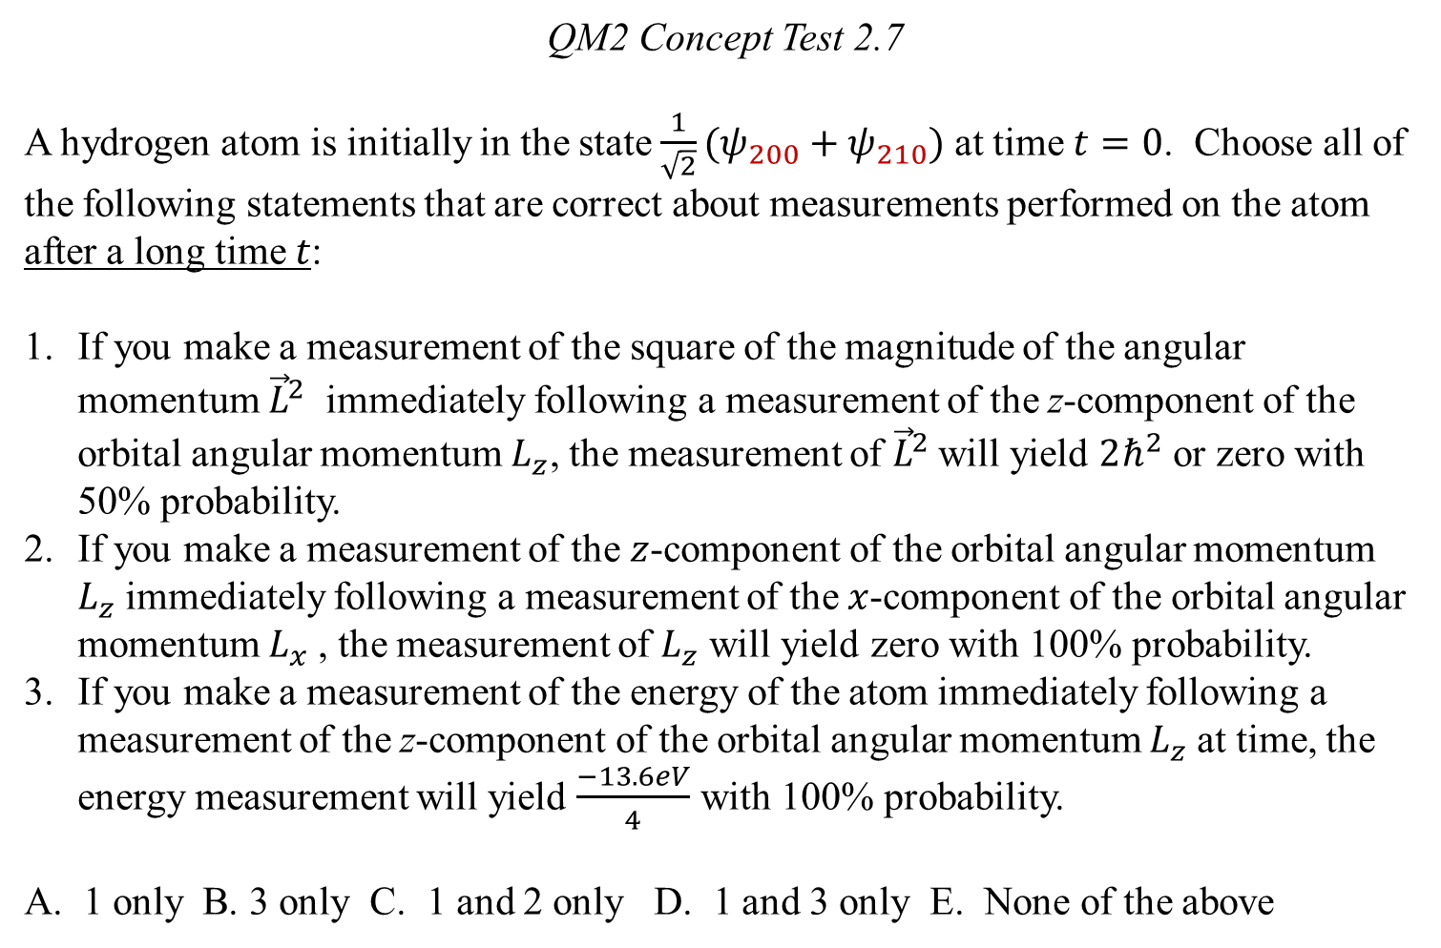
QM2 Concept Test 2.7
A hydrogen atom is initially in the state $\frac{1}{\sqrt{2}}(ψ_{200}+ψ_{210})$ at time $t=0$. Choose all of the following statements that are correct about measurements performed on the atom after a long time $t$:
If you make a measurement of the square of the magnitude of the angular momentum ${\vec{L}}^{2}$ immediately following a measurement of the z-component of the orbital angular momentum $L_{z}$, the measurement of ${\vec{L}}^{2}$will yield $2ℏ^{2}$ or zero with 50% probability.
If you make a measurement of the $z$-component of the orbital angular momentum $L_{z}$immediately following a measurement of the $x$-component of the orbital angular momentum $L_{x}$, the measurement of $L_{z}$ will yield zero with 100% probability.
If you make a measurement of the energy of the atom immediately following a measurement of the z-component of the orbital angular momentum $L_{z}$at time, the energy measurement will yield $\frac{−13.6eV}{4}$ with 100% probability.
A. 1 only B. 3 only C. 1 and 2 only D. 1 and 3 only E. None of the above

Slide 8

QM2 Concept Test 2.8
A hydrogen atom is initially in the state $\frac{1}{\sqrt{2}}(ψ_{100}+ψ_{210})$ at time $t=0$. Choose all of the following statements that are correct about measurements performed on the atom after a long time $t$:
If you make a measurement of the square of the magnitude of the angular momentum ${\vec{L}}^{2}$ immediately following a measurement of the z-component of the orbital angular momentum $L_{z}$, the measurement of ${\vec{L}}^{2}$will yield $2ℏ^{2}$ or zero with 50% probability.
If you make a measurement of the $z$-component of the orbital angular momentum $L_{z}$immediately following a measurement of the $x$-component of the orbital angular momentum $L_{x}$, the measurement of $L_{z}$ will yield zero with 100% probability.
If you make a measurement of the energy of the electron immediately following a measurement of the z-component of the orbital angular momentum $L_{z}$, the energy measurement will yield $\frac{−13.6eV}{4}$ with 100% probability.
A. 1 only B. 3 only C. 1 and 2 only D. 1 and 3 only E. None of the above

Slide 9
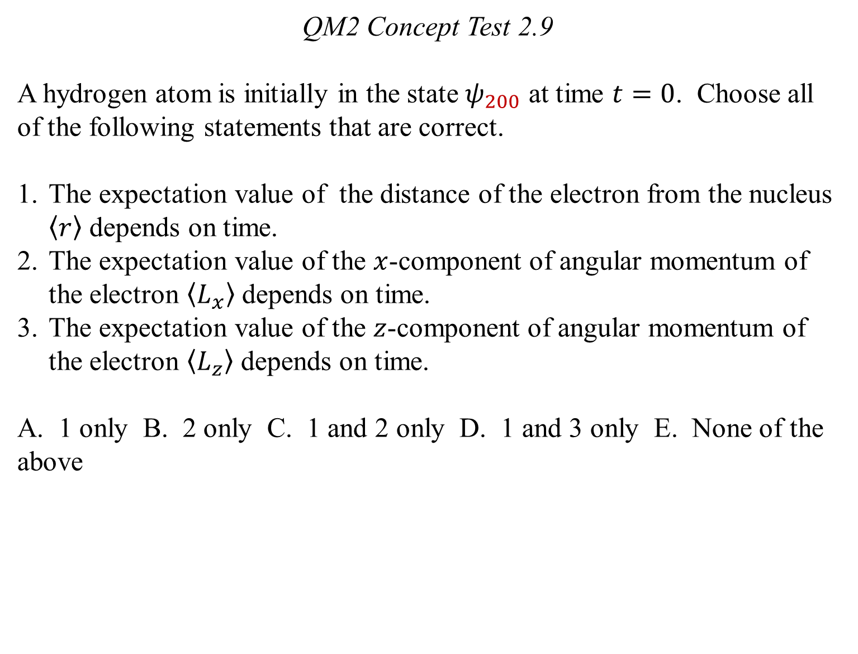
QM2 Concept Test 2.9
A hydrogen atom is initially in the state $ψ_{200}$ at time $t=0$. Choose all of the following statements that are correct.
The expectation value of the distance of the electron from the nucleus $\left\langle r\right\rangle$ depends on time.
The expectation value of the $x$-component of angular momentum of the electron $\left\langle L_{x}\right\rangle$ depends on time.
The expectation value of the $z$-component of angular momentum of the electron $\left\langle L_{z}\right\rangle$ depends on time.
A. 1 only B. 2 only C. 1 and 2 only D. 1 and 3 only E. None of the above

Slide 10
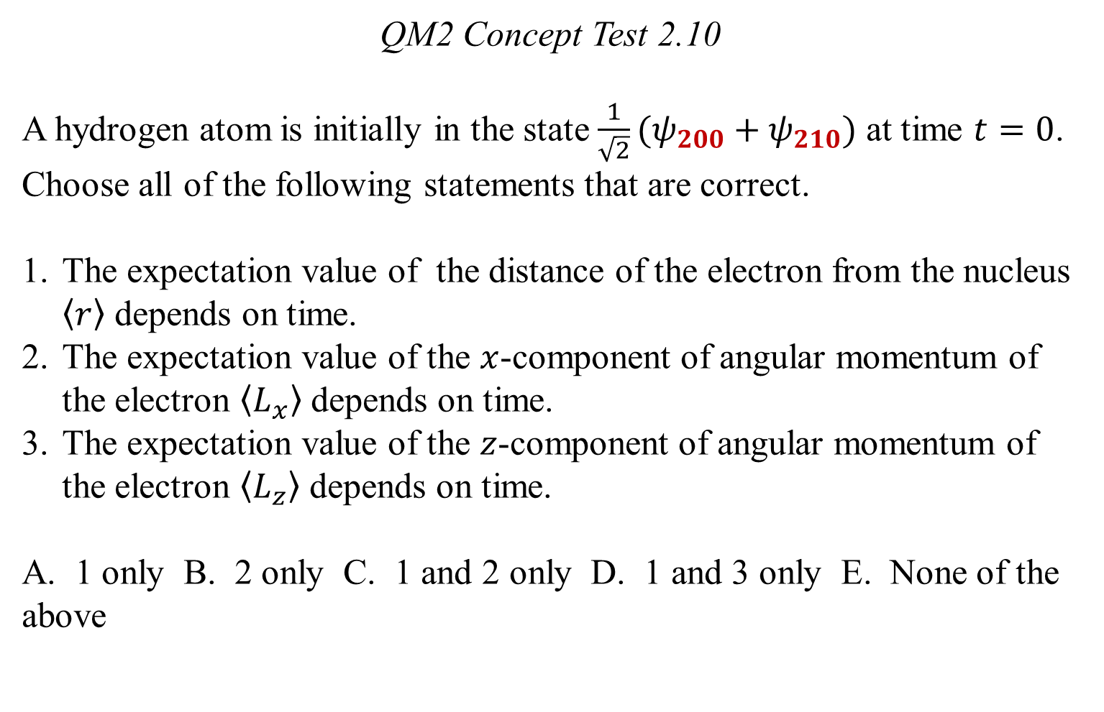
QM2 Concept Test 2.10
A hydrogen atom is initially in the state $\frac{1}{\sqrt{2}}(ψ_{200}+ψ_{210})$ at time $t=0$. Choose all of the following statements that are correct.
The expectation value of the distance of the electron from the nucleus $\left\langle r\right\rangle$ depends on time.
The expectation value of the $x$-component of angular momentum of the electron $\left\langle L_{x}\right\rangle$ depends on time.
The expectation value of the $z$-component of angular momentum of the electron $\left\langle L_{z}\right\rangle$ depends on time.
A. 1 only B. 2 only C. 1 and 2 only D. 1 and 3 only E. None of the above

Slide 11
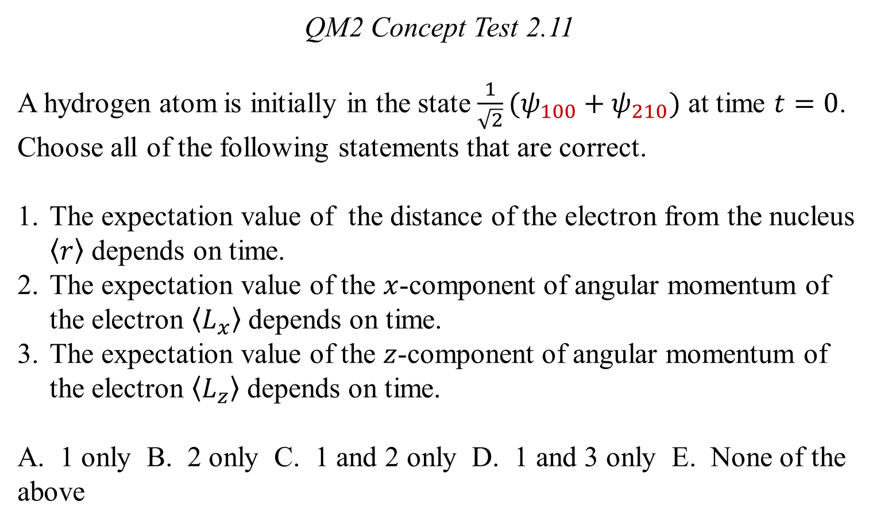
QM2 Concept Test 2.11
A hydrogen atom is initially in the state $\frac{1}{\sqrt{2}}(ψ_{100}+ψ_{210})$ at time $t=0$. Choose all of the following statements that are correct.
The expectation value of the distance of the electron from the nucleus $\left\langle r\right\rangle$ depends on time.
The expectation value of the $x$-component of angular momentum of the electron $\left\langle L_{x}\right\rangle$ depends on time.
The expectation value of the $z$-component of angular momentum of the electron $\left\langle L_{z}\right\rangle$ depends on time.
A. 1 only B. 2 only C. 1 and 2 only D. 1 and 3 only E. None of the above

Slide 12
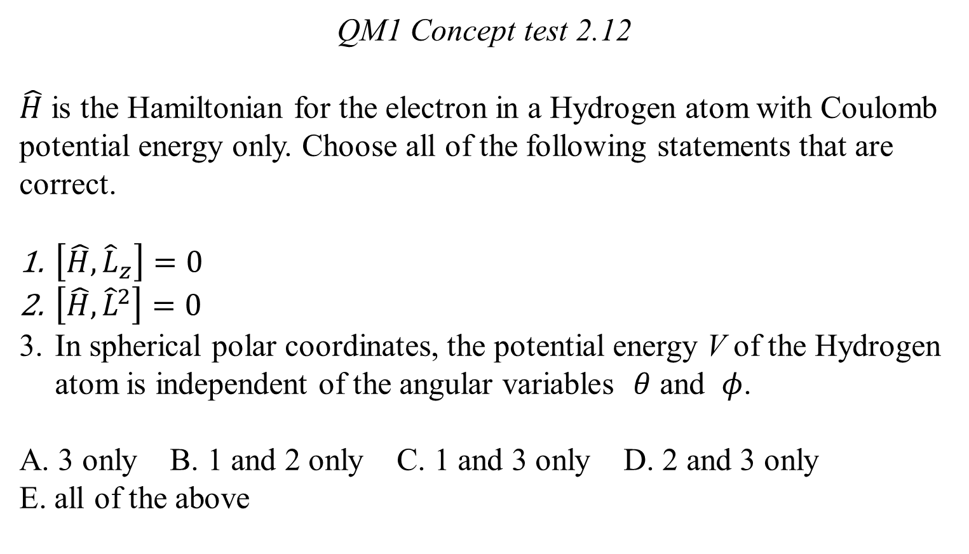
QM1 Concept test 2.12
$\hat{H}$ is the Hamiltonian for the electron in a Hydrogen atom with Coulomb potential energy only. Choose all of the following statements that are correct.
$\left[\hat{H},{\hat{L}}_{z}\right]=0$
$\left[\hat{H},{\hat{L}}^{2}\right]=0$
In spherical polar coordinates, the potential energy V of the Hydrogen atom is independent of the angular variables $θ$ and $φ$.
A. 3 only B. 1 and 2 only C. 1 and 3 only D. 2 and 3 only
E. all of the above

Slide 13
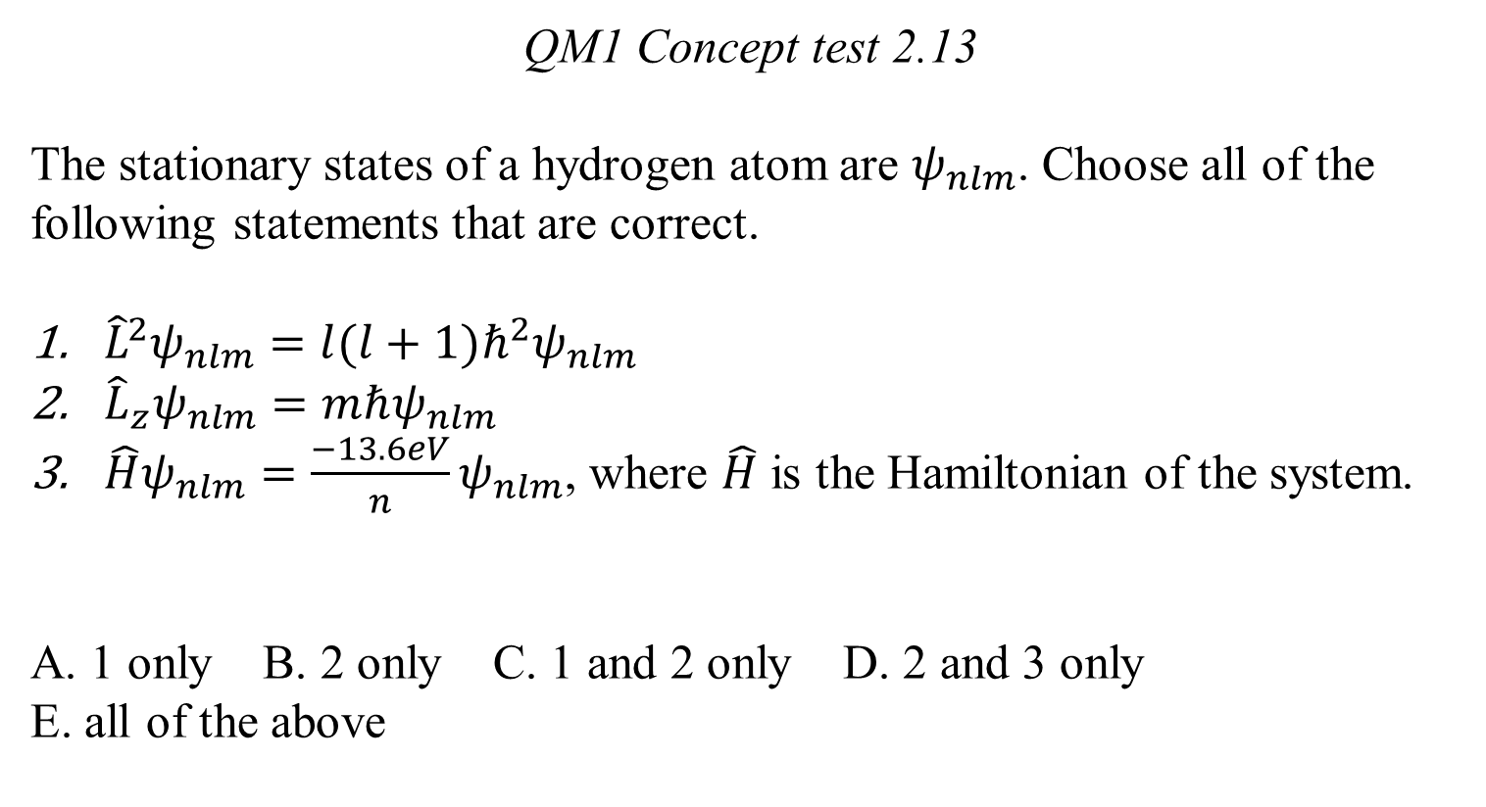
QM1 Concept test 2.13
The stationary states of a hydrogen atom are $ψ_{nlm}$. Choose all of the following statements that are correct.
${\hat{L}}^{2}ψ_{nlm}=l(l+1)ℏ^{2}ψ_{nlm}$
${\hat{L}}_{z}ψ_{nlm}=mℏψ_{nlm}$
$\hat{H}ψ_{nlm}=\frac{−13.6eV}{n}ψ_{nlm}$, where $\hat{H}$ is the Hamiltonian of the system.
A. 1 only B. 2 only C. 1 and 2 only D. 2 and 3 only
E. all of the above

