Slide 1
QM2 Concept test 4.1
Choose all of the following statements that are correct.
(1) If the spatial wave function of a two-particle system is symmetric, the system will behave as though there was a “force of attraction” between the particles compared to the case where the spatial wavefunction was not symmetrized.
(2) If the spatial wave function of a two-particle system is symmetric, the system will behave as though there was a “force of repulsion” between the particles compared to the case where the spatial wavefunction was not symmetrized.
(3) The “exchange force” only exists between charged identical particles.
A. 1 only B. 2 only C. 1 and 3 only D. 2 and 3 only
E. none of the above

Slide 2
QM2 Concept test 4.2
Choose all of the following statements that are correct about two identical bosons each with spin s=1.
(1) The spin part of the wave function must be symmetric for this system.
(2) The spatial part of the wave function must be symmetric for this system.
(3) The spin and spatial parts of the wave function must have the same symmetry, e.g., both must be symmetric or anti-symmetric.
A. 1 only B. 2 only C. 3 only D. All of the above
E. none of the above

Slide 3
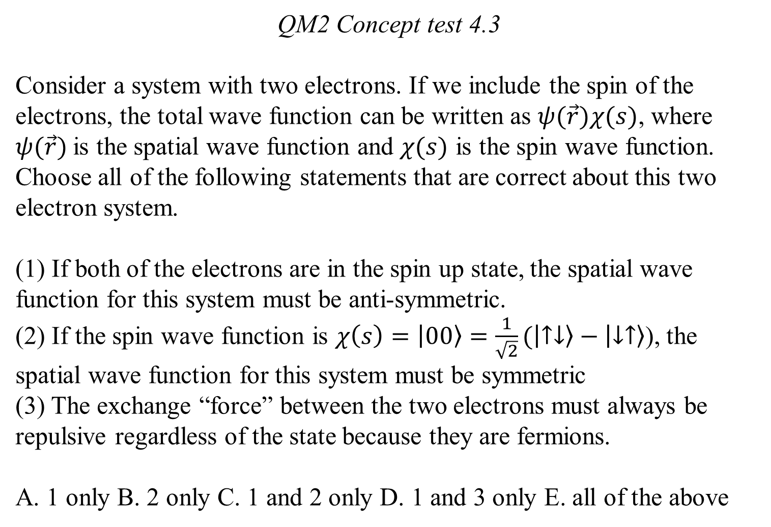
QM2 Concept test 4.3
Consider a system with two electrons. If we include the spin of the electrons, the total wave function can be written as $ψ(\vec{r})χ(s)$, where $ψ(\vec{r})$is the spatial wave function and $χ(s)$ is the spin wave function. Choose all of the following statements that are correct about this two electron system.
(1) If both of the electrons are in the spin up state, the spatial wave function for this system must be anti-symmetric.
(2) If the spin wave function is $χ\left(s\right)=\left.\left|00\right.\right\rangle =\frac{1}{\sqrt{2}}(\left.\left|↑↓\right.\right\rangle −\left.\left|↓↑\right.\right\rangle$), the spatial wave function for this system must be symmetric
(3) The exchange “force” between the two electrons must always be repulsive regardless of the state because they are fermions.
A. 1 only B. 2 only C. 1 and 2 only D. 1 and 3 only E. all of the above

Slide 4
QM2 Concept test 4.4
Choose all of the following statements that are true about the Helium atom.
The ground state of Helium must have an antisymmetric spin configuration (singlet configuration).
The excited states of Helium must have a symmetric spin configuration (triplet configuration).
If the Helium atom has a symmetric spin configuration (triplet configuration), it is known as orthohelium.
A. 1 only B. 2 only C. 3 only D. 1 and 3 only E. 2 and 3 only

Slide 5
QM2 Concept test 4.5
Choose all of the following statements that are correct about the Helium atom.
(1) If the Helium atom has an antisymmetric spin configuration, it is known as parahelium.
(2) The energies of the excited states are lower if the electron spins are in the singlet configuration (as opposed to the triplet configuration).
(3) The energies of the excited states are lower if the spatial wavefunctions are symmetric (as opposed to the anti-symmetric configuration).
A. 1 only B. 1 and 2 only C. 1 and 3 only D. 2 and 3 only
E. all of the above

Slide 6
QM2 Concept test 4.6
Choose all of the following statements that are correct for a Hydrogen molecule with two electrons.
(1) The spatial wavefunction is symmetric with respect to the exchange of the electrons in the ground state.
(2) When the spatial wavefunction is symmetric, the electrons have a higher probability of being found between the two protons compared to the case when the spatial wavefunction is anti-symmetric.
(3) When covalent bond forms, there is a minimum in the energy and the separation between the two protons is primarily determined by the balance between the electron-proton attraction and proton-proton repulsion.
A. 1 only B. 2 only C. 1 and 3 only D. 2 and 3 only
E. all of the above

Slide 7
QM2 Concept test 4.7
A neutral atom with a nuclear charge Ze is in its ground state. If we ignore the mutual repulsion between the electrons, the individual electrons occupy single particle hydrogenic states (n, l, m) called the orbitals. Choose all of the following statements that are correct.
(1) For n=2, there are only two possible orbitals given by (2,1,0) and (2,0,0).
(2) The n=2 shell can only hold a maximum of 8 electrons.
(3) If Z is even, the total spin quantum number for the atom in the ground state must be zero.
A. 1 only B. 2 only C. 1 and 3 only D. 2 and 3 only
E. All of the above

