Slide 1
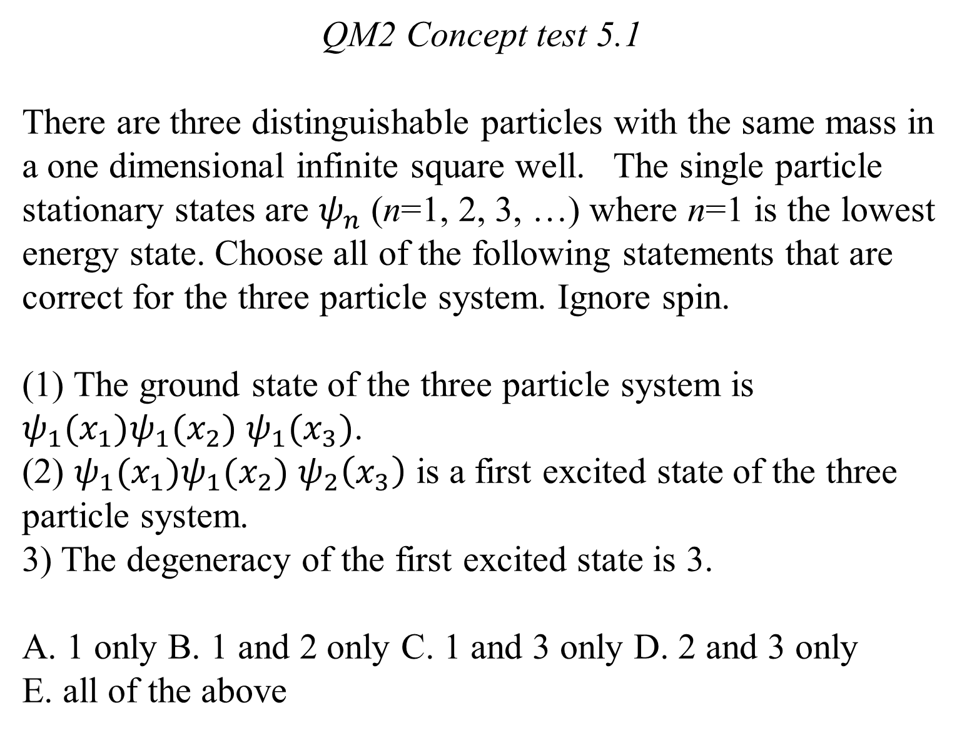
QM2 Concept test 5.1
There are three distinguishable particles with the same mass in a one dimensional infinite square well. The single particle stationary states are $ψ_{n}$ (n=1, 2, 3, …) where n=1 is the lowest energy state. Choose all of the following statements that are correct for the three particle system. Ignore spin.
(1) The ground state of the three particle system is $ψ_{1}(x_{1})ψ_{1}(x_{2})$ $ψ_{1}(x_{3})$.
(2) $ψ_{1}(x_{1})ψ_{1}(x_{2})$ $ψ_{2}\left(x_{3}\right)$ is a first excited state of the three particle system.
3) The degeneracy of the first excited state is 3.
A. 1 only B. 1 and 2 only C. 1 and 3 only D. 2 and 3 only
E. all of the above

Slide 2
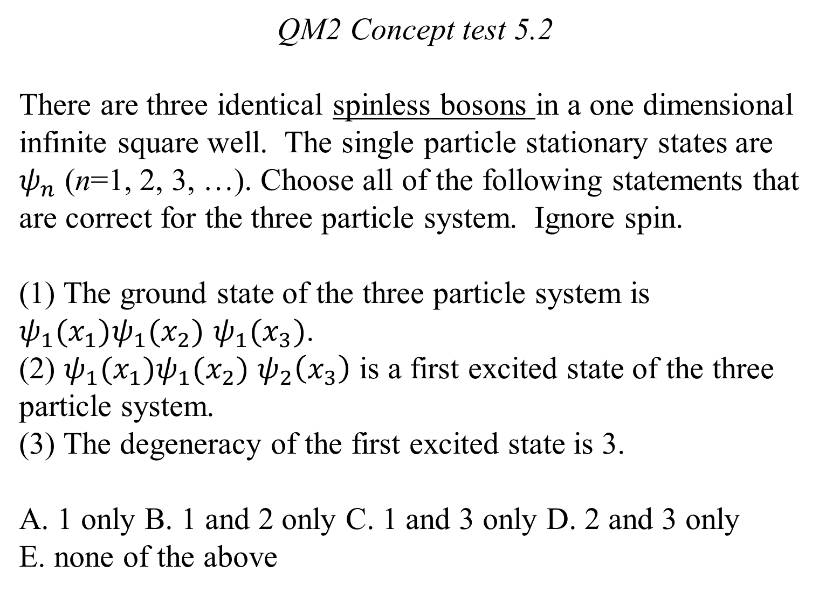
QM2 Concept test 5.2
There are three identical spinless bosons in a one dimensional infinite square well. The single particle stationary states are $ψ_{n}$ (n=1, 2, 3, …). Choose all of the following statements that are correct for the three particle system. Ignore spin.
(1) The ground state of the three particle system is $ψ_{1}(x_{1})ψ_{1}(x_{2})$ $ψ_{1}(x_{3})$.
(2) $ψ_{1}(x_{1})ψ_{1}(x_{2})$ $ψ_{2}\left(x_{3}\right)$ is a first excited state of the three particle system.
(3) The degeneracy of the first excited state is 3.
A. 1 only B. 1 and 2 only C. 1 and 3 only D. 2 and 3 only
E. none of the above

Slide 3
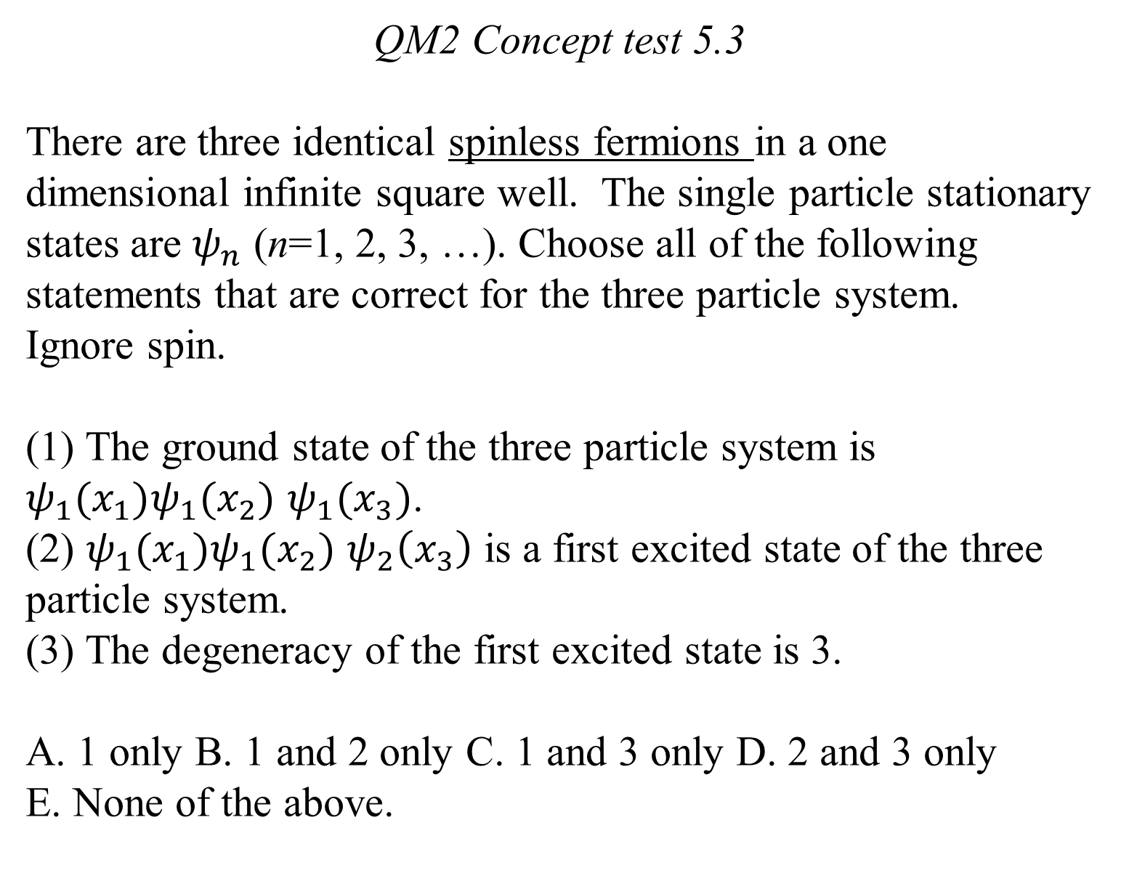
QM2 Concept test 5.3
There are three identical spinless fermions in a one dimensional infinite square well. The single particle stationary states are $ψ_{n}$ (n=1, 2, 3, …). Choose all of the following statements that are correct for the three particle system. Ignore spin.
(1) The ground state of the three particle system is $ψ_{1}(x_{1})ψ_{1}(x_{2})$ $ψ_{1}(x_{3})$.
(2) $ψ_{1}(x_{1})ψ_{1}(x_{2})$ $ψ_{2}\left(x_{3}\right)$ is a first excited state of the three particle system.
(3) The degeneracy of the first excited state is 3.
A. 1 only B. 1 and 2 only C. 1 and 3 only D. 2 and 3 only
E. None of the above.

Slide 4
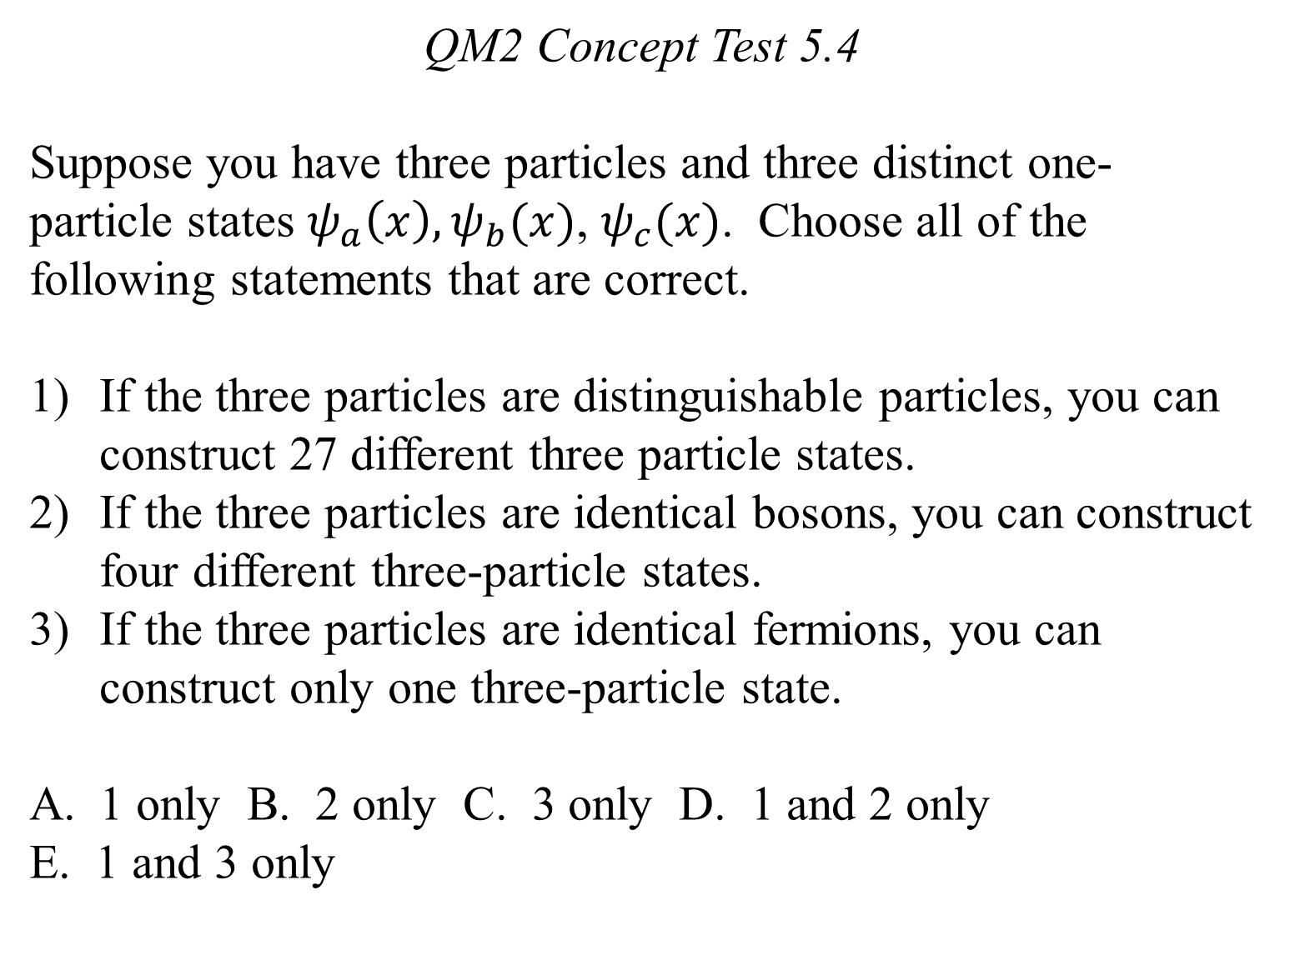
QM2 Concept Test 5.4
Suppose you have three particles and three distinct one-particle states $ψ_{a}\left(x\right),ψ_{b}(x)$, $ψ_{c}(x)$. Choose all of the following statements that are correct.
If the three particles are distinguishable particles, you can construct 27 different three particle states.
If the three particles are identical bosons, you can construct four different three-particle states.
If the three particles are identical fermions, you can construct only one three-particle state.
1 only B. 2 only C. 3 only D. 1 and 2 only
E. 1 and 3 only

Slide 5
QM2 Concept test 5.5
A neutral atom with a nuclear charge Ze is in its ground state. If we ignore the mutual repulsion between the electrons, the individual electrons occupy single particle hydrogenic states (n, l, m) called the orbitals. Choose all of the following statements that are correct.
(1) For n=2, there are only two possible orbitals given by (2,1,0) and (2,0,0).
(2) The n=2 shell can only hold a maximum of 8 electrons.
(3) If Z is even, the total spin quantum number for the atom in the ground state must be zero.
A. 1 only B. 2 only C. 1 and 3 only D. 2 and 3 only
E. All of the above

Slide 6
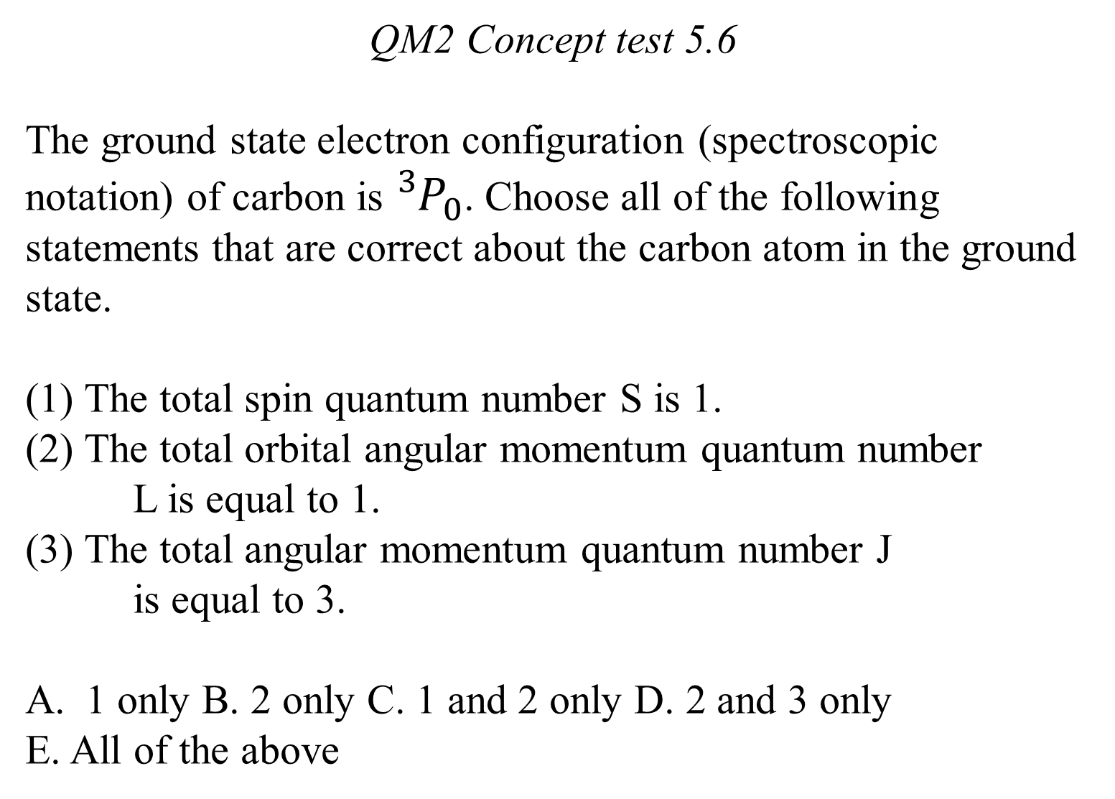
QM2 Concept test 5.6
The ground state electron configuration (spectroscopic notation) of carbon is ${}_{}^{3}{P_{0}}$. Choose all of the following statements that are correct about the carbon atom in the ground state.
(1) The total spin quantum number S is 1.
(2) The total orbital angular momentum quantum number
L is equal to 1.
(3) The total angular momentum quantum number J
is equal to 3.
1 only B. 2 only C. 1 and 2 only D. 2 and 3 only
E. All of the above

Slide 7
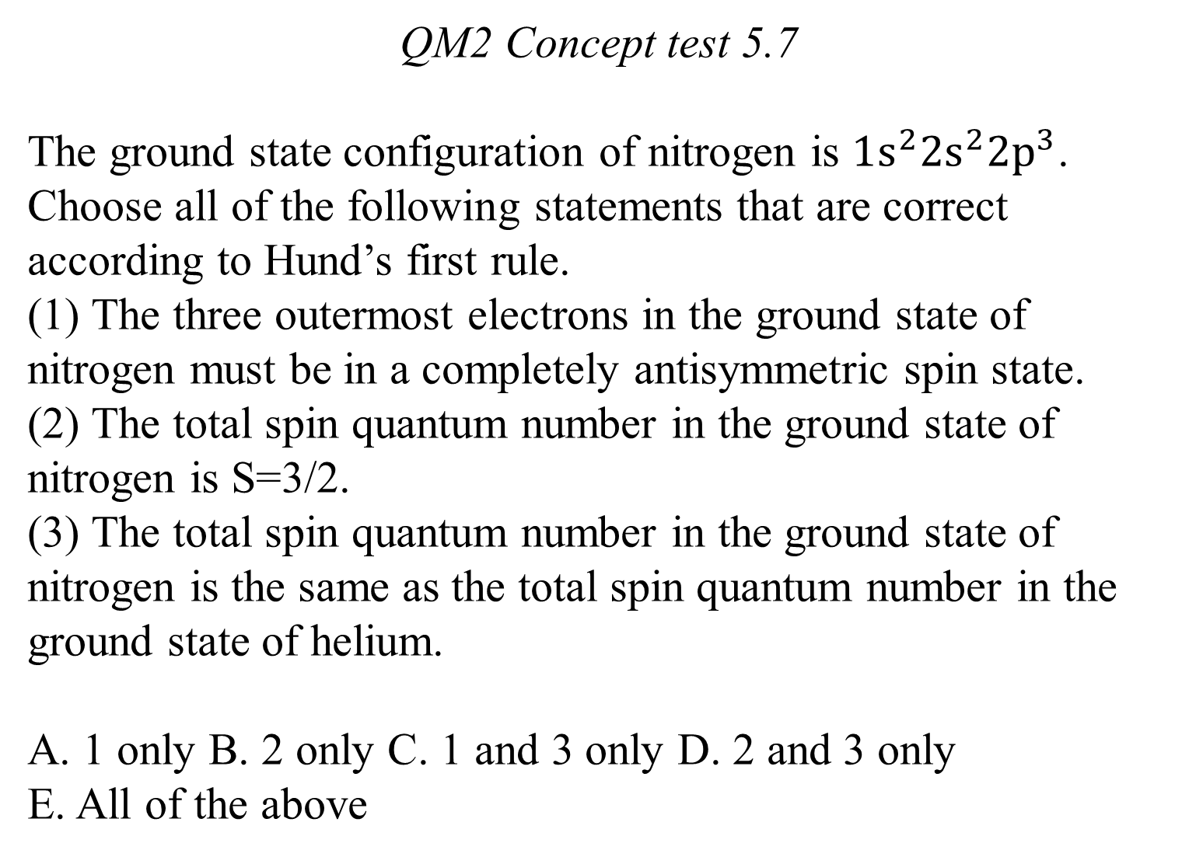
QM2 Concept test 5.7
The ground state configuration of nitrogen is $1s^{2}2s^{2}2p^{3}$. Choose all of the following statements that are correct according to Hund’s first rule.
(1) The three outermost electrons in the ground state of nitrogen must be in a completely antisymmetric spin state.
(2) The total spin quantum number in the ground state of nitrogen is S=3/2.
(3) The total spin quantum number in the ground state of nitrogen is the same as the total spin quantum number in the ground state of helium.
A. 1 only B. 2 only C. 1 and 3 only D. 2 and 3 only
E. All of the above

Slide 8
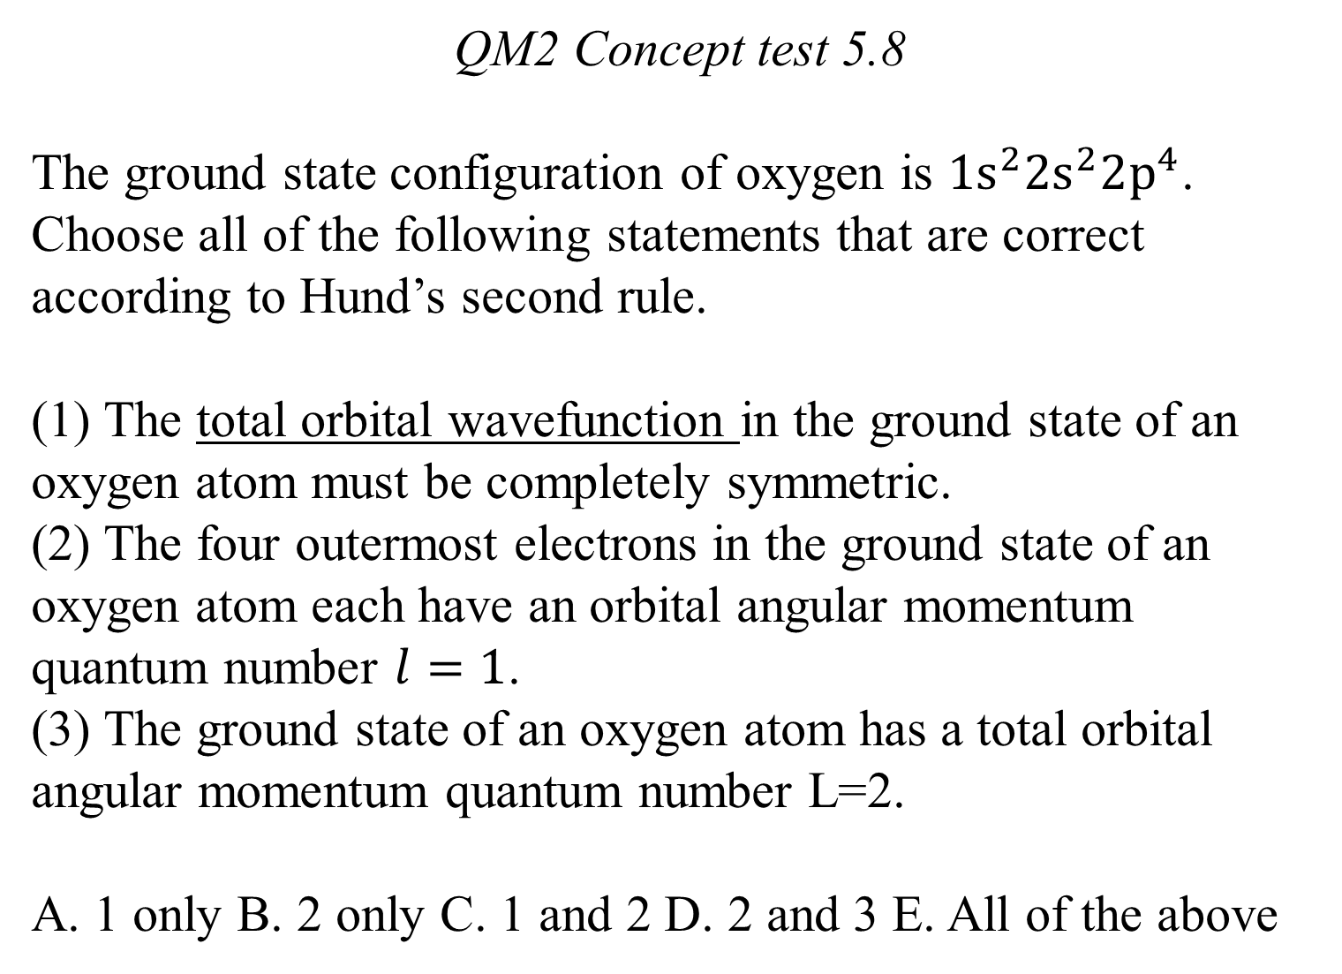
QM2 Concept test 5.8
The ground state configuration of oxygen is $1s^{2}2s^{2}2p^{4}$. Choose all of the following statements that are correct according to Hund’s second rule.
(1) The total orbital wavefunction in the ground state of an oxygen atom must be completely symmetric.
(2) The four outermost electrons in the ground state of an oxygen atom each have an orbital angular momentum quantum number $l=1$.
(3) The ground state of an oxygen atom has a total orbital angular momentum quantum number L=2.
A. 1 only B. 2 only C. 1 and 2 D. 2 and 3 E. All of the above

Slide 9
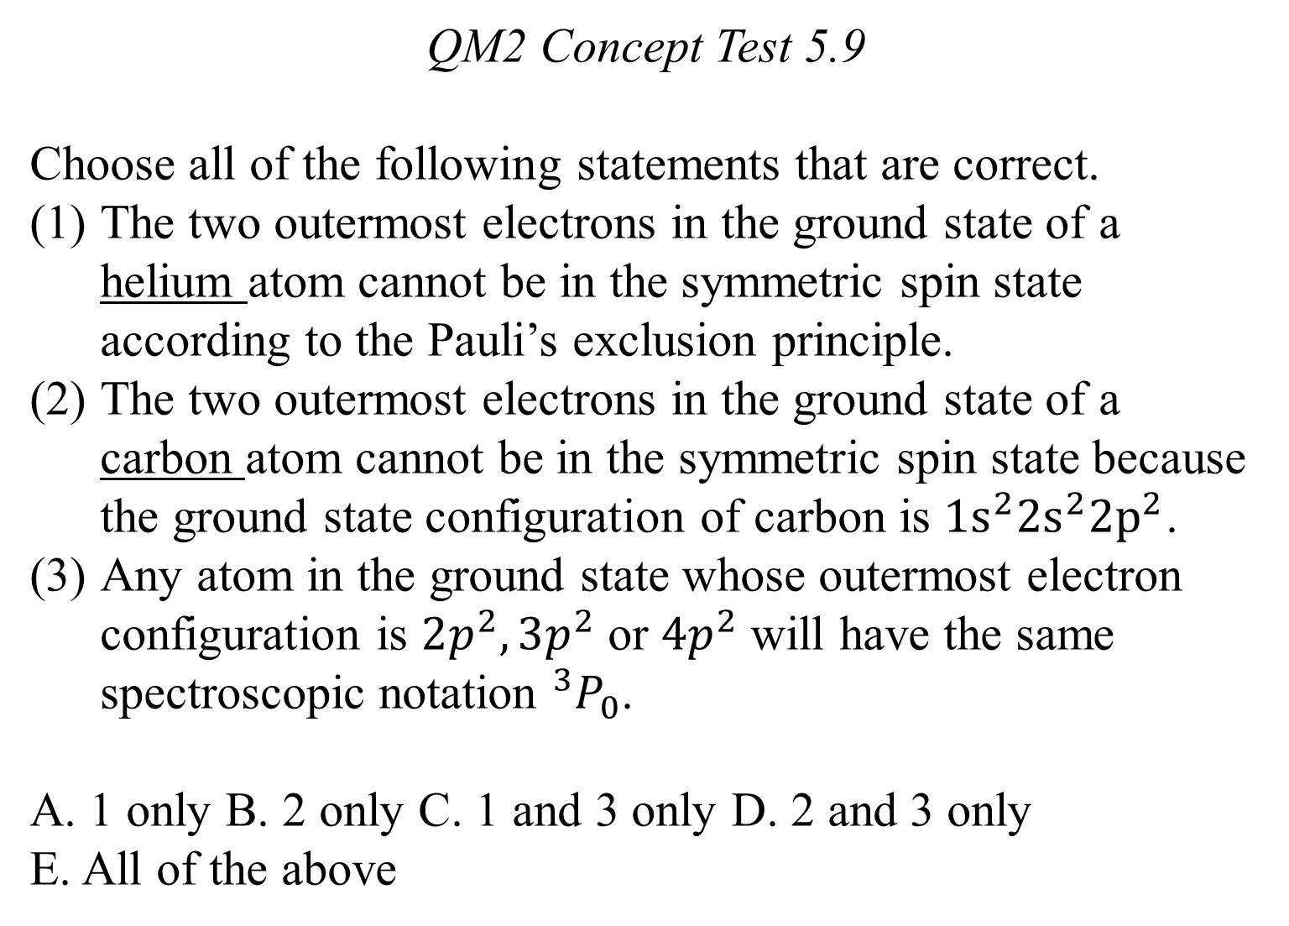
QM2 Concept Test 5.9
Choose all of the following statements that are correct.
The two outermost electrons in the ground state of a helium atom cannot be in the symmetric spin state according to the Pauli’s exclusion principle.
The two outermost electrons in the ground state of a carbon atom cannot be in the symmetric spin state because the ground state configuration of carbon is $1s^{2}2s^{2}2p^{2}$.
Any atom in the ground state whose outermost electron configuration is $2p^{2},3p^{2}$ or $4p^{2}$ will have the same spectroscopic notation ${}_{}^{3}{P_{0}}$.
A. 1 only B. 2 only C. 1 and 3 only D. 2 and 3 only
E. All of the above

