Slide 1
QM2 Concept Test 6.1
Choose all of the following statements that are correct about the free electron gas model.
The free electron gas model takes into account electron-electron repulsion.
The free electron gas model assumes that the ions in the solid are uniformly distributed and cancel out the charge of the free electrons.
The “free electrons” in the free electron gas model refer to all of the electrons in each atom in the solid.
1 only B. 2 only C. 1 and 2 only D. 2 and 3 only
E. None of the above.

Slide 2
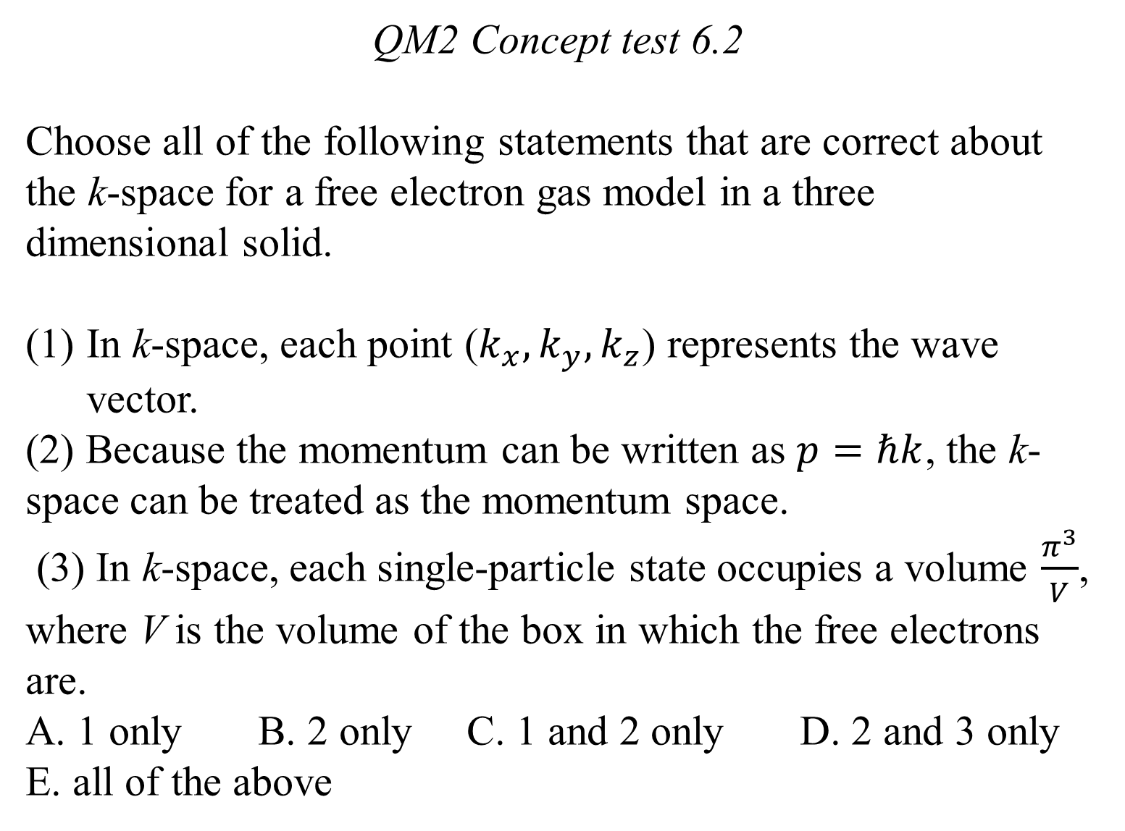
QM2 Concept test 6.2
Choose all of the following statements that are correct about the k-space for a free electron gas model in a three dimensional solid.
In k-space, each point ($k_{x},k_{y},k_{z}$) represents the wave vector.
(2) Because the momentum can be written as $p=ℏk$, the k-space can be treated as the momentum space.
(3) In k-space, each single-particle state occupies a volume $\frac{π^{3}}{V}$, where V is the volume of the box in which the free electrons are.
A. 1 only B. 2 only C. 1 and 2 only D. 2 and 3 only
E. all of the above

Slide 3
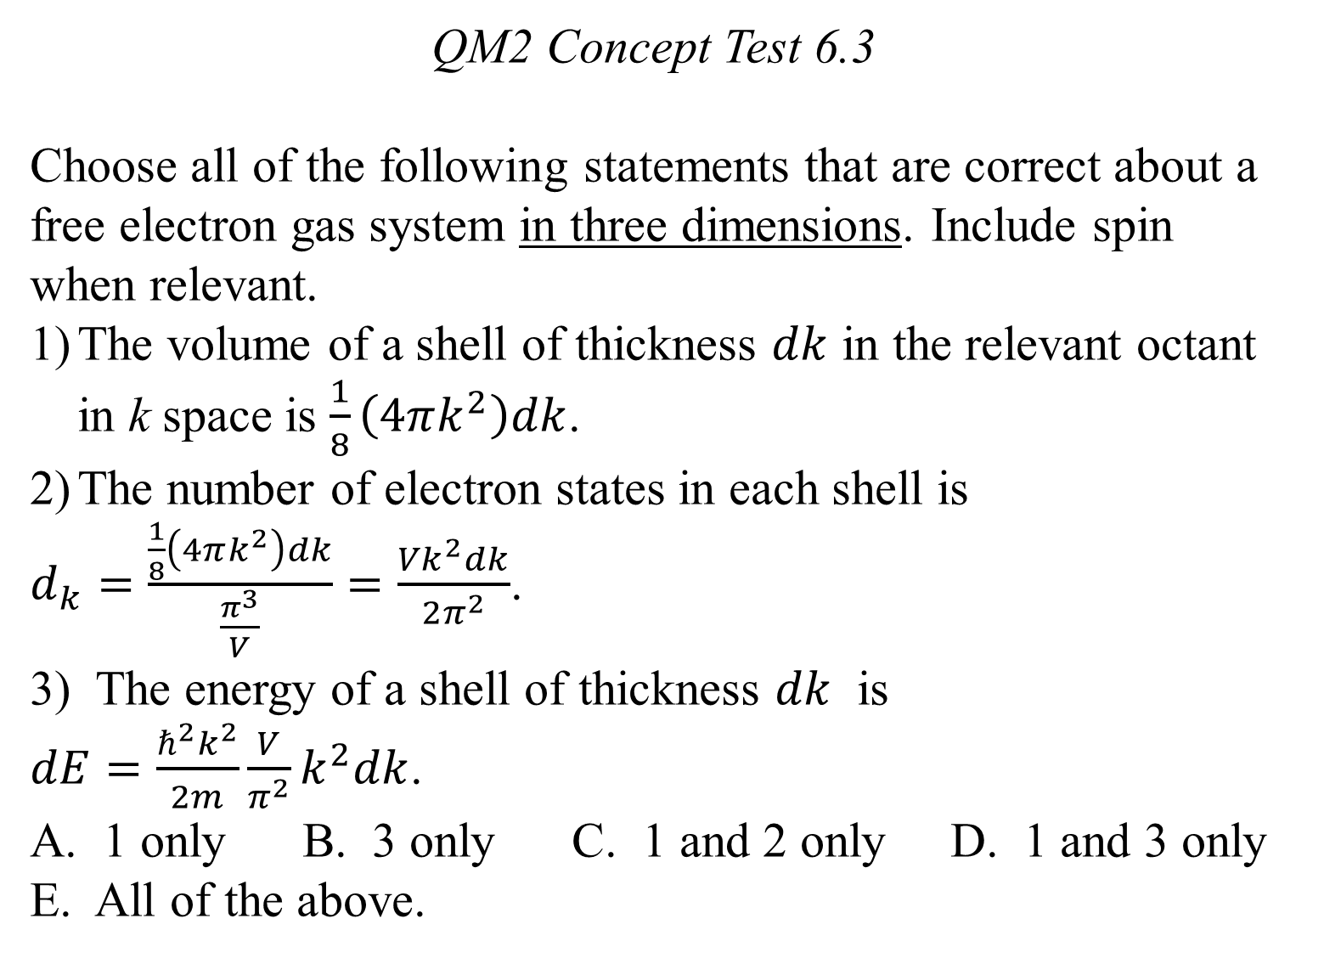
QM2 Concept Test 6.3
Choose all of the following statements that are correct about a free electron gas system in three dimensions. Include spin when relevant.
The volume of a shell of thickness $dk$ in the relevant octant in k space is $\frac{1}{8}\left(4πk^{2}\right)dk$.
The number of electron states in each shell is
$d_{k}=\frac{\frac{1}{8}\left(4πk^{2}\right)dk}{\frac{π^{3}}{V}}=\frac{{Vk}^{2}dk}{2π^{2}}$.
3) The energy of a shell of thickness $dk$ is $dE=\frac{ℏ^{2}k^{2}}{2m}\frac{V}{π^{2}}k^{2}dk$.
A. 1 only B. 3 only C. 1 and 2 only D. 1 and 3 only E. All of the above.

Slide 4
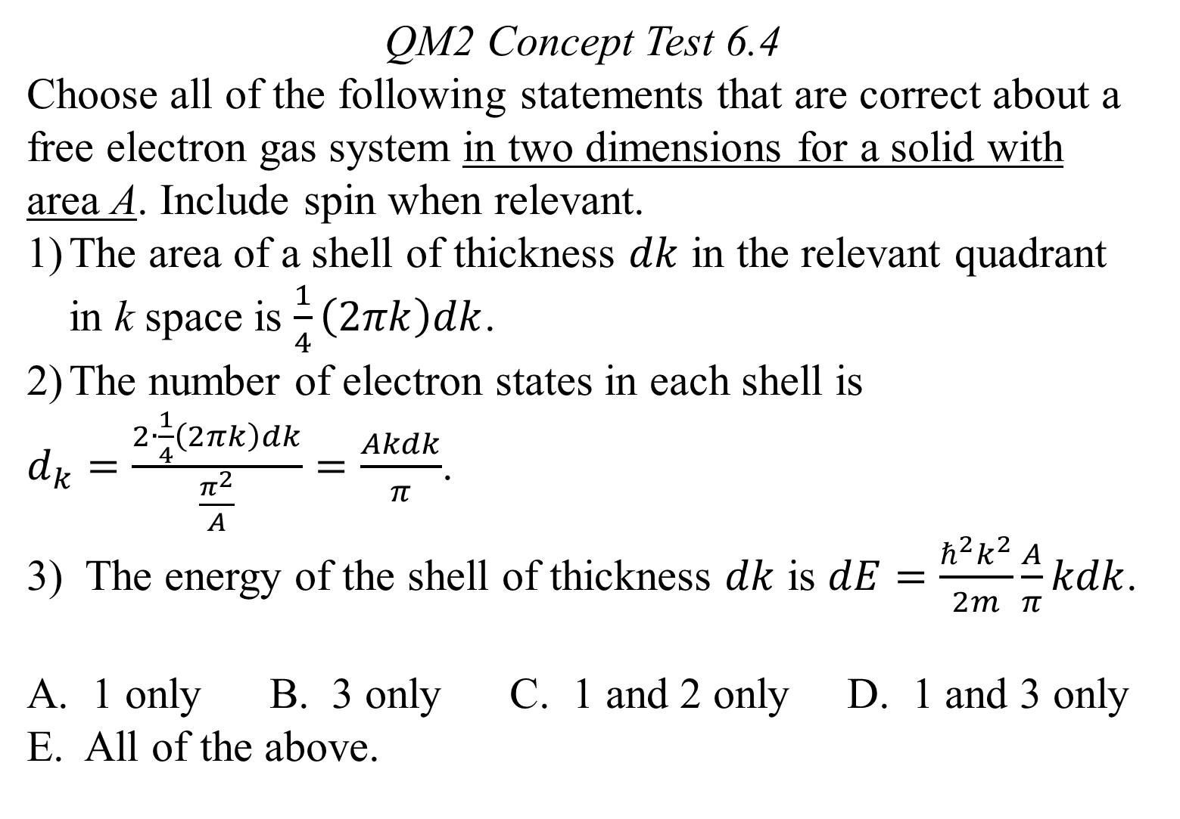
QM2 Concept Test 6.4
Choose all of the following statements that are correct about a free electron gas system in two dimensions for a solid with area A. Include spin when relevant.
The area of a shell of thickness $dk$ in the relevant quadrant in k space is $\frac{1}{4}\left(2πk\right)dk$.
The number of electron states in each shell is
$d_{k}=\frac{2∙\frac{1}{4}\left(2πk\right)dk}{\frac{π^{2}}{A}}=\frac{Akdk}{π}$.
3) The energy of the shell of thickness $dk$ is $dE=\frac{ℏ^{2}k^{2}}{2m}\frac{A}{π}kdk$.
A. 1 only B. 3 only C. 1 and 2 only D. 1 and 3 only E. All of the above.

Slide 5
QM2 Concept test 6.5
Cubes A and B with the same atom number density have N and 2N sodium atoms respectively. Choose all of the following statements that are correct.
At temperature T=0K, the Fermi energy of sodium in cube B is larger than the Fermi energy of sodium in cube A.
At temperature T=0K, the total energy of the electrons in cube B is larger than the total energy of the electrons in cube A.
If we slowly compress the volume of cube A , the total energy of the electrons in cube A will increase.
A. 1 only B. 2 only C. 1 and 2 only D. 2 and 3 only
E. all of the above

Slide 6
QM2 Concept Test 6.6
Choose all of the following statements that are true about Bloch’s Theorem.
Bloch’s theorem says that the stationary state wave function is periodic when the potential energy is periodic.
Bloch’s theorem says that the probability density for finding the particle in a stationary state is periodic when the potential energy is periodic.
Bloch’s theorem applies to the stationary state wave function for any periodic potential.
1 only B. 2 only C. 1 and 3 only D. 2 and 3 only
E. None of the above.

Slide 7
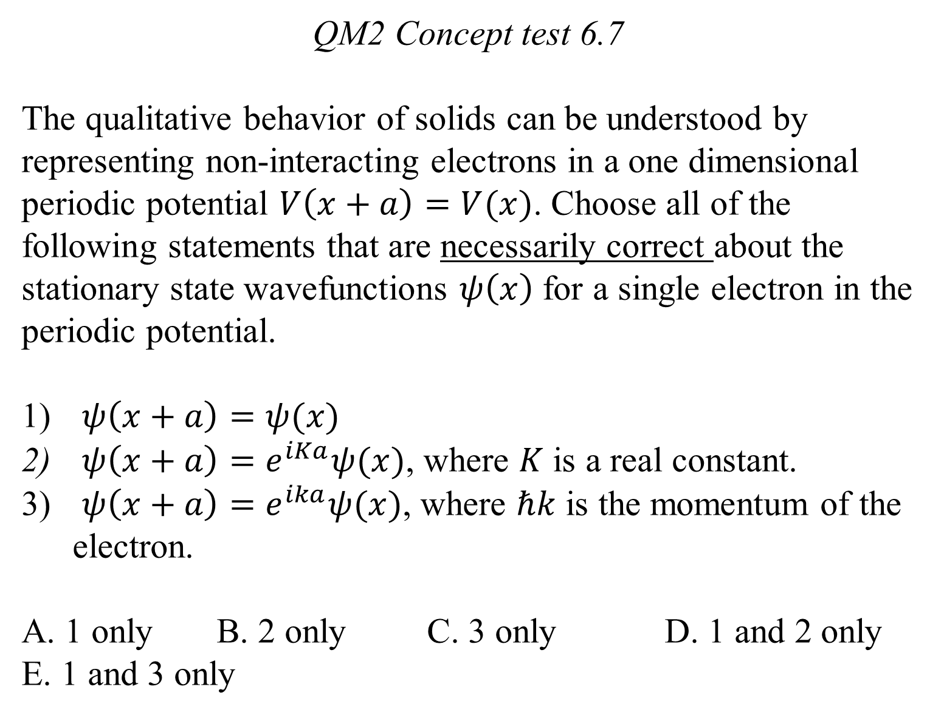
QM2 Concept test 6.7
The qualitative behavior of solids can be understood by representing non-interacting electrons in a one dimensional periodic potential $V\left(x+a\right)=V(x)$. Choose all of the following statements that are necessarily correct about the stationary state wavefunctions $ψ\left(x\right)$ for a single electron in the periodic potential.
$ψ\left(x+a\right)=ψ(x)$
$ψ\left(x+a\right)=e^{iKa}ψ(x)$, where $K$ is a real constant.
$ψ\left(x+a\right)=e^{ika}ψ(x)$, where $ℏk$ is the momentum of the electron.
A. 1 only B. 2 only C. 3 only D. 1 and 2 only
E. 1 and 3 only

Slide 8
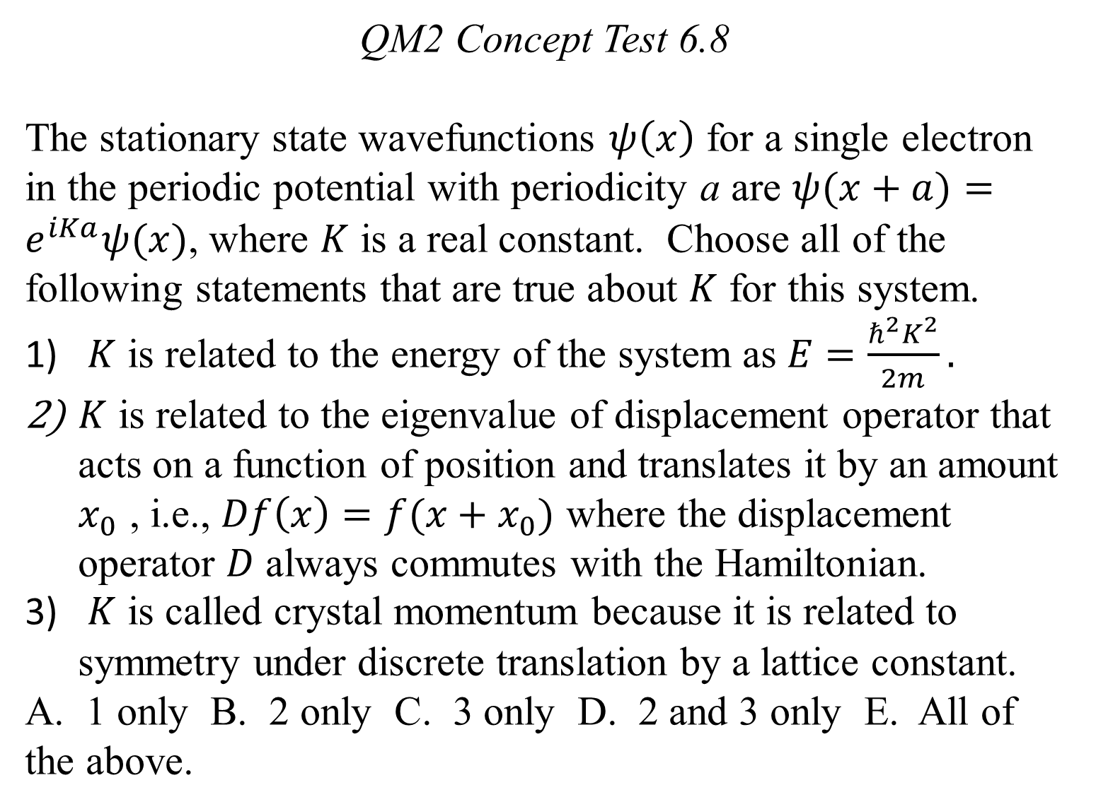
QM2 Concept Test 6.8
The stationary state wavefunctions $ψ\left(x\right)$ for a single electron in the periodic potential with periodicity a are $ψ(x+a)=e^{iKa}ψ(x)$, where $K$ is a real constant. Choose all of the following statements that are true about $K$ for this system.
$K$ is related to the energy of the system as $E=\frac{ℏ^{2}K^{2}}{2m}.$
$K$ is related to the eigenvalue of displacement operator that acts on a function of position and translates it by an amount $x_{0}$ , i.e., $Df\left(x\right)=f(x+x_{0})$ where the displacement operator $D$ always commutes with the Hamiltonian.
$K$ is called crystal momentum because it is related to symmetry under discrete translation by a lattice constant.
A. 1 only B. 2 only C. 3 only D. 2 and 3 only E. All of the above.

