Slide 1
QM2 Concept test 7.1
Choose all of the following statements that are correct.
(1) The Fermi energy is only defined for fermions.
(2) The degeneracy pressure plays a role in stabilizing a solid object.
(3) If the electrons were bosons, the total energy of the electron gas at temperature T=0K would be much less than what it actually is.
A. 1 only B. 2 only C. 1 and 3 only D. 2 and 3 only
E. all of the above

Slide 2
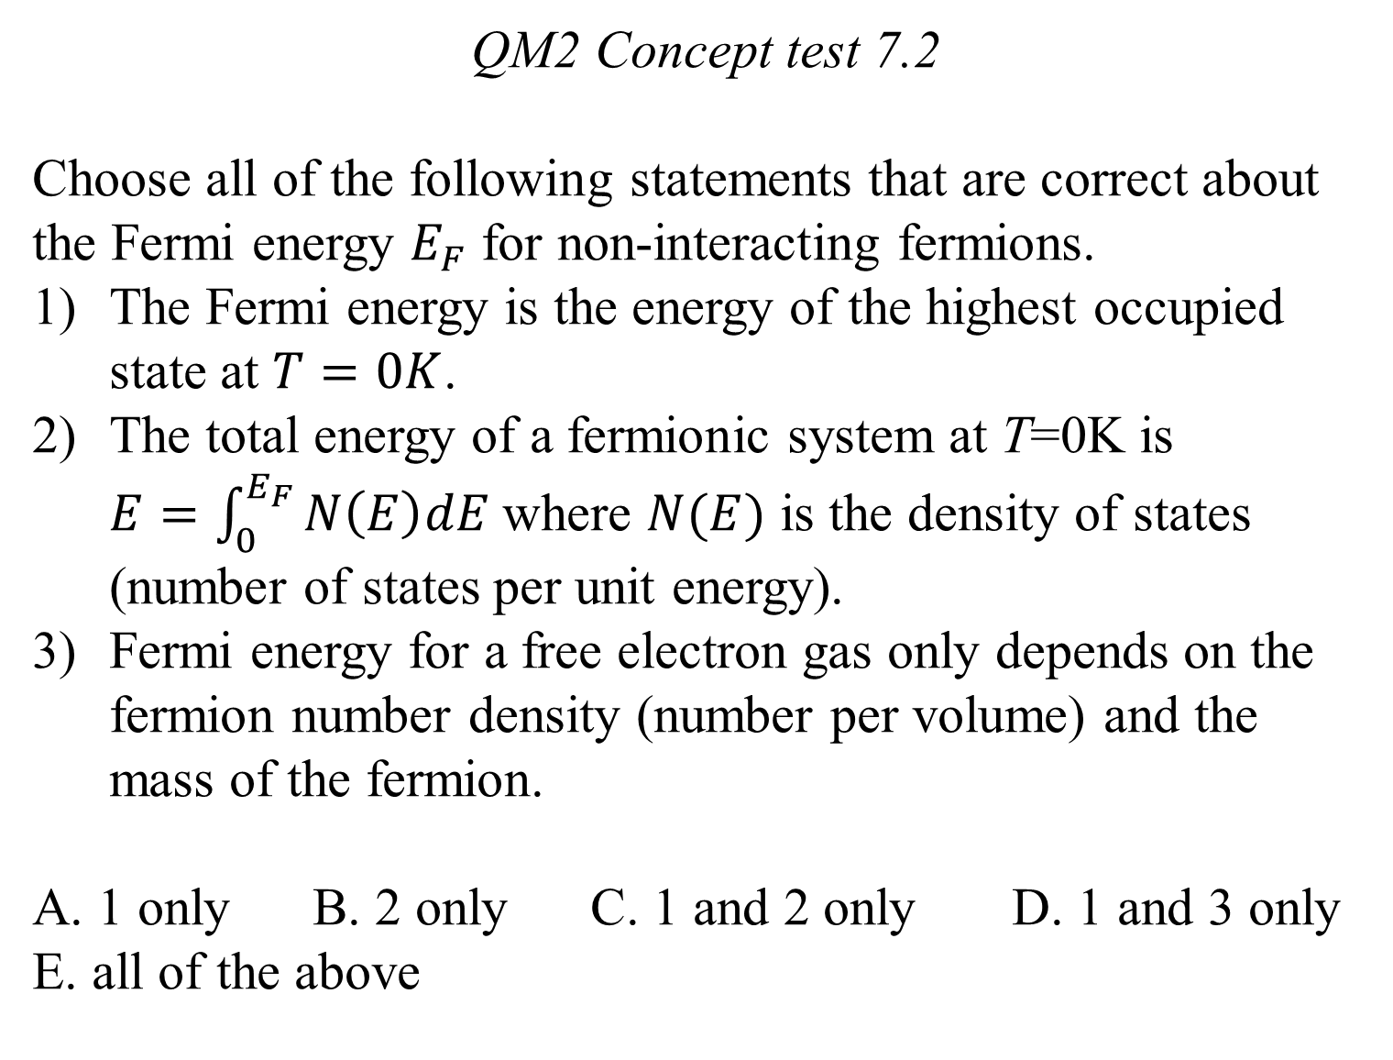
QM2 Concept test 7.2
Choose all of the following statements that are correct about the Fermi energy $E_{F}$ for non-interacting fermions.
The Fermi energy is the energy of the highest occupied state at $T=0K$.
The total energy of a fermionic system at T=0K is $E=\int_{0}^{E_{F}}{N\left(E\right)dE}$where $N(E)$ is the density of states (number of states per unit energy).
Fermi energy for a free electron gas only depends on the fermion number density (number per volume) and the mass of the fermion.
A. 1 only B. 2 only C. 1 and 2 only D. 1 and 3 only
E. all of the above

Slide 3
QM2 Concept test 7.3
In a periodic delta-function potential, N represents the number of unit cells, e.g., the number of atomic nuclei in a solid metal. Choose all of the following statements that are correct. Assume the system is one dimensional (the electrons are constrained in one dimension and spin is included).
(1) Each energy band can hold the same maximum number of electrons.
(2) The second energy band can only hold a maximum 2N electrons.
(3) The third energy band can hold 3/2 as many electrons as the second band.
A. 1 only B. 2 only C. 1 and 2 only D. 2 and 3 only
E. 3 only

Slide 4
QM2 Concept Test 7.4
Undoped silicon behaves as an insulator because its highest energy band is completely filled. Choose all of the following statements that are correct about silicon.
Doping silicon with atoms from the 3rd group of the periodic table, e.g., aluminum, creates energy states with holes near the top of the highest filled energy band.
Doping silicon with atoms from the 5th group of the periodic table , e.g., phosphorous, creates energy states with electrons just below the next higher unoccupied energy band.
The only way to make silicon behave as a semiconductor is to dope it with a small amount of atoms that have more valence electrons than silicon.
3 only B. 1 and 2 only C. 1 and 3 only D. 2 and 3 only
E. All of the above

Slide 5
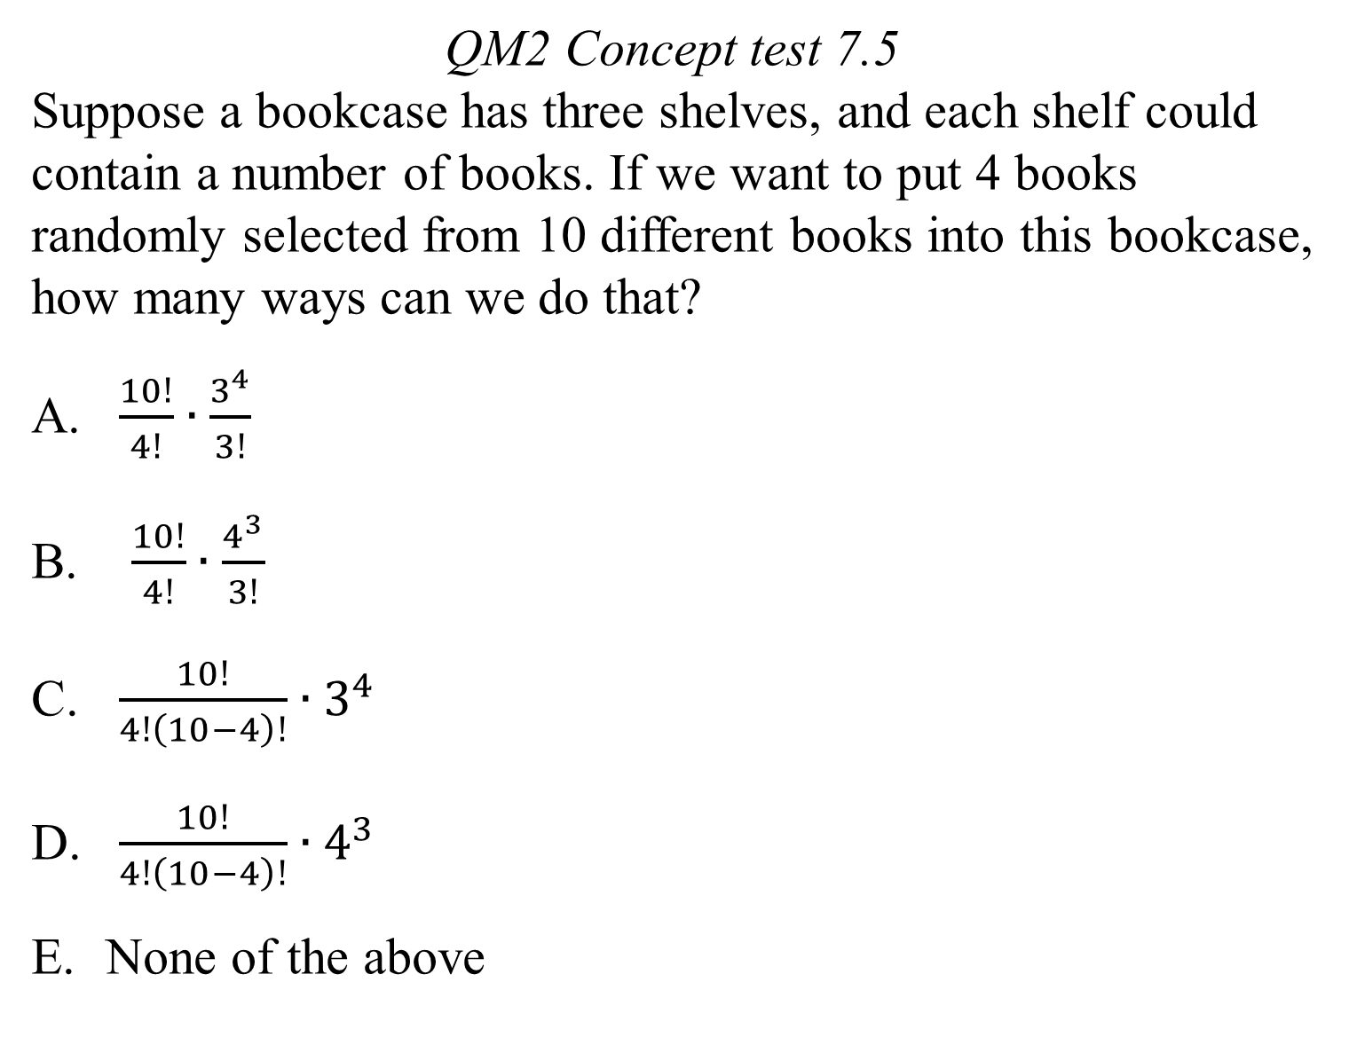
QM2 Concept test 7.5
Suppose a bookcase has three shelves, and each shelf could contain a number of books. If we want to put 4 books randomly selected from 10 different books into this bookcase, how many ways can we do that?
$\frac{10!}{4!}∙\frac{3^{4}}{3!}$
$\frac{10!}{4!}∙\frac{4^{3}}{3!}$
$\frac{10!}{4!\left(10−4\right)!}∙3^{4}$
$\frac{10!}{4!\left(10−4\right)!}∙4^{3}$
None of the above

Slide 6
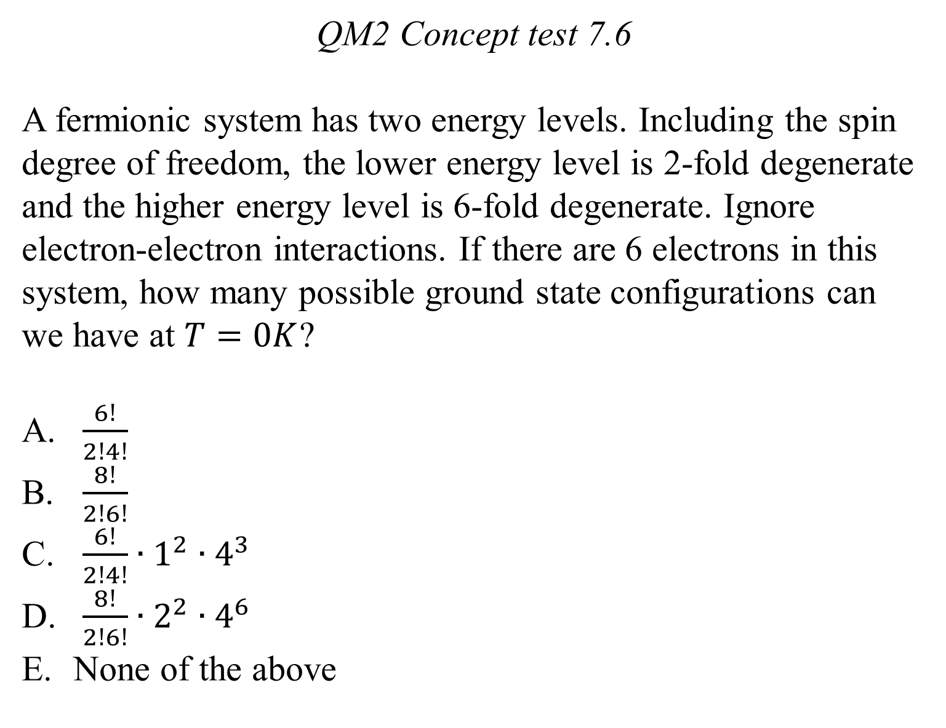
QM2 Concept test 7.6
A fermionic system has two energy levels. Including the spin degree of freedom, the lower energy level is 2-fold degenerate and the higher energy level is 6-fold degenerate. Ignore electron-electron interactions. If there are 6 electrons in this system, how many possible ground state configurations can we have at $T=0K$?
$\frac{6!}{2!4!}$
$\frac{8!}{2!6!}$
$\frac{6!}{2!4!}∙1^{2}∙4^{3}$
$\frac{8!}{2!6!}∙2^{2}∙4^{6}$
None of the above

Slide 7
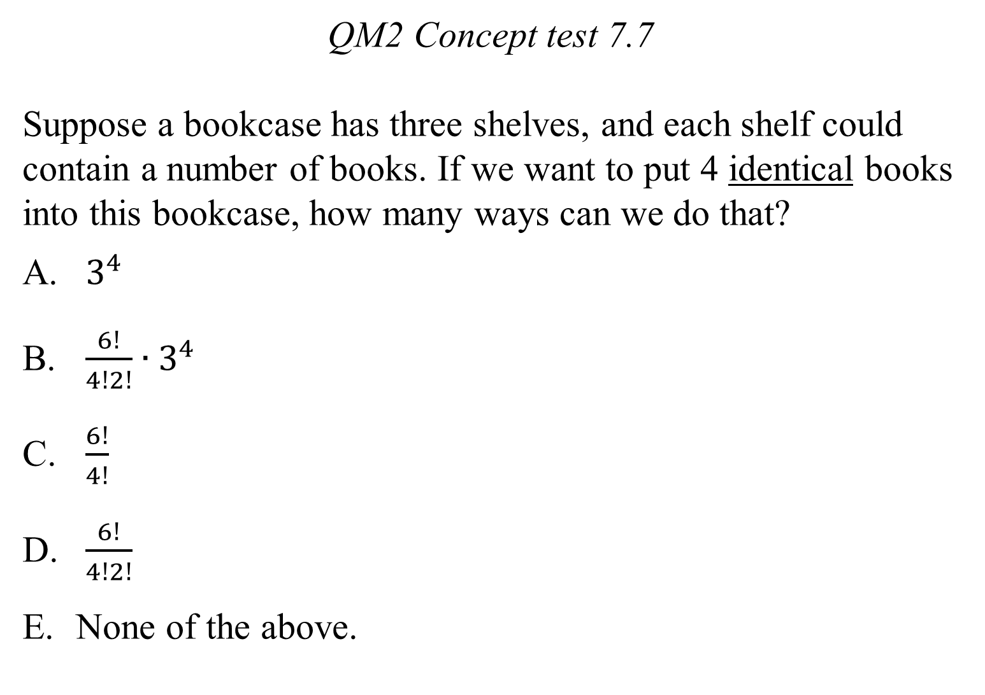
QM2 Concept test 7.7
Suppose a bookcase has three shelves, and each shelf could contain a number of books. If we want to put 4 identical books into this bookcase, how many ways can we do that?
$3^{4}$
$\frac{6!}{4!2!}∙3^{4}$
$\frac{6!}{4!}$
$\frac{6!}{4!2!}$
None of the above.

