Slide 1
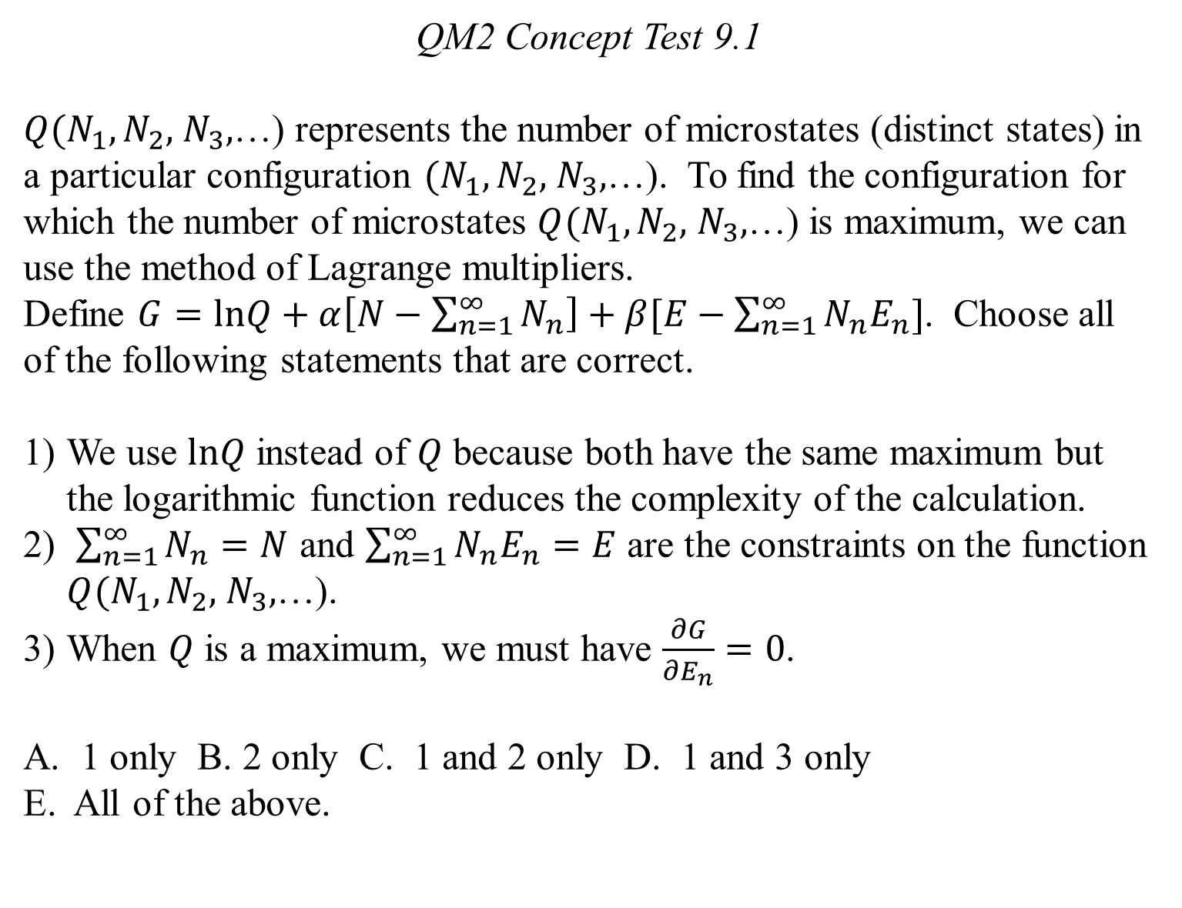
QM2 Concept Test 9.1
$Q(N_{1},N_{2},$ $N_{3},$…) represents the number of microstates (distinct states) in a particular configuration $(N_{1},N_{2},$ $N_{3},$…). To find the configuration for which the number of microstates $Q(N_{1},N_{2},$ $N_{3},$…) is maximum, we can use the method of Lagrange multipliers.
Define $G=lnQ+α\left[N−\sum_{n=1}^{∞}{N_{n}}\right]+β[E−\sum_{n=1}^{∞}{N_{n}E_{n}]}$. Choose all of the following statements that are correct.
We use $lnQ$ instead of $Q$ because both have the same maximum but the logarithmic function reduces the complexity of the calculation.
$\sum_{n=1}^{∞}{N_{n}}=N$ and $\sum_{n=1}^{∞}{N_{n}E_{n}=E}$ are the constraints on the function $Q(N_{1},N_{2},$ $N_{3},$…).
When $Q$ is a maximum, we must have $\frac{∂G}{∂E_{n}}=0$.
1 only B. 2 only C. 1 and 2 only D. 1 and 3 only
E. All of the above.

Slide 2
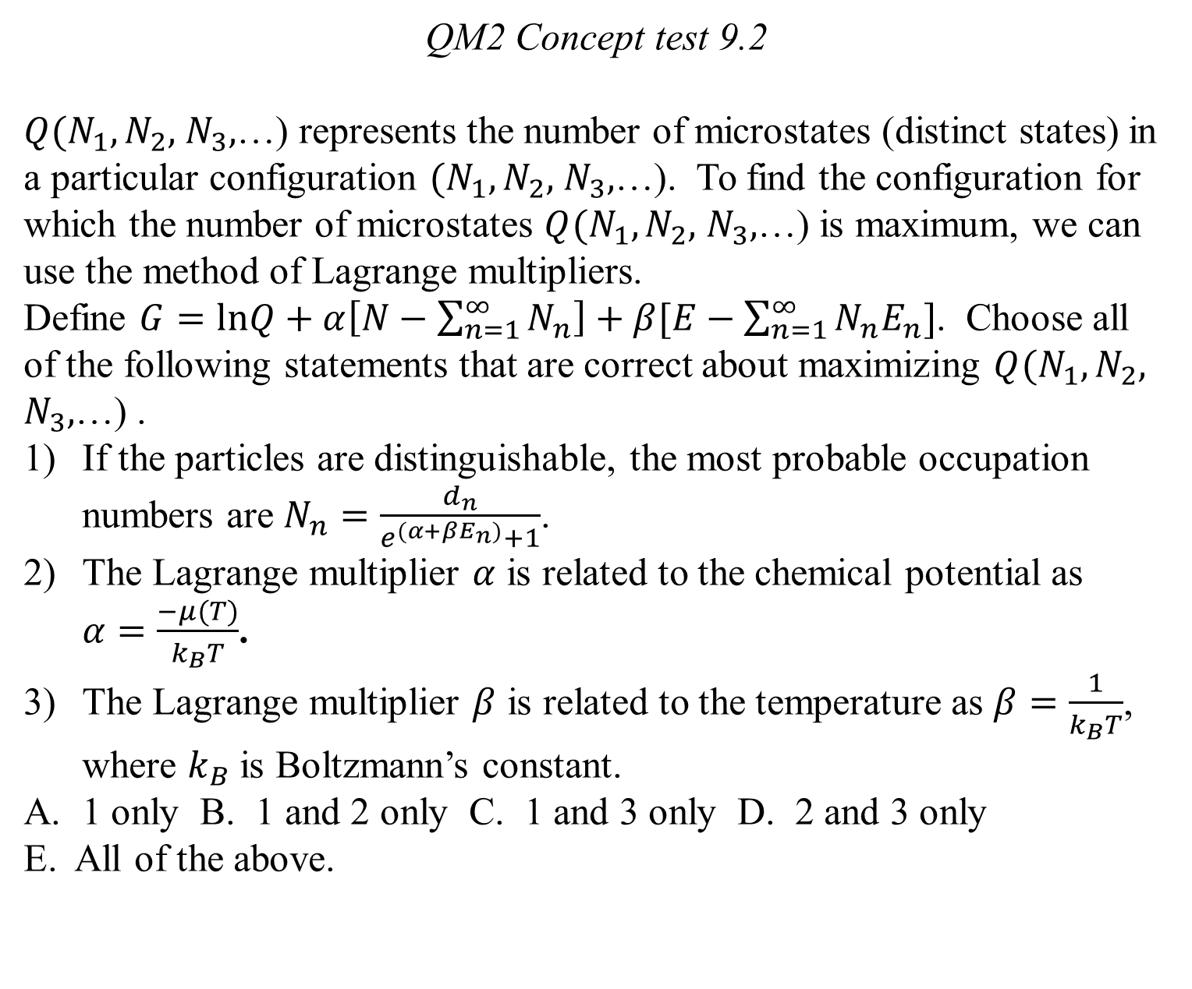
QM2 Concept test 9.2
$Q(N_{1},N_{2},$ $N_{3},$…) represents the number of microstates (distinct states) in a particular configuration $(N_{1},N_{2},$ $N_{3},$…). To find the configuration for which the number of microstates $Q(N_{1},N_{2},$ $N_{3},$…) is maximum, we can use the method of Lagrange multipliers.
Define $G=lnQ+α\left[N−\sum_{n=1}^{∞}{N_{n}}\right]+β[E−\sum_{n=1}^{∞}{N_{n}E_{n}]}$. Choose all of the following statements that are correct about maximizing $Q(N_{1},N_{2},$ $N_{3},$…) .
If the particles are distinguishable, the most probable occupation numbers are $N_{n}=\frac{d_{n}}{e^{(α+βE_{n})}+1}$.
The Lagrange multiplier $α$ is related to the chemical potential as $α=\frac{−μ(T)}{k_{B}T}$.
The Lagrange multiplier $β$ is related to the temperature as $β=\frac{1}{k_{B}T}$, where $k_{B}$ is Boltzmann’s constant.
1 only B. 1 and 2 only C. 1 and 3 only D. 2 and 3 only
E. All of the above.

Slide 3
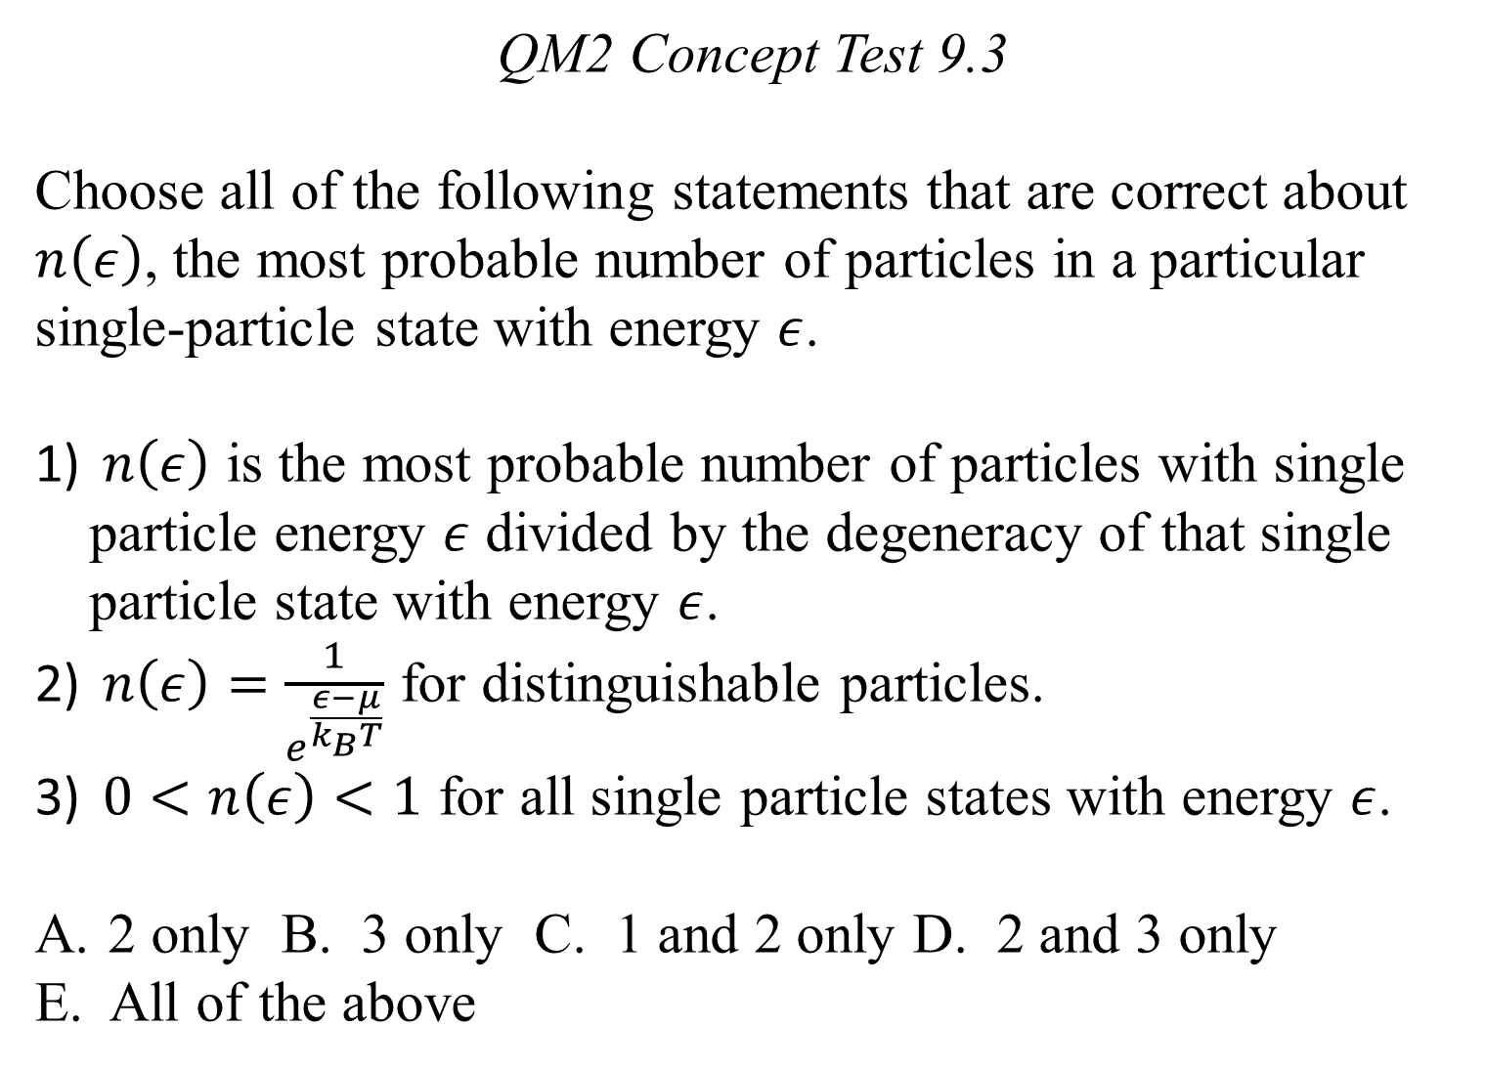
QM2 Concept Test 9.3
Choose all of the following statements that are correct about $n\left(ε\right)$, the most probable number of particles in a particular single-particle state with energy $ε$.
$n\left(ε\right)$ is the most probable number of particles with single particle energy $ε$ divided by the degeneracy of that single particle state with energy $ε$.
$n\left(ε\right)=\frac{1}{e^{\frac{ε−μ}{k_{B}T}}}$ for distinguishable particles.
$0<n\left(ε\right)<1$ for all single particle states with energy $ε$.
2 only B. 3 only C. 1 and 2 only D. 2 and 3 only
E. All of the above

Slide 4
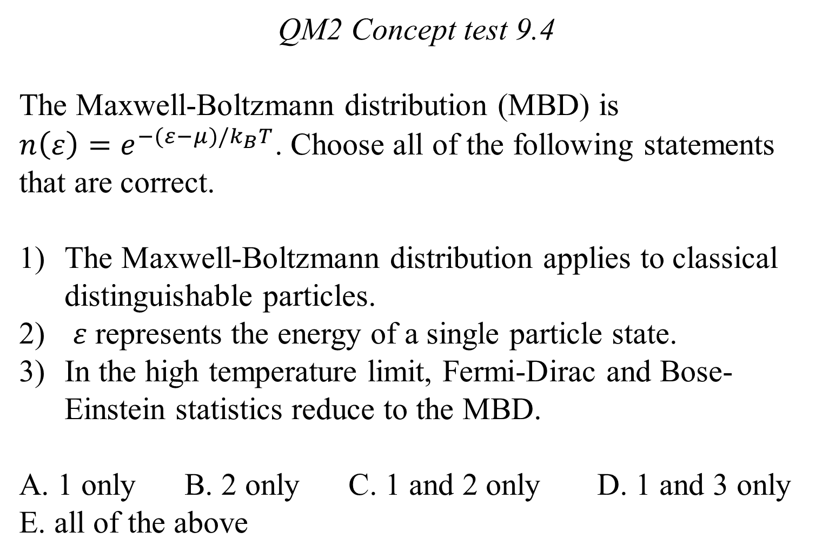
QM2 Concept test 9.4
The Maxwell-Boltzmann distribution (MBD) is
$n\left(ε\right)=e^{−(ε−μ)/k_{B}T}$. Choose all of the following statements that are correct.
The Maxwell-Boltzmann distribution applies to classical distinguishable particles.
$ε$ represents the energy of a single particle state.
In the high temperature limit, Fermi-Dirac and Bose-Einstein statistics reduce to the MBD.
A. 1 only B. 2 only C. 1 and 2 only D. 1 and 3 only
E. all of the above

Slide 5
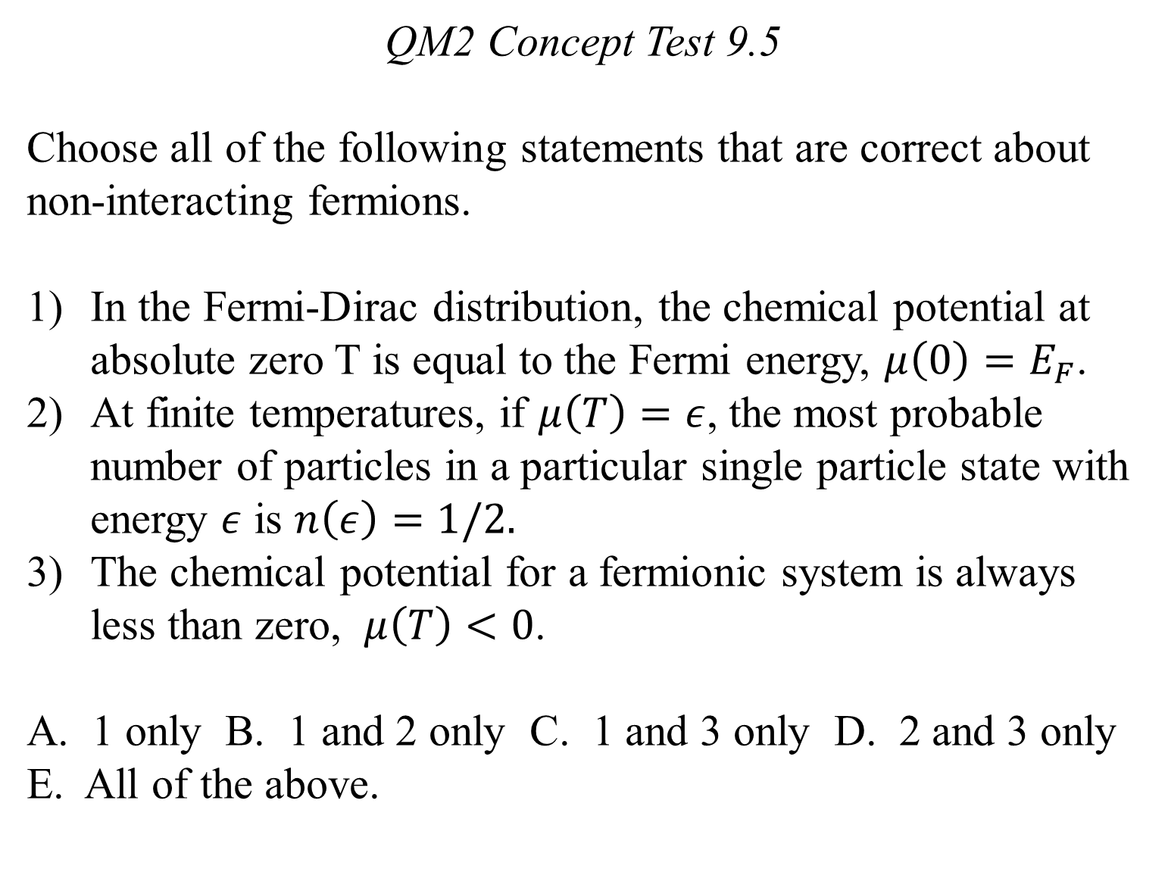
QM2 Concept Test 9.5
Choose all of the following statements that are correct about non-interacting fermions.
In the Fermi-Dirac distribution, the chemical potential at absolute zero T is equal to the Fermi energy, $μ\left(0\right)=E_{F}$.
At finite temperatures, if $μ\left(T\right)=ε$, the most probable number of particles in a particular single particle state with energy $ε$ is $n\left(ε\right)=1/2.$
The chemical potential for a fermionic system is always less than zero, $μ\left(T\right)<0$.
A. 1 only B. 1 and 2 only C. 1 and 3 only D. 2 and 3 only E. All of the above.

Slide 6
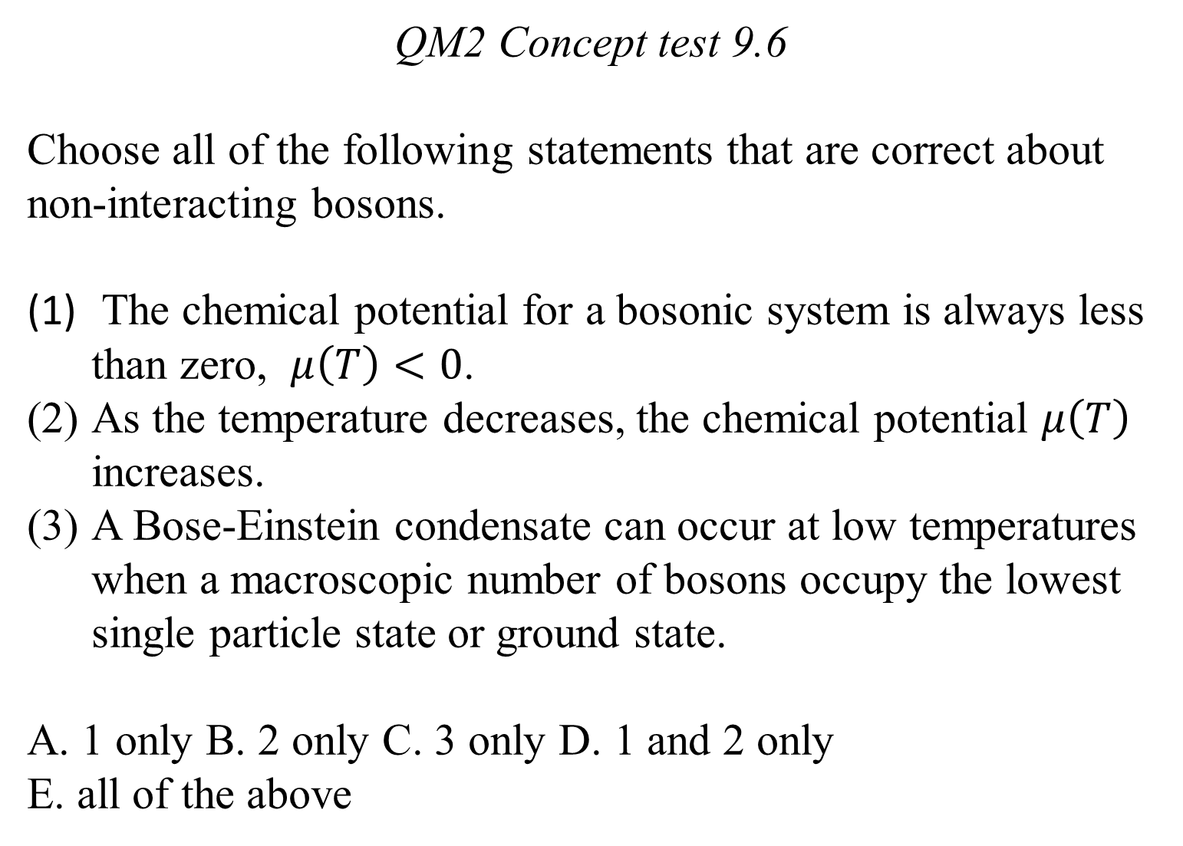
QM2 Concept test 9.6
Choose all of the following statements that are correct about non-interacting bosons.
The chemical potential for a bosonic system is always less than zero, $μ\left(T\right)<0$.
As the temperature decreases, the chemical potential $μ\left(T\right)$ increases.
A Bose-Einstein condensate can occur at low temperatures when a macroscopic number of bosons occupy the lowest single particle state or ground state.
A. 1 only B. 2 only C. 3 only D. 1 and 2 only
E. all of the above

Slide 7
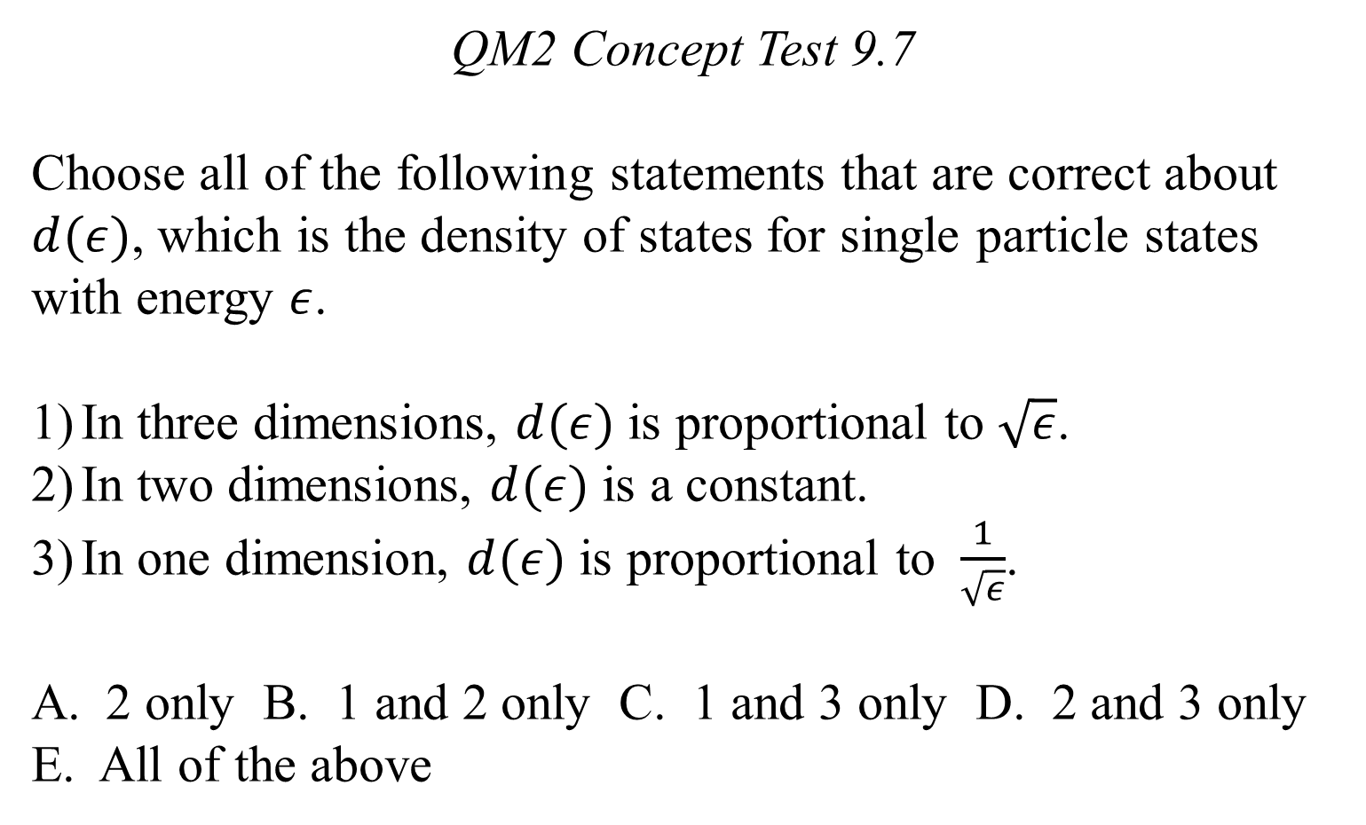
QM2 Concept Test 9.7
Choose all of the following statements that are correct about $d(ε)$, which is the density of states for single particle states with energy $ε$.
In three dimensions, $d(ε)$ is proportional to $\sqrt{ε}$.
In two dimensions, $d(ε)$ is a constant.
In one dimension, $d(ε)$ is proportional to $\frac{1}{\sqrt{ε}}$.
2 only B. 1 and 2 only C. 1 and 3 only D. 2 and 3 only
E. All of the above

