Slide 1
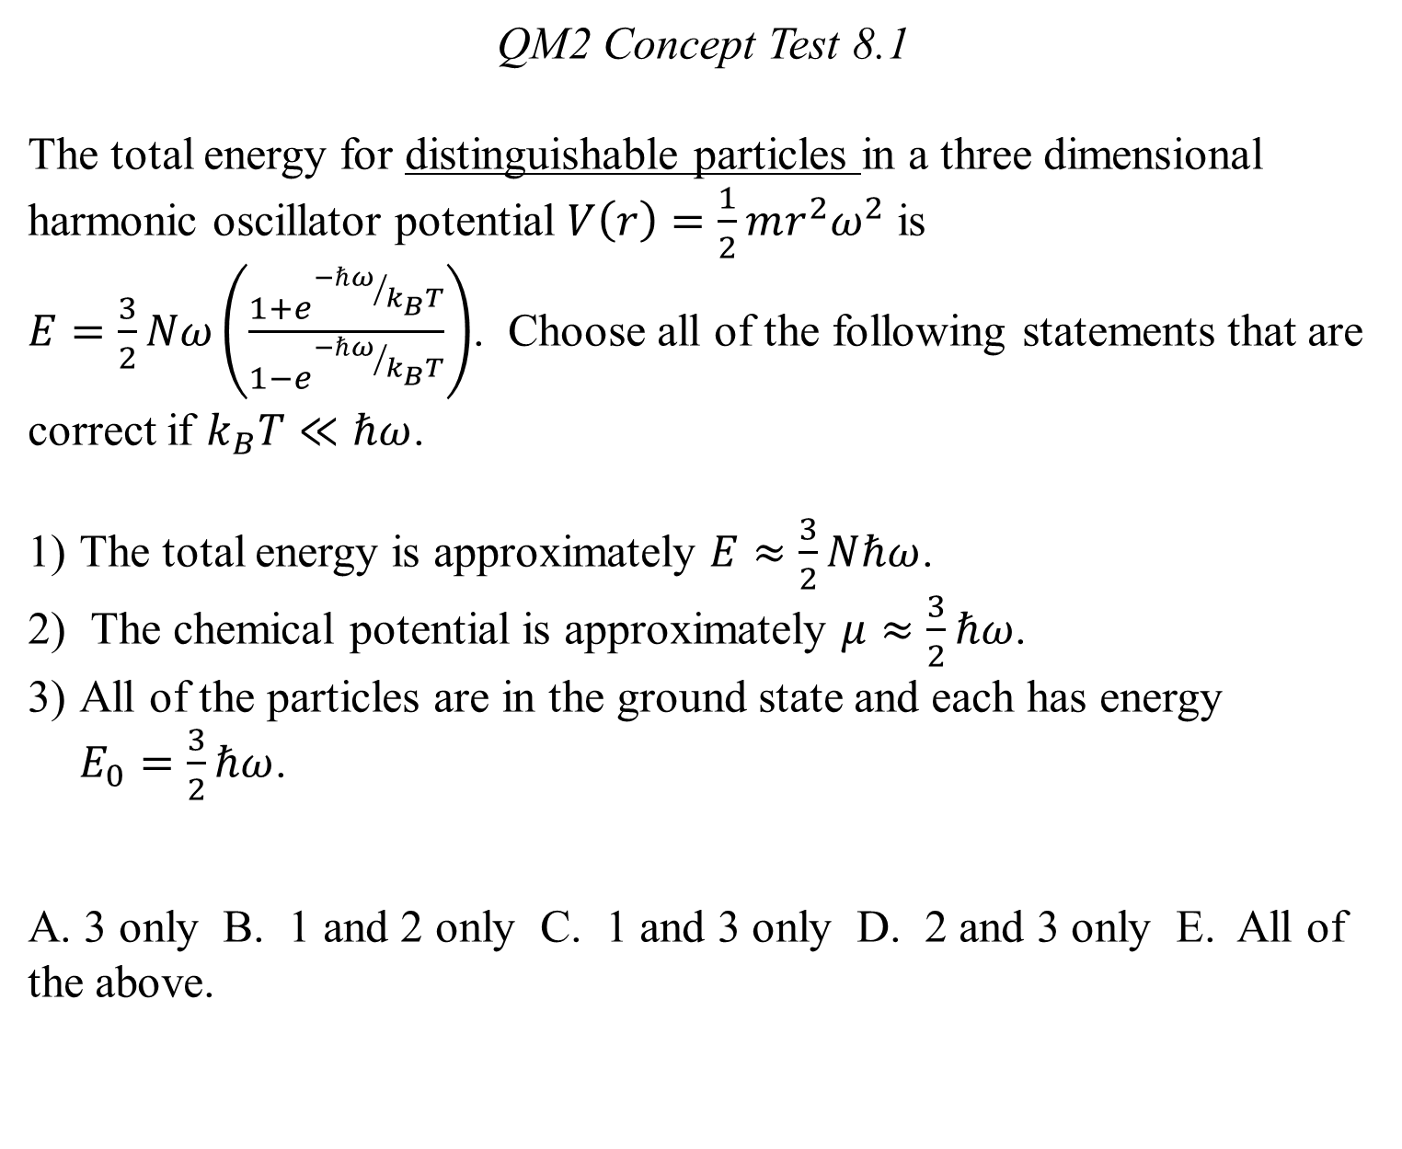
QM2 Concept Test 8.1
The total energy for distinguishable particles in a three dimensional harmonic oscillator potential $V\left(r\right)=\frac{1}{2}mr^{2}ω^{2}$ is $E=\frac{3}{2}Nω\left(\frac{1+e^{{−ℏω}/{k_{B}T}}}{1−e^{{−ℏω}/{k_{B}T}}}\right)$. Choose all of the following statements that are correct if $k_{B}T≪ℏω$.
The total energy is approximately $E≈\frac{3}{2}Nℏω$.
The chemical potential is approximately $μ≈\frac{3}{2}ℏω$.
All of the particles are in the ground state and each has energy $E_{0}=\frac{3}{2}ℏω$.
A. 3 only B. 1 and 2 only C. 1 and 3 only D. 2 and 3 only E. All of the above.

Slide 2
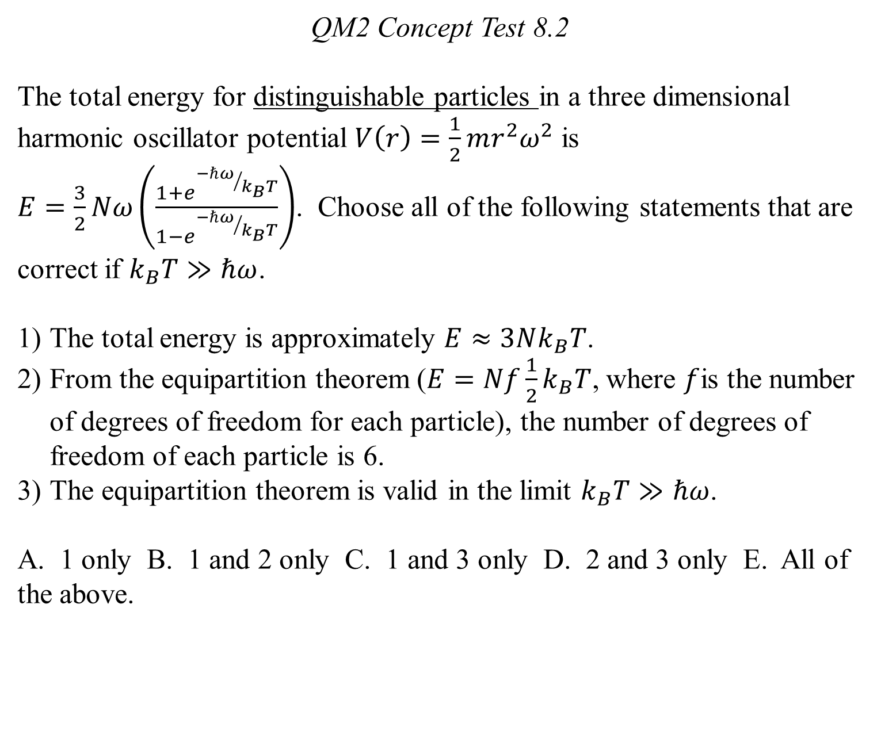
QM2 Concept Test 8.2
The total energy for distinguishable particles in a three dimensional harmonic oscillator potential $V\left(r\right)=\frac{1}{2}mr^{2}ω^{2}$ is $E=\frac{3}{2}Nω\left(\frac{1+e^{{−ℏω}/{k_{B}T}}}{1−e^{{−ℏω}/{k_{B}T}}}\right)$. Choose all of the following statements that are correct if $k_{B}T≫ℏω$.
The total energy is approximately $E≈3Nk_{B}T$.
From the equipartition theorem ($E=Nf\frac{1}{2}k_{B}T$, where $f$is the number of degrees of freedom for each particle), the number of degrees of freedom of each particle is 6.
The equipartition theorem is valid in the limit $k_{B}T≫ℏω$.
A. 1 only B. 1 and 2 only C. 1 and 3 only D. 2 and 3 only E. All of the above.

Slide 3
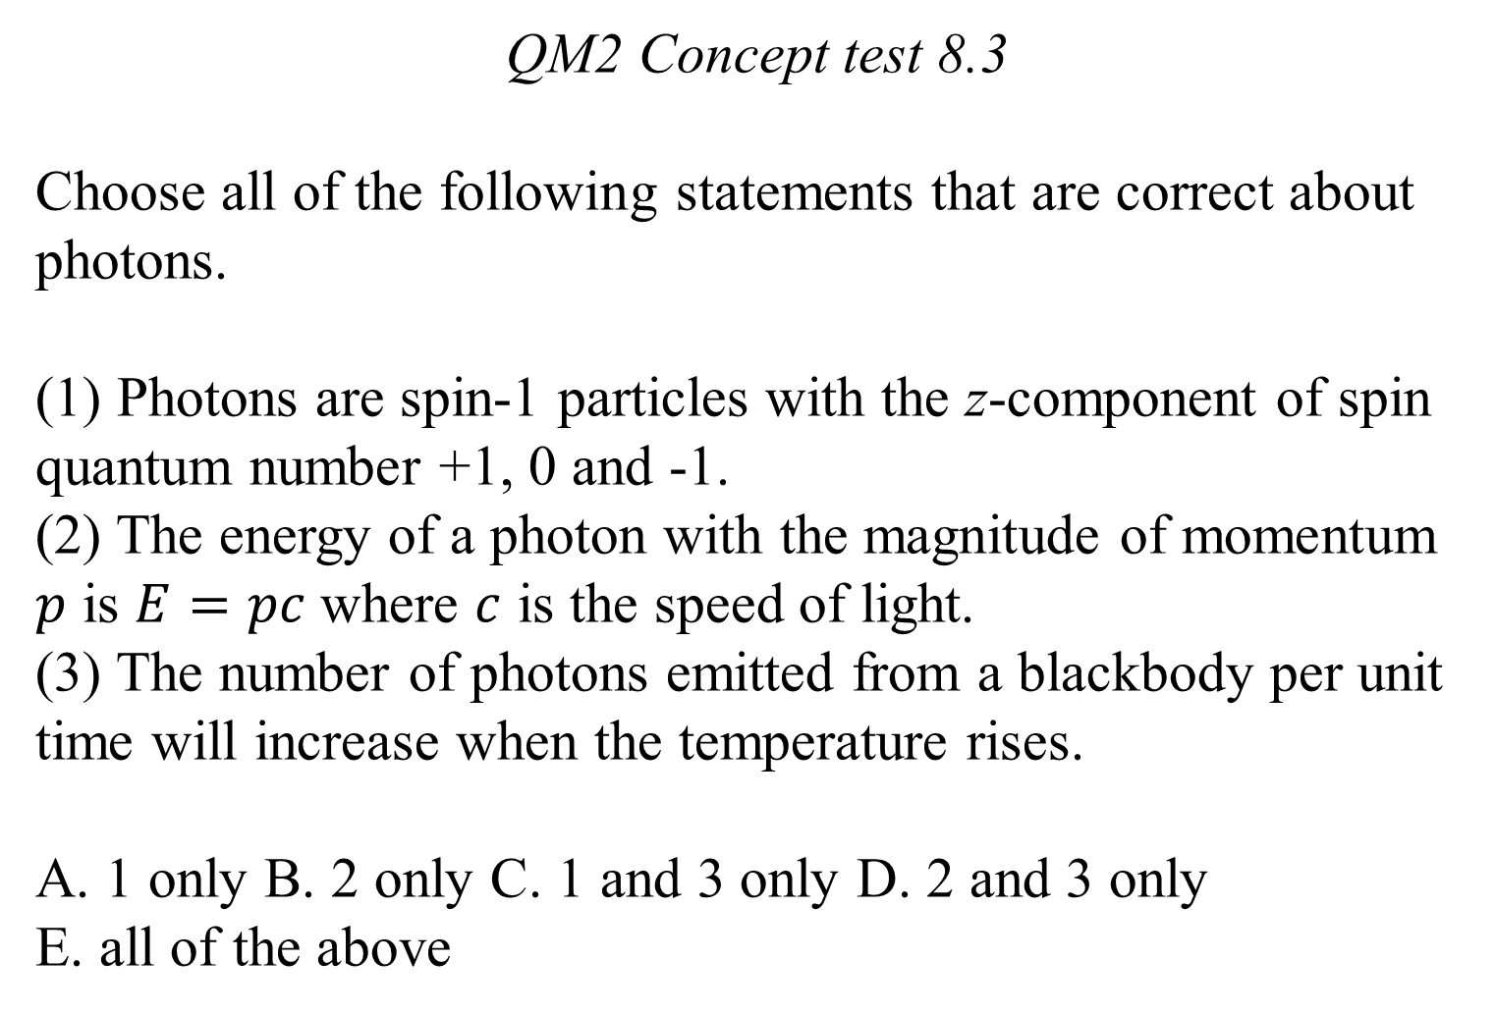
QM2 Concept test 8.3
Choose all of the following statements that are correct about photons.
(1) Photons are spin-1 particles with the z-component of spin quantum number +1, 0 and -1.
(2) The energy of a photon with the magnitude of momentum $p$ is $E=pc$where $c$ is the speed of light.
(3) The number of photons emitted from a blackbody per unit time will increase when the temperature rises.
A. 1 only B. 2 only C. 1 and 3 only D. 2 and 3 only
E. all of the above

Slide 4
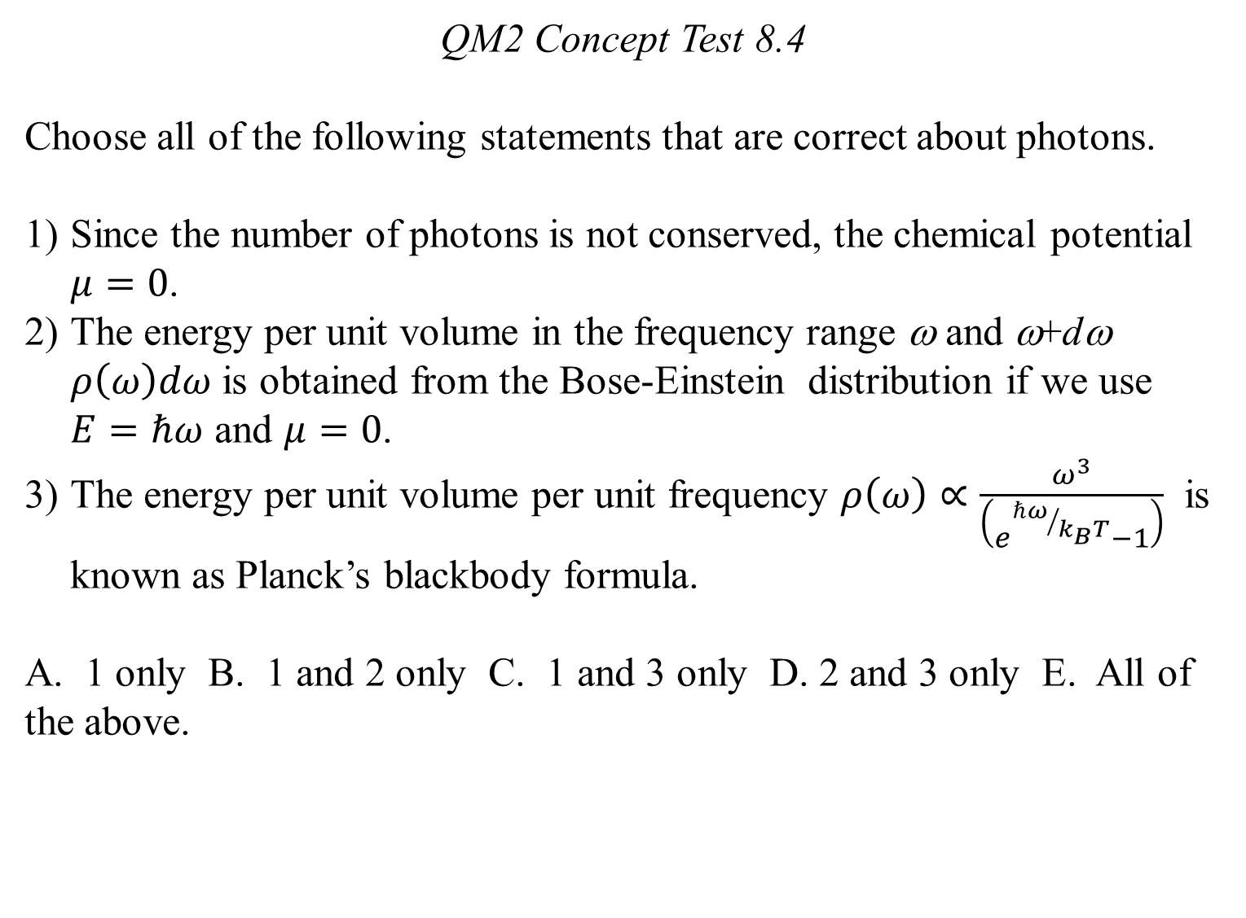
QM2 Concept Test 8.4
Choose all of the following statements that are correct about photons.
Since the number of photons is not conserved, the chemical potential $μ=0$.
The energy per unit volume in the frequency range ω and ω+dω $ρ\left(ω\right)dω$ is obtained from the Bose-Einstein distribution if we use $E=ℏω$ and $μ=0$.
The energy per unit volume per unit frequency $ρ\left(ω\right)∝\frac{ω^{3}}{\left(e^{{ℏω}/{k_{B}T}}−1\right)}$ is known as Planck’s blackbody formula.
A. 1 only B. 1 and 2 only C. 1 and 3 only D. 2 and 3 only E. All of the above.

Slide 5
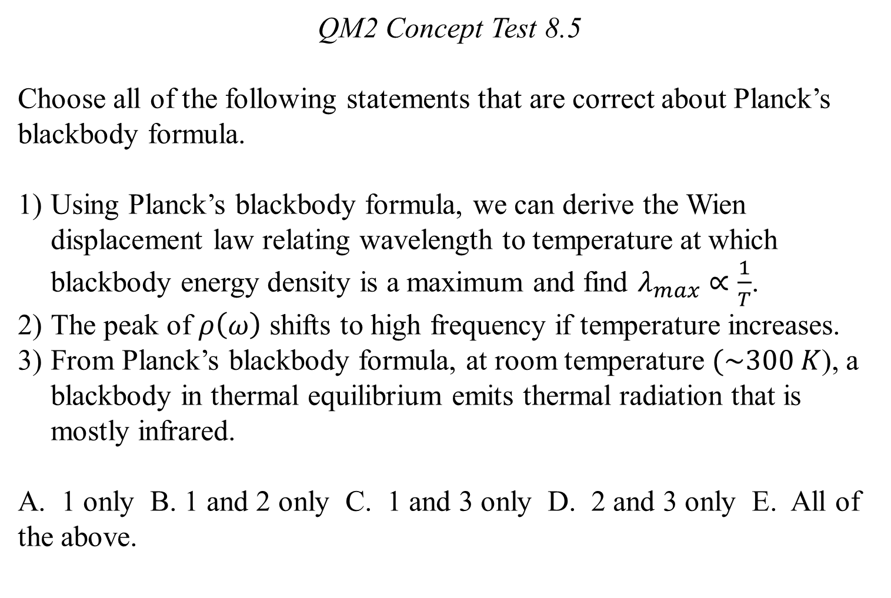
QM2 Concept Test 8.5
Choose all of the following statements that are correct about Planck’s blackbody formula.
Using Planck’s blackbody formula, we can derive the Wien displacement law relating wavelength to temperature at which blackbody energy density is a maximum and find $λ_{max}∝\frac{1}{T}$.
The peak of $ρ\left(ω\right)$ shifts to high frequency if temperature increases.
From Planck’s blackbody formula, at room temperature $(\sim 300 K$), a blackbody in thermal equilibrium emits thermal radiation that is mostly infrared.
A. 1 only B. 1 and 2 only C. 1 and 3 only D. 2 and 3 only E. All of the above.

Slide 6
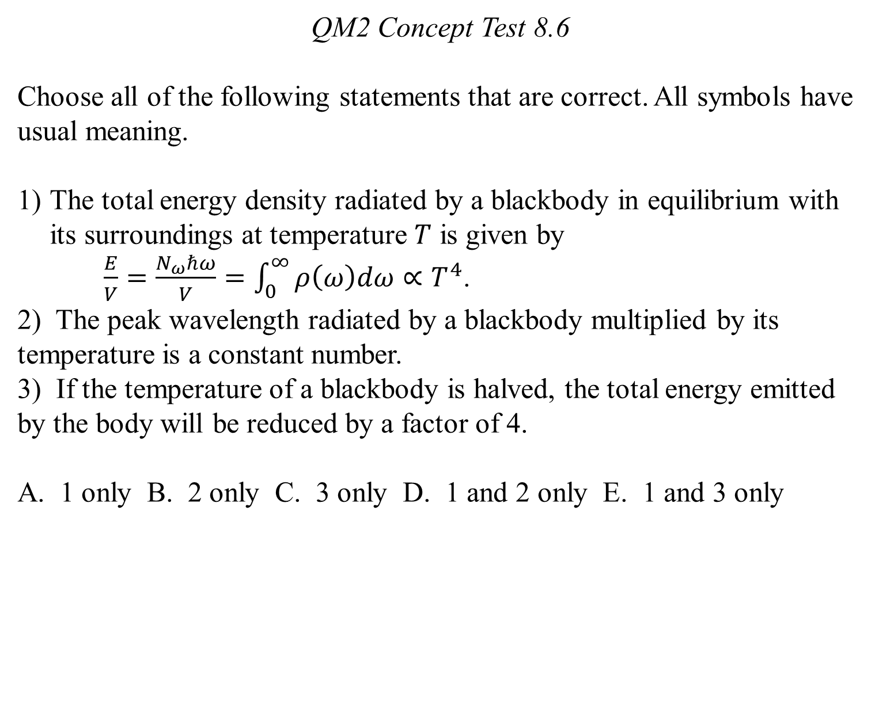
QM2 Concept Test 8.6
Choose all of the following statements that are correct. All symbols have usual meaning.
The total energy density radiated by a blackbody in equilibrium with its surroundings at temperature $T$ is given by
$\frac{E}{V}=\frac{N_{ω}ℏω}{V}=\int_{0}^{∞}{ρ\left(ω\right)dω}∝T^{4}$.
2) The peak wavelength radiated by a blackbody multiplied by its temperature is a constant number.
3) If the temperature of a blackbody is halved, the total energy emitted by the body will be reduced by a factor of 4.
A. 1 only B. 2 only C. 3 only D. 1 and 2 only E. 1 and 3 only

Slide 7
QM2 Concept Test 8.7
Choose all of the following statements that are true about a blackbody in thermal equilibrium emitting radiation.
As the temperature of a blackbody increases, the peak wavelength emitted by the blackbody decreases.
The sun is almost a blackbody which emits large amounts of ultraviolet and infrared radiation, and its emission is peaked in the visible spectrum.
Compared to our sun, a star that looks blue-white emits more of shorter wavelength radiation such as ultraviolet light and x rays.
A. 1 only B. 1 and 2only C. 1 and 3 only D. 2 and 3 only E. All of the above.

