Slide 1
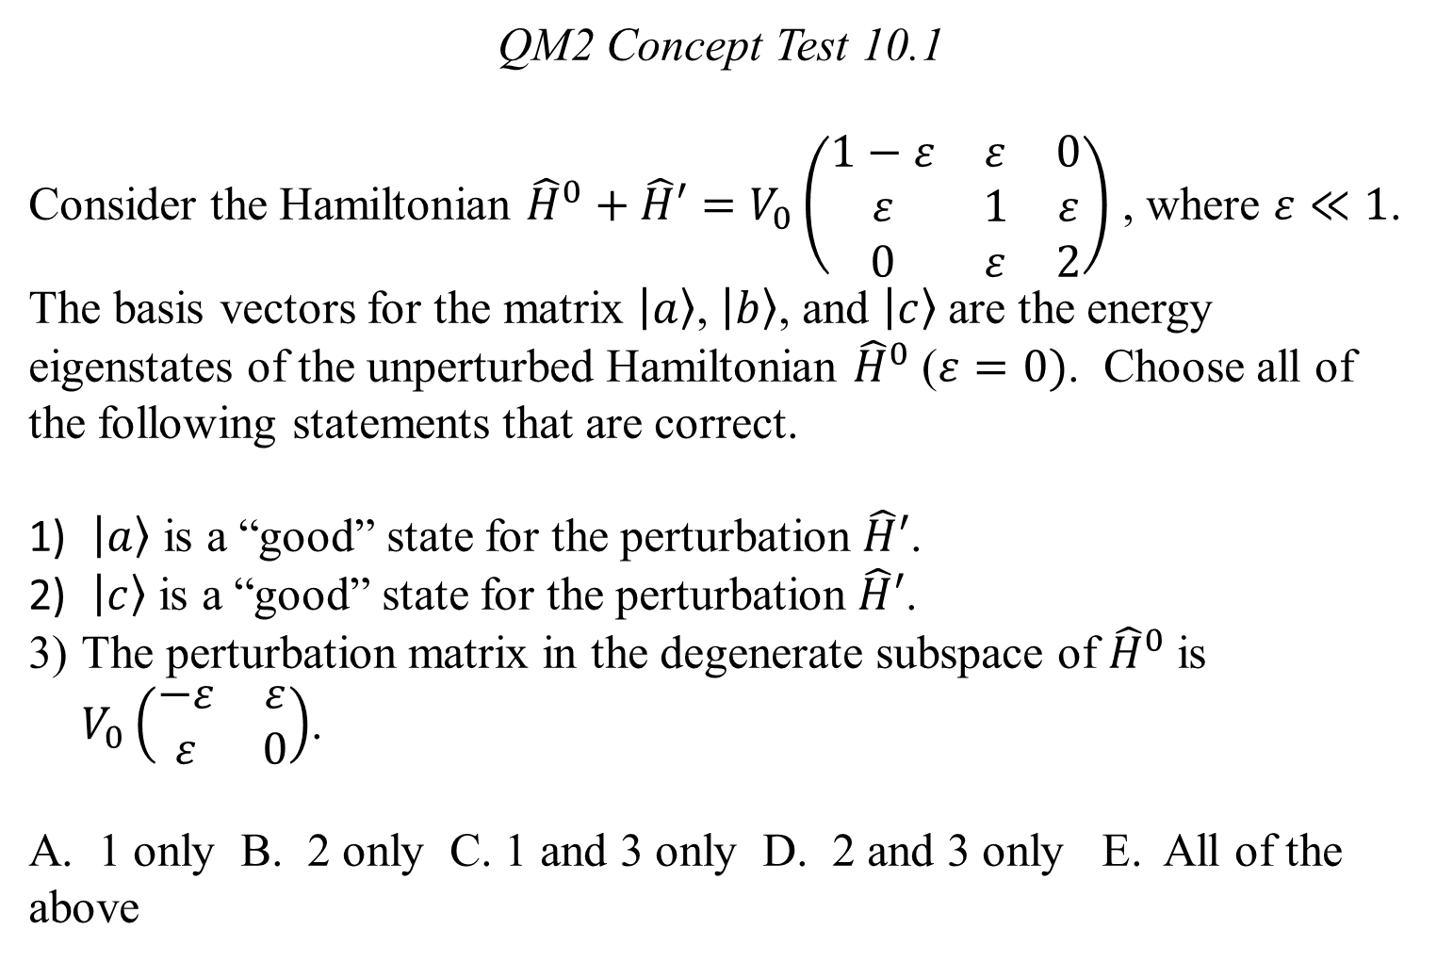
QM2 Concept Test 10.1
Consider the Hamiltonian ${\hat{H}}^{0}+\hat{H}′=V_{0}\left(\begin{matrix}1−ε & ε & 0 \\ ε & 1 & ε \\ 0 & ε & 2\end{matrix}\right)$ , where $ε≪1$. The basis vectors for the matrix $\left.\left|a\right.\right\rangle$, $\left.\left|b\right.\right\rangle$, and $\left.\left|c\right.\right\rangle$ are the energy eigenstates of the unperturbed Hamiltonian ${\hat{H}}^{0}$ ($ε=0)$. Choose all of the following statements that are correct.
$\left.\left|a\right.\right\rangle$ is a “good” state for the perturbation $\hat{H}′$.
$\left.\left|c\right.\right\rangle$ is a “good” state for the perturbation $\hat{H}′$.
The perturbation matrix in the degenerate subspace of ${\hat{H}}^{0}$ is $V_{0}\left(\begin{matrix}−ε & ε \\ ε & 0\end{matrix}\right)$.
A. 1 only B. 2 only C. 1 and 3 only D. 2 and 3 only E. All of the above

Slide 2
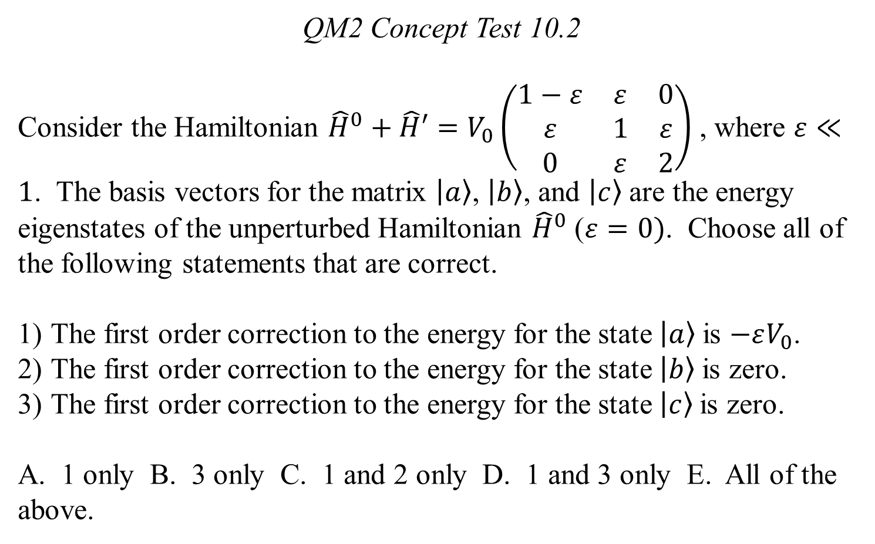
QM2 Concept Test 10.2
Consider the Hamiltonian ${\hat{H}}^{0}+\hat{H}′=V_{0}\left(\begin{matrix}1−ε & ε & 0 \\ ε & 1 & ε \\ 0 & ε & 2\end{matrix}\right)$ , where $ε≪1$. The basis vectors for the matrix $\left.\left|a\right.\right\rangle$, $\left.\left|b\right.\right\rangle$, and $\left.\left|c\right.\right\rangle$ are the energy eigenstates of the unperturbed Hamiltonian ${\hat{H}}^{0}$ ($ε=0)$. Choose all of the following statements that are correct.
The first order correction to the energy for the state $\left.\left|a\right.\right\rangle$is $−εV_{0}$.
The first order correction to the energy for the state $\left.\left|b\right.\right\rangle$is zero.
The first order correction to the energy for the state $\left.\left|c\right.\right\rangle$is zero.
A. 1 only B. 3 only C. 1 and 2 only D. 1 and 3 only E. All of the above.

Slide 3
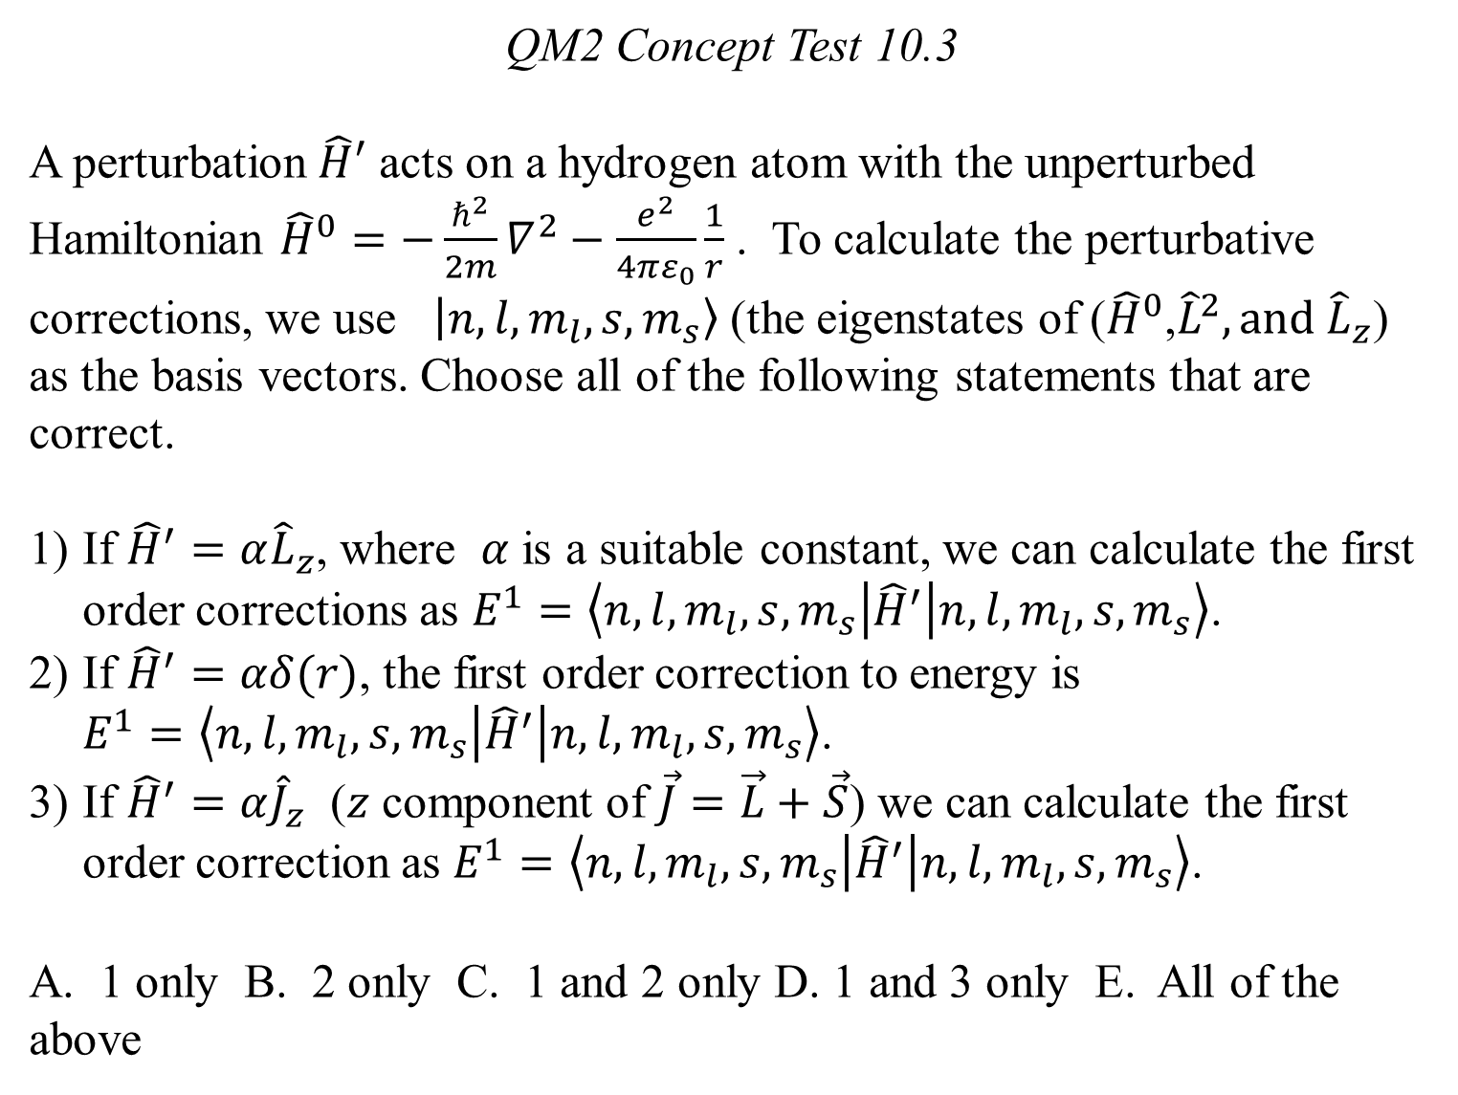
QM2 Concept Test 10.3
A perturbation $\hat{H}′$ acts on a hydrogen atom with the unperturbed Hamiltonian ${\hat{H}}^{0}=−\frac{ℏ^{2}}{2m}∇^{2}−\frac{e^{2}}{4πε_{0}}\frac{1}{r}$ . To calculate the perturbative corrections, we use $\left.\left|n,l,m_{l}, s, m_{s}\right.\right\rangle$ (the eigenstates of (${\hat{H}}^{0}$,${\hat{L}}^{2}, and {\hat{L}}_{z}$) as the basis vectors. Choose all of the following statements that are correct.
If ${\hat{H}}^{′}=α{\hat{L}}_{z}$, where $α$ is a suitable constant, we can calculate the first order corrections as $E^{1}=\left\langle n,l,m_{l}, s, m_{s} | {\hat{H}}^{′} | n,l,m_{l}, s, m_{s}\right\rangle$.
If ${\hat{H}}^{′}=αδ(r)$, the first order correction to energy is $E^{1}=\left\langle n,l,m_{l}, s, m_{s} | {\hat{H}}^{′} | n,l,m_{l}, s, m_{s}\right\rangle$.
If ${\hat{H}}^{′}=α{\hat{J}}_{z}$ ($z$ component of $\vec{J}=\vec{L}+\vec{S}$) we can calculate the first order correction as $E^{1}=\left\langle n,l,m_{l}, s, m_{s} | {\hat{H}}^{′} | n,l,m_{l}, s, m_{s}\right\rangle$.
A. 1 only B. 2 only C. 1 and 2 only D. 1 and 3 only E. All of the above

Slide 4
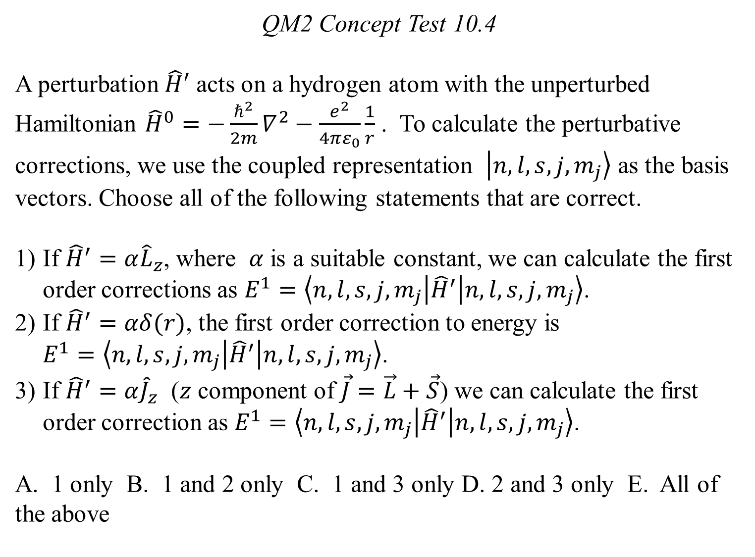
QM2 Concept Test 10.4
A perturbation $\hat{H}′$ acts on a hydrogen atom with the unperturbed Hamiltonian ${\hat{H}}^{0}=−\frac{ℏ^{2}}{2m}∇^{2}−\frac{e^{2}}{4πε_{0}}\frac{1}{r}$ . To calculate the perturbative corrections, we use the coupled representation $\left.\left|n,l,s,j,m_{j}\right.\right\rangle$ as the basis vectors. Choose all of the following statements that are correct.
If ${\hat{H}}^{′}=α{\hat{L}}_{z}$, where $α$ is a suitable constant, we can calculate the first order corrections as $E^{1}=\left\langle n,l,s,j,m_{j} | {\hat{H}}^{′} | n,l,s,j,m_{j}\right\rangle$.
If ${\hat{H}}^{′}=αδ(r)$, the first order correction to energy is $E^{1}=\left\langle n,l,s,j,m_{j} | {\hat{H}}^{′} | n,l,s,j,m_{j}\right\rangle$.
If ${\hat{H}}^{′}=α{\hat{J}}_{z}$ ($z$ component of $\vec{J}=\vec{L}+\vec{S}$) we can calculate the first order correction as $E^{1}=\left\langle n,l,s,j,m_{j} | {\hat{H}}^{′} | n,l,s,j,m_{j}\right\rangle$.
A. 1 only B. 1 and 2 only C. 1 and 3 only D. 2 and 3 only E. All of the above

Slide 5
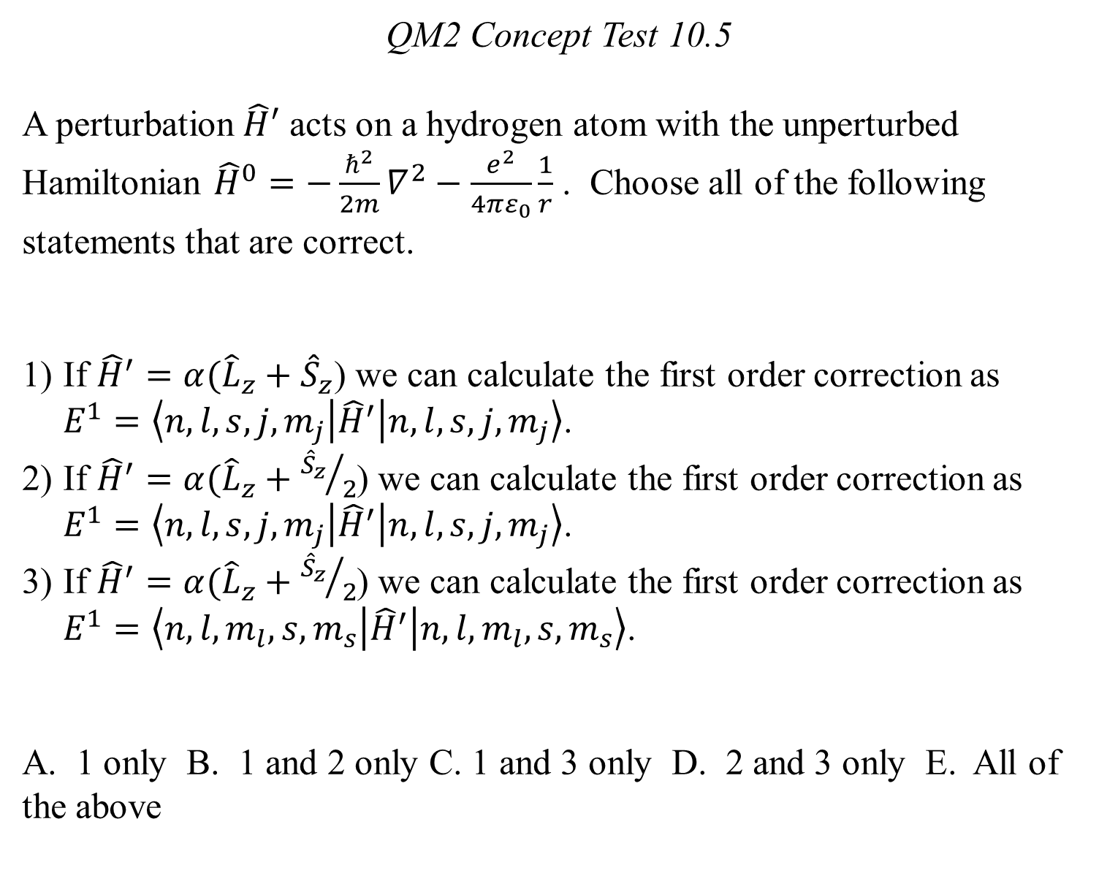
QM2 Concept Test 10.5
A perturbation $\hat{H}′$ acts on a hydrogen atom with the unperturbed Hamiltonian ${\hat{H}}^{0}=−\frac{ℏ^{2}}{2m}∇^{2}−\frac{e^{2}}{4πε_{0}}\frac{1}{r}$ . Choose all of the following statements that are correct.
If ${\hat{H}}^{′}=α({\hat{L}}_{z}+{\hat{S}}_{z}$) we can calculate the first order correction as $E^{1}=\left\langle n,l,s,j,m_{j} | {\hat{H}}^{′} | n,l,s,j,m_{j}\right\rangle$.
If ${\hat{H}}^{′}=α({\hat{L}}_{z}+{{\hat{S}}_{z}}/2$) we can calculate the first order correction as $E^{1}=\left\langle n,l,s,j,m_{j} | {\hat{H}}^{′} | n,l,s,j,m_{j}\right\rangle$.
If ${\hat{H}}^{′}=α({\hat{L}}_{z}+{{\hat{S}}_{z}}/2$) we can calculate the first order correction as $E^{1}=\left\langle n,l,m_{l}, s, m_{s} | {\hat{H}}^{′} | n,l,m_{l}, s, m_{s}\right\rangle$.
A. 1 only B. 1 and 2 only C. 1 and 3 only D. 2 and 3 only E. All of the above

Slide 6
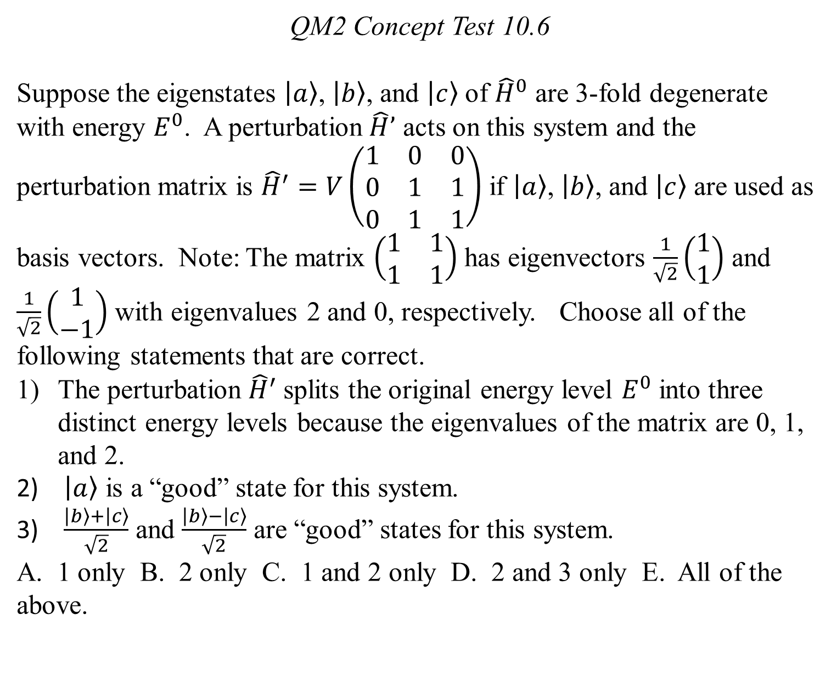
QM2 Concept Test 10.6
Suppose the eigenstates $\left.\left|a\right.\right\rangle$, $\left.\left|b\right.\right\rangle$, and $\left.\left|c\right.\right\rangle$ of ${\hat{H}}^{0}$ are 3-fold degenerate with energy $E^{0}$. A perturbation $\hat{H}’$ acts on this system and the perturbation matrix is ${\hat{H}}^{′}=V\left(\begin{matrix}1 & 0 & 0 \\ 0 & 1 & 1 \\ 0 & 1 & 1\end{matrix}\right)$ if $\left.\left|a\right.\right\rangle$, $\left.\left|b\right.\right\rangle$, and $\left.\left|c\right.\right\rangle$ are used as basis vectors. Note: The matrix $\left(\begin{matrix}1 & 1 \\ 1 & 1\end{matrix}\right)$ has eigenvectors $\frac{1}{\sqrt{2}}\left(\begin{matrix}1 \\ 1\end{matrix}\right)$ and $\frac{1}{\sqrt{2}}\left(\begin{matrix}1 \\ −1\end{matrix}\right)$ with eigenvalues 2 and 0, respectively. Choose all of the following statements that are correct.
The perturbation ${\hat{H}}^{′}$splits the original energy level $E^{0}$ into three distinct energy levels because the eigenvalues of the matrix are 0, 1, and 2.
$\left.\left|a\right.\right\rangle$ is a “good” state for this system.
$\frac{\left.\left|b\right.\right\rangle +\left.\left|c\right.\right\rangle }{\sqrt{2}}$ and $\frac{\left.\left|b\right.\right\rangle −\left.\left|c\right.\right\rangle }{\sqrt{2}}$ are “good” states for this system.
A. 1 only B. 2 only C. 1 and 2 only D. 2 and 3 only E. All of the above.

Slide 7
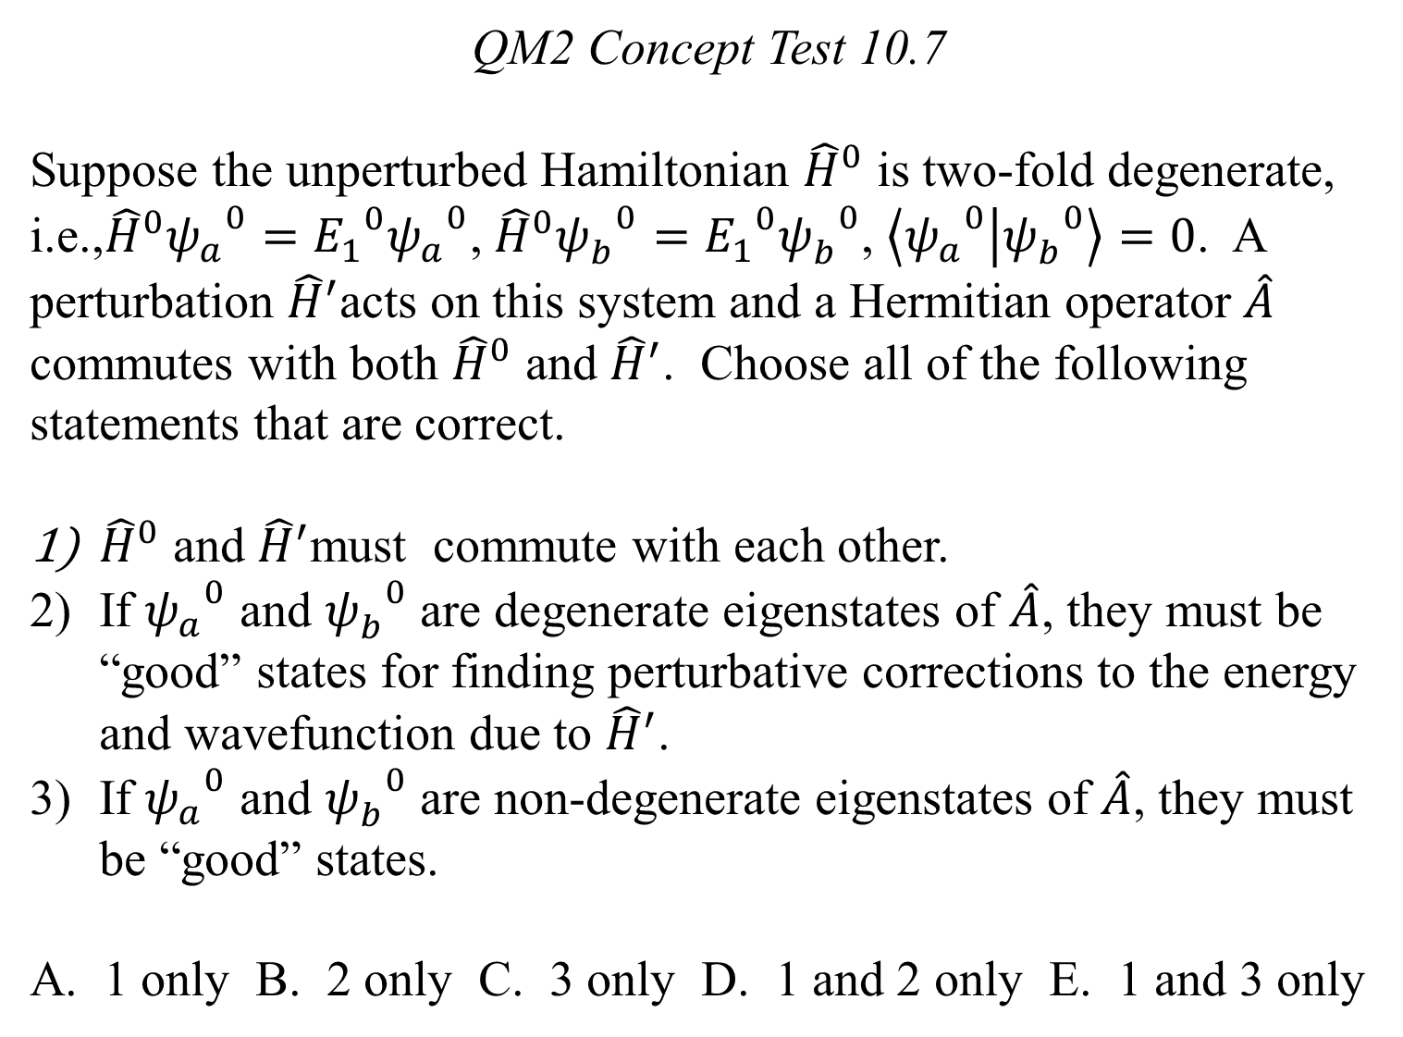
QM2 Concept Test 10.7
Suppose the unperturbed Hamiltonian ${\hat{H}}^{0}$ is two-fold degenerate, i.e.,${\hat{H}}^{0}{ψ_{a}^{}}^{0}={E_{1}}^{0}{ψ_{a}^{}}^{0}$, ${\hat{H}}^{0}{ψ_{b}^{}}^{0}={E_{1}}^{0}{ψ_{b}^{}}^{0}$, $\left\langle {ψ_{a}^{}}^{0} | {ψ_{b}^{}}^{0}\right\rangle =0$. A perturbation ${\hat{H}}^{′}$acts on this system and a Hermitian operator $\hat{A}$ commutes with both ${\hat{H}}^{0}$ and ${\hat{H}}^{′}$. Choose all of the following statements that are correct.
${\hat{H}}^{0}$ and ${\hat{H}}^{′}$must commute with each other.
If ${ψ_{a}^{}}^{0}$ and ${ψ_{b}^{}}^{0}$ are degenerate eigenstates of $\hat{A}$, they must be “good” states for finding perturbative corrections to the energy and wavefunction due to ${\hat{H}}^{′}$.
If ${ψ_{a}^{}}^{0}$ and ${ψ_{b}^{}}^{0}$ are non-degenerate eigenstates of $\hat{A}$, they must be “good” states.
A. 1 only B. 2 only C. 3 only D. 1 and 2 only E. 1 and 3 only

