Slide 1
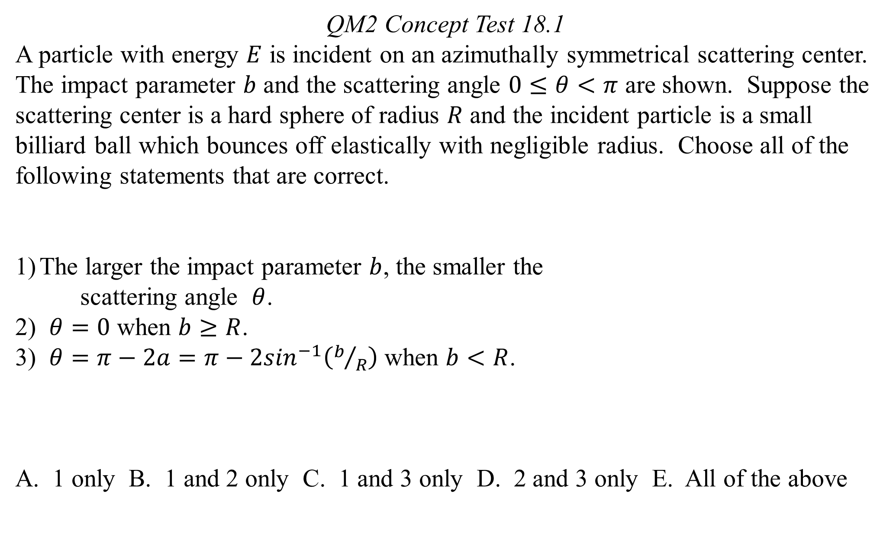
QM2 Concept Test 18.1
A particle with energy $E$ is incident on an azimuthally symmetrical scattering center. The impact parameter $b$ and the scattering angle $0≤θ<π$ are shown. Suppose the scattering center is a hard sphere of radius $R$ and the incident particle is a small billiard ball which bounces off elastically with negligible radius. Choose all of the following statements that are correct.
The larger the impact parameter $b$, the smaller the
scattering angle $θ$.
2) $θ=0$ when $b≥R$.
3) $θ=π−2a=π−2\sin^{−1}\left(b/R\right)$ when $b<R$.
A. 1 only B. 1 and 2 only C. 1 and 3 only D. 2 and 3 only E. All of the above

Slide 2
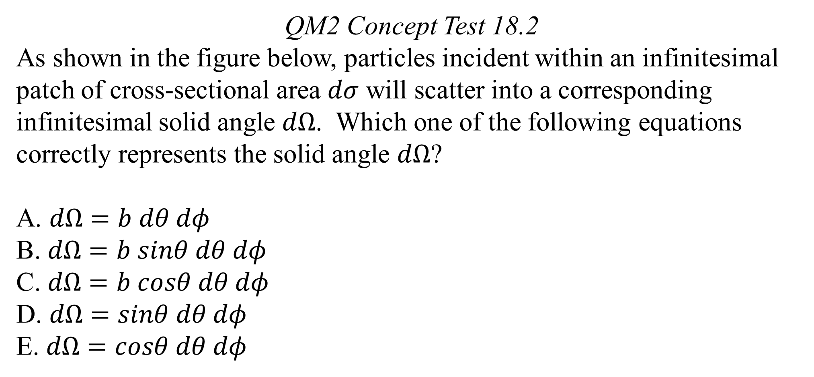
QM2 Concept Test 18.2
As shown in the figure below, particles incident within an infinitesimal patch of cross-sectional area $dσ$ will scatter into a corresponding infinitesimal solid angle $dΩ$. Which one of the following equations correctly represents the solid angle $dΩ$?
A. $dΩ=b dθ dφ$
B. $dΩ=b sinθ dθ dφ$
C. $dΩ=b cosθ dθ dφ$
D. $dΩ=sinθ dθ dφ$
E. $dΩ=cosθ dθ dφ$

Slide 3
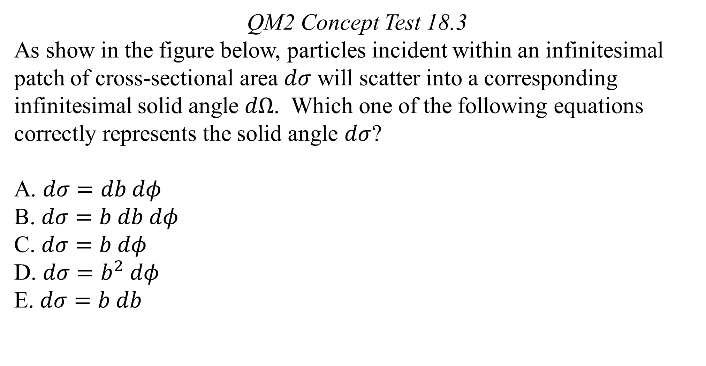
QM2 Concept Test 18.3
As show in the figure below, particles incident within an infinitesimal patch of cross-sectional area $dσ$ will scatter into a corresponding infinitesimal solid angle $dΩ$. Which one of the following equations correctly represents the solid angle $dσ$?
$dσ=db dφ$
$dσ=b db dφ$
$dσ=b dφ$
$dσ=b^{2} dφ$
$dσ=b db$

Slide 4
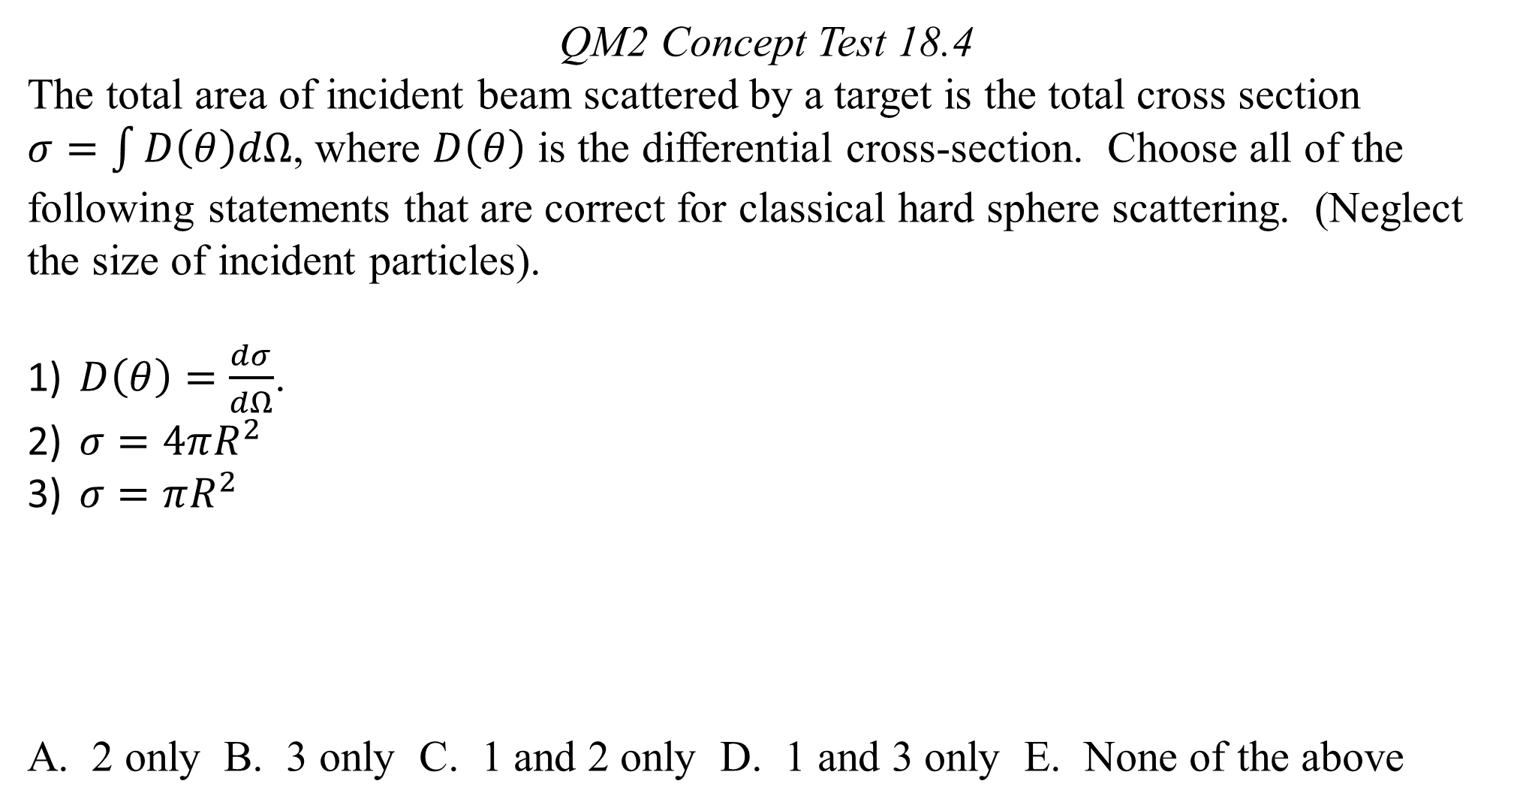
QM2 Concept Test 18.4
The total area of incident beam scattered by a target is the total cross section
$σ=\int{D\left(θ\right)dΩ}$, where $D\left(θ\right)$ is the differential cross-section. Choose all of the following statements that are correct for classical hard sphere scattering. (Neglect the size of incident particles).
$D\left(θ\right)=\frac{dσ}{dΩ}$.
$σ=4πR^{2}$
$σ=πR^{2}$
A. 2 only B. 3 only C. 1 and 2 only D. 1 and 3 only E. None of the above

Slide 5
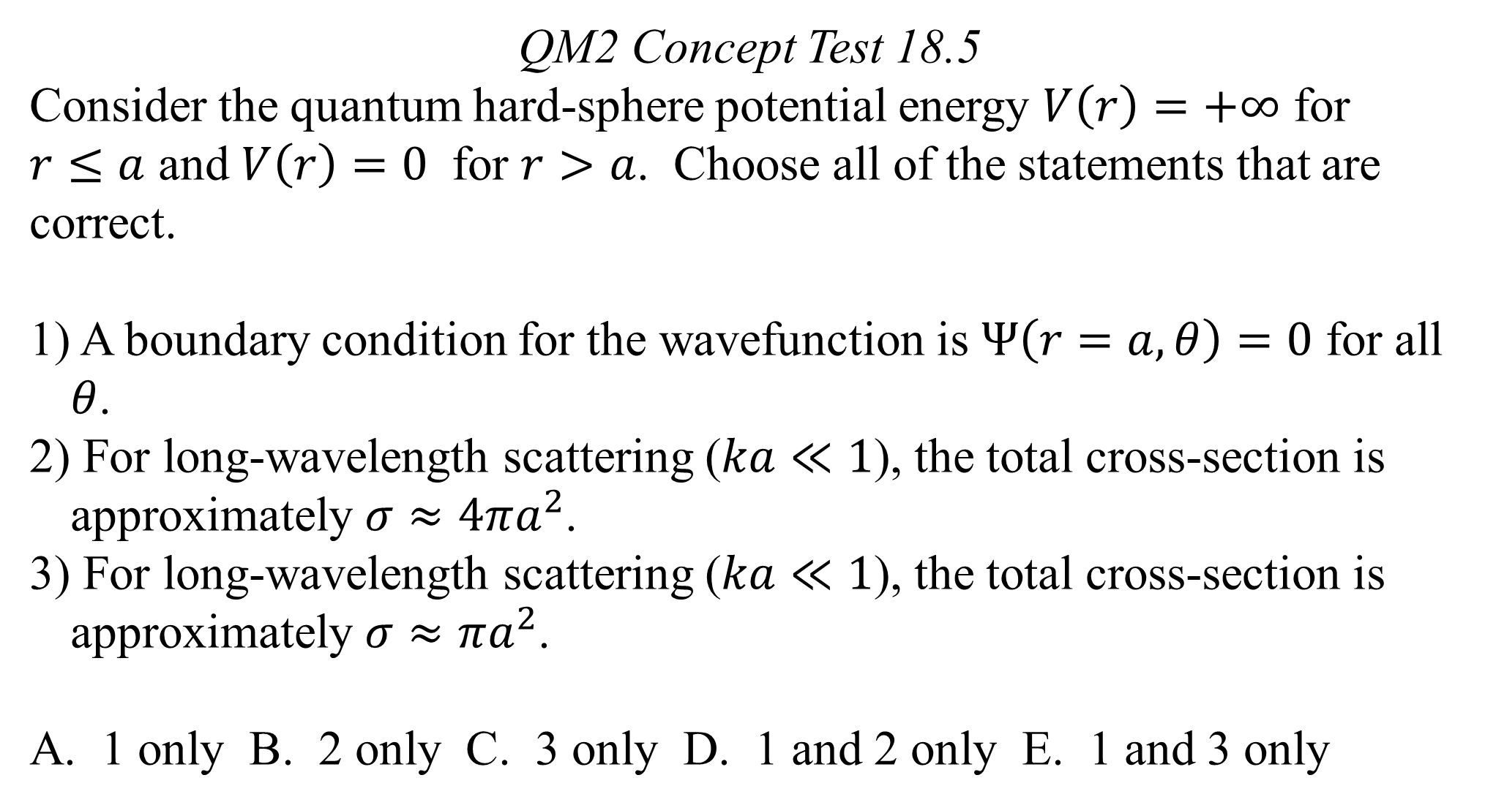
QM2 Concept Test 18.5
Consider the quantum hard-sphere potential energy $V\left(r\right)=+∞$ for
$r≤a$ and $V\left(r\right)=0$ for $r>a$. Choose all of the statements that are correct.
A boundary condition for the wavefunction is $Ψ\left(r=a, θ\right)=0$ for all $θ$.
For long-wavelength scattering ($ka≪1$), the total cross-section is approximately $σ≈4πa^{2}$.
For long-wavelength scattering ($ka≪1$), the total cross-section is approximately $σ≈πa^{2}$.
A. 1 only B. 2 only C. 3 only D. 1 and 2 only E. 1 and 3 only

Slide 6
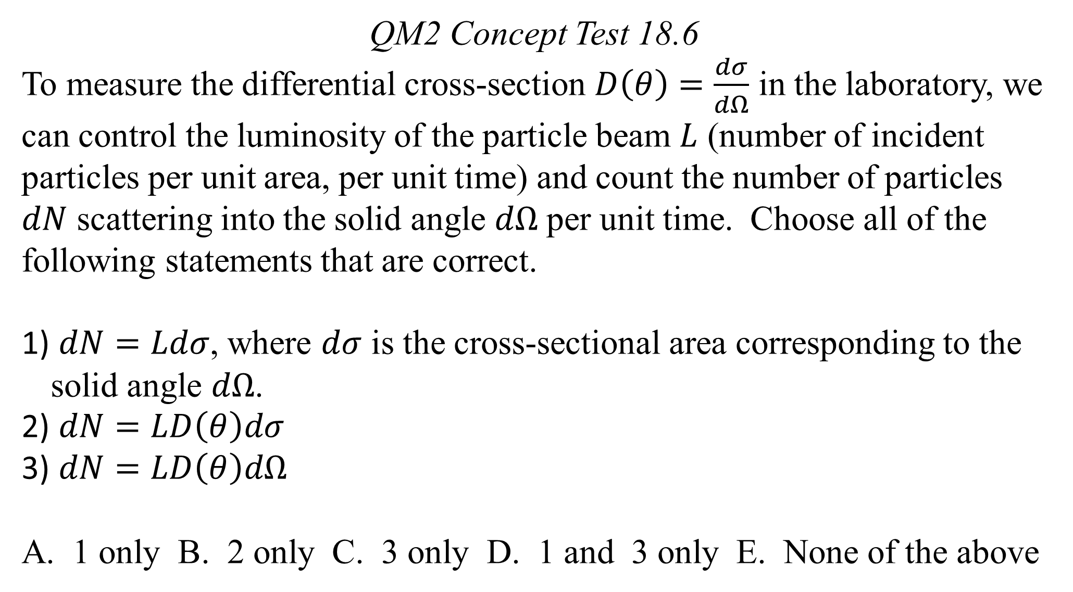
QM2 Concept Test 18.6
To measure the differential cross-section $D\left(θ\right)=\frac{dσ}{dΩ}$ in the laboratory, we can control the luminosity of the particle beam $L$ (number of incident particles per unit area, per unit time) and count the number of particles $dN$ scattering into the solid angle $dΩ$ per unit time. Choose all of the following statements that are correct.
$dN=Ldσ$, where $dσ$ is the cross-sectional area corresponding to the solid angle $dΩ$.
$dN=LD\left(θ\right)dσ$
$dN=LD\left(θ\right)dΩ$
A. 1 only B. 2 only C. 3 only D. 1 and 3 only E. None of the above

Slide 7
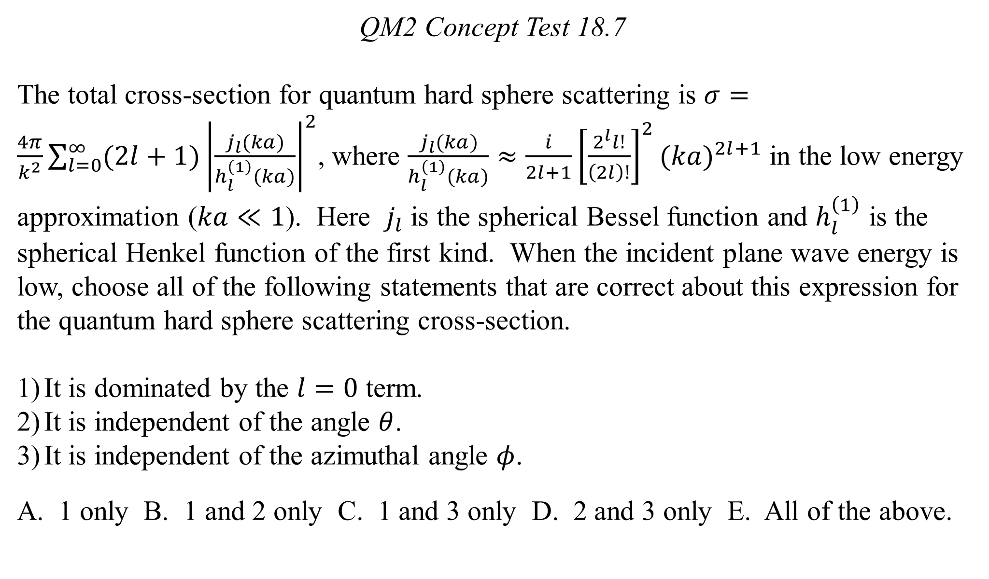
QM2 Concept Test 18.7
The total cross-section for quantum hard sphere scattering is $σ=\frac{4π}{k^{2}}\sum_{l=0}^{∞}{(2l+1){\left|\frac{j_{l}(ka)}{h_{l}^{\left(1\right)}(ka)}\right|}^{2}}$, where $\frac{j_{l}(ka)}{h_{l}^{\left(1\right)}(ka)}≈\frac{i}{2l+1}{\left[\frac{2^{l}l!}{\left(2l\right)!}\right]}^{2}{(ka)}^{2l+1}$ in the low energy approximation ($ka≪1$). Here $j_{l}$ is the spherical Bessel function and $h_{l}^{\left(1\right)}$ is the spherical Henkel function of the first kind. When the incident plane wave energy is low, choose all of the following statements that are correct about this expression for the quantum hard sphere scattering cross-section.
It is dominated by the $l=0$ term.
It is independent of the angle $θ$.
It is independent of the azimuthal angle $φ$.
A. 1 only B. 1 and 2 only C. 1 and 3 only D. 2 and 3 only E. All of the above.

