Slide 1
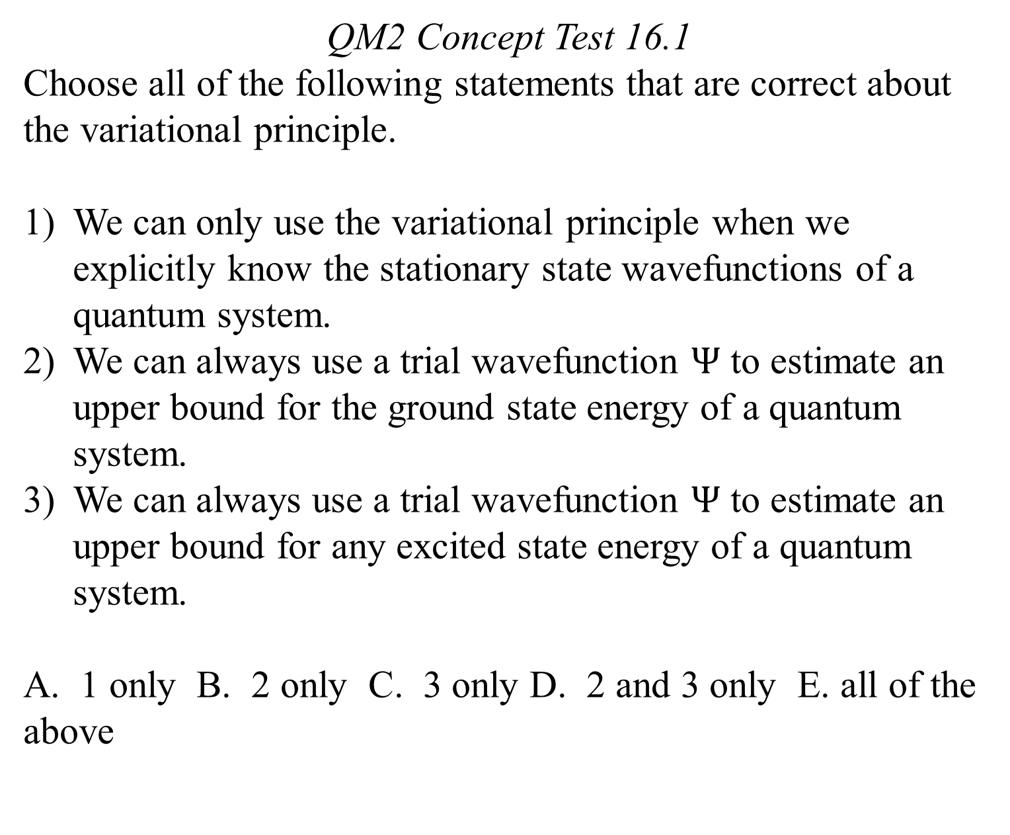
QM2 Concept Test 16.1
Choose all of the following statements that are correct about the variational principle.
We can only use the variational principle when we explicitly know the stationary state wavefunctions of a quantum system.
We can always use a trial wavefunction $Ψ$ to estimate an upper bound for the ground state energy of a quantum system.
We can always use a trial wavefunction $Ψ$ to estimate an upper bound for any excited state energy of a quantum system.
A. 1 only B. 2 only C. 3 only D. 2 and 3 only E. all of the above

Slide 2
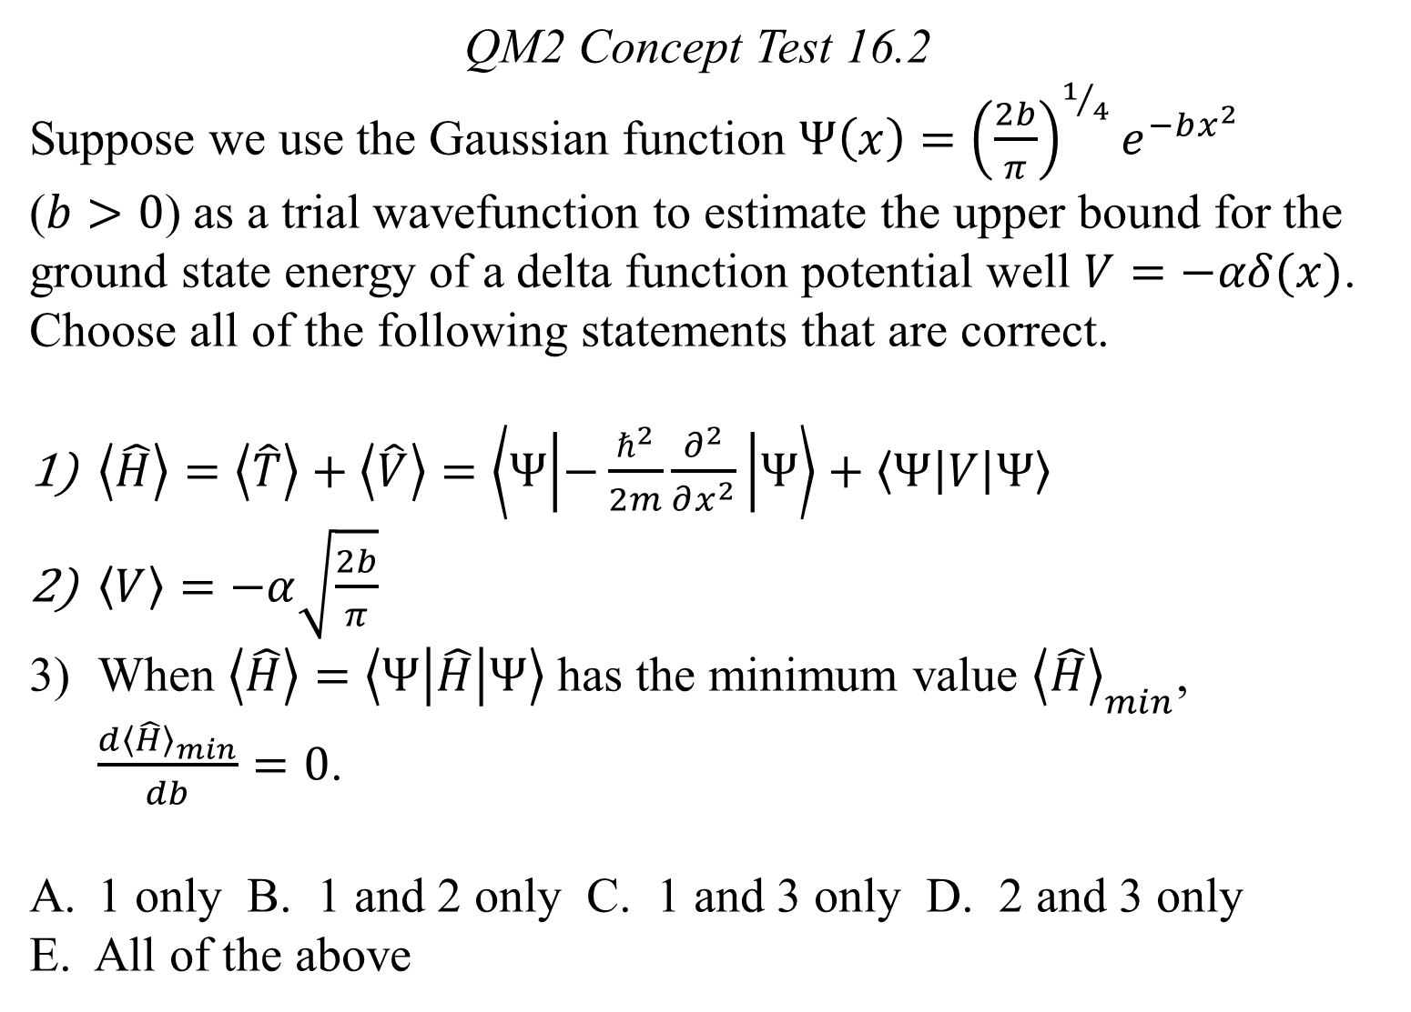
QM2 Concept Test 16.2
Suppose we use the Gaussian function $Ψ\left(x\right)={\left(\frac{2b}{π}\right)}^{1/4}e^{−bx^{2}}$ ($b>0$) as a trial wavefunction to estimate the upper bound for the ground state energy of a delta function potential well $V=−αδ(x)$. Choose all of the following statements that are correct.
$\left\langle \hat{H}\right\rangle =\left\langle \hat{T}\right\rangle +\left\langle \hat{V}\right\rangle =\left\langle Ψ | −\frac{ℏ^{2}}{2m}\frac{∂^{2}}{∂x^{2}} | Ψ\right\rangle +\left\langle Ψ | V | Ψ\right\rangle$
$\left\langle V\right\rangle =−α\sqrt{\frac{2b}{π}}$
When $\left\langle \hat{H}\right\rangle =\left\langle Ψ | \hat{H} | Ψ\right\rangle$ has the minimum value ${\left\langle \hat{H}\right\rangle }_{min}$, $\frac{d{\left\langle \hat{H}\right\rangle }_{min}}{db}=0$.
1 only B. 1 and 2 only C. 1 and 3 only D. 2 and 3 only
E. All of the above

Slide 3
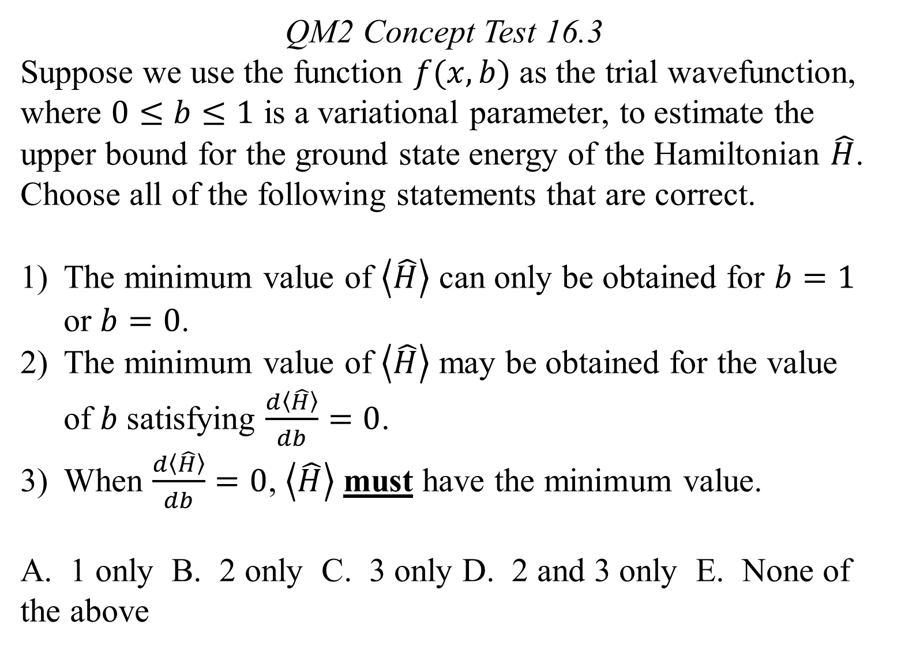
QM2 Concept Test 16.3
Suppose we use the function $f(x, b)$ as the trial wavefunction, where $0≤b≤1$ is a variational parameter, to estimate the upper bound for the ground state energy of the Hamiltonian $\hat{H}$. Choose all of the following statements that are correct.
The minimum value of $\left\langle \hat{H}\right\rangle$ can only be obtained for $b=1$ or $b=0$.
The minimum value of $\left\langle \hat{H}\right\rangle$ may be obtained for the value of $b$satisfying $\frac{d\left\langle \hat{H}\right\rangle }{db}=0$.
When $\frac{d\left\langle \hat{H}\right\rangle }{db}=0$, $\left\langle \hat{H}\right\rangle$ must have the minimum value.
A. 1 only B. 2 only C. 3 only D. 2 and 3 only E. None of the above

Slide 4
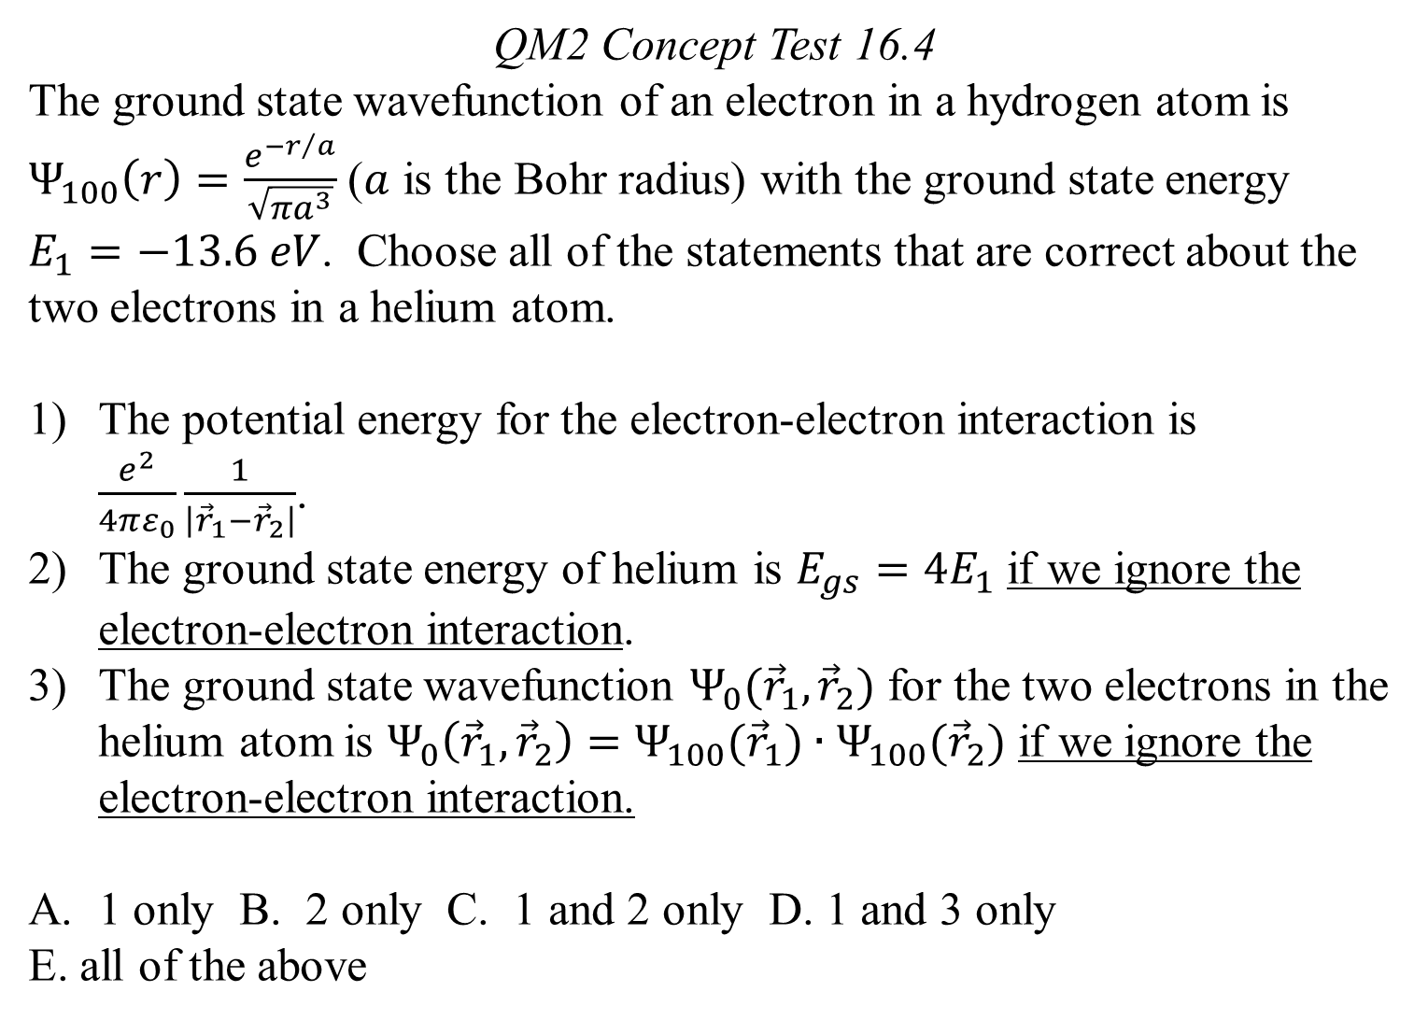
QM2 Concept Test 16.4
The ground state wavefunction of an electron in a hydrogen atom is $Ψ_{100}\left(r\right)=\frac{e^{{−r}/a}}{\sqrt{πa^{3}}}$ ($a$ is the Bohr radius) with the ground state energy $E_{1}=−13.6 eV$. Choose all of the statements that are correct about the two electrons in a helium atom.
The potential energy for the electron-electron interaction is $\frac{e^{2}}{4πε_{0}}\frac{1}{\left|{\vec{r}}_{1}−{\vec{r}}_{2}\right|}$.
The ground state energy of helium is $E_{gs}=4E_{1}$ if we ignore the electron-electron interaction.
The ground state wavefunction $Ψ_{0}({\vec{r}}_{1},{\vec{r}}_{2})$ for the two electrons in the helium atom is $Ψ_{0}\left({\vec{r}}_{1},{\vec{r}}_{2}\right)=Ψ_{100}({\vec{r}}_{1})∙Ψ_{100}({\vec{r}}_{2})$ if we ignore the electron-electron interaction.
1 only B. 2 only C. 1 and 2 only D. 1 and 3 only
E. all of the above

Slide 5
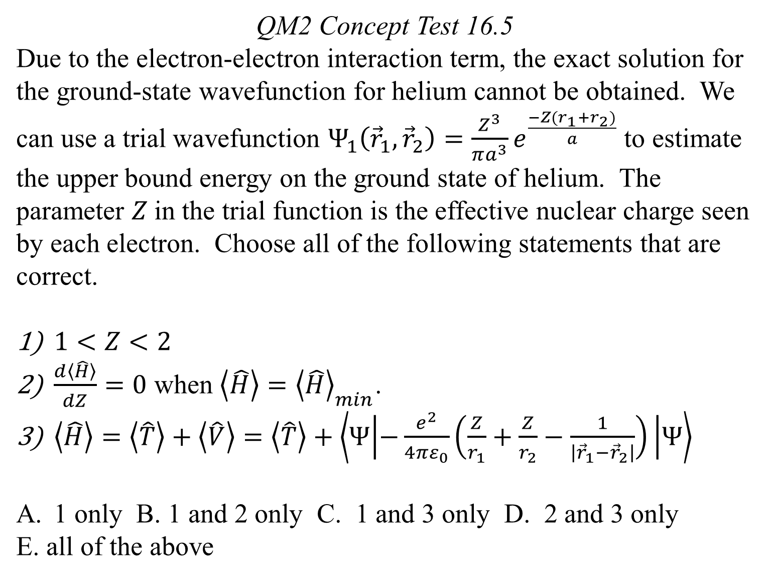
QM2 Concept Test 16.5
Due to the electron-electron interaction term, the exact solution for the ground-state wavefunction for helium cannot be obtained. We can use a trial wavefunction $Ψ_{1}\left({\vec{r}}_{1},{\vec{r}}_{2}\right)=\frac{Z^{3}}{πa^{3}}e^{\frac{−Z(r_{1}+r_{2})}{a}}$ to estimate the upper bound energy on the ground state of helium. The parameter $Z$in the trial function is the effective nuclear charge seen by each electron. Choose all of the following statements that are correct.
$1<Z<2$
$\frac{d\left\langle \hat{H}\right\rangle }{dZ}=0$ when $\left\langle \hat{H}\right\rangle ={\left\langle \hat{H}\right\rangle }_{min}$.
$\left\langle \hat{H}\right\rangle =\left\langle \hat{T}\right\rangle +\left\langle \hat{V}\right\rangle =\left\langle \hat{T}\right\rangle +\left\langle Ψ | −\frac{e^{2}}{4πε_{0}}\left(\frac{Z}{r_{1}}+\frac{Z}{r_{2}}−\frac{1}{\left|{\vec{r}}_{1}−{\vec{r}}_{2}\right|}\right) | Ψ\right\rangle$
1 only B. 1 and 2 only C. 1 and 3 only D. 2 and 3 only
E. all of the above

