Slide 1
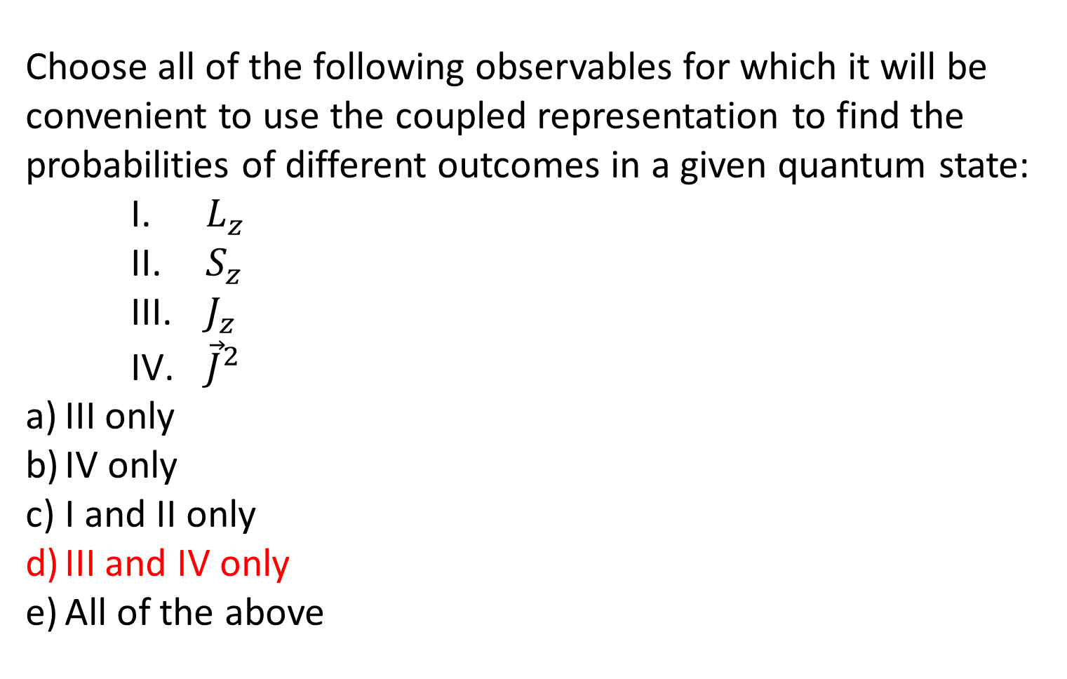
Choose all of the following observables for which it will be convenient to use the coupled representation to find the probabilities of different outcomes in a given quantum state:
    $L_{z}$
    $S_{z}$
    $J_{z}$
    ${\vec{J}}^{2}$
III only
IV only
I and II only
III and IV only
All of the above

Slide 2
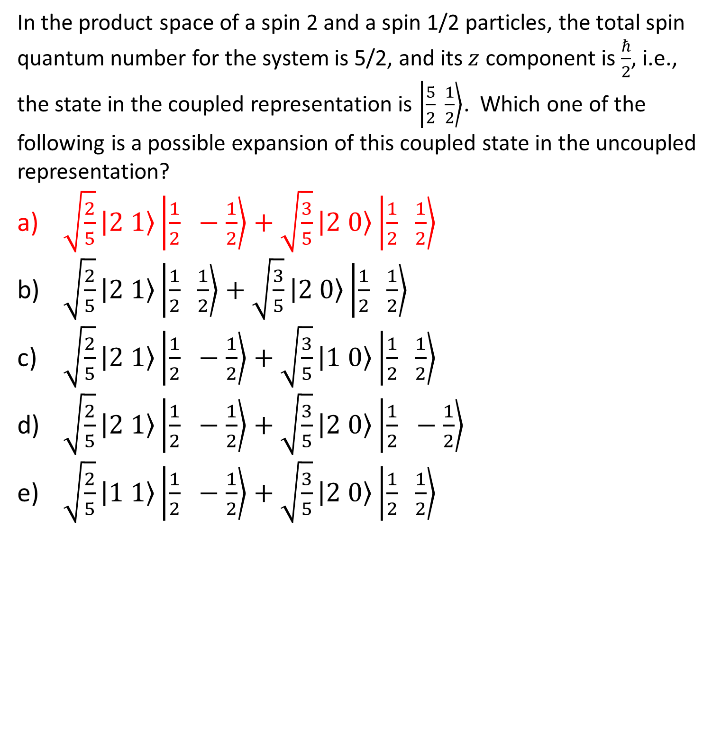
In the product space of a spin 2 and a spin 1/2 particles, the total spin quantum number for the system is 5/2, and its $z$ component is $\frac{ℏ}{2}$, i.e., the state in the coupled representation is $\left.\left|\frac{5}{2} \frac{1}{2}\right.\right\rangle$. Which one of the following is a possible expansion of this coupled state in the uncoupled representation?
$\sqrt{\frac{2}{5}}\left.\left|2 1\right.\right\rangle \left.\left|\frac{1}{2} −\frac{1}{2}\right.\right\rangle +\sqrt{\frac{3}{5}}\left.\left|2 0\right.\right\rangle \left.\left|\frac{1}{2} \frac{1}{2}\right.\right\rangle$
$\sqrt{\frac{2}{5}}\left.\left|2 1\right.\right\rangle \left.\left|\frac{1}{2} \frac{1}{2}\right.\right\rangle +\sqrt{\frac{3}{5}}\left.\left|2 0\right.\right\rangle \left.\left|\frac{1}{2} \frac{1}{2}\right.\right\rangle$
$\sqrt{\frac{2}{5}}\left.\left|2 1\right.\right\rangle \left.\left|\frac{1}{2} −\frac{1}{2}\right.\right\rangle +\sqrt{\frac{3}{5}}\left.\left|1 0\right.\right\rangle \left.\left|\frac{1}{2} \frac{1}{2}\right.\right\rangle$
$\sqrt{\frac{2}{5}}\left.\left|2 1\right.\right\rangle \left.\left|\frac{1}{2} −\frac{1}{2}\right.\right\rangle +\sqrt{\frac{3}{5}}\left.\left|2 0\right.\right\rangle \left.\left|\frac{1}{2} −\frac{1}{2}\right.\right\rangle$
$\sqrt{\frac{2}{5}}\left.\left|1 1\right.\right\rangle \left.\left|\frac{1}{2} −\frac{1}{2}\right.\right\rangle +\sqrt{\frac{3}{5}}\left.\left|2 0\right.\right\rangle \left.\left|\frac{1}{2} \frac{1}{2}\right.\right\rangle$

Slide 3
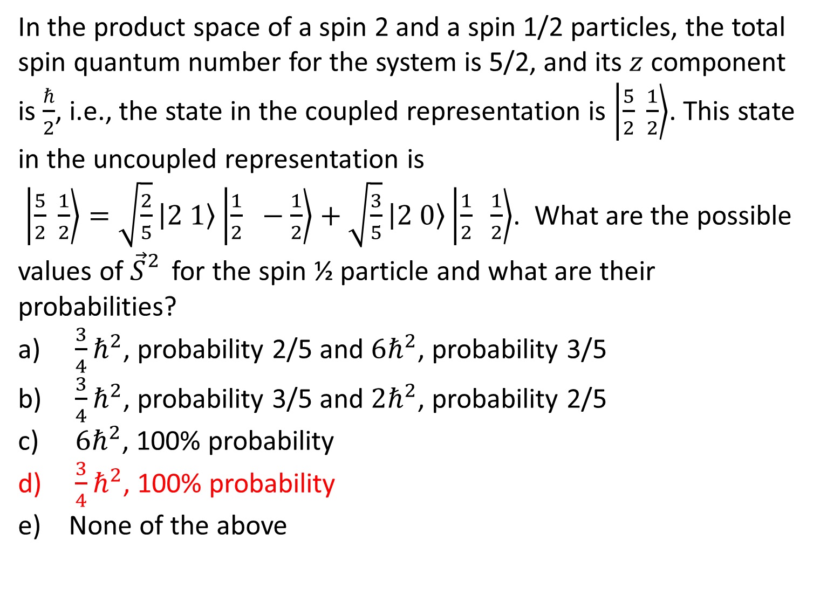
In the product space of a spin 2 and a spin 1/2 particles, the total spin quantum number for the system is 5/2, and its $z$ component is $\frac{ℏ}{2}$, i.e., the state in the coupled representation is $\left.\left|\frac{5}{2} \frac{1}{2}\right.\right\rangle$. This state in the uncoupled representation is
$\left.\left|\frac{5}{2} \frac{1}{2}\right.\right\rangle =\sqrt{\frac{2}{5}}\left.\left|2 1\right.\right\rangle \left.\left|\frac{1}{2} −\frac{1}{2}\right.\right\rangle +\sqrt{\frac{3}{5}}\left.\left|2 0\right.\right\rangle \left.\left|\frac{1}{2} \frac{1}{2}\right.\right\rangle$. What are the possible values of ${\vec{S}}_{}^{2}$ for the spin ½ particle and what are their probabilities?
$\frac{3}{4}ℏ^{2}$, probability 2/5 and $6ℏ^{2}$, probability 3/5
$\frac{3}{4}ℏ^{2}$, probability 3/5 and $2ℏ^{2}$, probability 2/5
$6ℏ^{2}$, 100% probability
$\frac{3}{4}ℏ^{2}$, 100% probability
None of the above

Slide 4
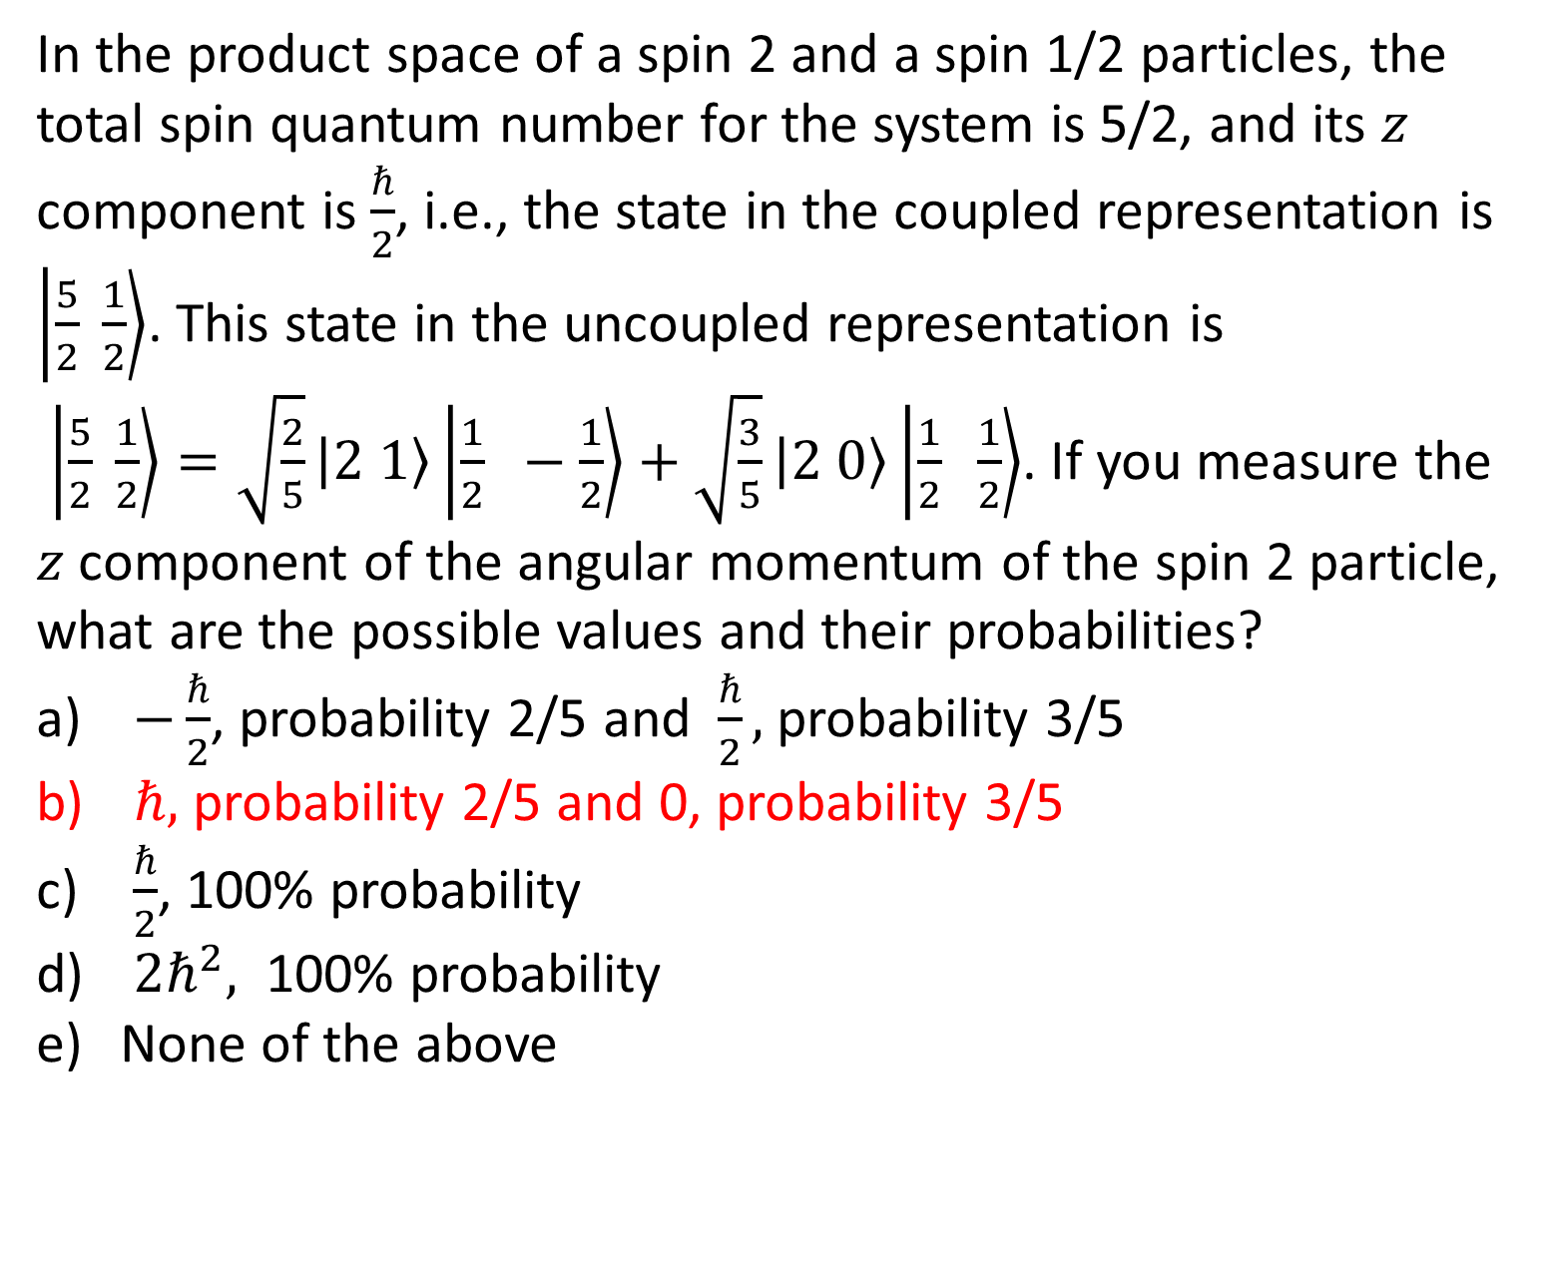
In the product space of a spin 2 and a spin 1/2 particles, the total spin quantum number for the system is 5/2, and its $z$ component is $\frac{ℏ}{2}$, i.e., the state in the coupled representation is $\left.\left|\frac{5}{2} \frac{1}{2}\right.\right\rangle$. This state in the uncoupled representation is
$\left.\left|\frac{5}{2} \frac{1}{2}\right.\right\rangle =\sqrt{\frac{2}{5}}\left.\left|2 1\right.\right\rangle \left.\left|\frac{1}{2} −\frac{1}{2}\right.\right\rangle +\sqrt{\frac{3}{5}}\left.\left|2 0\right.\right\rangle \left.\left|\frac{1}{2} \frac{1}{2}\right.\right\rangle$. If you measure the $z$ component of the angular momentum of the spin 2 particle, what are the possible values and their probabilities?
$−\frac{ℏ}{2}$, probability 2/5 and $\frac{ℏ}{2},$probability 3/5
$ℏ,$ probability 2/5 and 0, probability 3/5
$\frac{ℏ}{2}$, 100% probability
$2ℏ^{2},$ 100% probability
None of the above

Slide 5
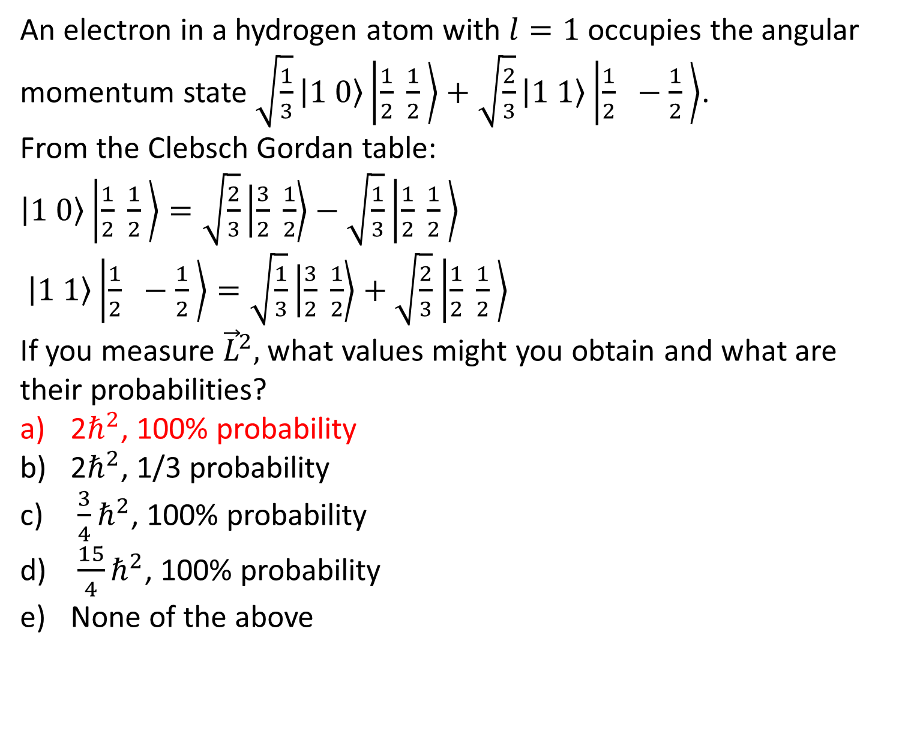
An electron in a hydrogen atom with $l=1$ occupies the angular momentum state $\sqrt{\frac{1}{3}}\left.\left|1 0\right.\right\rangle \left.\left|\frac{1}{2}\right. \frac{1}{2} \right\rangle +\sqrt{\frac{2}{3}}\left.\left|1 1\right.\right\rangle \left.\left|\frac{1}{2}\right. −\frac{1}{2} \right\rangle$.
From the Clebsch Gordan table:
$\left.\left|1 0\right.\right\rangle \left.\left|\frac{1}{2}\right. \frac{1}{2} \right\rangle =\sqrt{\frac{2}{3}}\left.\left|\frac{3}{2} \right.\frac{1}{2}\right\rangle −\sqrt{\frac{1}{3}}\left.\left|\frac{1}{2}\right. \frac{1}{2} \right\rangle$
$\left.\left|1 1\right.\right\rangle \left.\left|\frac{1}{2}\right. −\frac{1}{2} \right\rangle =\sqrt{\frac{1}{3}}\left.\left|\frac{3}{2} \right.\frac{1}{2}\right\rangle +\sqrt{\frac{2}{3}}$ $\left.\left|\frac{1}{2}\right. \frac{1}{2} \right\rangle$
If you measure ${\vec{L}}^{2},$ what values might you obtain and what are their probabilities?
2$ℏ^{2}$, 100% probability
2$ℏ^{2}$, 1/3 probability
$\frac{3}{4}ℏ^{2}$, 100% probability
$\frac{15}{4}ℏ^{2}$, 100% probability
None of the above

Slide 6
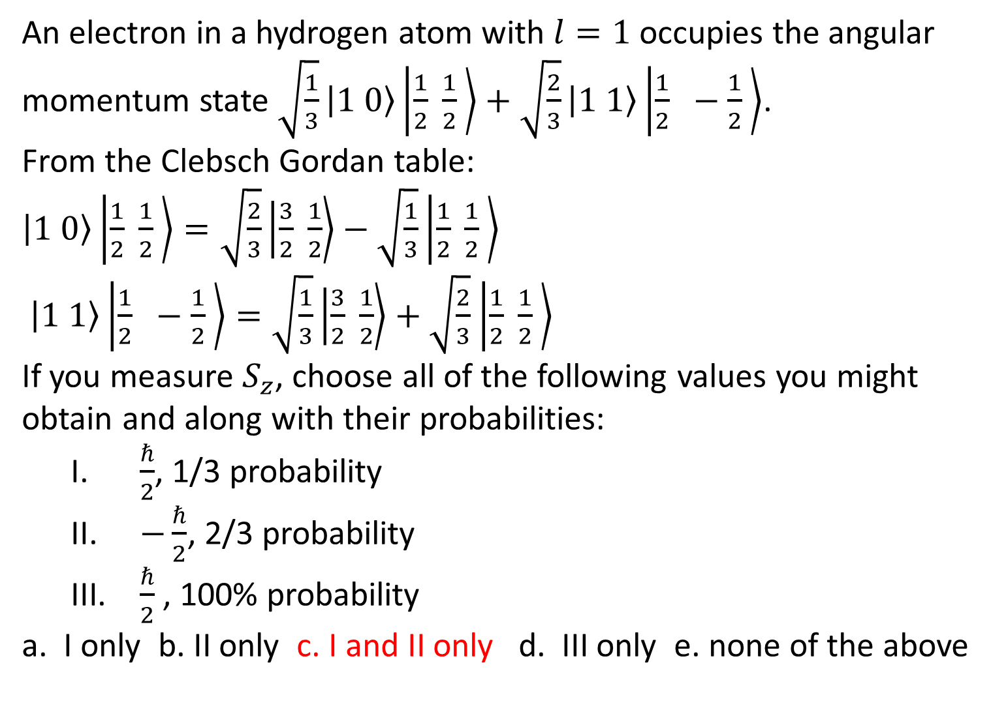
An electron in a hydrogen atom with $l=1$ occupies the angular momentum state $\sqrt{\frac{1}{3}}\left.\left|1 0\right.\right\rangle \left.\left|\frac{1}{2}\right. \frac{1}{2} \right\rangle +\sqrt{\frac{2}{3}}\left.\left|1 1\right.\right\rangle \left.\left|\frac{1}{2}\right. −\frac{1}{2} \right\rangle$.
From the Clebsch Gordan table:
$\left.\left|1 0\right.\right\rangle \left.\left|\frac{1}{2}\right. \frac{1}{2} \right\rangle =\sqrt{\frac{2}{3}}\left.\left|\frac{3}{2} \right.\frac{1}{2}\right\rangle −\sqrt{\frac{1}{3}}\left.\left|\frac{1}{2}\right. \frac{1}{2} \right\rangle$
$\left.\left|1 1\right.\right\rangle \left.\left|\frac{1}{2}\right. −\frac{1}{2} \right\rangle =\sqrt{\frac{1}{3}}\left.\left|\frac{3}{2} \right.\frac{1}{2}\right\rangle +\sqrt{\frac{2}{3}}$ $\left.\left|\frac{1}{2}\right. \frac{1}{2} \right\rangle$
If you measure $S_{z}$, choose all of the following values you might obtain and along with their probabilities:
  $\frac{ℏ}{2}$, 1/3 probability
  $−\frac{ℏ}{2}$, 2/3 probability
  $\frac{ℏ}{2}$ , 100% probability
a. I only b. II only c. I and II only d. III only e. none of the above

Slide 7
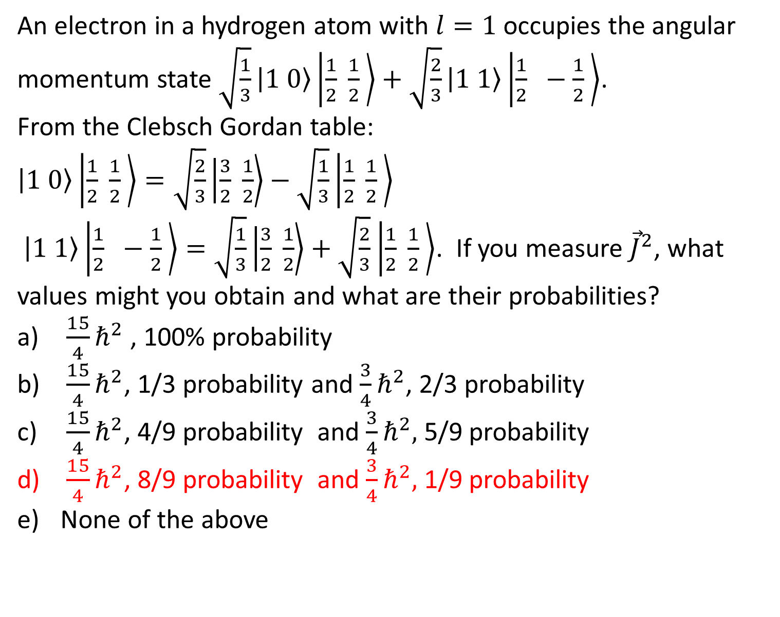
An electron in a hydrogen atom with $l=1$ occupies the angular momentum state $\sqrt{\frac{1}{3}}\left.\left|1 0\right.\right\rangle \left.\left|\frac{1}{2}\right. \frac{1}{2} \right\rangle +\sqrt{\frac{2}{3}}\left.\left|1 1\right.\right\rangle \left.\left|\frac{1}{2}\right. −\frac{1}{2} \right\rangle$.
From the Clebsch Gordan table:
$\left.\left|1 0\right.\right\rangle \left.\left|\frac{1}{2}\right. \frac{1}{2} \right\rangle =\sqrt{\frac{2}{3}}\left.\left|\frac{3}{2} \right.\frac{1}{2}\right\rangle −\sqrt{\frac{1}{3}}\left.\left|\frac{1}{2}\right. \frac{1}{2} \right\rangle$
$\left.\left|1 1\right.\right\rangle \left.\left|\frac{1}{2}\right. −\frac{1}{2} \right\rangle =\sqrt{\frac{1}{3}}\left.\left|\frac{3}{2} \right.\frac{1}{2}\right\rangle +\sqrt{\frac{2}{3}}$ $\left.\left|\frac{1}{2}\right. \frac{1}{2} \right\rangle$. If you measure ${\vec{J}}^{2}$, what values might you obtain and what are their probabilities?
$\frac{15}{4}ℏ^{2}$ , 100% probability
$\frac{15}{4}ℏ^{2}$, 1/3 probability and $\frac{3}{4}ℏ^{2}$, 2/3 probability
$\frac{15}{4}ℏ^{2}$, 4/9 probability and $\frac{3}{4}ℏ^{2},$ 5/9 probability
$\frac{15}{4}ℏ^{2}$, 8/9 probability and $\frac{3}{4}ℏ^{2},$ 1/9 probability
None of the above

Slide 8
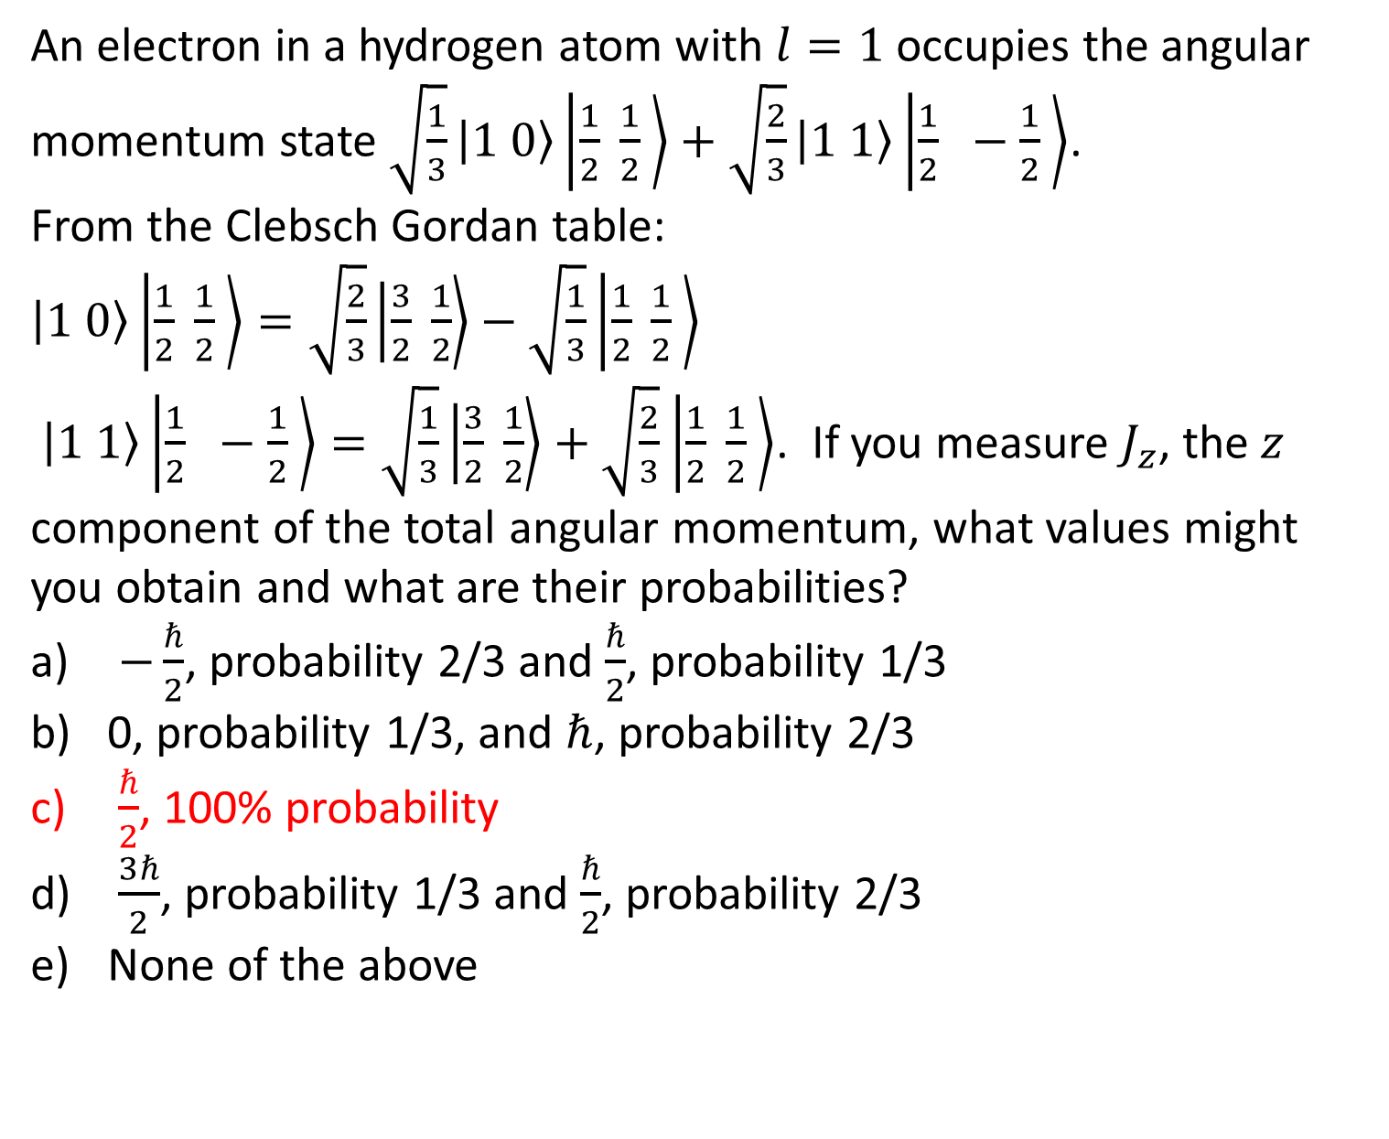
An electron in a hydrogen atom with $l=1$ occupies the angular momentum state $\sqrt{\frac{1}{3}}\left.\left|1 0\right.\right\rangle \left.\left|\frac{1}{2}\right. \frac{1}{2} \right\rangle +\sqrt{\frac{2}{3}}\left.\left|1 1\right.\right\rangle \left.\left|\frac{1}{2}\right. −\frac{1}{2} \right\rangle$.
From the Clebsch Gordan table:
$\left.\left|1 0\right.\right\rangle \left.\left|\frac{1}{2}\right. \frac{1}{2} \right\rangle =\sqrt{\frac{2}{3}}\left.\left|\frac{3}{2} \right.\frac{1}{2}\right\rangle −\sqrt{\frac{1}{3}}\left.\left|\frac{1}{2}\right. \frac{1}{2} \right\rangle$
$\left.\left|1 1\right.\right\rangle \left.\left|\frac{1}{2}\right. −\frac{1}{2} \right\rangle =\sqrt{\frac{1}{3}}\left.\left|\frac{3}{2} \right.\frac{1}{2}\right\rangle +\sqrt{\frac{2}{3}}$ $\left.\left|\frac{1}{2}\right. \frac{1}{2} \right\rangle$. If you measure $J_{z}$, the $z$ component of the total angular momentum, what values might you obtain and what are their probabilities?
$−\frac{ℏ}{2}$, probability 2/3 and $\frac{ℏ}{2}$, probability 1/3
0, probability 1/3, and $ℏ$, probability 2/3
$\frac{ℏ}{2}$, 100% probability
$\frac{3ℏ}{2}$, probability 1/3 and $\frac{ℏ}{2}$, probability 2/3
None of the above

Slide 9
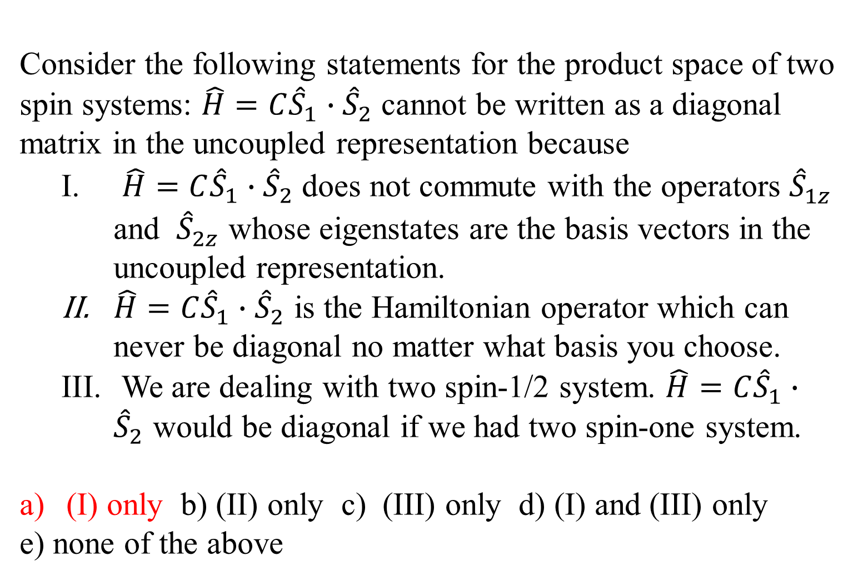
Consider the following statements for the product space of two spin systems: $\hat{H}=C{\hat{S}}_{1}∙{\hat{S}}_{2}$ cannot be written as a diagonal matrix in the uncoupled representation because
  $\hat{H}=C{\hat{S}}_{1}∙{\hat{S}}_{2}$ does not commute with the operators ${\hat{S}}_{1z}^{}$ and ${\hat{S}}_{2z}^{}$ whose eigenstates are the basis vectors in the uncoupled representation.
  $\hat{H}=C{\hat{S}}_{1}∙{\hat{S}}_{2}$ is the Hamiltonian operator which can never be diagonal no matter what basis you choose.
  We are dealing with two spin-1/2 system. $\hat{H}=C{\hat{S}}_{1}∙{\hat{S}}_{2}$ would be diagonal if we had two spin-one system.
(I) only b) (II) only c) (III) only d) (I) and (III) only
e) none of the above

Slide 10
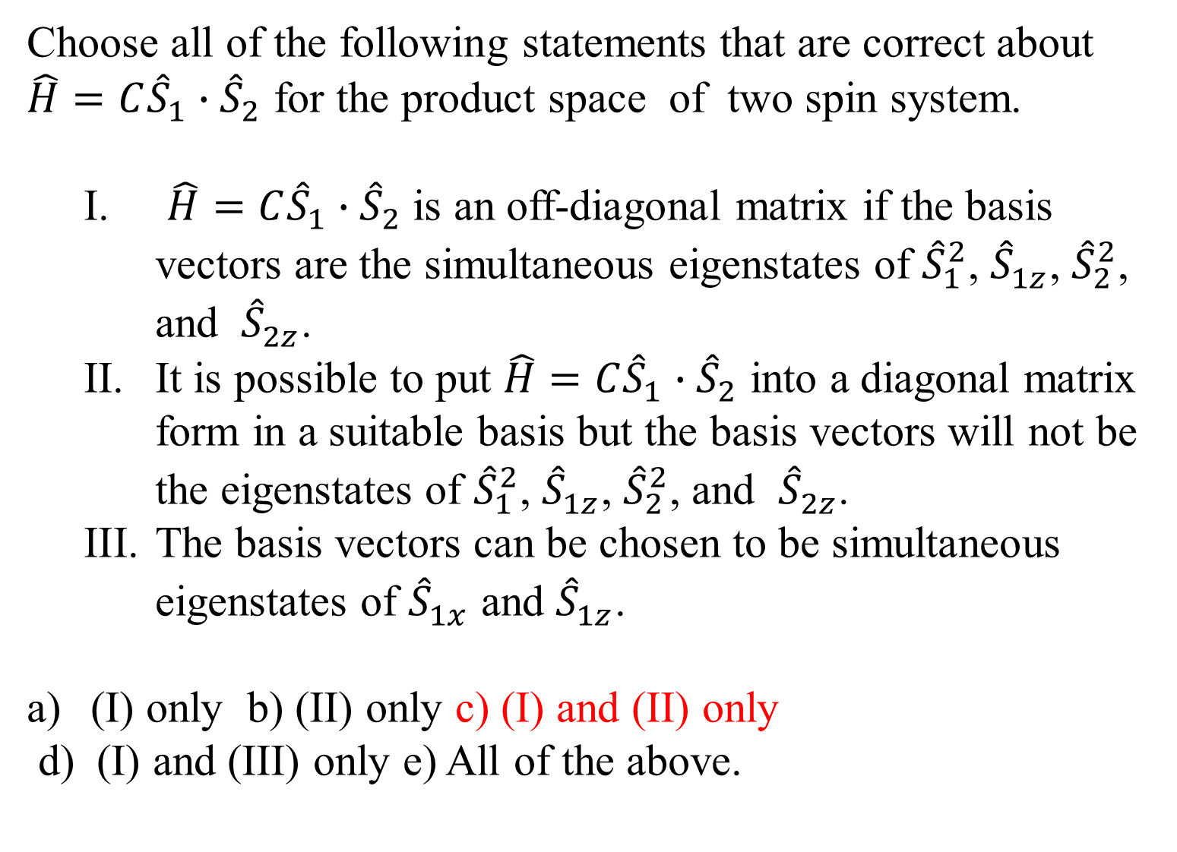
Choose all of the following statements that are correct about $\hat{H}=C{\hat{S}}_{1}∙{\hat{S}}_{2}$ for the product space of two spin system.
  $\hat{H}=C{\hat{S}}_{1}∙{\hat{S}}_{2}$ is an off-diagonal matrix if the basis vectors are the simultaneous eigenstates of ${\hat{S}}_{1}^{2}$, ${\hat{S}}_{1z}^{}$, ${\hat{S}}_{2}^{2}$, and ${\hat{S}}_{2z}^{}$.
  It is possible to put $\hat{H}=C{\hat{S}}_{1}∙{\hat{S}}_{2}$ into a diagonal matrix form in a suitable basis but the basis vectors will not be the eigenstates of ${\hat{S}}_{1}^{2}$, ${\hat{S}}_{1z}^{}$, ${\hat{S}}_{2}^{2}$, and ${\hat{S}}_{2z}^{}$.
  The basis vectors can be chosen to be simultaneous eigenstates of ${\hat{S}}_{1x}^{}$ and ${\hat{S}}_{1z}^{}$.
(I) only b) (II) only c) (I) and (II) only
d) (I) and (III) only e) All of the above.

Slide 11
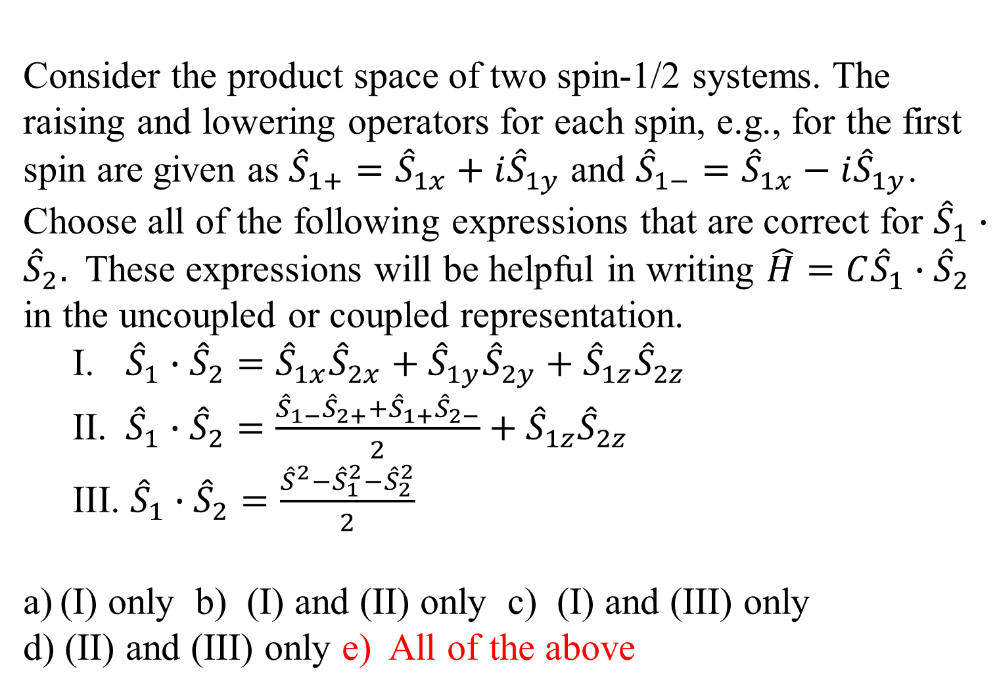
Consider the product space of two spin-1/2 systems. The raising and lowering operators for each spin, e.g., for the first spin are given as ${\hat{S}}_{1+}={\hat{S}}_{1x}+i{\hat{S}}_{1y}$ and ${\hat{S}}_{1−}={\hat{S}}_{1x}−i{\hat{S}}_{1y}$. Choose all of the following expressions that are correct for ${\hat{S}}_{1}∙{\hat{S}}_{2}.$ These expressions will be helpful in writing $\hat{H}=C{\hat{S}}_{1}∙{\hat{S}}_{2}$ in the uncoupled or coupled representation.
  ${\hat{S}}_{1}∙{\hat{S}}_{2}={\hat{S}}_{1x}{\hat{S}}_{2x}+{\hat{S}}_{1y}{\hat{S}}_{2y}+{\hat{S}}_{1z}{\hat{S}}_{2z}$
  ${\hat{S}}_{1}∙{\hat{S}}_{2}=\frac{{\hat{S}}_{1−}{\hat{S}}_{2+}+{\hat{S}}_{1+}{\hat{S}}_{2−}}{2}+{\hat{S}}_{1z}{\hat{S}}_{2z}$
  ${\hat{S}}_{1}∙{\hat{S}}_{2}=\frac{{\hat{S}}^{2}−{\hat{S}}_{1}^{2}−{\hat{S}}_{2}^{2}}{2}$
(I) only b) (I) and (II) only c) (I) and (III) only
d) (II) and (III) only e) All of the above

Slide 12
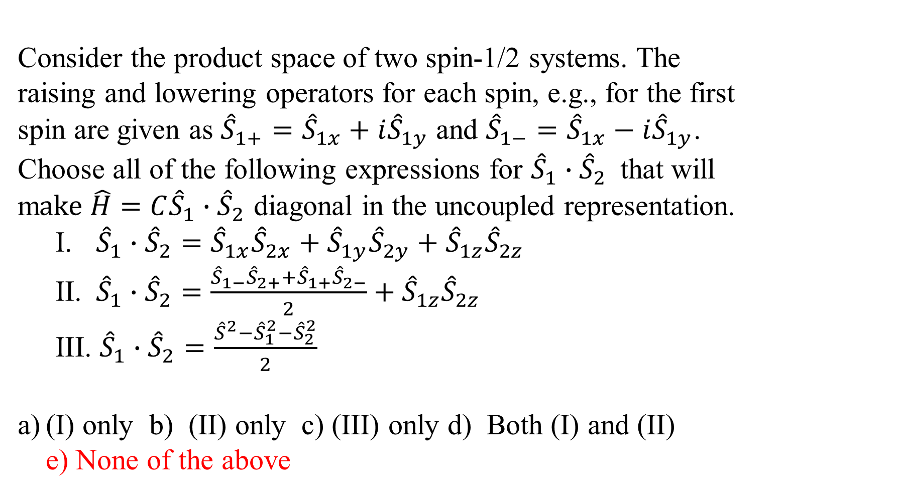
Consider the product space of two spin-1/2 systems. The raising and lowering operators for each spin, e.g., for the first spin are given as ${\hat{S}}_{1+}={\hat{S}}_{1x}+i{\hat{S}}_{1y}$ and ${\hat{S}}_{1−}={\hat{S}}_{1x}−i{\hat{S}}_{1y}$. Choose all of the following expressions for ${\hat{S}}_{1}∙{\hat{S}}_{2}$that will m$ake \hat{H}=C{\hat{S}}_{1}∙{\hat{S}}_{2}$ diagonal in the uncoupled representation.
  ${\hat{S}}_{1}∙{\hat{S}}_{2}={\hat{S}}_{1x}{\hat{S}}_{2x}+{\hat{S}}_{1y}{\hat{S}}_{2y}+{\hat{S}}_{1z}{\hat{S}}_{2z}$
  ${\hat{S}}_{1}∙{\hat{S}}_{2}=\frac{{\hat{S}}_{1−}{\hat{S}}_{2+}+{\hat{S}}_{1+}{\hat{S}}_{2−}}{2}+{\hat{S}}_{1z}{\hat{S}}_{2z}$
  ${\hat{S}}_{1}∙{\hat{S}}_{2}=\frac{{\hat{S}}^{2}−{\hat{S}}_{1}^{2}−{\hat{S}}_{2}^{2}}{2}$
(I) only b) (II) only c) (III) only d) Both (I) and (II) e) None of the above

Slide 13
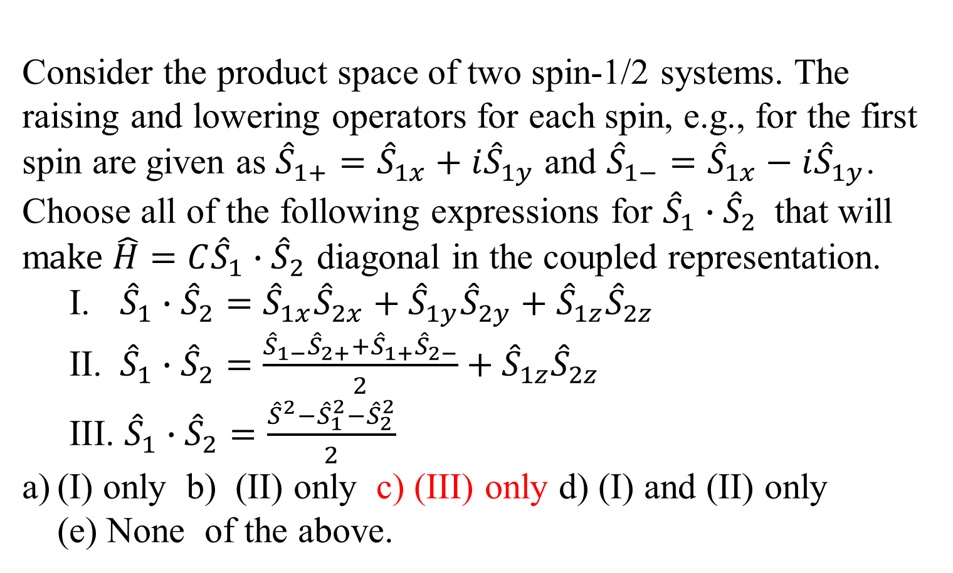
Consider the product space of two spin-1/2 systems. The raising and lowering operators for each spin, e.g., for the first spin are given as ${\hat{S}}_{1+}={\hat{S}}_{1x}+i{\hat{S}}_{1y}$ and ${\hat{S}}_{1−}={\hat{S}}_{1x}−i{\hat{S}}_{1y}$. Choose all of the following expressions for ${\hat{S}}_{1}∙{\hat{S}}_{2}$that will m$ake \hat{H}=C{\hat{S}}_{1}∙{\hat{S}}_{2}$ diagonal in the coupled representation.
  ${\hat{S}}_{1}∙{\hat{S}}_{2}={\hat{S}}_{1x}{\hat{S}}_{2x}+{\hat{S}}_{1y}{\hat{S}}_{2y}+{\hat{S}}_{1z}{\hat{S}}_{2z}$
  ${\hat{S}}_{1}∙{\hat{S}}_{2}=\frac{{\hat{S}}_{1−}{\hat{S}}_{2+}+{\hat{S}}_{1+}{\hat{S}}_{2−}}{2}+{\hat{S}}_{1z}{\hat{S}}_{2z}$
  ${\hat{S}}_{1}∙{\hat{S}}_{2}=\frac{{\hat{S}}^{2}−{\hat{S}}_{1}^{2}−{\hat{S}}_{2}^{2}}{2}$
(I) only b) (II) only c) (III) only d) (I) and (II) only (e) None of the above.

Slide 14
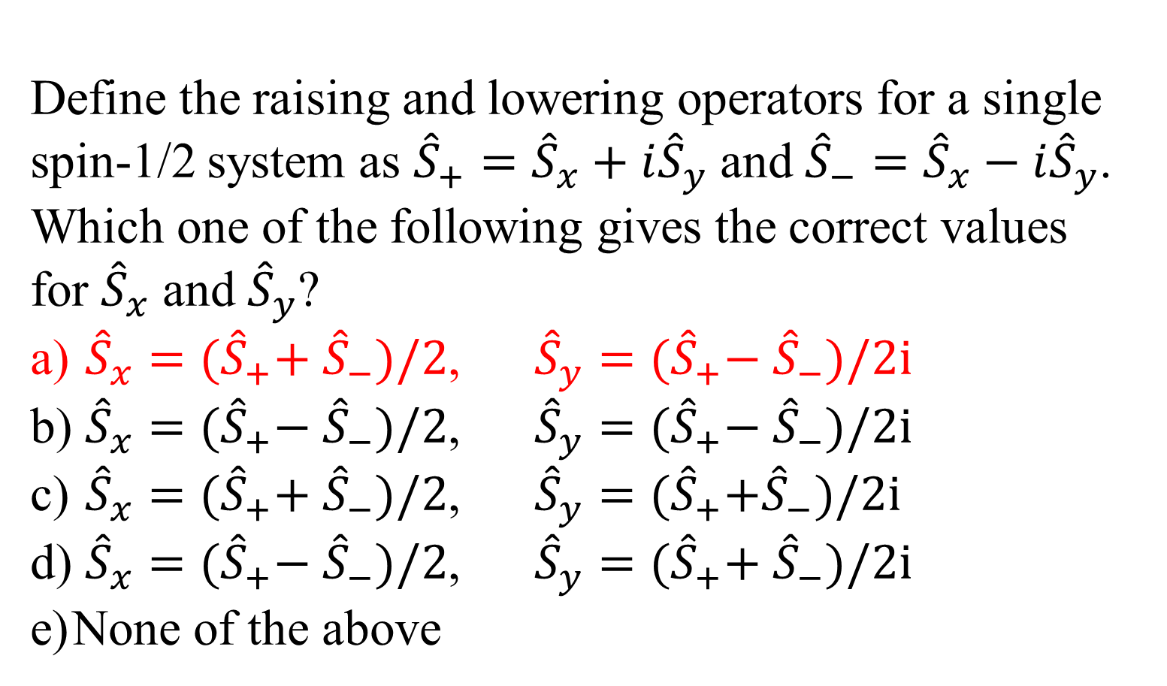
Define the raising and lowering operators for a single spin-1/2 system as ${\hat{S}}_{+}={\hat{S}}_{x}+i{\hat{S}}_{y}$ and ${\hat{S}}_{−}={\hat{S}}_{x}−i{\hat{S}}_{y}$. Which one of the following gives the correct values for ${\hat{S}}_{x}$ and ${\hat{S}}_{y}$?
${\hat{S}}_{x}={(\hat{S}}_{+}+{ \hat{S}}_{−})/2$, ${\hat{S}}_{y}={(\hat{S}}_{+}−{ \hat{S}}_{−})/2i$
${\hat{S}}_{x}={(\hat{S}}_{+}−{ \hat{S}}_{−})/2$, ${\hat{S}}_{y}={(\hat{S}}_{+}−{ \hat{S}}_{−})/2i$
${\hat{S}}_{x}={(\hat{S}}_{+}+{ \hat{S}}_{−})/2$, ${\hat{S}}_{y}={(\hat{S}}_{+}+{\hat{S}}_{−})/2i$
${\hat{S}}_{x}={(\hat{S}}_{+}−{ \hat{S}}_{−})/2$, ${\hat{S}}_{y}={(\hat{S}}_{+}+{ \hat{S}}_{−})/2i$
None of the above

Slide 15
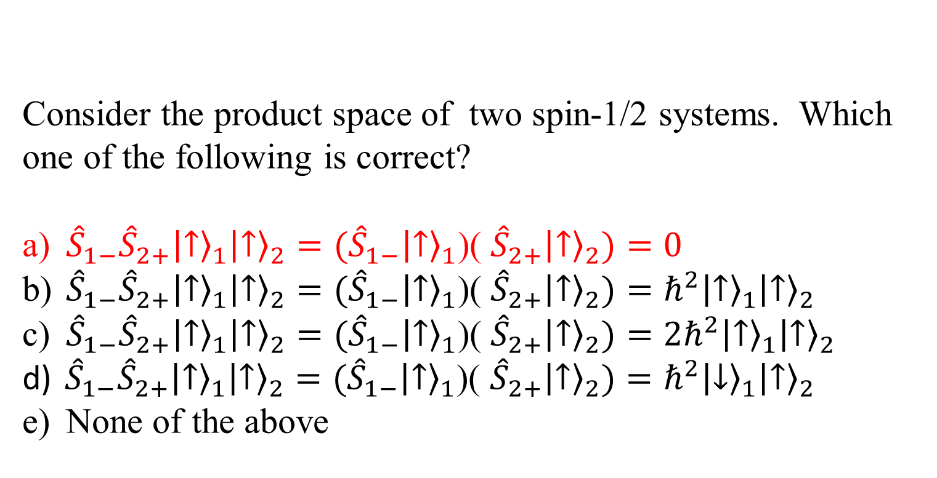
Consider the product space of two spin-1/2 systems. Which one of the following is correct?
${\hat{S}}_{1−}{\hat{S}}_{2+}{\left.\left|↑\right.\right\rangle }_{1}{\left.\left|↑\right.\right\rangle }_{2}=({\hat{S}}_{1−}{\left.\left|↑\right.\right\rangle }_{1}$)( ${\hat{S}}_{2+}{\left.\left|↑\right.\right\rangle }_{2})=0$
${\hat{S}}_{1−}{\hat{S}}_{2+}{\left.\left|↑\right.\right\rangle }_{1}{\left.\left|↑\right.\right\rangle }_{2}=({\hat{S}}_{1−}{\left.\left|↑\right.\right\rangle }_{1}$)( ${\hat{S}}_{2+}{\left.\left|↑\right.\right\rangle }_{2})=ℏ^{2}{\left.\left|↑\right.\right\rangle }_{1}{\left.\left|↑\right.\right\rangle }_{2}$
${\hat{S}}_{1−}{\hat{S}}_{2+}{\left.\left|↑\right.\right\rangle }_{1}{\left.\left|↑\right.\right\rangle }_{2}=({\hat{S}}_{1−}{\left.\left|↑\right.\right\rangle }_{1}$)( ${\hat{S}}_{2+}{\left.\left|↑\right.\right\rangle }_{2})={2ℏ}^{2}{\left.\left|↑\right.\right\rangle }_{1}{\left.\left|↑\right.\right\rangle }_{2}$
${\hat{S}}_{1−}{\hat{S}}_{2+}{\left.\left|↑\right.\right\rangle }_{1}{\left.\left|↑\right.\right\rangle }_{2}=({\hat{S}}_{1−}{\left.\left|↑\right.\right\rangle }_{1}$)( ${\hat{S}}_{2+}{\left.\left|↑\right.\right\rangle }_{2})=ℏ^{2}{\left.\left|↓\right.\right\rangle }_{1}{\left.\left|↑\right.\right\rangle }_{2}$
None of the above

Slide 16
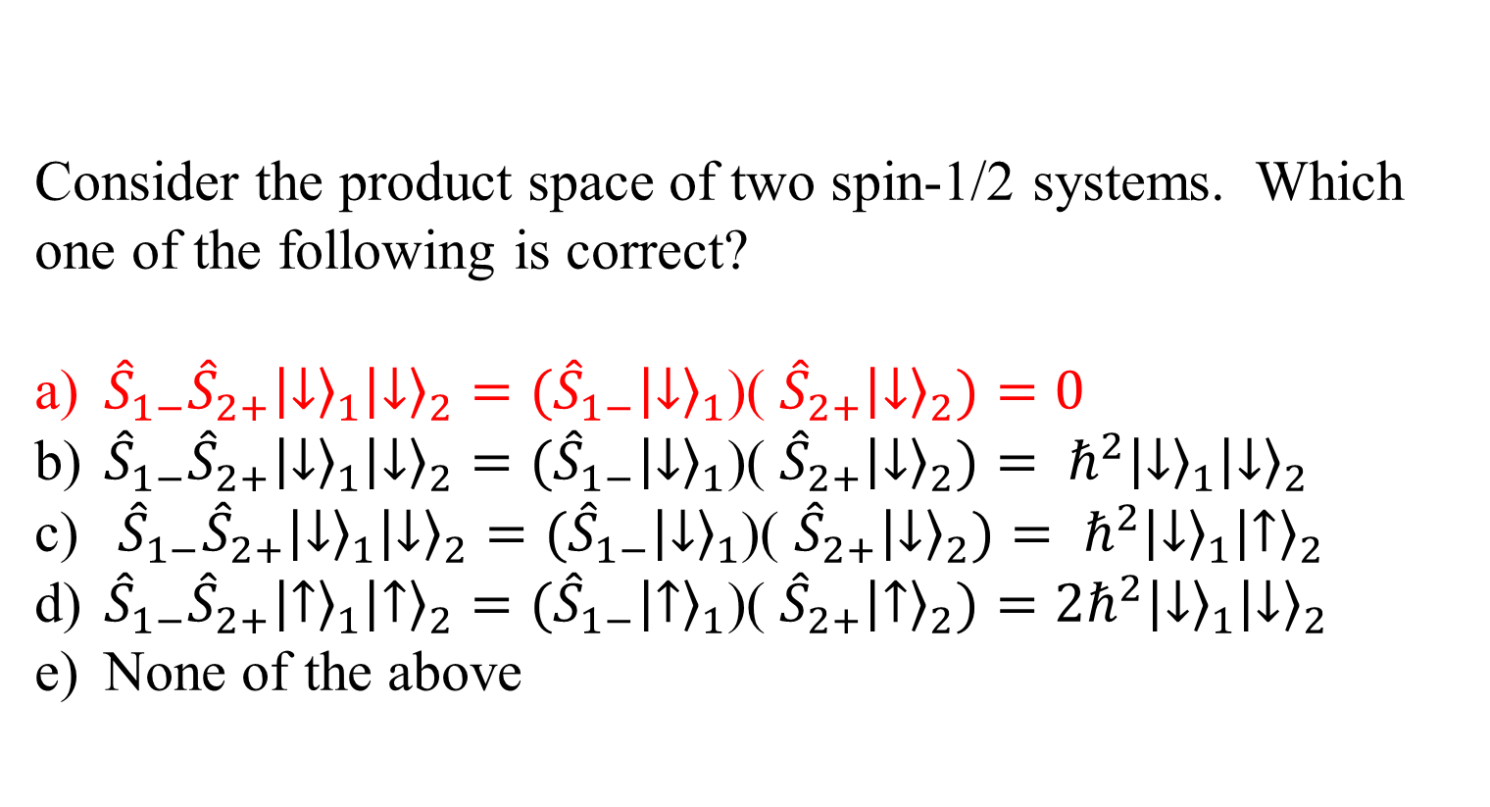
Consider the product space of two spin-1/2 systems. Which one of the following is correct?
${\hat{S}}_{1−}{\hat{S}}_{2+}{\left.\left|↓\right.\right\rangle }_{1}{\left.\left|↓\right.\right\rangle }_{2}=({\hat{S}}_{1−}{\left.\left|↓\right.\right\rangle }_{1}$)( ${\hat{S}}_{2+}{\left.\left|↓\right.\right\rangle }_{2})=0$
${\hat{S}}_{1−}{\hat{S}}_{2+}{\left.\left|↓\right.\right\rangle }_{1}{\left.\left|↓\right.\right\rangle }_{2}=({\hat{S}}_{1−}{\left.\left|↓\right.\right\rangle }_{1}$)( ${\hat{S}}_{2+}{\left.\left|↓\right.\right\rangle }_{2})= ℏ^{2}{\left.\left|↓\right.\right\rangle }_{1}{\left.\left|↓\right.\right\rangle }_{2}$
${\hat{S}}_{1−}{\hat{S}}_{2+}{\left.\left|↓\right.\right\rangle }_{1}{\left.\left|↓\right.\right\rangle }_{2}=({\hat{S}}_{1−}{\left.\left|↓\right.\right\rangle }_{1}$)( ${\hat{S}}_{2+}{\left.\left|↓\right.\right\rangle }_{2})= ℏ^{2}{\left.\left|↓\right.\right\rangle }_{1}{\left.\left|↑\right.\right\rangle }_{2}$
${\hat{S}}_{1−}{\hat{S}}_{2+}{\left.\left|↑\right.\right\rangle }_{1}{\left.\left|↑\right.\right\rangle }_{2}=({\hat{S}}_{1−}{\left.\left|↑\right.\right\rangle }_{1}$)( ${\hat{S}}_{2+}{\left.\left|↑\right.\right\rangle }_{2})={2ℏ}^{2}{\left.\left|↓\right.\right\rangle }_{1}{\left.\left|↓\right.\right\rangle }_{2}$
None of the above

Slide 17
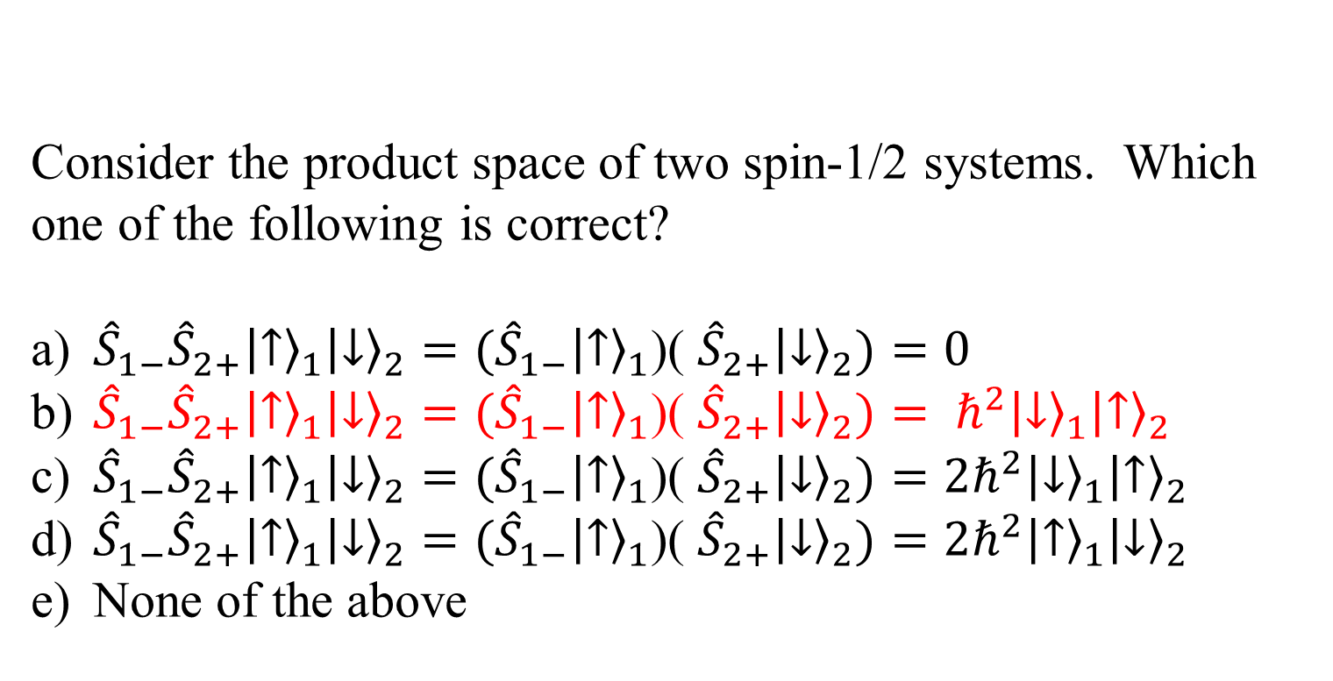
Consider the product space of two spin-1/2 systems. Which one of the following is correct?
${\hat{S}}_{1−}{\hat{S}}_{2+}{\left.\left|↑\right.\right\rangle }_{1}{\left.\left|↓\right.\right\rangle }_{2}=({\hat{S}}_{1−}{\left.\left|↑\right.\right\rangle }_{1}$)( ${\hat{S}}_{2+}{\left.\left|↓\right.\right\rangle }_{2})=0$
${\hat{S}}_{1−}{\hat{S}}_{2+}{\left.\left|↑\right.\right\rangle }_{1}{\left.\left|↓\right.\right\rangle }_{2}=({\hat{S}}_{1−}{\left.\left|↑\right.\right\rangle }_{1}$)( ${\hat{S}}_{2+}{\left.\left|↓\right.\right\rangle }_{2})= ℏ^{2}{\left.\left|↓\right.\right\rangle }_{1}{\left.\left|↑\right.\right\rangle }_{2}$
${\hat{S}}_{1−}{\hat{S}}_{2+}{\left.\left|↑\right.\right\rangle }_{1}{\left.\left|↓\right.\right\rangle }_{2}=({\hat{S}}_{1−}{\left.\left|↑\right.\right\rangle }_{1}$)( ${\hat{S}}_{2+}{\left.\left|↓\right.\right\rangle }_{2})={2ℏ}^{2}{\left.\left|↓\right.\right\rangle }_{1}{\left.\left|↑\right.\right\rangle }_{2}$
${\hat{S}}_{1−}{\hat{S}}_{2+}{\left.\left|↑\right.\right\rangle }_{1}{\left.\left|↓\right.\right\rangle }_{2}=({\hat{S}}_{1−}{\left.\left|↑\right.\right\rangle }_{1}$)( ${\hat{S}}_{2+}{\left.\left|↓\right.\right\rangle }_{2})={2ℏ}^{2}{\left.\left|↑\right.\right\rangle }_{1}{\left.\left|↓\right.\right\rangle }_{2}$
None of the above

Slide 18
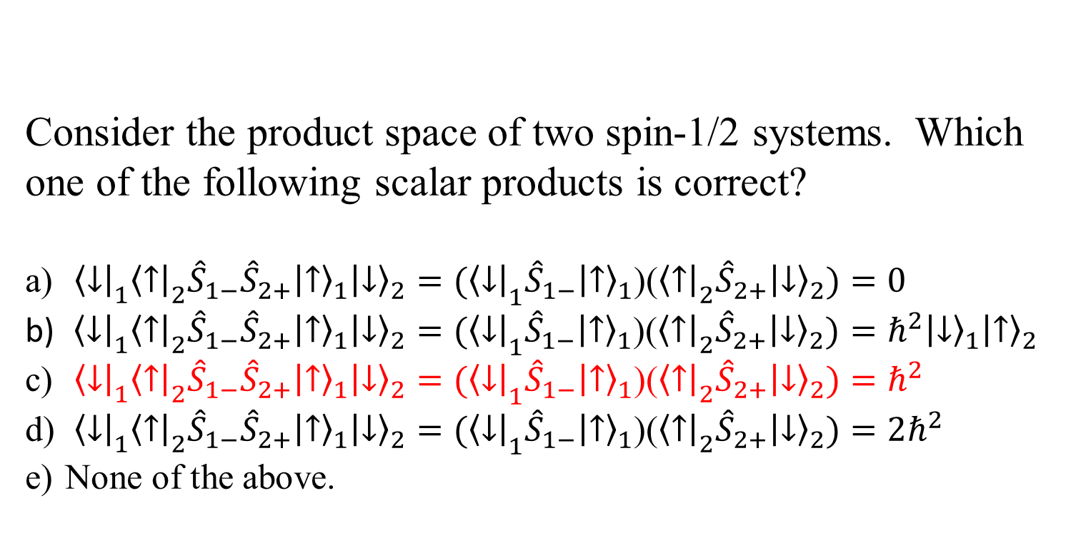
Consider the product space of two spin-1/2 systems. Which one of the following scalar products is correct?
${\left\langle \left.↓\right|\right.}_{1}{\left\langle \left.↑\right|\right.}_{2}{\hat{S}}_{1−}{\hat{S}}_{2+}{\left.\left|↑\right.\right\rangle }_{1}{\left.\left|↓\right.\right\rangle }_{2}={(\left\langle \left.↓\right|\right.}_{1}{\hat{S}}_{1−}{\left.\left|↑\right.\right\rangle }_{1}$)(${\left\langle \left.↑\right|\right.}_{2}{\hat{S}}_{2+}{\left.\left|↓\right.\right\rangle }_{2})=0$
${\left\langle \left.↓\right|\right.}_{1}{\left\langle \left.↑\right|\right.}_{2}{\hat{S}}_{1−}{\hat{S}}_{2+}{\left.\left|↑\right.\right\rangle }_{1}{\left.\left|↓\right.\right\rangle }_{2}={(\left\langle \left.↓\right|\right.}_{1}{\hat{S}}_{1−}{\left.\left|↑\right.\right\rangle }_{1}$)(${\left\langle \left.↑\right|\right.}_{2}{\hat{S}}_{2+}{\left.\left|↓\right.\right\rangle }_{2})=ℏ^{2}{\left.\left|↓\right.\right\rangle }_{1}{\left.\left|↑\right.\right\rangle }_{2}$
${\left\langle \left.↓\right|\right.}_{1}{\left\langle \left.↑\right|\right.}_{2}{\hat{S}}_{1−}{\hat{S}}_{2+}{\left.\left|↑\right.\right\rangle }_{1}{\left.\left|↓\right.\right\rangle }_{2}={(\left\langle \left.↓\right|\right.}_{1}{\hat{S}}_{1−}{\left.\left|↑\right.\right\rangle }_{1}$)(${\left\langle \left.↑\right|\right.}_{2}{\hat{S}}_{2+}{\left.\left|↓\right.\right\rangle }_{2})=ℏ^{2}$
${\left\langle \left.↓\right|\right.}_{1}{\left\langle \left.↑\right|\right.}_{2}{\hat{S}}_{1−}{\hat{S}}_{2+}{\left.\left|↑\right.\right\rangle }_{1}{\left.\left|↓\right.\right\rangle }_{2}={(\left\langle \left.↓\right|\right.}_{1}{\hat{S}}_{1−}{\left.\left|↑\right.\right\rangle }_{1}$)(${\left\langle \left.↑\right|\right.}_{2}{\hat{S}}_{2+}{\left.\left|↓\right.\right\rangle }_{2})={2ℏ}^{2}$
None of the above.

Slide 19
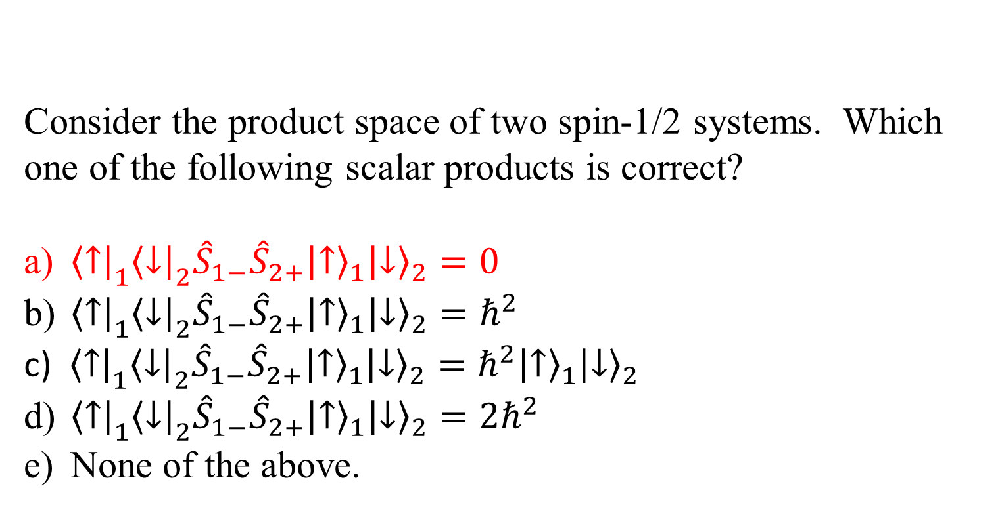
Consider the product space of two spin-1/2 systems. Which one of the following scalar products is correct?
${\left\langle \left.↑\right|\right.}_{1}{\left\langle \left.↓\right|\right.}_{2}{\hat{S}}_{1−}{\hat{S}}_{2+}{\left.\left|↑\right.\right\rangle }_{1}{\left.\left|↓\right.\right\rangle }_{2}=0$
${\left\langle \left.↑\right|\right.}_{1}{\left\langle \left.↓\right|\right.}_{2}{\hat{S}}_{1−}{\hat{S}}_{2+}{\left.\left|↑\right.\right\rangle }_{1}{\left.\left|↓\right.\right\rangle }_{2}=ℏ^{2}$
${\left\langle \left.↑\right|\right.}_{1}{\left\langle \left.↓\right|\right.}_{2}{\hat{S}}_{1−}{\hat{S}}_{2+}{\left.\left|↑\right.\right\rangle }_{1}{\left.\left|↓\right.\right\rangle }_{2}=ℏ^{2}{\left.\left|↑\right.\right\rangle }_{1}{\left.\left|↓\right.\right\rangle }_{2}$
${\left\langle \left.↑\right|\right.}_{1}{\left\langle \left.↓\right|\right.}_{2}{\hat{S}}_{1−}{\hat{S}}_{2+}{\left.\left|↑\right.\right\rangle }_{1}{\left.\left|↓\right.\right\rangle }_{2}={2ℏ}^{2}$
None of the above.

