Slide 1
QM2 Concept Test 11.1
In a 3D Hilbert space, ${\hat{H}}^{0}$ is the unperturbed Hamiltonian. $\left.\left|a\right.\right\rangle \left. and \left|b\right.\right\rangle$ are the 2-fold degenerate energy eigenstates with energy $E_{1}$and $\left.\left|c\right.\right\rangle$ is the energy eigenstate with energy $E_{2}$. If $\left.\left|a\right.\right\rangle \left. and \left|b\right.\right\rangle$are not “good” states for the perturbation $\hat{H}′$, choose all of the following statements that must be correct.
${H′}_{ac}={H′}_{bc}≠0$, where $\left\langle i | \hat{H}’ | j\right\rangle ={H′}_{ij}$.
${H′}_{ab}={\left({H^{′}}_{ab}\right)}^{∗}≠0$
If ${\hat{H}}^{′}$ does not commute with ${\hat{H}}^{0}$, we can never find a proper set of coefficients $α_{1}$, $β_{1},α_{2}\text{, }β_{2}$ to diagonalize both ${\hat{H}}^{0} and {\hat{H}}^{′}$ completely using the basis vectors $α_{1}\left.\left|a\right.\right\rangle +β_{1}\left.\left|b\right.\right\rangle$, $α_{2}\left.\left|a\right.\right\rangle +β_{2}\left.\left|b\right.\right\rangle$, and $\left.\left|c\right.\right\rangle$.
A. 2 only B. 3 only C. 1 and 2 only D. 2 and 3 only E. all of the above

Slide 2
QM2 Concept Test 11.2
Choose all of the following statements that are correct.
If ${\hat{H}}^{0}$ and $\hat{H}’$commute with each other , we can always find a basis to diagonalize the matrices for both ${\hat{H}}^{0}$ and $\hat{H}’$simultaneously.
If ${\hat{H}}^{0}$ and $H’$do not commute with each other , we cannot find a basis to diagonalize the matrices for both ${\hat{H}}^{0}$ and $\hat{H}’$simultaneously.
In perturbation theory, ${\hat{H}}^{0}$ is chosen to be a diagonal matrix and the basis vectors are chosen as the orthonormal eigenstates of ${\hat{H}}^{0}$.
A. 1 only B. 3 only C. 1 and 2 only D. 1 and 3 only E. All of the above.

Slide 3
QM2 Concept Test 11.3
Suppose ${\hat{H}}^{0}$ and $\hat{H}′$commute with each other. Choose all of the following statements that are correct.
If ${\hat{H}}^{0}$ is diagonal in a given basis and there is no degeneracy in the eigenvalue spectrum of ${\hat{H}}^{0}$ and $\hat{H}′$, then $\hat{H}′$must be diagonal in that basis.
If ${\hat{H}}^{0}$ is diagonal in a given basis and there is a degeneracy in the eigenvalue spectrum of ${\hat{H}}^{0}$ , then $\hat{H}′$must be diagonal in that basis.
We can always find a special basis in which both ${\hat{H}}^{0}$ and $\hat{H}′$ are diagonal simultaneously.
A. 1 only B. 1 and 2 only C. 1 and 3 only D. 2 and 3 only E. All of the above

Slide 4
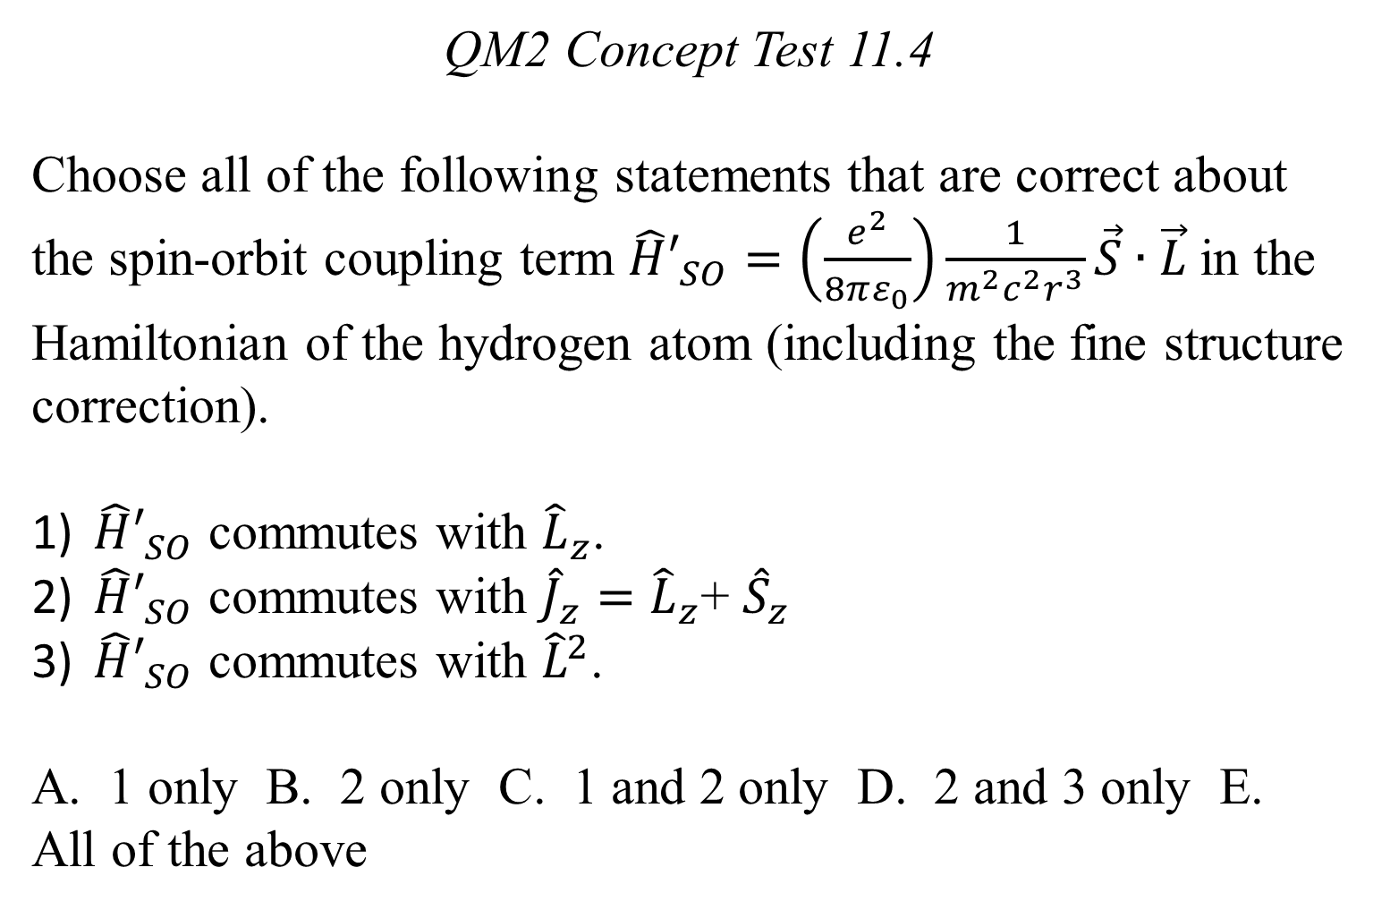
QM2 Concept Test 11.4
Choose all of the following statements that are correct about the spin-orbit coupling term ${\hat{H}′}_{SO}=\left(\frac{e^{2}}{8πε_{0}}\right)\frac{1}{m^{2}c^{2}r^{3}}\vec{S}∙\vec{L}$in the Hamiltonian of the hydrogen atom (including the fine structure correction).
${\hat{H}′}_{SO}$ commutes with ${\hat{L}}_{z}$.
${\hat{H}′}_{SO}$ commutes with ${\hat{J}}_{z}={\hat{L}}_{z}$+ ${\hat{S}}_{z}$
${\hat{H}′}_{SO}$ commutes with ${\hat{L}}^{2}$.
A. 1 only B. 2 only C. 1 and 2 only D. 2 and 3 only E. All of the above

Slide 5
QM2 Concept Test 11.5
The fine structure correction for the hydrogen atom is $E_{fs}=E_{SO}+E_{r}=\frac{{\left(E_{n}\right)}^{2}}{2mc^{2}}\left(3−\frac{4n}{j+1/2}\right)$, where $j=l+s, l+s−1, …\left|l−s\right|$ is the quantum number corresponding to the total angular momentum and $n=1,2,3…$. Choose all of the following statements that are correct including fine structure.
$E_{fs}$ is always negative for any possible value of $n$ and $j$.
When $n=2$, there are 2 distinct values of $j$.
There is no degeneracy left for the energy level with $n=3, j=3/2$ after we account for fine structure correction.
A. 1 only B. 2 only C. 1 and 2 only D. 2 and 3 only E. All of the above.

Slide 6
QM2 Concept Test 11.6
Without considering the fine structure, the energy for a hydrogen atom is $E_{n}=\frac{−13.6 eV}{n^{2}}$. Choose all of the following statements that are correct.
Ignoring spin, the energy level n=2 is four-fold degenerate corresponding to ($l=1, m_{l}=1$), ($l=1, m_{l}=0$), ($l=1, m_{l}=−1$), and ($l=0, m_{l}=0$).
Including the fine structure, when the electron is in the state ($n=2, j=1/2$), we will definitely obtain zero if we measure the square of the magnitude of the angular momentum ${\hat{L}}^{2}$.
Including the fine structure correction, when the electron is in the state ($n=2, j=3/2$), we will definitely obtain $2ℏ^{2}$ if we measure the square of the magnitude of the angular momentum ${\hat{L}}^{2}$.
A. 1 only B. 1 and 2 only C. 1 and 3 only D. 2 and 3 only E. All of the above

Slide 7
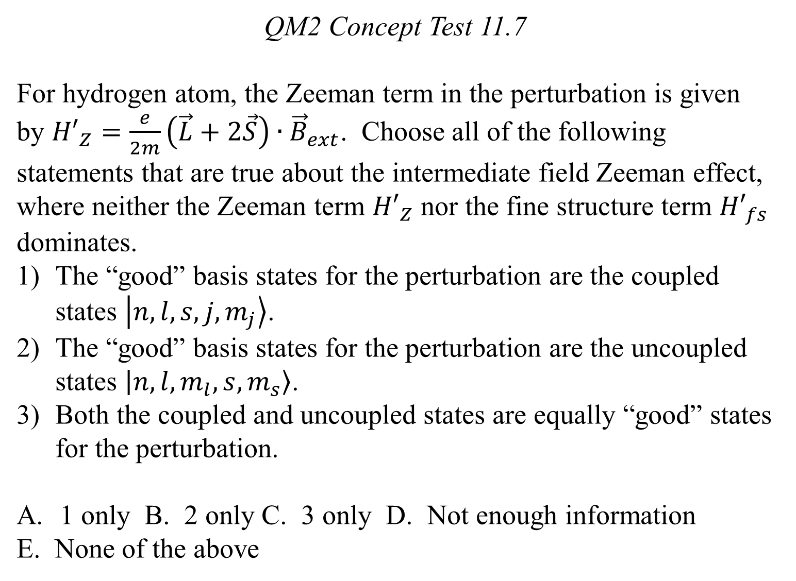
QM2 Concept Test 11.7
For hydrogen atom, the Zeeman term in the perturbation is given by ${H′}_{Z}=\frac{e}{2m}\left(\vec{L}+2\vec{S}\right)∙{\vec{B}}_{ext}$. Choose all of the following statements that are true about the intermediate field Zeeman effect, where neither the Zeeman term ${H′}_{Z}$ nor the fine structure term ${H′}_{fs}$ dominates.
The “good” basis states for the perturbation are the coupled states $\left.\left|n, l, s, j, m_{j}\right.\right\rangle$.
The “good” basis states for the perturbation are the uncoupled states $\left.\left|n, l, m_{l}, s,m_{s}\right.\right\rangle$.
Both the coupled and uncoupled states are equally “good” states for the perturbation.
1 only B. 2 only C. 3 only D. Not enough information
E. None of the above

