Slide 1
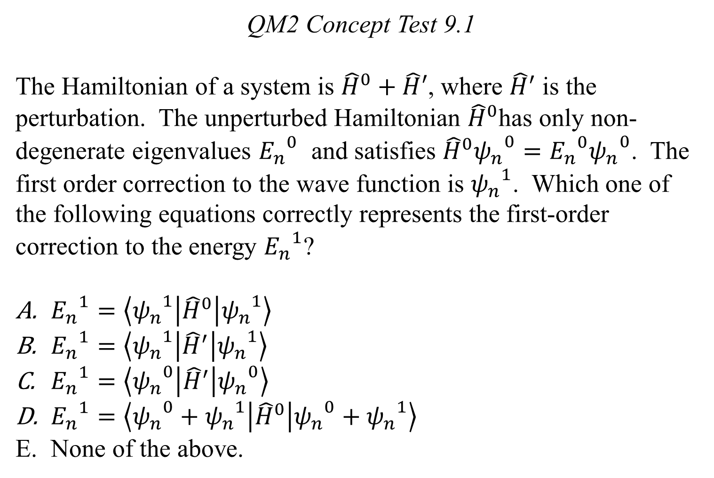
QM2 Concept Test 9.1
The Hamiltonian of a system is ${\hat{H}}^{0}+\hat{H}′$, where ${\hat{H}}^{′}$ is the perturbation. The unperturbed Hamiltonian ${\hat{H}}^{0}$has only non-degenerate eigenvalues ${E_{n}}^{0}$ and satisfies ${\hat{H}}^{0}{ψ_{n}^{}}^{0}={E_{n}}^{0}{ψ_{n}^{}}^{0}$. The first order correction to the wave function is ${ψ_{n}^{}}^{1}$. Which one of the following equations correctly represents the first-order correction to the energy ${E_{n}^{}}^{1}$?
${E_{n}^{}}^{1}=\left\langle {ψ_{n}^{}}^{1} | {\hat{H}}^{0} | {ψ_{n}^{}}^{1}\right\rangle$
${E_{n}^{}}^{1}=\left\langle {ψ_{n}^{}}^{1} | {\hat{H}}^{′} | {ψ_{n}^{}}^{1}\right\rangle$
${E_{n}^{}}^{1}=\left\langle {ψ_{n}^{}}^{0} | {\hat{H}}^{′} | {ψ_{n}^{}}^{0}\right\rangle$
${E_{n}^{}}^{1}=\left\langle {ψ_{n}^{}}^{0}+{ψ_{n}^{}}^{1} | {\hat{H}}^{0} | {ψ_{n}^{}}^{0}+{ψ_{n}^{}}^{1}\right\rangle$
None of the above.

Slide 2
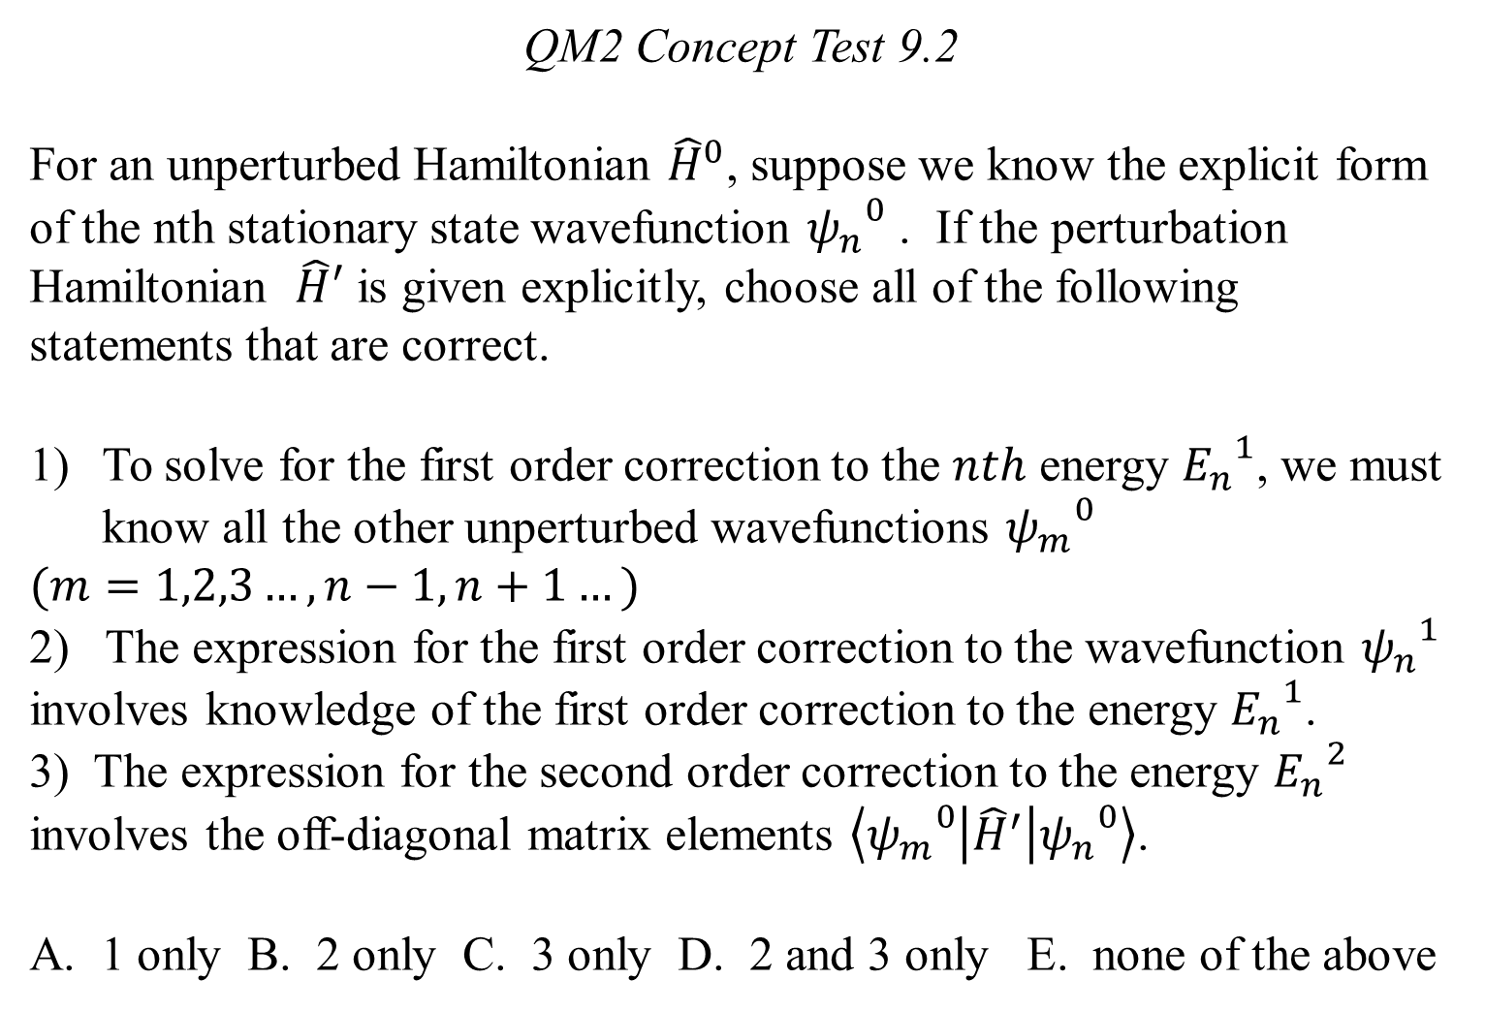
QM2 Concept Test 9.2
For an unperturbed Hamiltonian ${\hat{H}}^{0}$, suppose we know the explicit form of the nth stationary state wavefunction ${ψ_{n}^{}}^{0}$ . If the perturbation Hamiltonian $\hat{H}′$ is given explicitly, choose all of the following statements that are correct.
To solve for the first order correction to the $nth$ energy ${E_{n}^{}}^{1}$, we must know all the other unperturbed wavefunctions ${ψ_{m}^{}}^{0}$
$$(m=1,2,3…, n−1, n+1…)$$
2) The expression for the first order correction to the wavefunction ${ψ_{n}^{}}^{1}$ involves knowledge of the first order correction to the energy ${E_{n}^{}}^{1}$.
3) The expression for the second order correction to the energy ${E_{n}^{}}^{2}$ involves the off-diagonal matrix elements $\left\langle {ψ_{m}^{}}^{0} | {\hat{H}}^{′} | {ψ_{n}^{}}^{0}\right\rangle$.
A. 1 only B. 2 only C. 3 only D. 2 and 3 only E. none of the above

Slide 3
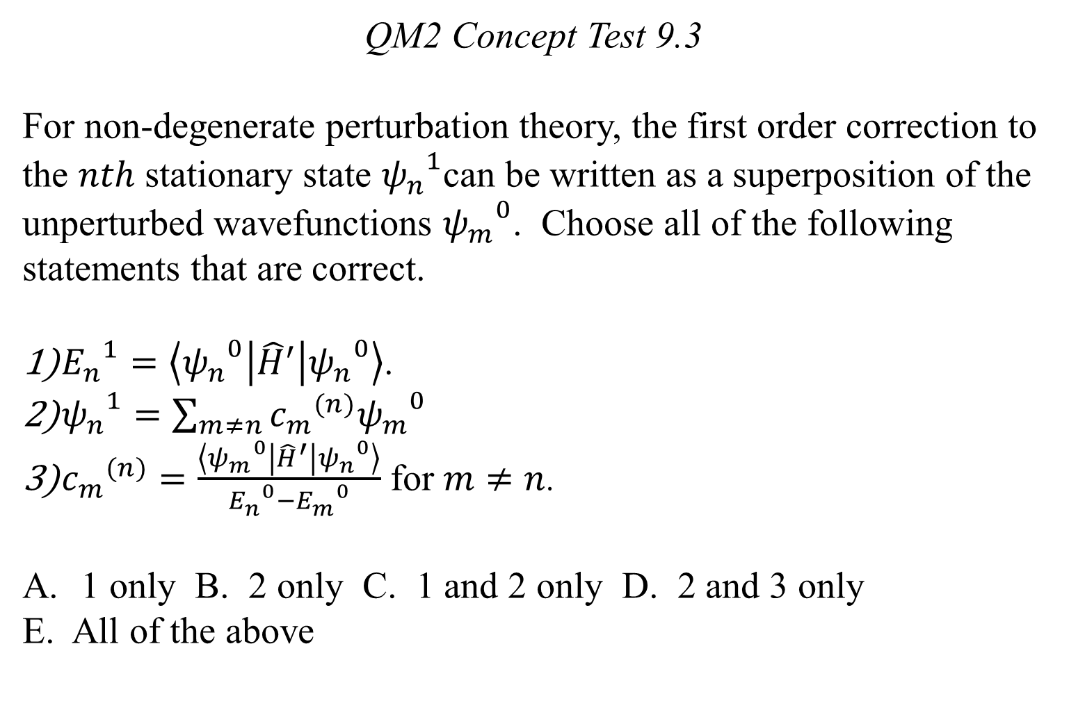
QM2 Concept Test 9.3
For non-degenerate perturbation theory, the first order correction to the $nth$ stationary state ${ψ_{n}^{}}^{1}$can be written as a superposition of the unperturbed wavefunctions ${ψ_{m}^{}}^{0}$. Choose all of the following statements that are correct.
${E_{n}^{}}^{1}=\left\langle {ψ_{n}^{}}^{0} | {\hat{H}}^{′} | {ψ_{n}^{}}^{0}\right\rangle$.
${ψ_{n}^{}}^{1}=\sum_{m≠n}{{c_{m}}^{(n)}{ψ_{m}^{}}^{0}}$
${c_{m}}^{(n)}=\frac{\left\langle {ψ_{m}^{}}^{0} | {\hat{H}}^{′} | {ψ_{n}^{}}^{0}\right\rangle }{{E_{n}^{}}^{0}−{E_{m}^{}}^{0}}$ for $m≠n$.
1 only B. 2 only C. 1 and 2 only D. 2 and 3 only
E. All of the above

Slide 4
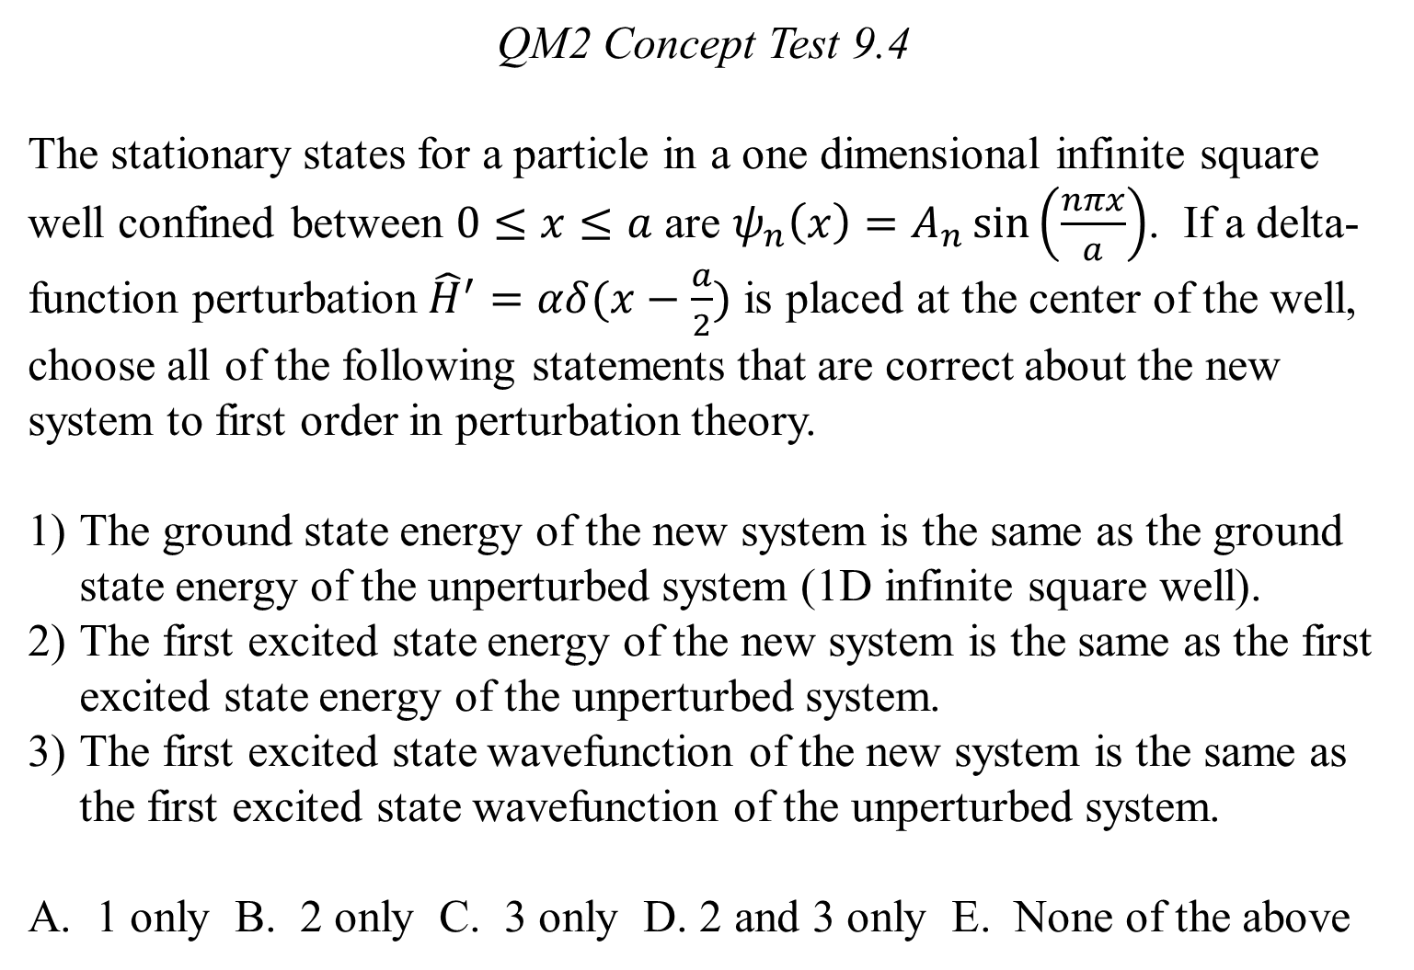
QM2 Concept Test 9.4
The stationary states for a particle in a one dimensional infinite square well confined between $0≤x≤a$ are $ψ_{n}\left(x\right)=A_{n}\sin\left(\frac{nπx}{a}\right)$. If a delta-function perturbation ${\hat{H}}^{′}=αδ(x−\frac{a}{2})$ is placed at the center of the well, choose all of the following statements that are correct about the new system to first order in perturbation theory.
The ground state energy of the new system is the same as the ground state energy of the unperturbed system (1D infinite square well).
The first excited state energy of the new system is the same as the first excited state energy of the unperturbed system.
The first excited state wavefunction of the new system is the same as the first excited state wavefunction of the unperturbed system.
A. 1 only B. 2 only C. 3 only D. 2 and 3 only E. None of the above

Slide 5
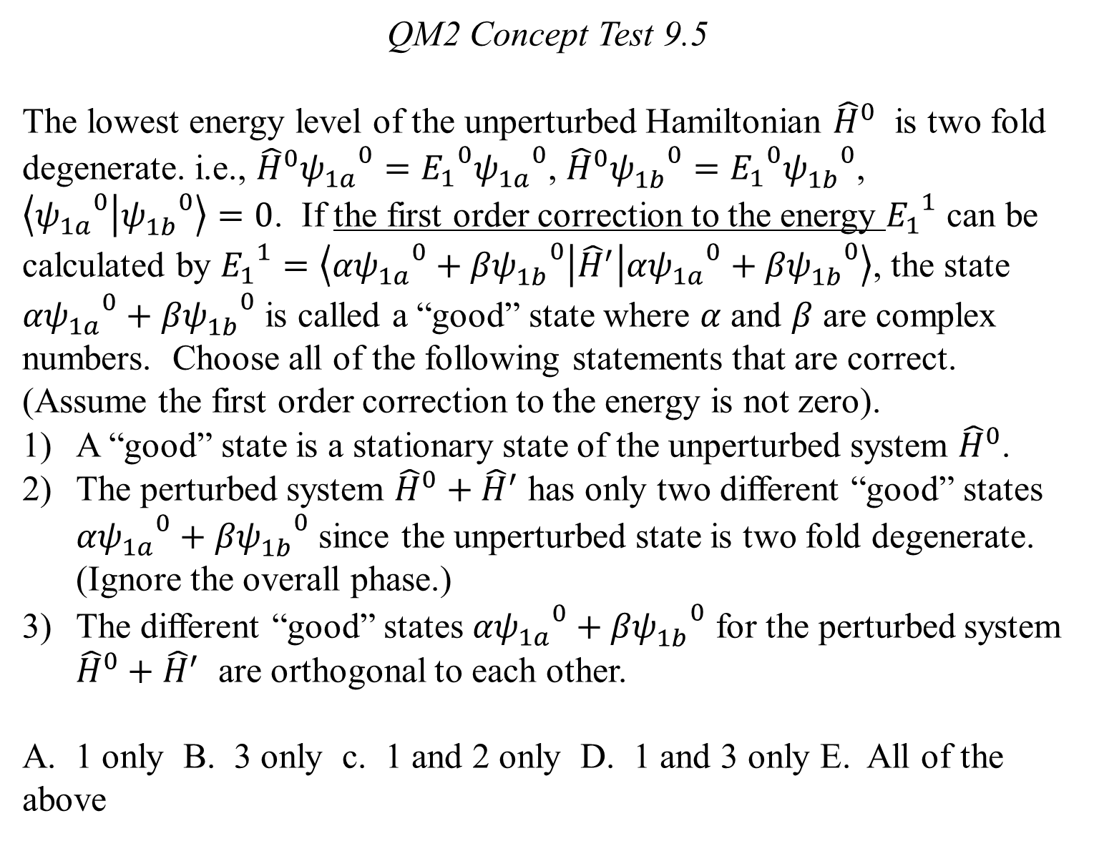
QM2 Concept Test 9.5
The lowest energy level of the unperturbed Hamiltonian ${\hat{H}}^{0}$ is two fold degenerate. i.e., ${\hat{H}}^{0}{ψ_{1a}^{}}^{0}={E_{1}}^{0}{ψ_{1a}^{}}^{0}$, ${\hat{H}}^{0}{ψ_{1b}^{}}^{0}={E_{1}}^{0}{ψ_{1b}^{}}^{0}$, $\left\langle {ψ_{1a}^{}}^{0} | {ψ_{1b}^{}}^{0}\right\rangle =0$. If the first order correction to the energy ${E_{1}}^{1}$ can be calculated by ${E_{1}}^{1}=\left\langle {{αψ}_{1a}^{}}^{0}+{{βψ}_{1b}^{}}^{0} | {\hat{H}}^{′} | {{αψ}_{1a}^{}}^{0}+{{βψ}_{1b}^{}}^{0}\right\rangle$, the state ${{αψ}_{1a}^{}}^{0}+{{βψ}_{1b}^{}}^{0}$ is called a “good” state where $α$ and $β$ are complex numbers. Choose all of the following statements that are correct. (Assume the first order correction to the energy is not zero).
A “good” state is a stationary state of the unperturbed system ${\hat{H}}^{0}$.
The perturbed system ${\hat{H}}^{0}+{\hat{H}}^{′}$ has only two different “good” states ${{αψ}_{1a}^{}}^{0}+{{βψ}_{1b}^{}}^{0}$ since the unperturbed state is two fold degenerate. (Ignore the overall phase.)
The different “good” states ${{αψ}_{1a}^{}}^{0}+{{βψ}_{1b}^{}}^{0}$ for the perturbed system ${\hat{H}}^{0}+{\hat{H}}^{′}$ are orthogonal to each other.
A. 1 only B. 3 only c. 1 and 2 only D. 1 and 3 only E. All of the above

Slide 6
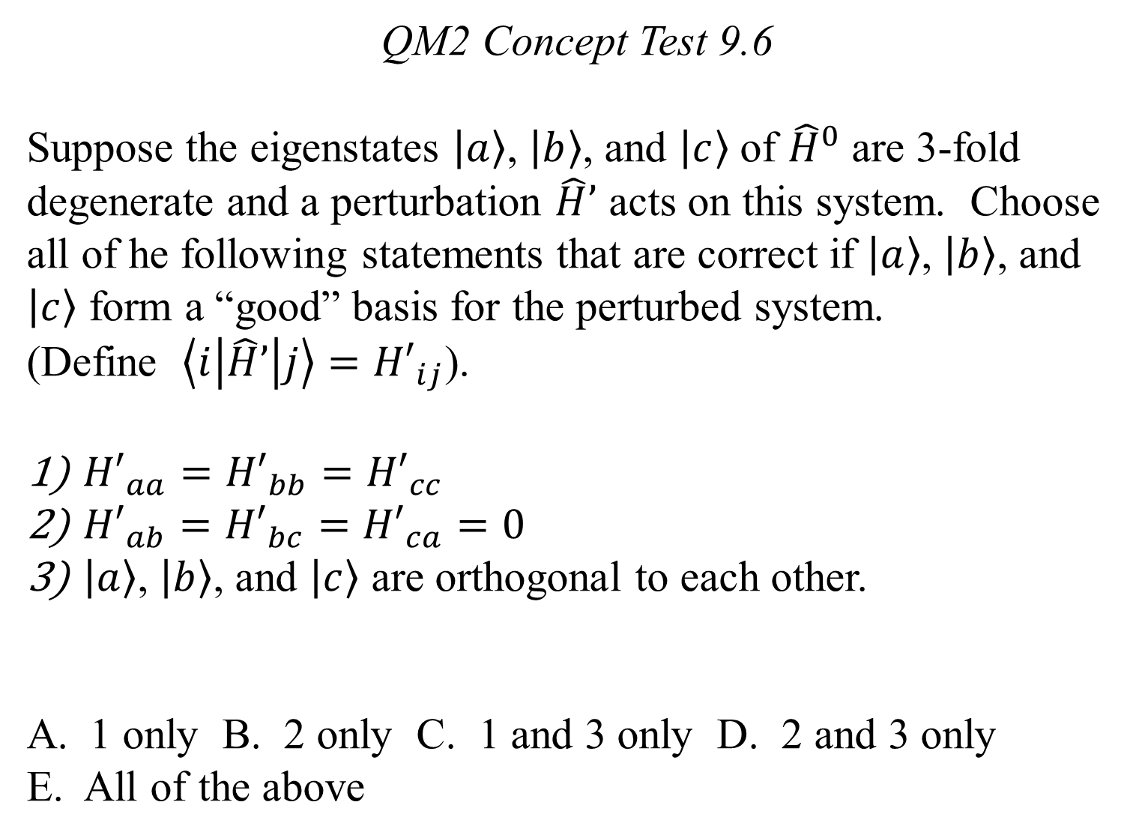
QM2 Concept Test 9.6
Suppose the eigenstates $\left.\left|a\right.\right\rangle$, $\left.\left|b\right.\right\rangle$, and $\left.\left|c\right.\right\rangle$ of ${\hat{H}}^{0}$ are 3-fold degenerate and a perturbation $\hat{H}’$ acts on this system. Choose all of he following statements that are correct if $\left.\left|a\right.\right\rangle$, $\left.\left|b\right.\right\rangle$, and $\left.\left|c\right.\right\rangle$ form a “good” basis for the perturbed system.
(Define $\left\langle i | \hat{H}’ | j\right\rangle ={H′}_{ij}$).
${H′}_{aa}={H′}_{bb}={H′}_{cc}$
${H′}_{ab}={H′}_{bc}={H′}_{ca}=0$
$\left.\left|a\right.\right\rangle$, $\left.\left|b\right.\right\rangle$, and $\left.\left|c\right.\right\rangle$ are orthogonal to each other.
1 only B. 2 only C. 1 and 3 only D. 2 and 3 only
E. All of the above

Slide 7
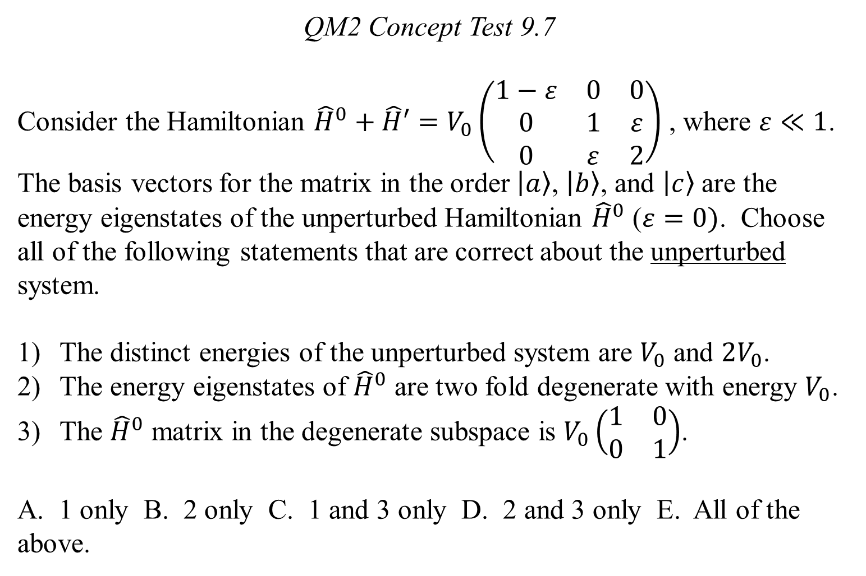
QM2 Concept Test 9.7
Consider the Hamiltonian ${\hat{H}}^{0}+\hat{H}′=V_{0}\left(\begin{matrix}1−ε & 0 & 0 \\ 0 & 1 & ε \\ 0 & ε & 2\end{matrix}\right)$ , where $ε≪1$. The basis vectors for the matrix in the order $\left.\left|a\right.\right\rangle$, $\left.\left|b\right.\right\rangle$, and $\left.\left|c\right.\right\rangle$ are the energy eigenstates of the unperturbed Hamiltonian ${\hat{H}}^{0}$ ($ε=0)$. Choose all of the following statements that are correct about the unperturbed system.
The distinct energies of the unperturbed system are $V_{0}$ and ${2V}_{0}$.
The energy eigenstates of ${\hat{H}}^{0}$ are two fold degenerate with energy $V_{0}$.
The ${\hat{H}}^{0}$ matrix in the degenerate subspace is $V_{0}\left(\begin{matrix}1 & 0 \\ 0 & 1\end{matrix}\right)$.
A. 1 only B. 2 only C. 1 and 3 only D. 2 and 3 only E. All of the above.

Slide 8
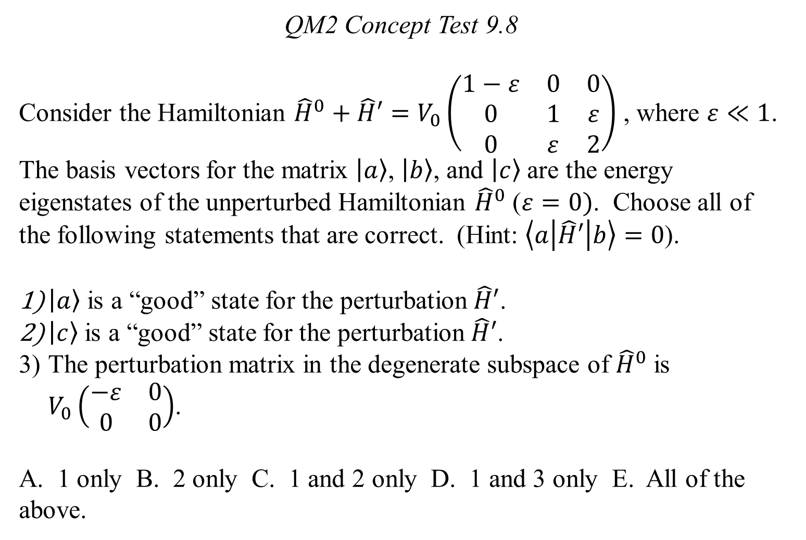
QM2 Concept Test 9.8
Consider the Hamiltonian ${\hat{H}}^{0}+\hat{H}′=V_{0}\left(\begin{matrix}1−ε & 0 & 0 \\ 0 & 1 & ε \\ 0 & ε & 2\end{matrix}\right)$ , where $ε≪1$. The basis vectors for the matrix $\left.\left|a\right.\right\rangle$, $\left.\left|b\right.\right\rangle$, and $\left.\left|c\right.\right\rangle$ are the energy eigenstates of the unperturbed Hamiltonian ${\hat{H}}^{0}$ ($ε=0)$. Choose all of the following statements that are correct. (Hint: $\left\langle a | \hat{H}′ | b\right\rangle =0$).
$\left.\left|a\right.\right\rangle$ is a “good” state for the perturbation $\hat{H}′$.
$\left.\left|c\right.\right\rangle$ is a “good” state for the perturbation $\hat{H}′$.
The perturbation matrix in the degenerate subspace of ${\hat{H}}^{0}$ is $V_{0}\left(\begin{matrix}−ε & 0 \\ 0 & 0\end{matrix}\right)$.
A. 1 only B. 2 only C. 1 and 2 only D. 1 and 3 only E. All of the above.

Slide 9
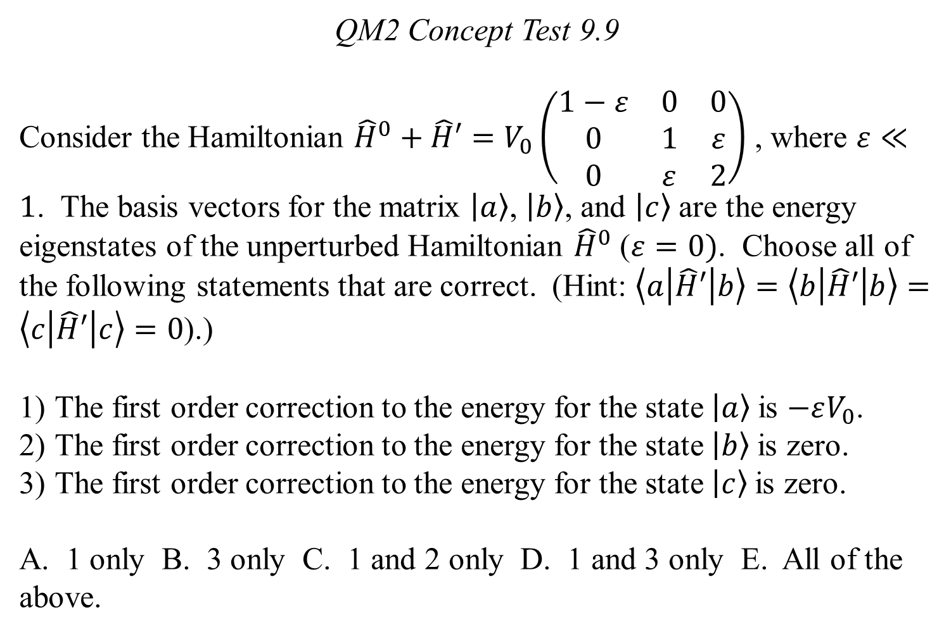
QM2 Concept Test 9.9
Consider the Hamiltonian ${\hat{H}}^{0}+\hat{H}′=V_{0}\left(\begin{matrix}1−ε & 0 & 0 \\ 0 & 1 & ε \\ 0 & ε & 2\end{matrix}\right)$ , where $ε≪1$. The basis vectors for the matrix $\left.\left|a\right.\right\rangle$, $\left.\left|b\right.\right\rangle$, and $\left.\left|c\right.\right\rangle$ are the energy eigenstates of the unperturbed Hamiltonian ${\hat{H}}^{0}$ ($ε=0)$. Choose all of the following statements that are correct. (Hint: $\left\langle a | \hat{H}′ | b\right\rangle =\left\langle b | \hat{H}′ | b\right\rangle =\left\langle c | \hat{H}′ | c\right\rangle =0$).)
The first order correction to the energy for the state $\left.\left|a\right.\right\rangle$is $−εV_{0}$.
The first order correction to the energy for the state $\left.\left|b\right.\right\rangle$is zero.
The first order correction to the energy for the state $\left.\left|c\right.\right\rangle$is zero.
A. 1 only B. 3 only C. 1 and 2 only D. 1 and 3 only E. All of the above.

