Slide 1
QM2 Concept Test 15.1
$\left.\left|nlm\right.\right\rangle$ and $\left.\left|n′l′m′\right.\right\rangle$ are two different states of an isolated hydrogen atom. The electric dipole transition between these states is proportional to the absolute square of the matrix element $\left\langle n^{′}l^{′}m′ | \hat{\vec{r}} | nlm\right\rangle$. Assume $\left.\left|nlm\right.\right\rangle$ has a higher energy than $\left.\left|n′l′m′\right.\right\rangle$. Choose all of the following statements that are correct.
In first order perturbation theory, the transition between $\left.\left|nlm\right.\right\rangle$ and $\left.\left|n′l′m′\right.\right\rangle$ can only occur when $\left\langle n^{′}l^{′}m′ | \hat{\vec{r}} | nlm\right\rangle$ is non-zero.
$\left\langle n^{′}l^{′}m′ | \left[{\hat{L}}_{z}, \hat{z}\right] | nlm\right\rangle =(m^{′}−m)ℏ\left\langle n^{′}l^{′}m′ | \hat{z} | nlm\right\rangle$.
Since $\left\langle n^{′}l^{′}m′ | \left[{\hat{L}}_{z}, \hat{z}\right] | nlm\right\rangle =0$, either $m^{′}=m$ or $\left\langle n^{′}l^{′}m′ | \hat{z} | nlm\right\rangle =0$.
1 only B. 1 and 2 only C. 1 and 3 only D. 2 and 3 only
E. All of the above.

Slide 2
QM2 Concept Test 15.2
$\left.\left|nlm\right.\right\rangle$ and $\left.\left|n′l′m′\right.\right\rangle$ are two different states of an isolated hydrogen atom. Assume $\left.\left|nlm\right.\right\rangle$ has a higher energy than $\left.\left|n′l′m′\right.\right\rangle$. We know that since $\left[{\hat{L}}_{z}, \hat{x}\right]=iℏ\hat{y} we have \left\langle n^{′}l^{′}m′ | \left[{\hat{L}}_{z}, \hat{x}\right] | nlm\right\rangle =$
$(m^{′}−m)ℏ\left\langle n^{′}l^{′}m′ | \hat{x} | nlm\right\rangle =iℏ\left\langle n^{′}l^{′}m′ | \hat{y} | nlm\right\rangle$. Choose all of the following statements that are correct assuming$\left[{\hat{L}}_{z}, \hat{y}\right]=−iℏ\hat{x}$.
$\left(m^{′}−m\right)ℏ\left\langle n^{′}l^{′}m^{′} | \hat{y} | nlm\right\rangle =−iℏ\left\langle n^{′}l^{′}m^{′} | \hat{x} | nlm\right\rangle$
${(m^{′}−m)}^{2}\left\langle n^{′}l^{′}m′ | \hat{x} | nlm\right\rangle =\left\langle n^{′}l^{′}m′ | \hat{x} | nlm\right\rangle$
${(m^{′}−m)}^{2}\left\langle n^{′}l^{′}m′ | \hat{x} | nlm\right\rangle =i\left\langle n^{′}l^{′}m′ | \hat{x} | nlm\right\rangle$
A. 1 only B. 2 only C. 3 only D. 1 and 2 only E. 1 and 3 only

Slide 3
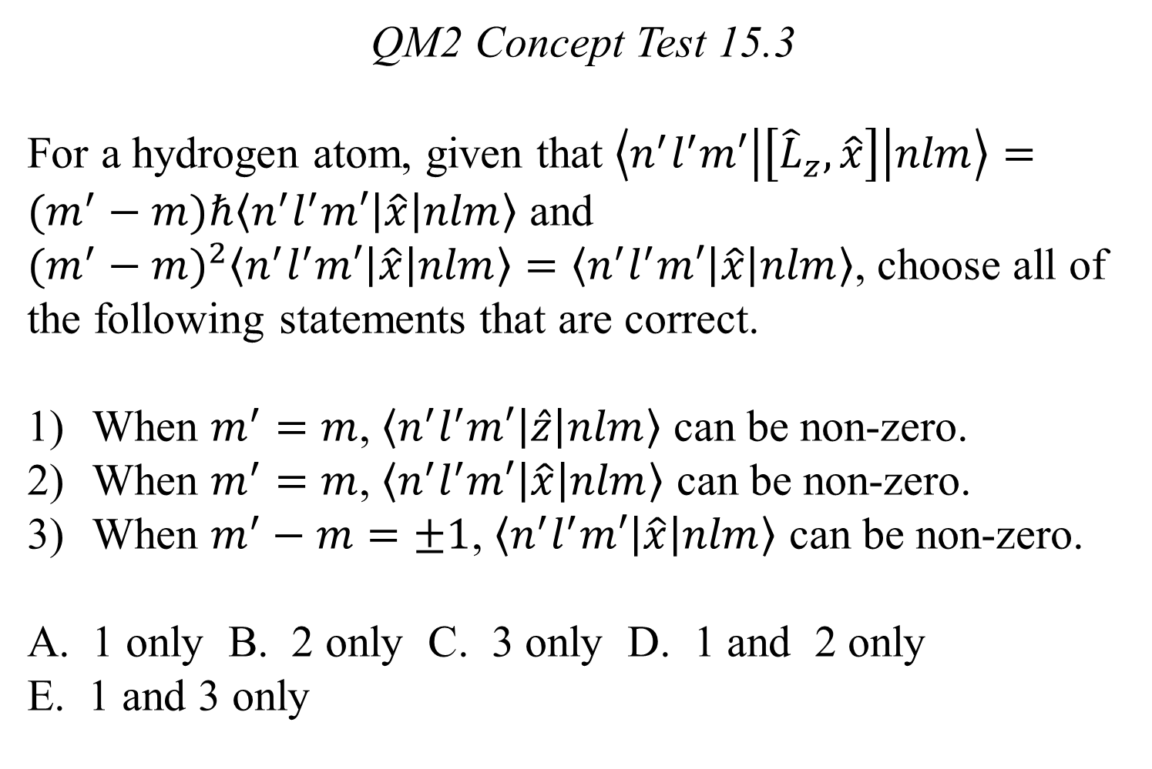
QM2 Concept Test 15.3
For a hydrogen atom, given that $\left\langle n^{′}l^{′}m′ | \left[{\hat{L}}_{z}, \hat{x}\right] | nlm\right\rangle =(m^{′}−m)ℏ\left\langle n^{′}l^{′}m′ | \hat{x} | nlm\right\rangle$ and ${(m^{′}−m)}^{2}\left\langle n^{′}l^{′}m′ | \hat{x} | nlm\right\rangle =\left\langle n^{′}l^{′}m′ | \hat{x} | nlm\right\rangle$, choose all of the following statements that are correct.
When $m^{′}=m$, $\left\langle n^{′}l^{′}m′ | \hat{z} | nlm\right\rangle$ can be non-zero.
When $m^{′}=m$, $\left\langle n^{′}l^{′}m′ | \hat{x} | nlm\right\rangle$ can be non-zero.
When $m^{′}−m=±1$, $\left\langle n^{′}l^{′}m′ | \hat{x} | nlm\right\rangle$ can be non-zero.
1 only B. 2 only C. 3 only D. 1 and 2 only
E. 1 and 3 only

Slide 4
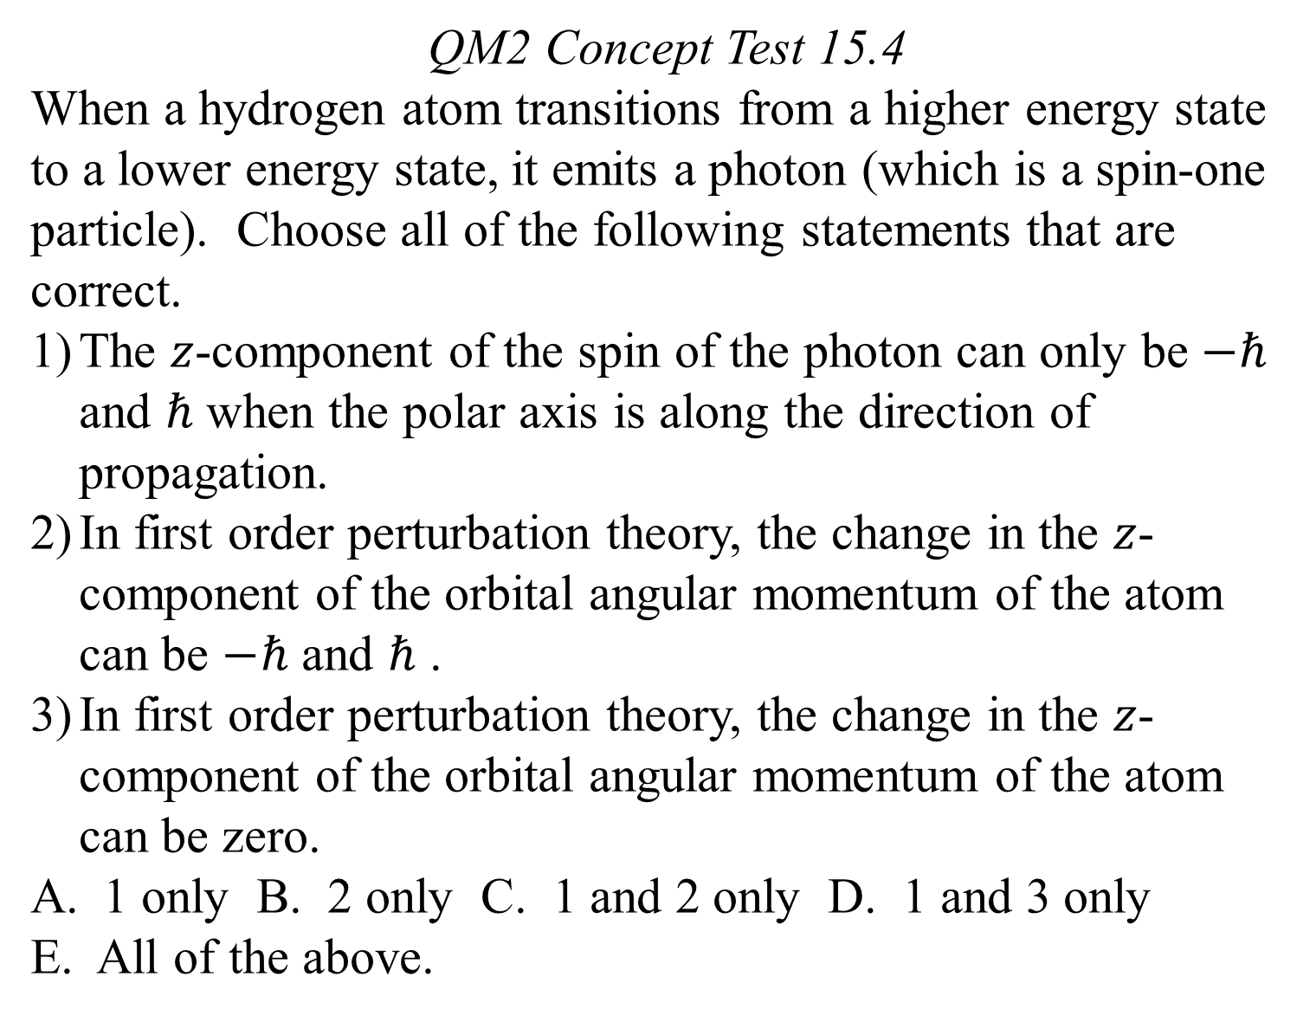
QM2 Concept Test 15.4
When a hydrogen atom transitions from a higher energy state to a lower energy state, it emits a photon (which is a spin-one particle). Choose all of the following statements that are correct.
The $z$-component of the spin of the photon can only be $−ℏ$ and $ℏ$ when the polar axis is along the direction of propagation.
In first order perturbation theory, the change in the $z$-component of the orbital angular momentum of the atom can be $−ℏ$ and $ℏ$ .
In first order perturbation theory, the change in the $z$-component of the orbital angular momentum of the atom can be zero.
1 only B. 2 only C. 1 and 2 only D. 1 and 3 only
E. All of the above.

Slide 5
QM2 Concept Test 15.5
By calculating $\left\langle n^{′}l^{′}m′ | \left[{\hat{L}}^{2},\left[{\hat{L}}^{2},\hat{\vec{r}}\right]\right] | nlm\right\rangle$ for a hydrogen atom, we can conclude that either $\left\langle n^{′}l^{′}m′ | \hat{\vec{r}} | nlm\right\rangle =0$ or $\left[{\left(l^{′}+l+1\right)}^{2}−1\right]\left[{\left(l^{′}−l\right)}^{2}−1\right]=0$. Choose all of the following statements that are correct about the selection rules for the orbital angular momentum quantum number $l$ for electric dipole transitions between states $\left.\left|nlm\right.\right\rangle$ and $\left.\left|n′l′m′\right.\right\rangle$.
Transitions are allowed when $l^{′}−l=±1$.
Transitions are allowed when $l′=l=0$.
When $l^{′}=l=0$, $\left\langle n^{′}00 | \hat{\vec{r}} | n00\right\rangle =\frac{1}{4π}\int{R_{n^{′}0}\left(r\right)R_{n0}\left(r\right)\left(x\hat{i}+y\hat{j}+z\hat{k}\right)dxdydz}$.
1 only B. 2 only C. 1 and 2 only D. 1 and 3 only
E. None of the above.

Slide 6
QM2 Concept Test 15.6
Choose all of the following matrix elements between the given states $\left.\left|nlm\right.\right\rangle$ and $\left.\left|n′l′m′\right.\right\rangle$ that are zero for a spherically symmetric potential energy such as a hydrogen atom.
$\left\langle 211 | \hat{z} | 21−1\right\rangle$
$\left\langle 310 | \hat{z} | 210\right\rangle$
$\left\langle 311 | \hat{x} | 200\right\rangle$
1 only B. 2 only C. 3 only D. 1 and 2 only
E. All of the above.

Slide 7
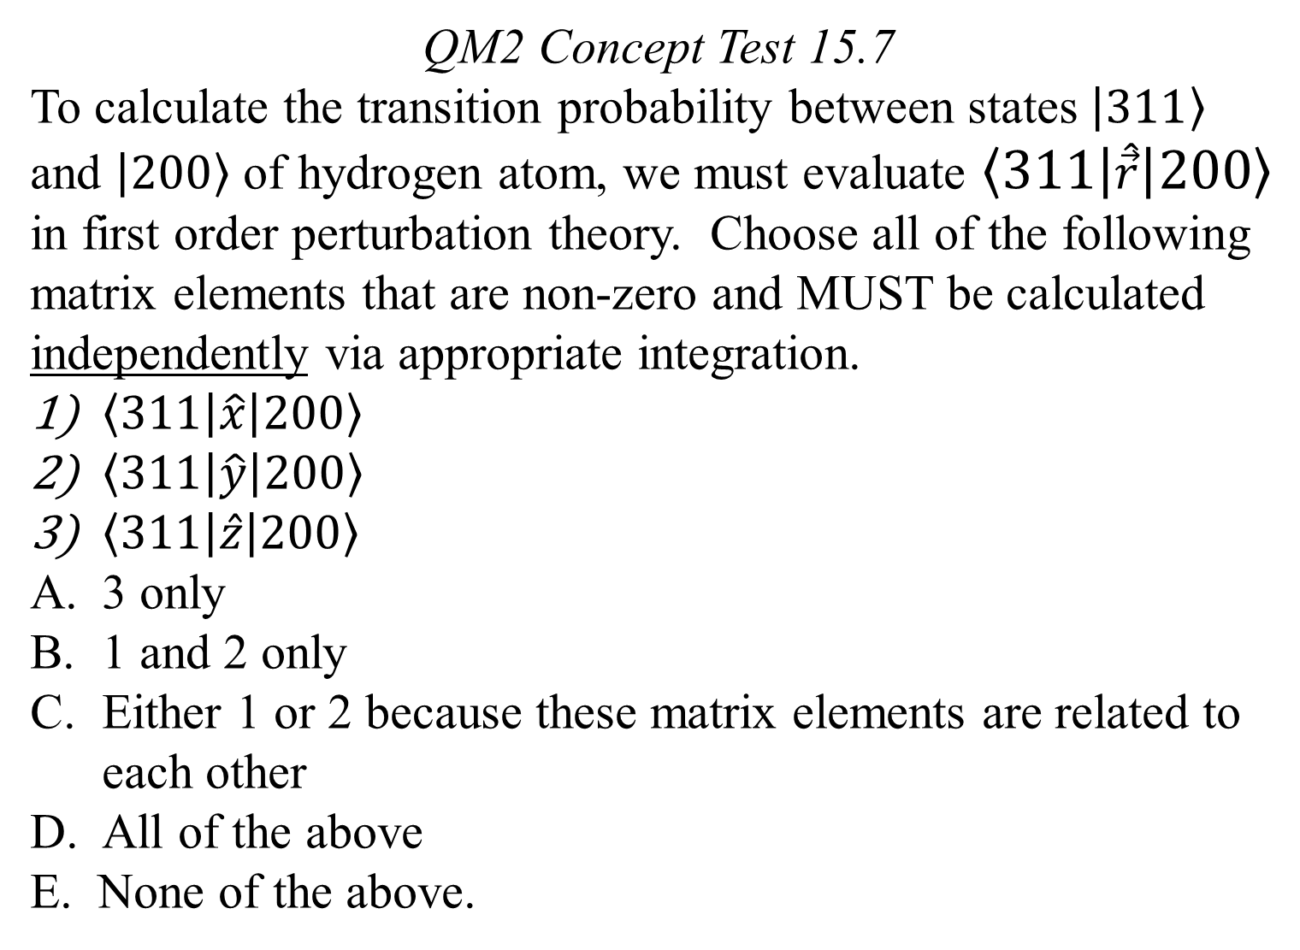
QM2 Concept Test 15.7
To calculate the transition probability between states $\left.\left|311\right.\right\rangle$ and $\left.\left|200\right.\right\rangle$ of hydrogen atom, we must evaluate $\left\langle 311 | \hat{\vec{r}} | 200\right\rangle$ in first order perturbation theory. Choose all of the following matrix elements that are non-zero and MUST be calculated independently via appropriate integration.
$\left\langle 311 | \hat{x} | 200\right\rangle$
$\left\langle 311 | \hat{y} | 200\right\rangle$
$\left\langle 311 | \hat{z} | 200\right\rangle$
3 only
1 and 2 only
Either 1 or 2 because these matrix elements are related to each other
All of the above
E. None of the above.

Slide 8
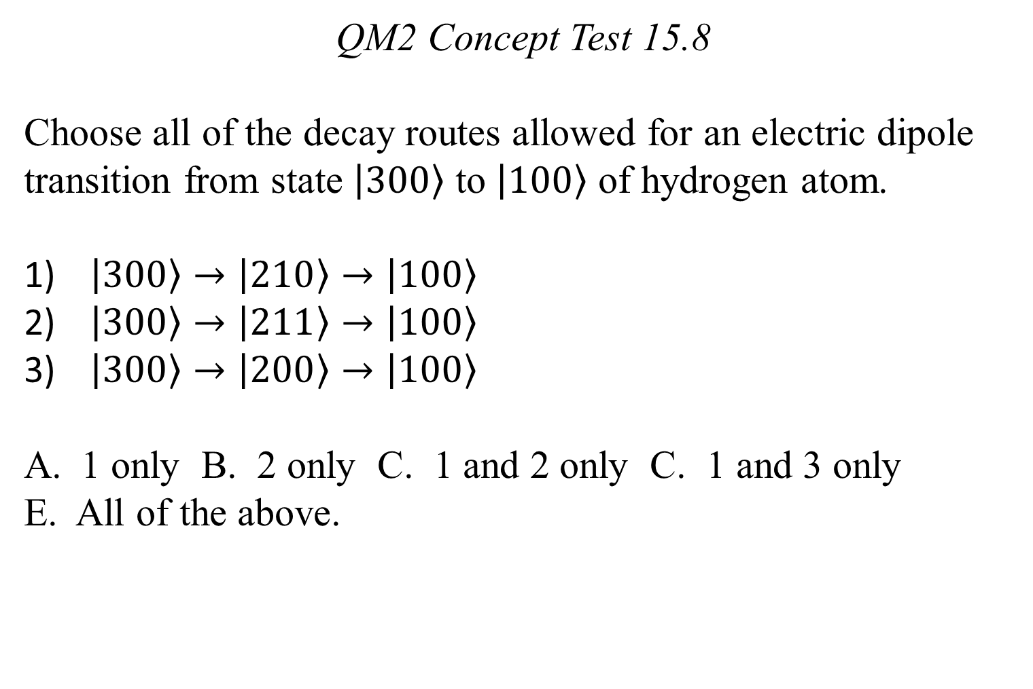
QM2 Concept Test 15.8
Choose all of the decay routes allowed for an electric dipole transition from state $\left.\left|300\right.\right\rangle$ to $\left.\left|100\right.\right\rangle$ of hydrogen atom.
$\left.\left|300\right.\right\rangle →\left.\left|210\right.\right\rangle →\left.\left|100\right.\right\rangle$
$\left.\left|300\right.\right\rangle →\left.\left|211\right.\right\rangle →\left.\left|100\right.\right\rangle$
$\left.\left|300\right.\right\rangle →\left.\left|200\right.\right\rangle →\left.\left|100\right.\right\rangle$
1 only B. 2 only C. 1 and 2 only C. 1 and 3 only
E. All of the above.

Slide 9
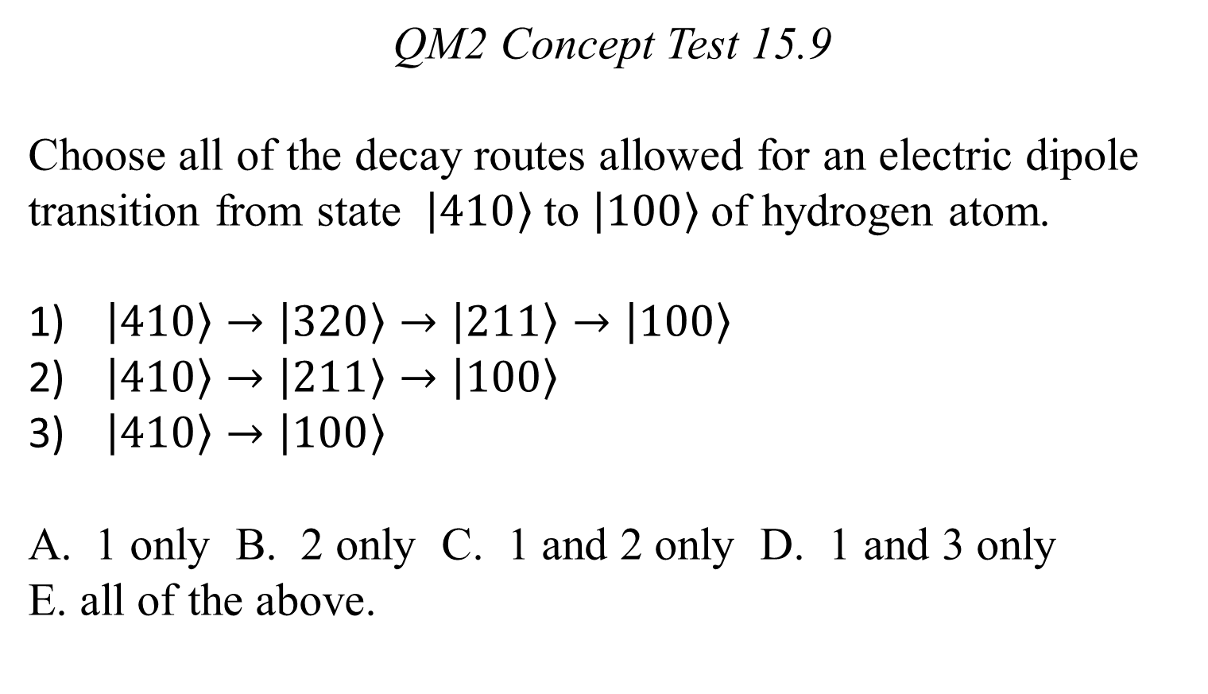
QM2 Concept Test 15.9
Choose all of the decay routes allowed for an electric dipole transition from state $\left.\left|410\right.\right\rangle$ to $\left.\left|100\right.\right\rangle$ of hydrogen atom.
$\left.\left|410\right.\right\rangle →\left.\left|320\right.\right\rangle →\left.\left|211\right.\right\rangle →\left.\left|100\right.\right\rangle$
$\left.\left|410\right.\right\rangle →\left.\left|211\right.\right\rangle →\left.\left|100\right.\right\rangle$
$\left.\left|410\right.\right\rangle →\left.\left|100\right.\right\rangle$
1 only B. 2 only C. 1 and 2 only D. 1 and 3 only
E. all of the above.

