Slide 1
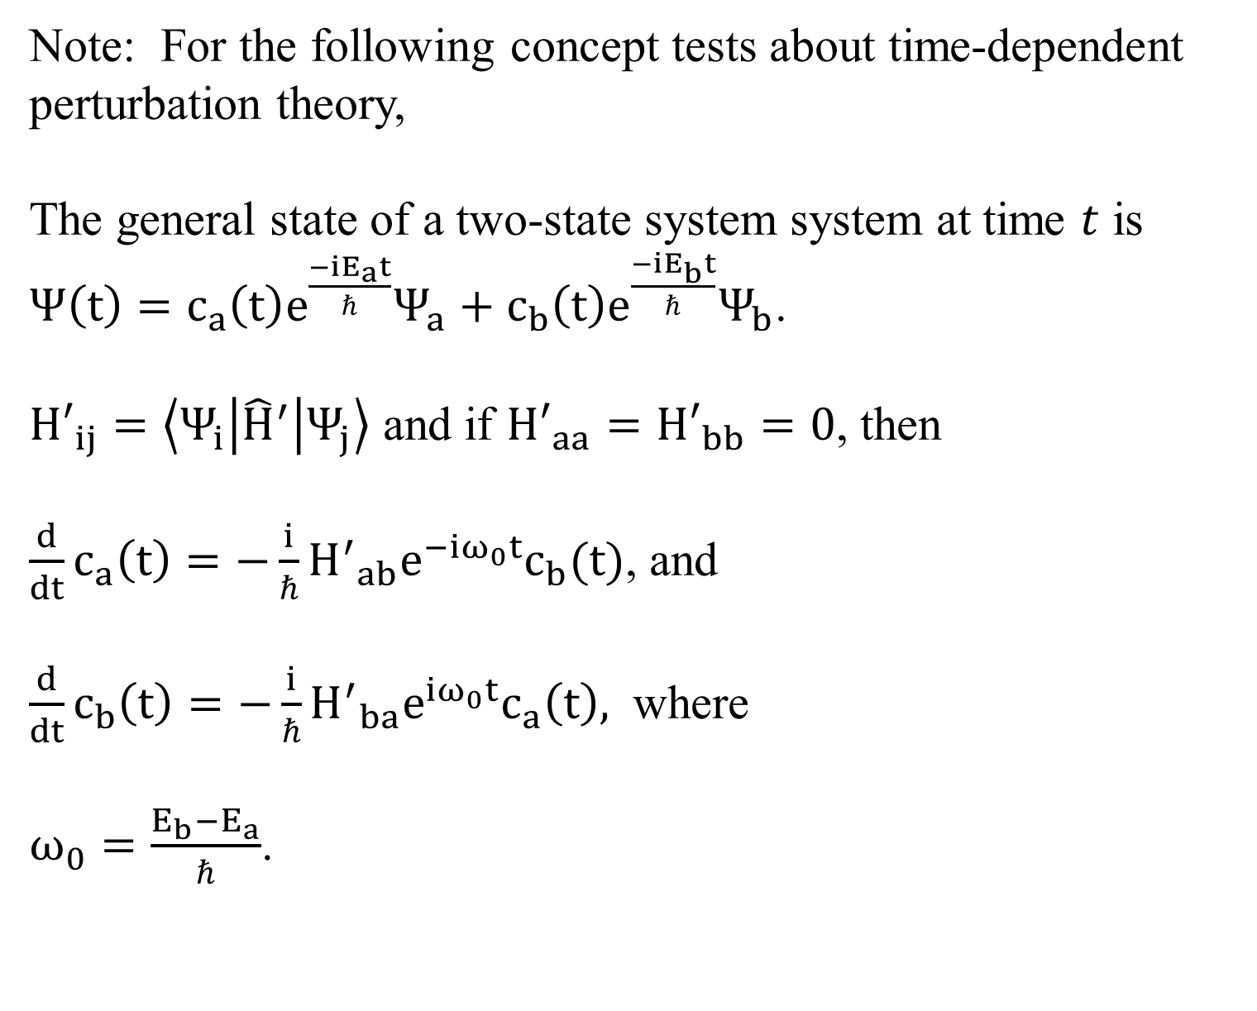
Note: For the following concept tests about time-dependent perturbation theory,
The general state of a two-state system system at time $t$ is $Ψ\left(t\right)=c_{a}\left(t\right)e^{\frac{−iE_{a}t}{ℏ}}Ψ_{a}+c_{b}\left(t\right)e^{\frac{−iE_{b}t}{ℏ}}Ψ_{b}$.
${H′}_{ij}=\left\langle Ψ_{i} | {\hat{H}}^{′} | Ψ_{j}\right\rangle$ and if ${H′}_{aa}={H′}_{bb}=0$, then
$\frac{d}{dt}c_{a}\left(t\right)=−\frac{i}{ℏ}{H^{′}}_{ab}e^{−iω_{0}t}c_{b}(t)$, and
$\frac{d}{dt}c_{b}\left(t\right)=−\frac{i}{ℏ}{H^{′}}_{ba}e^{iω_{0}t}c_{a}\left(t\right),$ where
$ω_{0}=\frac{E_{b}−E_{a}}{ℏ}$.

Slide 2
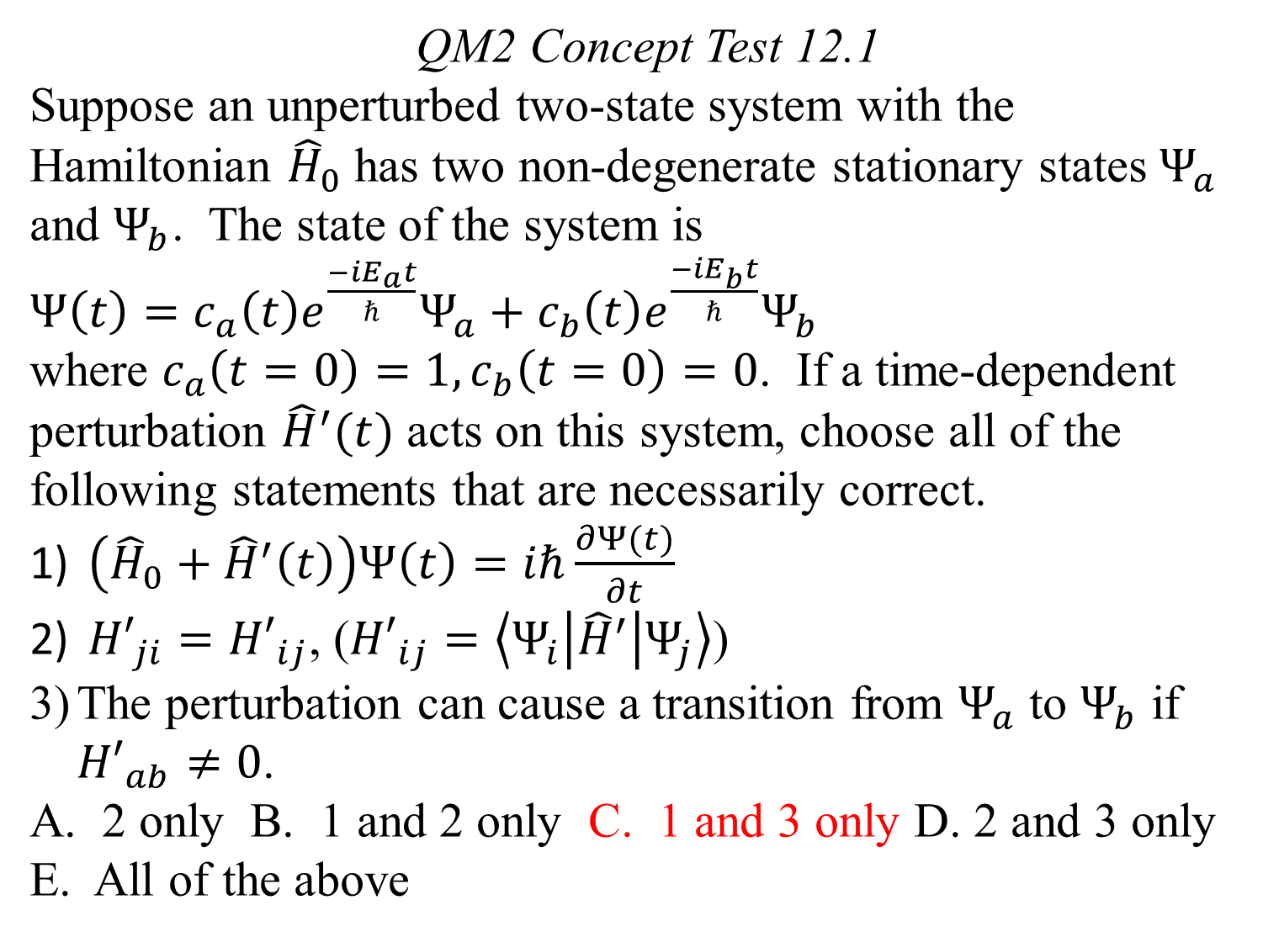
QM2 Concept Test 12.1
Suppose an unperturbed two-state system with the Hamiltonian ${\hat{H}}_{0}$ has two non-degenerate stationary states $Ψ_{a}$ and $Ψ_{b}$. The state of the system is
$Ψ\left(t\right)=c_{a}\left(t\right)e^{\frac{−iE_{a}t}{ℏ}}Ψ_{a}+c_{b}\left(t\right)e^{\frac{−iE_{b}t}{ℏ}}Ψ_{b}$
where $c_{a}\left(t=0\right)=1, c_{b}\left(t=0\right)=0$. If a time-dependent perturbation ${\hat{H}}^{′}(t)$ acts on this system, choose all of the following statements that are necessarily correct.
$\left({\hat{H}}_{0}+{\hat{H}}^{′}\left(t\right)\right)Ψ\left(t\right)=iℏ\frac{∂Ψ(t)}{∂t}$
${H′}_{ji}={H′}_{ij}$, (${H′}_{ij}=\left\langle Ψ_{i} | {\hat{H}}^{′} | Ψ_{j}\right\rangle$)
The perturbation can cause a transition from $Ψ_{a}$ to $Ψ_{b}$ if ${H′}_{ab}≠0$.
A. 2 only B. 1 and 2 only C. 1 and 3 only D. 2 and 3 only E. All of the above

Slide 3
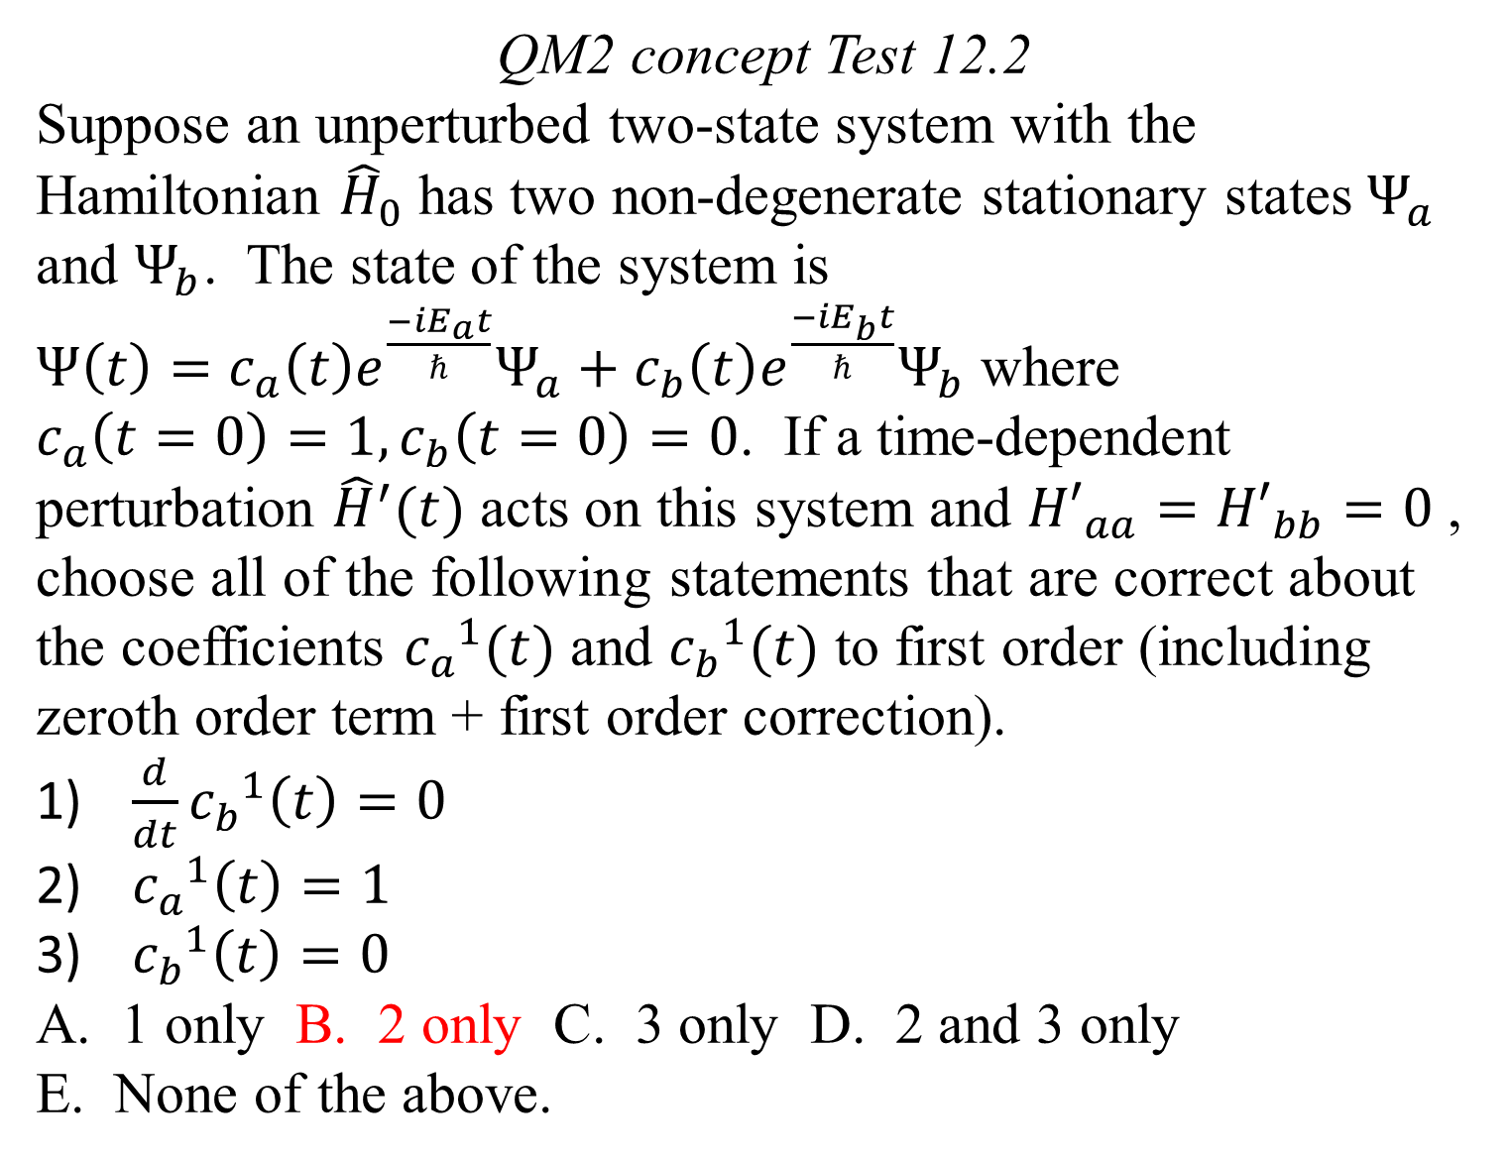
QM2 concept Test 12.2
Suppose an unperturbed two-state system with the Hamiltonian ${\hat{H}}_{0}$ has two non-degenerate stationary states $Ψ_{a}$ and $Ψ_{b}$. The state of the system is
$Ψ\left(t\right)=c_{a}\left(t\right)e^{\frac{−iE_{a}t}{ℏ}}Ψ_{a}+c_{b}\left(t\right)e^{\frac{−iE_{b}t}{ℏ}}Ψ_{b}$ where
$c_{a}\left(t=0\right)=1, c_{b}\left(t=0\right)=0$. If a time-dependent perturbation ${\hat{H}}^{′}(t)$ acts on this system and ${H′}_{aa}={H′}_{bb}=0$ , choose all of the following statements that are correct about the coefficients ${c_{a}}^{1}(t)$ and ${c_{b}}^{1}(t)$ to first order (including zeroth order term + first order correction).
$\frac{d}{dt}{c_{b}}^{1}\left(t\right)=0$
${c_{a}}^{1}\left(t\right)=1$
${c_{b}}^{1}\left(t\right)=0$
A. 1 only B. 2 only C. 3 only D. 2 and 3 only
E. None of the above.

Slide 4
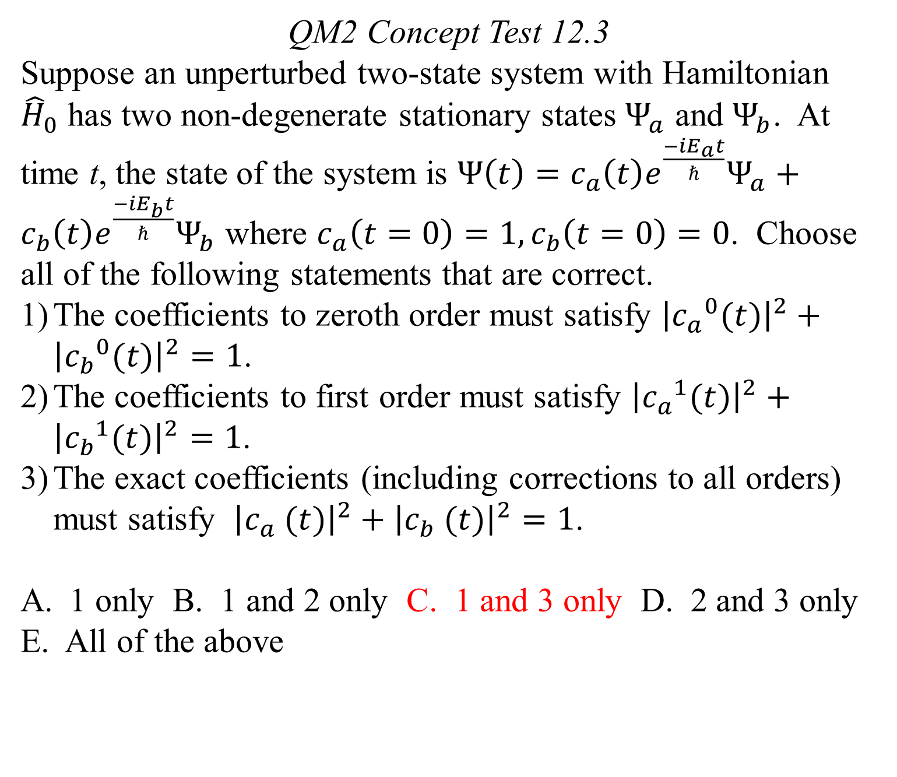
QM2 Concept Test 12.3
Suppose an unperturbed two-state system with Hamiltonian ${\hat{H}}_{0}$ has two non-degenerate stationary states $Ψ_{a}$ and $Ψ_{b}$. At time t, the state of the system is $Ψ\left(t\right)=c_{a}\left(t\right)e^{\frac{−iE_{a}t}{ℏ}}Ψ_{a}+c_{b}\left(t\right)e^{\frac{−iE_{b}t}{ℏ}}Ψ_{b}$ where $c_{a}\left(t=0\right)=1, c_{b}\left(t=0\right)=0$. Choose all of the following statements that are correct.
The coefficients to zeroth order must satisfy ${\left|{c_{a}}^{0}(t)\right|}^{2}+{\left|{c_{b}}^{0}(t)\right|}^{2}=1$.
The coefficients to first order must satisfy ${\left|{c_{a}}^{1}(t)\right|}^{2}+{\left|{c_{b}}^{1}(t)\right|}^{2}=1$.
The exact coefficients (including corrections to all orders) must satisfy ${\left|c_{a} (t)\right|}^{2}+{\left|c_{b} (t)\right|}^{2}=1$.
1 only B. 1 and 2 only C. 1 and 3 only D. 2 and 3 only
E. All of the above

Slide 5
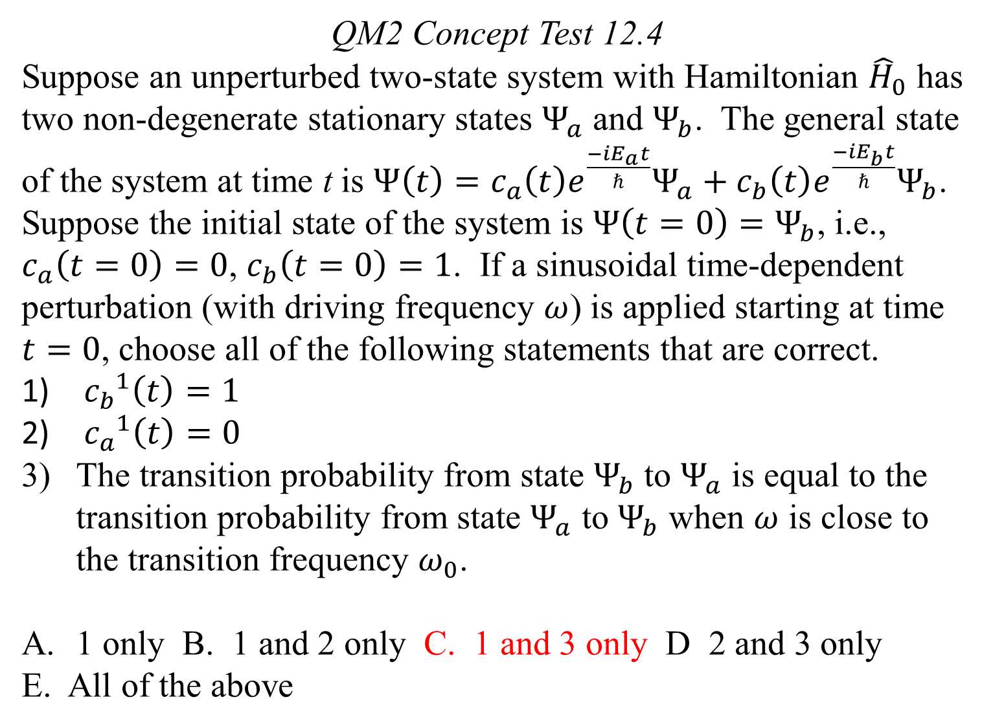
QM2 Concept Test 12.4
Suppose an unperturbed two-state system with Hamiltonian ${\hat{H}}_{0}$ has two non-degenerate stationary states $Ψ_{a}$ and $Ψ_{b}$. The general state of the system at time t is $Ψ\left(t\right)=c_{a}\left(t\right)e^{\frac{−iE_{a}t}{ℏ}}Ψ_{a}+c_{b}\left(t\right)e^{\frac{−iE_{b}t}{ℏ}}Ψ_{b}$. Suppose the initial state of the system is $Ψ\left(t=0\right)=Ψ_{b}$, i.e., $c_{a}\left(t=0\right)=0$, $c_{b}\left(t=0\right)=1$. If a sinusoidal time-dependent perturbation (with driving frequency $ω$) is applied starting at time $t=0$, choose all of the following statements that are correct.
${c_{b}}^{1}\left(t\right)=1$
${c_{a}}^{1}\left(t\right)=0$
The transition probability from state $Ψ_{b}$ to $Ψ_{a}$ is equal to the transition probability from state $Ψ_{a}$ to $Ψ_{b}$ when $ω$ is close to the transition frequency $ω_{0}$.
1 only B. 1 and 2 only C. 1 and 3 only D 2 and 3 only
E. All of the above

Slide 6
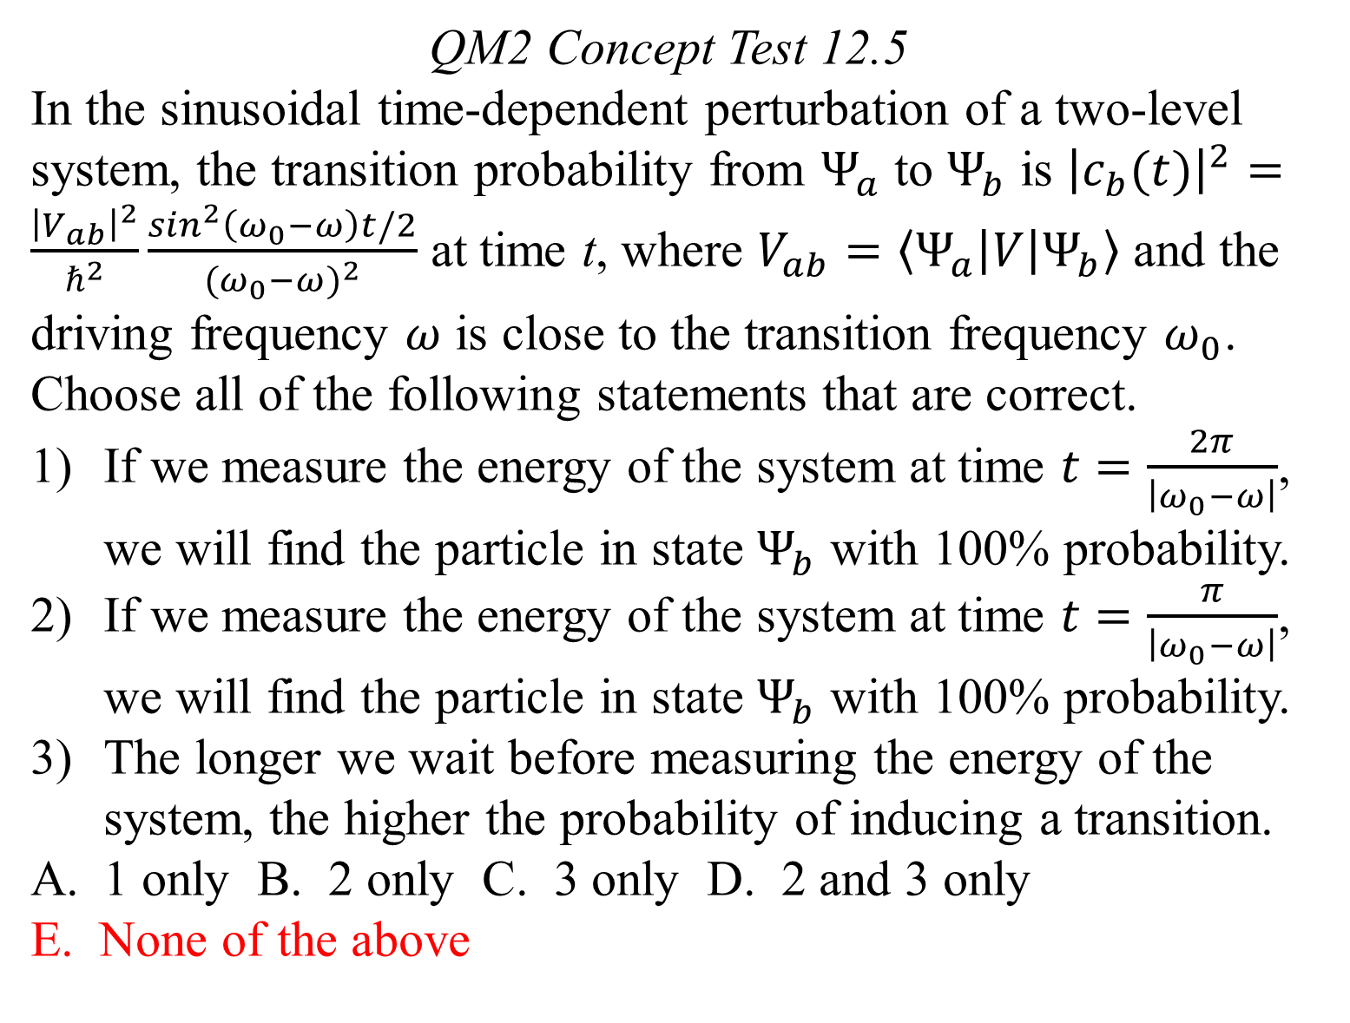
QM2 Concept Test 12.5
In the sinusoidal time-dependent perturbation of a two-level system, the transition probability from $Ψ_{a}$ to $Ψ_{b}$ is ${\left|c_{b}(t)\right|}^{2}=\frac{{\left|V_{ab}\right|}^{2}}{ℏ^{2}}\frac{\sin^{2}\left(ω_{0}−ω\right)t/2}{{(ω_{0}−ω)}^{2}}$ at time t, where $V_{ab}=\left\langle Ψ_{a} | V | Ψ_{b}\right\rangle$ and the driving frequency $ω$ is close to the transition frequency $ω_{0}$. Choose all of the following statements that are correct.
If we measure the energy of the system at time $t=\frac{2π}{\left|ω_{0}−ω\right|}$, we will find the particle in state $Ψ_{b}$ with 100% probability.
If we measure the energy of the system at time $t=\frac{π}{\left|ω_{0}−ω\right|}$, we will find the particle in state $Ψ_{b}$ with 100% probability.
The longer we wait before measuring the energy of the system, the higher the probability of inducing a transition.
1 only B. 2 only C. 3 only D. 2 and 3 only
E. None of the above

Slide 7
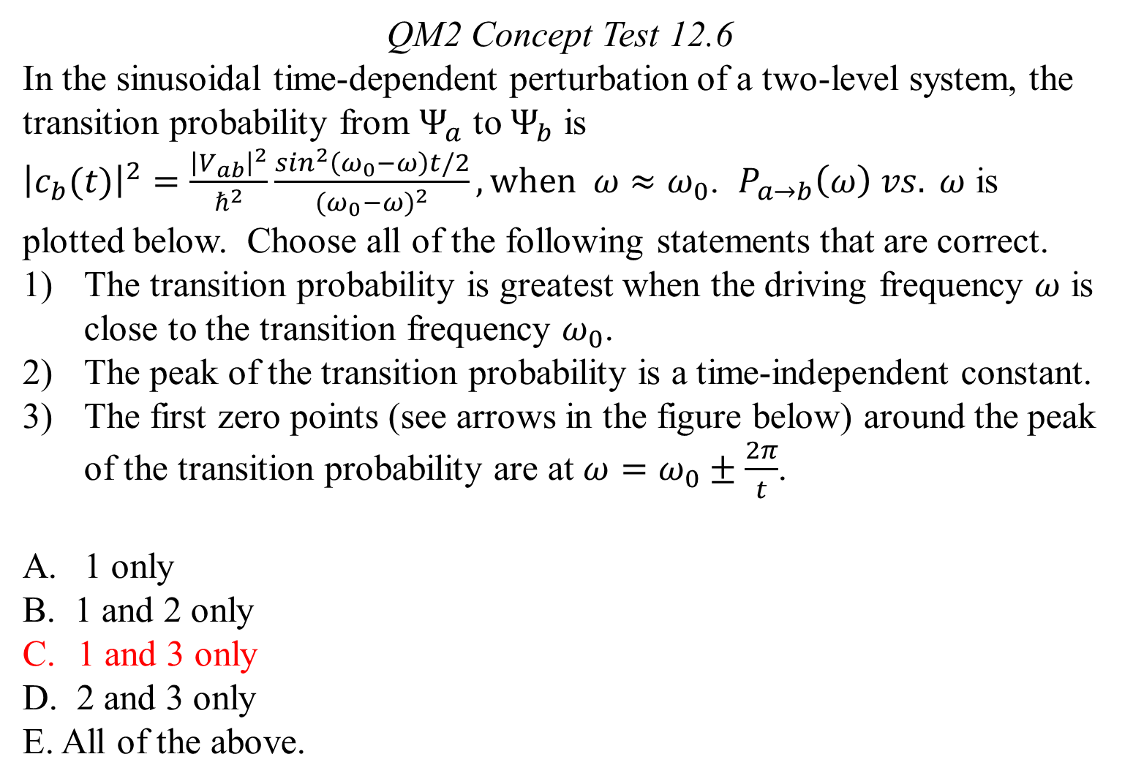
QM2 Concept Test 12.6
In the sinusoidal time-dependent perturbation of a two-level system, the transition probability from $Ψ_{a}$ to $Ψ_{b}$ is ${\left|c_{b}(t)\right|}^{2}=\frac{{\left|V_{ab}\right|}^{2}}{ℏ^{2}}\frac{\sin^{2}\left(ω_{0}−ω\right)t/2}{{(ω_{0}−ω)}^{2}}, when ω≈ω_{0}$. $P_{a→b}\left(ω\right) vs. ω$ is plotted below. Choose all of the following statements that are correct.
The transition probability is greatest when the driving frequency $ω$ is close to the transition frequency $ω_{0}$.
The peak of the transition probability is a time-independent constant.
The first zero points (see arrows in the figure below) around the peak of the transition probability are at $ω=ω_{0}±\frac{2π}{t}$.
1 only
B. 1 and 2 only
1 and 3 only
D. 2 and 3 only
E. All of the above.

Slide 8
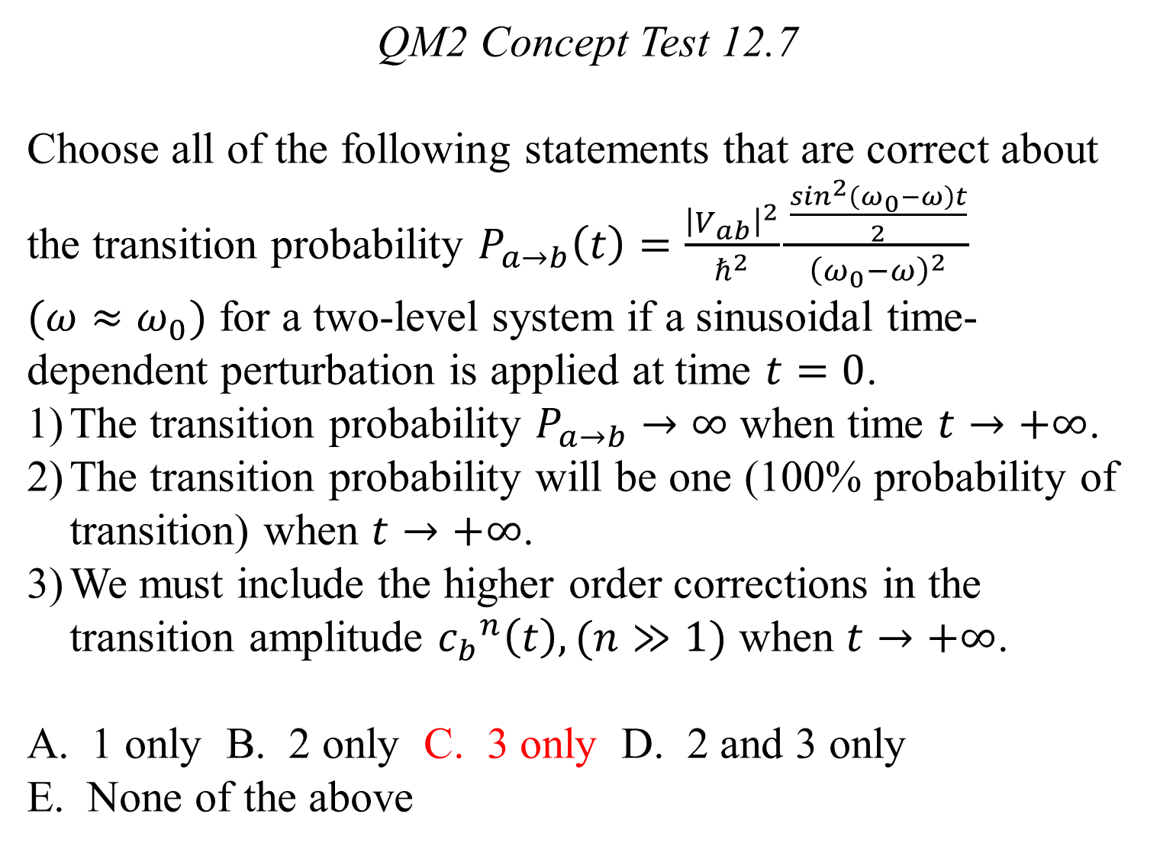
QM2 Concept Test 12.7
Choose all of the following statements that are correct about the transition probability $P_{a→b}\left(t\right)=\frac{{\left|V_{ab}\right|}^{2}}{ℏ^{2}}\frac{\frac{\sin^{2}\left(ω_{0}−ω\right)t}{2}}{{\left(ω_{0}−ω\right)}^{2}}$
$(ω≈ω_{0})$ for a two-level system if a sinusoidal time-dependent perturbation is applied at time $t=0$.
The transition probability $P_{a→b}→∞$ when time $t→+∞$.
The transition probability will be one (100% probability of transition) when $t→+∞$.
We must include the higher order corrections in the transition amplitude ${c_{b}}^{n}\left(t\right), (n≫1)$ when $t→+∞$.
1 only B. 2 only C. 3 only D. 2 and 3 only
E. None of the above

