Slide 1
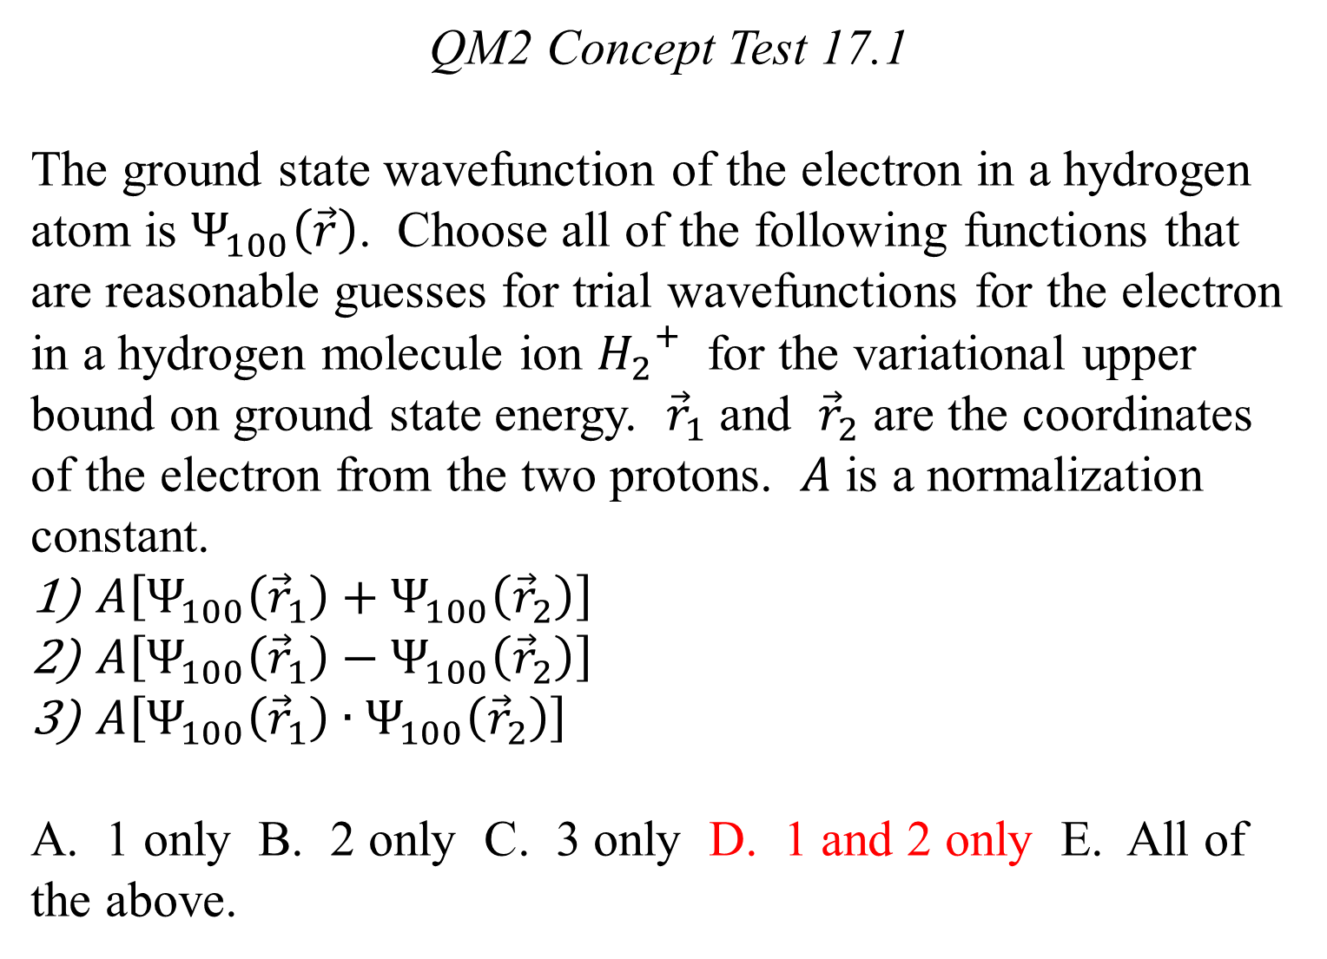
QM2 Concept Test 17.1
The ground state wavefunction of the electron in a hydrogen atom is $Ψ_{100}\left(\vec{r}\right)$. Choose all of the following functions that are reasonable guesses for trial wavefunctions for the electron in a hydrogen molecule ion ${H_{2}}^{+}$ for the variational upper bound on ground state energy. ${\vec{r}}_{1}$ and ${\vec{r}}_{2}$ are the coordinates of the electron from the two protons. $A$ is a normalization constant.
$A\left[Ψ_{100}\left({\vec{r}}_{1}\right)+Ψ_{100}\left({\vec{r}}_{2}\right)\right]$
$A\left[Ψ_{100}\left({\vec{r}}_{1}\right)−Ψ_{100}\left({\vec{r}}_{2}\right)\right]$
$A\left[Ψ_{100}\left({\vec{r}}_{1}\right)∙Ψ_{100}\left({\vec{r}}_{2}\right)\right]$
A. 1 only B. 2 only C. 3 only D. 1 and 2 only E. All of the above.

Slide 2
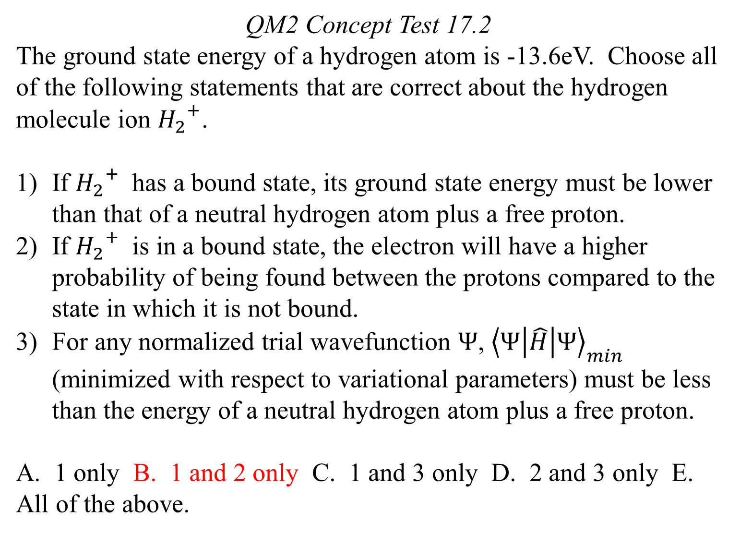
QM2 Concept Test 17.2
The ground state energy of a hydrogen atom is -13.6eV. Choose all of the following statements that are correct about the hydrogen molecule ion ${H_{2}}^{+}$.
If ${H_{2}}^{+}$ has a bound state, its ground state energy must be lower than that of a neutral hydrogen atom plus a free proton.
If ${H_{2}}^{+}$ is in a bound state, the electron will have a higher probability of being found between the protons compared to the state in which it is not bound.
For any normalized trial wavefunction $Ψ$, ${\left\langle Ψ | \hat{H} | Ψ\right\rangle }_{min}$ (minimized with respect to variational parameters) must be less than the energy of a neutral hydrogen atom plus a free proton.
A. 1 only B. 1 and 2 only C. 1 and 3 only D. 2 and 3 only E. All of the above.

Slide 3
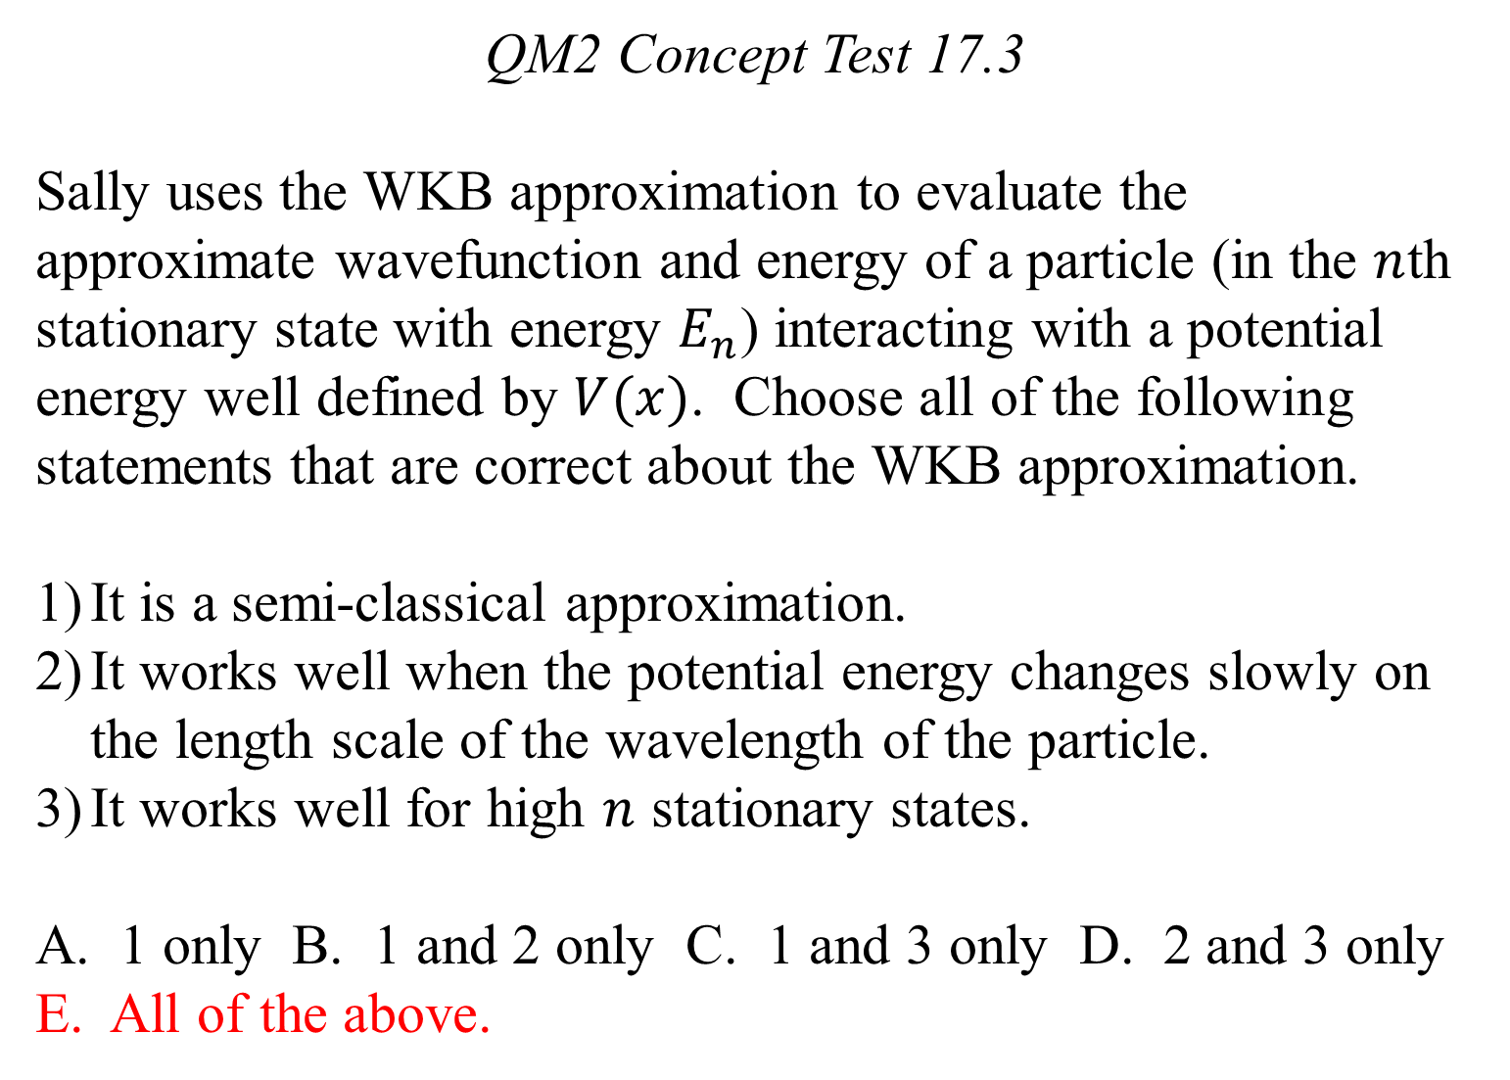
QM2 Concept Test 17.3
Sally uses the WKB approximation to evaluate the approximate wavefunction and energy of a particle (in the $n$th stationary state with energy $E_{n}$) interacting with a potential energy well defined by $V(x)$. Choose all of the following statements that are correct about the WKB approximation.
It is a semi-classical approximation.
It works well when the potential energy changes slowly on the length scale of the wavelength of the particle.
It works well for high $n$ stationary states.
A. 1 only B. 1 and 2 only C. 1 and 3 only D. 2 and 3 only E. All of the above.

Slide 4
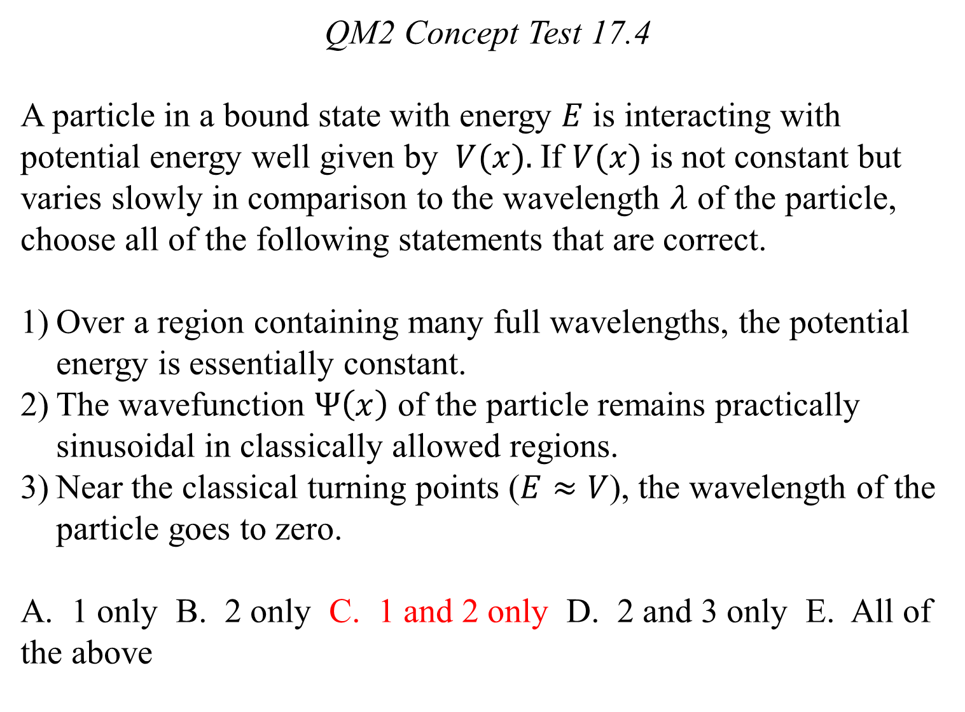
QM2 Concept Test 17.4
A particle in a bound state with energy $E$ is interacting with potential energy well given by $V(x).$If $V(x)$is not constant but varies slowly in comparison to the wavelength $λ$ of the particle, choose all of the following statements that are correct.
Over a region containing many full wavelengths, the potential energy is essentially constant.
The wavefunction $Ψ\left(x\right)$ of the particle remains practically sinusoidal in classically allowed regions.
Near the classical turning points ($E≈V$), the wavelength of the particle goes to zero.
A. 1 only B. 2 only C. 1 and 2 only D. 2 and 3 only E. All of the above

Slide 5
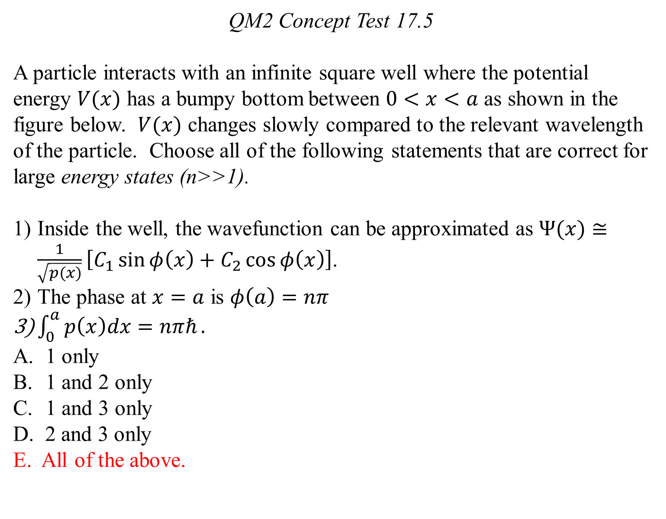
QM2 Concept Test 17.5
A particle interacts with an infinite square well where the potential energy $V(x)$ has a bumpy bottom between $0<x<a$ as shown in the figure below. $V(x)$ changes slowly compared to the relevant wavelength of the particle. Choose all of the following statements that are correct for large energy states (n>>1).
Inside the well, the wavefunction can be approximated as $Ψ(x)≅\frac{1}{\sqrt{p(x)}}\left[C_{1}\sin{φ\left(x\right)+C_{2}\cos{φ\left(x\right)}}\right]$.
The phase at $x=a$ is $φ\left(a\right)=nπ$
$\int_{0}^{a}{p\left(x\right)dx=nπℏ}.$
1 only
1 and 2 only
1 and 3 only
D. 2 and 3 only
E. All of the above.

Slide 6
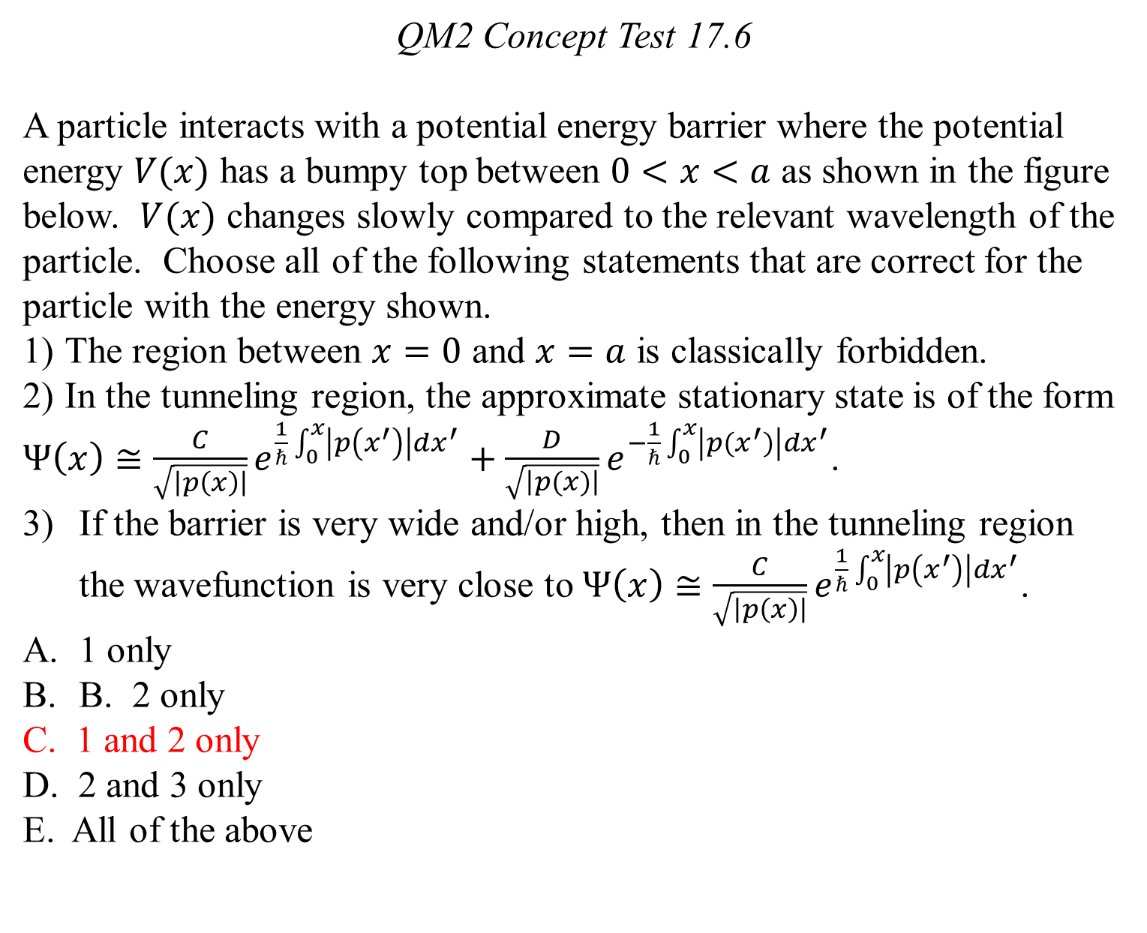
QM2 Concept Test 17.6
A particle interacts with a potential energy barrier where the potential energy $V(x)$ has a bumpy top between $0<x<a$ as shown in the figure below. $V(x)$ changes slowly compared to the relevant wavelength of the particle. Choose all of the following statements that are correct for the particle with the energy shown.
The region between $x=0$ and $x=a$ is classically forbidden.
In the tunneling region, the approximate stationary state is of the form
$Ψ\left(x\right)≅\frac{C}{\sqrt{\left|p\left(x\right)\right|}}e^{\frac{1}{ℏ}\int_{0}^{x}{\left|p\left(x^{′}\right)\right|dx^{′}}}+\frac{D}{\sqrt{\left|p(x)\right|}}e^{−\frac{1}{ℏ}\int_{0}^{x}{\left|p(x^{′})\right|dx^{′}}}$.
If the barrier is very wide and/or high, then in the tunneling region the wavefunction is very close to $Ψ\left(x\right)≅\frac{C}{\sqrt{\left|p\left(x\right)\right|}}e^{\frac{1}{ℏ}\int_{0}^{x}{\left|p\left(x^{′}\right)\right|dx^{′}}}$.
1 only
B. 2 only
C. 1 and 2 only
D. 2 and 3 only
E. All of the above

Slide 7
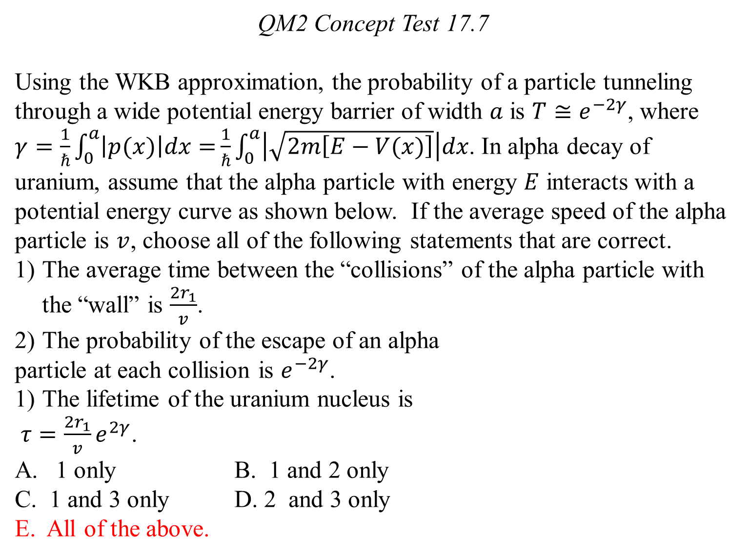
QM2 Concept Test 17.7
Using the WKB approximation, the probability of a particle tunneling through a wide potential energy barrier of width $a$ is $T≅e^{−2γ}$, where $γ=\frac{1}{ℏ}\int_{0}^{a}{\left|p(x)\right|dx=}\frac{1}{ℏ}\int_{0}^{a}{\left|\sqrt{2m\left[E−V(x)\right]}\right|dx}$. In alpha decay of uranium, assume that the alpha particle with energy $E$ interacts with a potential energy curve as shown below. If the average speed of the alpha particle is $v$, choose all of the following statements that are correct.
The average time between the “collisions” of the alpha particle with the “wall” is $\frac{2r_{1}}{v}$.
The probability of the escape of an alpha
particle at each collision is $e^{−2γ}$.
The lifetime of the uranium nucleus is
$τ=\frac{2r_{1}}{v}e^{2γ}$.
1 only B. 1 and 2 only
C. 1 and 3 only D. 2 and 3 only
E. All of the above.

Slide 8
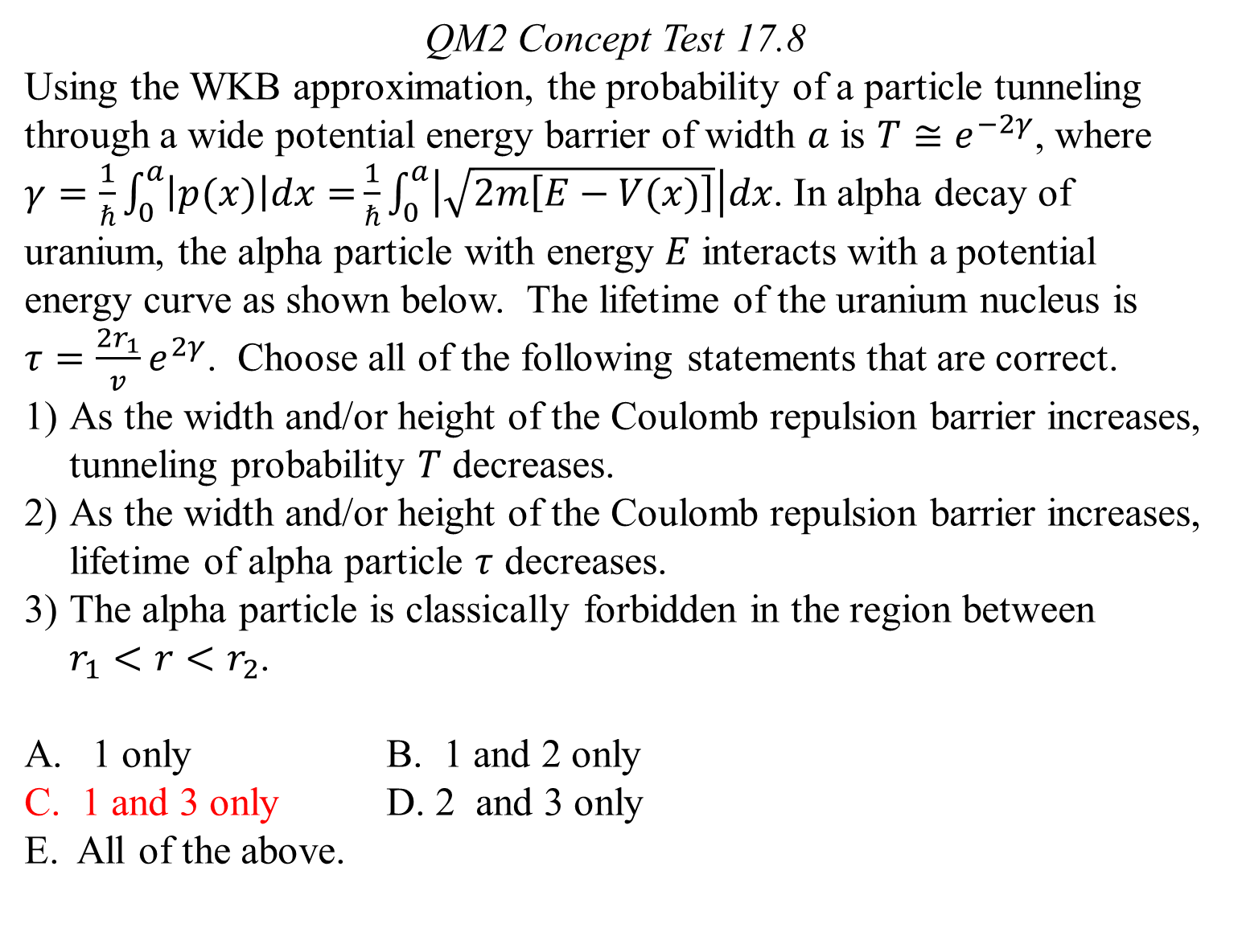
QM2 Concept Test 17.8
Using the WKB approximation, the probability of a particle tunneling through a wide potential energy barrier of width $a$ is $T≅e^{−2γ}$, where $γ=\frac{1}{ℏ}\int_{0}^{a}{\left|p(x)\right|dx=}\frac{1}{ℏ}\int_{0}^{a}{\left|\sqrt{2m\left[E−V(x)\right]}\right|dx}$. In alpha decay of uranium, the alpha particle with energy $E$ interacts with a potential energy curve as shown below. The lifetime of the uranium nucleus is $τ=\frac{2r_{1}}{v}e^{2γ}$. Choose all of the following statements that are correct.
As the width and/or height of the Coulomb repulsion barrier increases, tunneling probability $T$ decreases.
As the width and/or height of the Coulomb repulsion barrier increases, lifetime of alpha particle $τ$ decreases.
The alpha particle is classically forbidden in the region between $r_{1}<r<r_{2}$.
1 only B. 1 and 2 only
C. 1 and 3 only D. 2 and 3 only
E. All of the above.

Slide 9
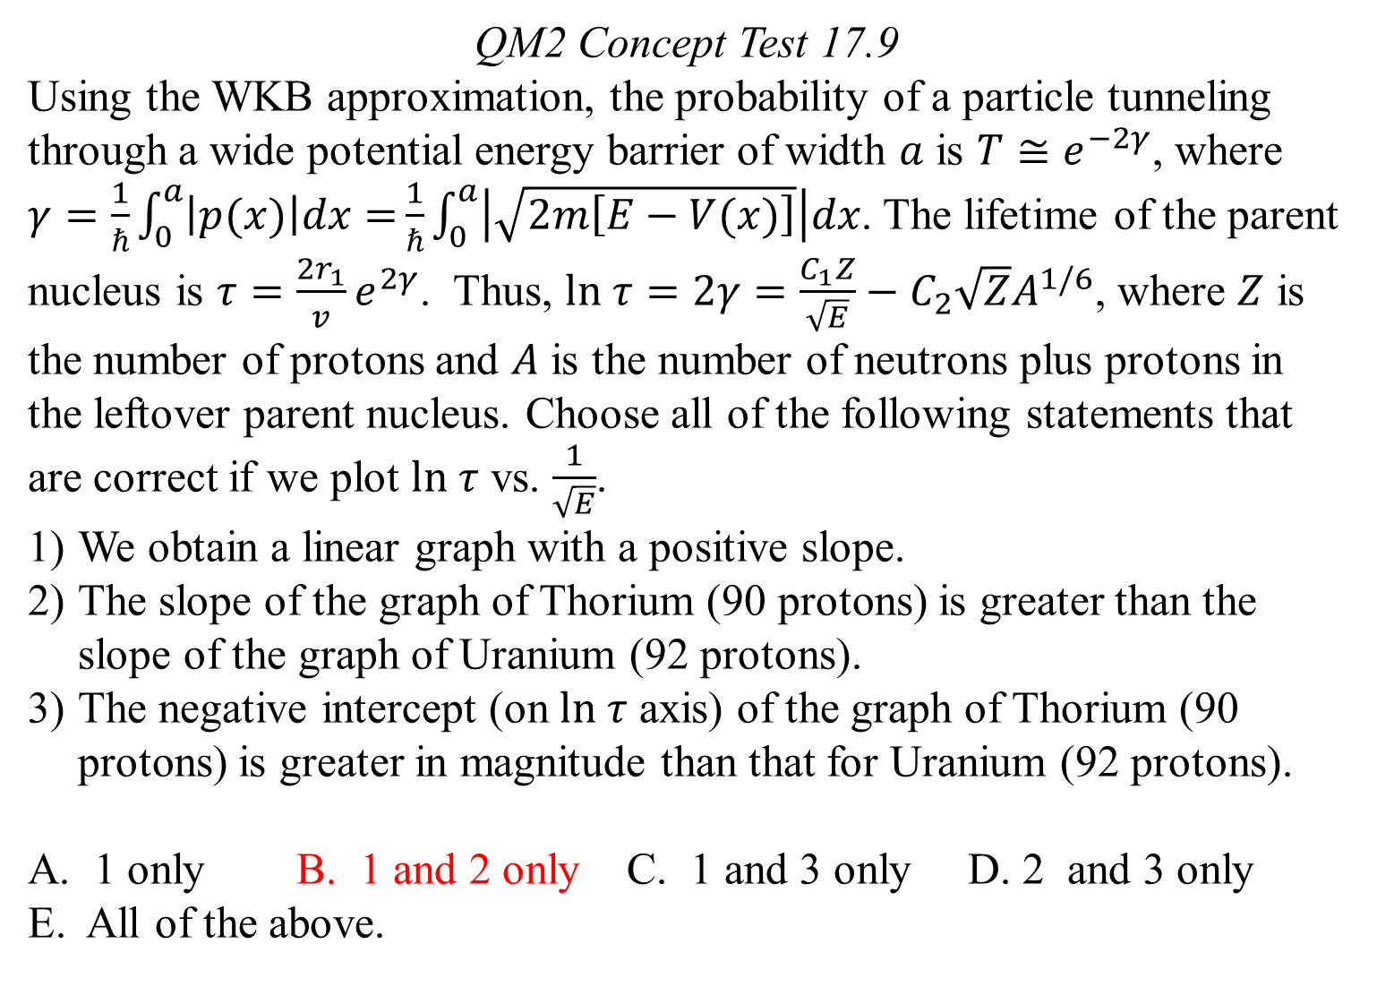
QM2 Concept Test 17.9
Using the WKB approximation, the probability of a particle tunneling through a wide potential energy barrier of width $a$ is $T≅e^{−2γ}$, where $γ=\frac{1}{ℏ}\int_{0}^{a}{\left|p(x)\right|dx=}\frac{1}{ℏ}\int_{0}^{a}{\left|\sqrt{2m\left[E−V(x)\right]}\right|dx}$. The lifetime of the parent nucleus is $τ=\frac{2r_{1}}{v}e^{2γ}$. Thus, $ln τ=2γ=\frac{C_{1}Z}{\sqrt{E}}−C_{2}\sqrt{Z}A^{1/6}$, where $Z$ is the number of protons and $A$ is the number of neutrons plus protons in the leftover parent nucleus. Choose all of the following statements that are correct if we plot $ln τ$ vs. $\frac{1}{\sqrt{E}}$.
We obtain a linear graph with a positive slope.
The slope of the graph of Thorium (90 protons) is greater than the slope of the graph of Uranium (92 protons).
The negative intercept (on $ln τ$ axis) of the graph of Thorium (90 protons) is greater in magnitude than that for Uranium (92 protons).
A. 1 only B. 1 and 2 only C. 1 and 3 only D. 2 and 3 only
E. All of the above.

Slide 10
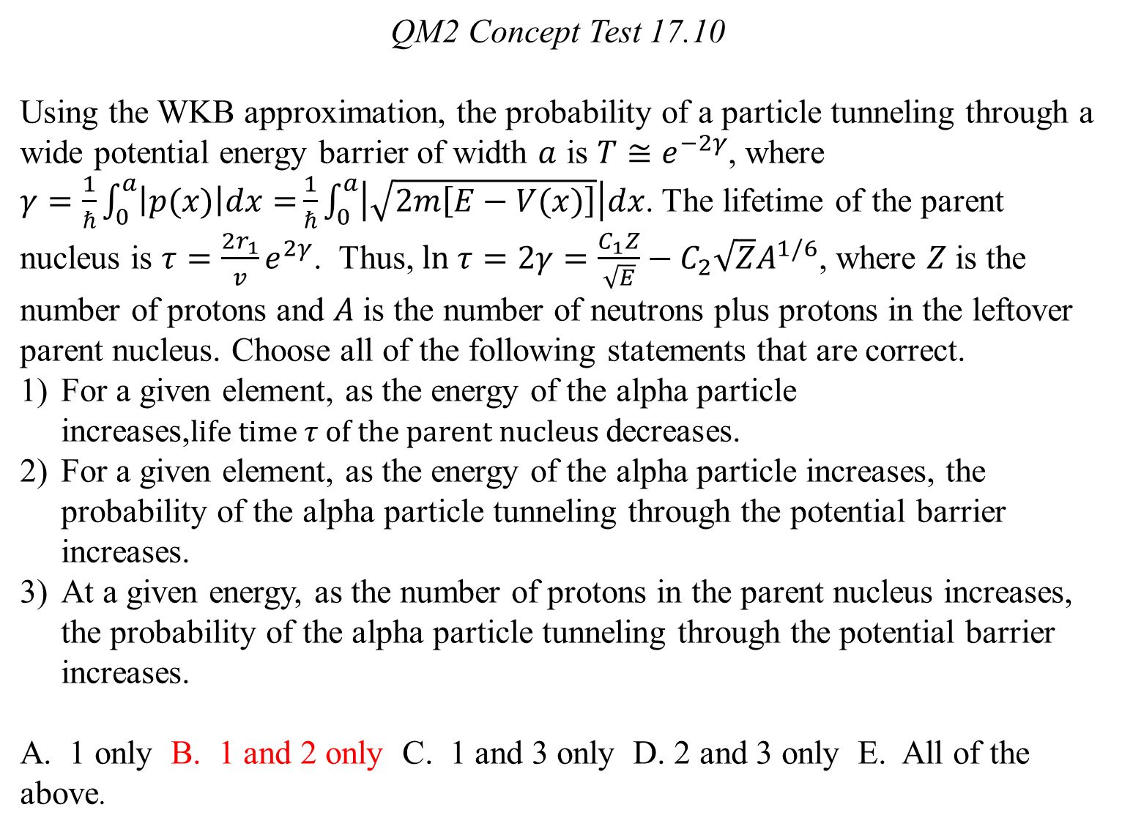
QM2 Concept Test 17.10
Using the WKB approximation, the probability of a particle tunneling through a wide potential energy barrier of width $a$ is $T≅e^{−2γ}$, where $γ=\frac{1}{ℏ}\int_{0}^{a}{\left|p(x)\right|dx=}\frac{1}{ℏ}\int_{0}^{a}{\left|\sqrt{2m\left[E−V(x)\right]}\right|dx}$. The lifetime of the parent nucleus is $τ=\frac{2r_{1}}{v}e^{2γ}$. Thus, $ln τ=2γ=\frac{C_{1}Z}{\sqrt{E}}−C_{2}\sqrt{Z}A^{1/6}$, where $Z$ is the number of protons and $A$ is the number of neutrons plus protons in the leftover parent nucleus. Choose all of the following statements that are correct.
For a given element, as the energy of the alpha particle increases,$life time τ of the parent nucleus$decreases.
For a given element, as the energy of the alpha particle increases, the probability of the alpha particle tunneling through the potential barrier increases.
At a given energy, as the number of protons in the parent nucleus increases, the probability of the alpha particle tunneling through the potential barrier increases.
A. 1 only B. 1 and 2 only C. 1 and 3 only D. 2 and 3 only E. All of the above.

