Slide 1
Concept Test 13.1
Choose all of the following statements that are correct:
A quantum mechanical bound state is always the same as a classical bound state.
In a quantum mechanical bound state, the particle cannot be found in the classically forbidden region.
In a quantum mechanical bound state, the particle can be found in the classically forbidden region, but its wave function will decay in that region
In a quantum mechanical bound state, the particle can be found in the classically forbidden region and it can have an oscillatory wave function in that classically forbidden region.
A. (II) only B. (III) only C. (IV) only D. (I) and (II) only
E. (III) and (IV) only

Slide 2
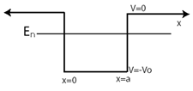
Concept Test 13.2
Choose all of the following statements that are correct about an electron in a bound state interacting with a finite square well shown in the figure below.
Its wave function is zero outside the well.
Its wave function must be normalizable.
It can only have discrete energies.
(I) only B. (II) only C. (I) and (II) only D. (I) and (III) only
E. (II) and (III) only

Slide 3
Concept Test 13.3
Consider an electron interacting with a finite square well with the energy as shown in the Figure above. The electron is not sent from one side of the well but it is still in a scattering state. Choose all of the following wave functions that are possible wave functions assuming that the energy is very localized around the particular value shown.
(I) only B. (II) only C. (III) only D. (I) and (II) only
E. (II) and (III) only

Slide 4
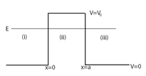
Concept Test 13.4
Choose all of the following statements that are correct about an electron with energy E interacting with a potential energy barrier, as shown in the figure below.
It is in a bound state.
It is in a scattering state.
Such an energy level is not possible because energy should be higher inside the barrier.
It is in a bound state in region II and it is in a scattering state in regions I and III.
None of the above.

Slide 5
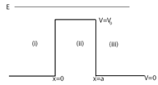
Concept Test 13.5
Choose all of the following statements that are correct about an electron with energy E interacting with a potential energy barrier, as shown in the figure below.
It is in a bound state.
It is in a scattering state.
Such energy is not possible because energy should be lower outside the well.
It is in a bound state in region II and it is in a scattering state in regions I and III.
None of the above.

Slide 6
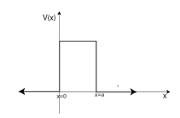
Concept Test 13.6
Which one of the following statements is correct about the bound and scattering states for the potential energy barrier shown in the figure below?
It only allows bound states.
It only allows scattering states.
It allows both bound states and scattering states.
It allows bound states inside the barrier and scattering states outside the barrier.
Nothing can be said without knowing the height of the barrier explicitly.

Slide 7
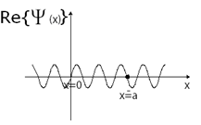
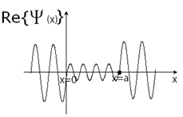
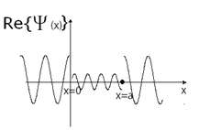
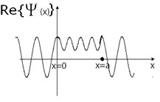
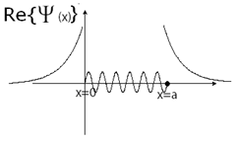
Concept Test 13.7
Which one of the following figures best represents the scattering state wavefunction for an electron interacting with a finite square well if there is no directional preference (no preference for the direction from which the electron is launched)?
A. B. C.
D. E.

Slide 8
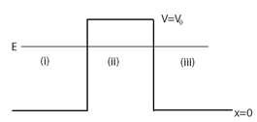
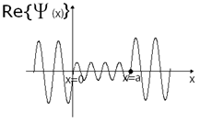
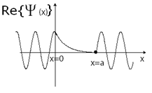
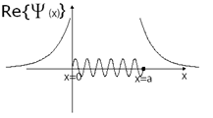
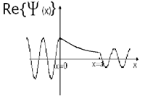
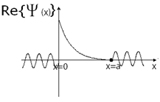

Concept Test 13.8
Choose the figure that best represents the scattering state wave function of the electron interacting with the potential energy barrier shown above. Assume the incident particle is launched from the left side ($x→−∞)$of the potential energy barrier.
A. B. C.
D. E.

Slide 9
Concept Test 14.7
Choose all of the following statements are true about a particle interacting with a double delta function potential energy barrier, as shown below:
It is possible to find the particle in all three regions.
If the particle starts out in region II, then the particle is in a bound state.
The energy levels for this system are discrete.
A. (I) only B. (II) only C. (III) only D. (II) and (III) only E. None of the above
V(x)
$$V\left(x\right)=V_{0}δ(x+a)$$
$$V\left(x\right)=V_{0}δ(x−a)$$
I
II
III
x
$$δ(x+a)$$
$$δ(x−a)$$

