Slide 6
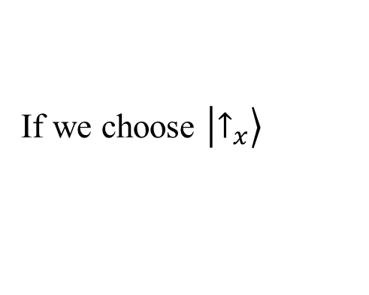
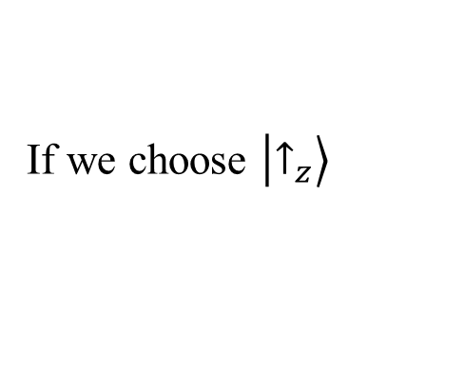
Concept test
5.6
Choose all of the following statements that are true about the
ˆ
=
ˆ
−
ˆ
H
C
2
2
(
Hamiltonian
S
S
)
for a spin
-
0
z
1/2 system where
C
is a constant.
(1)
If we choose $\left.\left|↑_{z}\right.\right\rangle$
and
↓
as the basis
vector
s
for the spin space, the
z
Hamiltonian is a diagonal matrix.
(2)
If we choose $\left.\left|↑_{x}\right.\right\rangle$
and
↓
as the basis
vectors
for the spin
space, the
x
Hamiltonian is a diagonal matrix.
(3)
The Hamiltonian must always be diagonal by
definition
.
A. 1 only B. 2 only C. 1 and 2 only D. all of the above
E. none of the above

