Slide 5
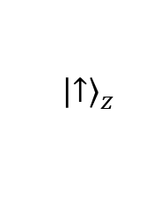
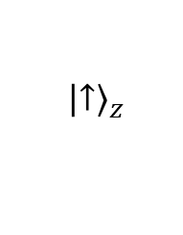
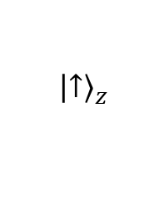
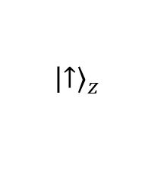
Concept Test 7.5
The initial state of a beam of neutral silver atoms is ${\left.\left|↑\right.\right\rangle }_{z}$. Suppose you want to prepare a beam of neutral silver atoms in spin state ${\left.\left|↓\right.\right\rangle }_{z}$. Which of the following shows an appropriate SGA to collect neutral silver atoms in spin state ${\left.\left|↓\right.\right\rangle }_{z}$?
SGZ-
SGZ-
$${\left.\left|↑\right.\right\rangle }_{z}$$
SGX-
$${\left.\left|↑\right.\right\rangle }_{z}$$
A
B
SGX-
SGX-
SGX+
SGZ-
$${\left.\left|↑\right.\right\rangle }_{z}$$
$${\left.\left|↑\right.\right\rangle }_{z}$$
C
D

Slide 8
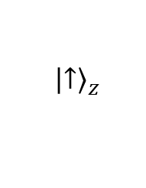
Concept Test 7.7
The initial state of a beam of neutral silver atoms is ${\left.\left|↑\right.\right\rangle }_{z}$. It propagates through three SGAs as shown below. What is the probability that the detector will click for the atoms that enter the first SGA?
½
¼
1/8
1
None of the above
SGX-
SGX+
SGZ-
$${\left.\left|↑\right.\right\rangle }_{z}$$

