Slide 1
QM2 Concept test 3.1
Choose all of the following statements that are correct about bosons.
(1) The spin of a boson is an integer.
(2) The overall wavefunction of identical bosons can be anti-symmetric.
(3) Two bosons cannot occupy the same quantum state.
A. 1 only B. 2 only C. 1 and 2 only D. 1 and 3 only
E. All of the above

Slide 2
QM2 Concept test 3.2
Choose all of the following statements that are correct about the Pauli exclusion principle.
(1) All identical spin-1/2 particles satisfy the Pauli exclusion principle.
(2) An $up$ quark ($u$) and a $down$ quark ($d$) cannot occupy the same quantum state simultaneously.
(3) Two electrons in an atom cannot occupy the same quantum state simultaneously.
A. 1 only B. 3 only C. 1 and 2 only D. 1 and 3 only
E. all of the above

Slide 3
QM2 Concept test 3.3
Choose all of the following statements that are correct about the exchange operator $\hat{P}$.
$\hat{P}f\left(x_{1},x_{2}\right)=f(x_{2},x_{1})$, where $f\left(x_{1},x_{2}\right)$ is a function of $x_{1}$ and $x_{2}$.
The eigenvalues of the operator are $\hat{P}$ are $±1$.
(3) $\left[\hat{P},\hat{H}\right]=0$ if $\hat{H}$ is the Hamiltonian operator of a system of identical particles.
1 only B. 2 only C. 1 and 2 only D. 1 and 3 only
E. All of the above

Slide 4
QM2 Concept Test 3.4
Choose all of the following statements that are true about the symmetrization requirement for identical particles:
We can find a complete set of functions that are simultaneous eigenstates of the exchange operator and the Hamiltonian operator.
All linear superpositions of the stationary states of a system of identical particles must follow the symmetrization requirement.
If a system of identical particles starts out in a symmetric or antisymmetric state, it will remain in that state at future times.
1 only B. 1 and 2 only C. 1 and 3 only D. 2 and 3 only
E. All of the above.

Slide 5
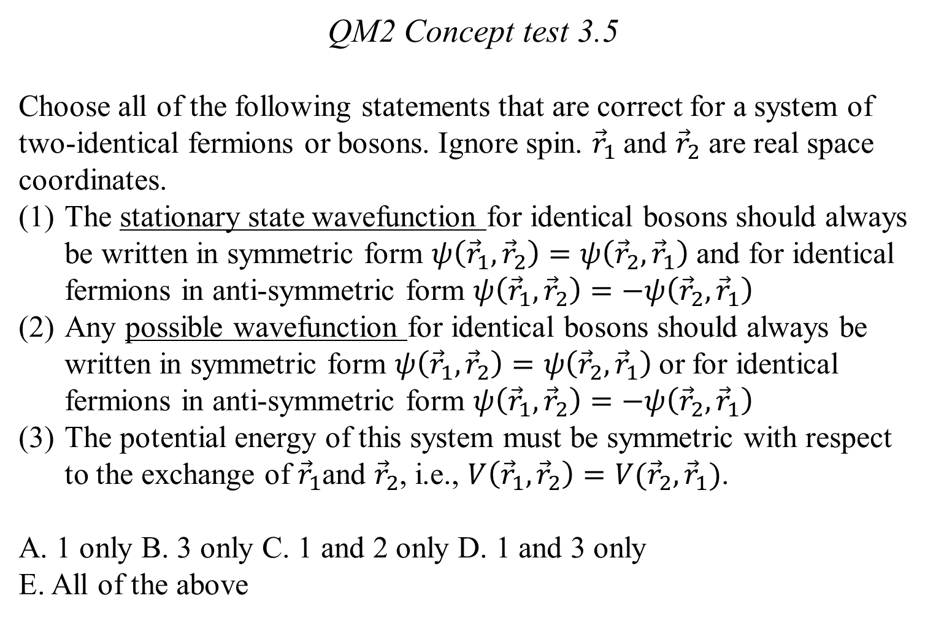
QM2 Concept test 3.5
Choose all of the following statements that are correct for a system of two-identical fermions or bosons. Ignore spin. ${\vec{r}}_{1}$and ${\vec{r}}_{2}$ are real space coordinates.
The stationary state wavefunction for identical bosons should always be written in symmetric form $ψ\left({\vec{r}}_{1},{\vec{r}}_{2}\right)=ψ\left({\vec{r}}_{2},{\vec{r}}_{1}\right)$ and for identical fermions in anti-symmetric form $ψ\left({\vec{r}}_{1},{\vec{r}}_{2}\right)=−ψ\left({\vec{r}}_{2},{\vec{r}}_{1}\right)$
Any possible wavefunction for identical bosons should always be written in symmetric form $ψ\left({\vec{r}}_{1},{\vec{r}}_{2}\right)=ψ\left({\vec{r}}_{2},{\vec{r}}_{1}\right)$or for identical fermions in anti-symmetric form $ψ\left({\vec{r}}_{1},{\vec{r}}_{2}\right)=−ψ\left({\vec{r}}_{2},{\vec{r}}_{1}\right)$
The potential energy of this system must be symmetric with respect to the exchange of ${\vec{r}}_{1}$and ${\vec{r}}_{2}$, i.e., $V\left({\vec{r}}_{1},{\vec{r}}_{2}\right)={V(\vec{r}}_{2},{\vec{r}}_{1})$.
A. 1 only B. 3 only C. 1 and 2 only D. 1 and 3 only
E. All of the above

Slide 6
QM2 Concept test 3.6
The wavefunction for two particles in a one dimensional infinite square well ($V(x)=0$for $0≤x≤a$) is $A\sin\left(\frac{πx_{1}}{a}\right)\sin\left(\frac{πx_{2}}{a}\right)$.Choose all of the following statements that are correct. Ignore spin. $A$ is a normalization constant.
(1) The two particles can be distinguishable.
(2) The two particles can be identical bosons
(3) The two particles can be identical fermions.
A. 1 only B. 2 only C. 1 and 2 only D. 1 and 3 only
E. All of the above

Slide 7
QM2 Concept Test 3.7
The stationary states for a particle in an infinite square well
($V(x)=0$for $0≤x≤a$) are $A_{n}\sin\left(\frac{nπx}{a}\right)$ where $n=1,2,3,….$Choose all of the following statements that are correct about a two particle system in an infinite square well of width a. Ignore spin. $A$ is a normalization constant.
If the two particles are identical bosons, the first excited state of the system is $A[\sin\left(\frac{πx_{1}}{a}\right)\sin\left(\frac{πx_{2}}{a}\right)+\sin\left(\frac{2πx_{1}}{a}\right)\sin\left(\frac{2πx_{2}}{a}\right)$]
If the two particles are identical bosons, the first excited state of the system is $A\sin\left(\frac{πx_{1}}{a}\right)\sin\left(\frac{2πx_{2}}{a}\right)$
If the two particles are identical fermions, the first excited state of the system is $A[\sin\left(\frac{πx_{1}}{a}\right)\sin\left(\frac{2πx_{2}}{a}\right)−\sin\left(\frac{2πx_{1}}{a}\right)\sin\left(\frac{πx_{2}}{a}\right)$]
A. 1 only B. 2 only C. 3 only D. 1 and 3 only E. none of the above

Slide 8
QM2 Concept test 3.8
Choose all of the following wavefunctions that are possible for two fermions in a one-dimensional infinite square well with width a. Ignore spin. $A$ is a suitable normalization constant.
$A\sin\left(\frac{πx_{1}}{a}\right)\sin\left(\frac{πx_{2}}{a}\right)$
$A[\sin\left(\frac{πx_{1}}{a}\right)−\sin\left(\frac{πx_{2}}{a}\right)$]
$A[\sin\left(\frac{2πx_{1}}{a}\right)\sin\left(\frac{3πx_{2}}{a}\right)−\sin\left(\frac{3πx_{1}}{a}\right)\sin\left(\frac{2πx_{2}}{a}\right)]$
A. only 1 B. only 2 C. 3 only D. 1 and 3 only
E. 2 and 3 only

Slide 9
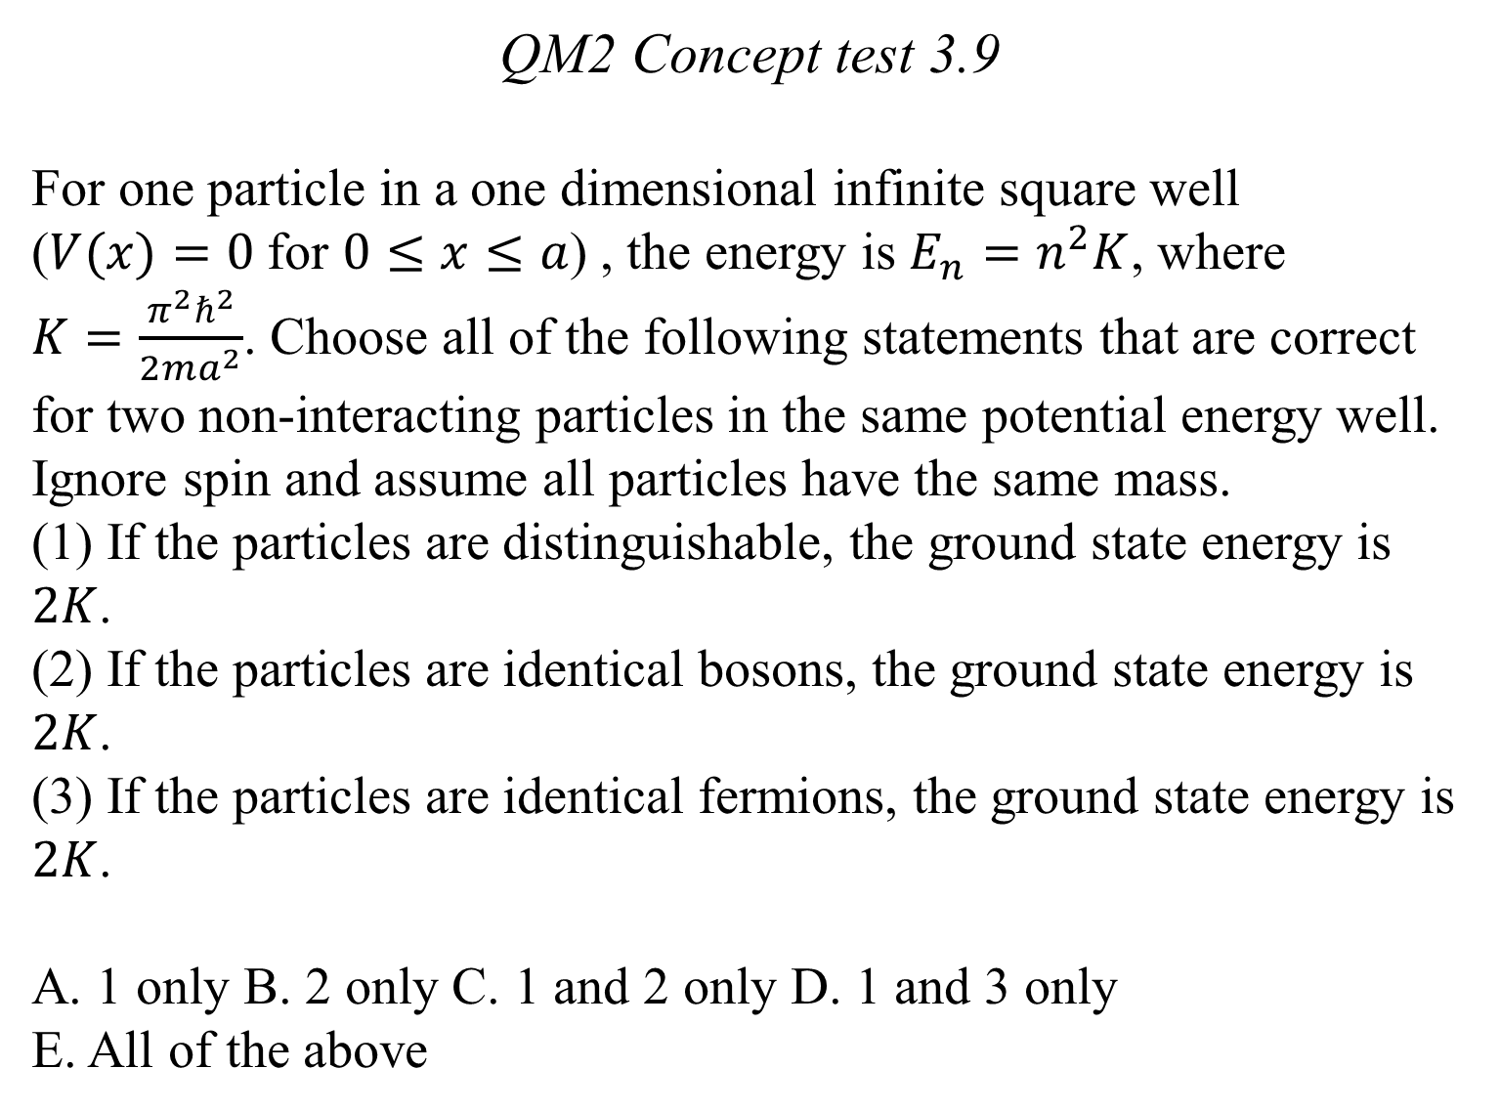
QM2 Concept test 3.9
For one particle in a one dimensional infinite square well ($V(x)=0$for $0≤x≤a$) , the energy is $E_{n}=n^{2}K$, where $K=\frac{π^{2}ℏ^{2}}{2ma^{2}}$. Choose all of the following statements that are correct for two non-interacting particles in the same potential energy well. Ignore spin and assume all particles have the same mass.
(1) If the particles are distinguishable, the ground state energy is $2K$.
(2) If the particles are identical bosons, the ground state energy is $2K$.
(3) If the particles are identical fermions, the ground state energy is $2K$.
A. 1 only B. 2 only C. 1 and 2 only D. 1 and 3 only
E. All of the above

Slide 10
QM2 Concept test 3.10
Suppose at time $t=0$, $ψ_{a}\left(x\right)$ is the wavefunction for particle 1 in a potential energy well and $ψ_{b}\left(x\right)$is the wavefunction for particle 2 in the same well. Particles 1 and 2 are non-interacting. Choose all of the following statements that are correct for this two-particle system. Ignore spin. $A$ is a normalization constant.
$Ψ\left(x_{1}, x_{2}\right)=A[ψ_{a}\left(x_{1}\right)$ $ψ_{b}\left(x_{2}\right)$+ $ψ_{b}\left(x_{1}\right) ψ_{a}\left(x_{2}\right)]$ is a possible wavefunction for this system if particles 1 and 2 are identical bosons.
If particles 1 and 2 are identical fermions, the wavefunction must be anti-symmetric at all times.
(3) $Ψ\left(x_{1}, x_{2}\right)=Aψ_{a}\left(x_{1}\right)$ $ψ_{b}\left(x_{2}\right)$can be a possible wavefunction for this system if particle 1 is a boson and particle 2 is a fermion.
A. 1 only B. 2 only C. 1 and 2 D. 1 and 3 E. all of the above

