Slide 1
QM2 Concept test 8.1
We have three non-interacting particles in a one-dimensional infinite square well. The energy of the three particle system is
$E_{n_{1}n_{2}n_{3}}={{(n}_{1}^{}}^{2}+{n_{2}^{}}^{2}+{n_{2}^{}}^{2})E_{1}$, in which $E_{1}$ is the ground state energy for one particle. If the total energy $E=27E_{0}$ and the particles are distinguishable, choose all of the following statements that are correct. Note: The combinations of three positive numbers, the sum of whose squares give 27 are (1,1,5), (1,5,1), (5,1,1) and (3,3,3).
There are 4 distinct states in this system with the energy $E=27E_{0}$.
If we randomly measure the energy of one particle when the total energy of the three particle system is $27E_{0}$, the probability of obtaining $E_{0}$ is 2/3.
If we randomly measure the energy of one particle when the total energy of the three particle system is $27E_{0}$, the probability of obtaining $E_{0}$ is 1/2.
A. 1 only B. 3 only C. 1 and 2 D. 1 and 3 only E. none of the above

Slide 2
QM2 Concept Test 8.2
We have three non-interacting particles in a one-dimensional infinite square well. The total energy for the three particle system is $E_{n_{1}n_{2}n_{3}}={{(n}_{1}^{}}^{2}+{n_{2}^{}}^{2}+{n_{2}^{}}^{2})E_{1}$, in which $E_{1}$ is the ground state energy for one particle. If the total energy $E=27E_{0}$ and the particles are identical, choose all of the following statements that are correct. Note: The combinations of three positive numbers, the sum of whose squares give 27 are (1,1,5), (1,5,1), (5,1,1) and (3,3,3).
The particles can be either bosons or fermions.
If the particles are spinless bosons, there are 4 distinct states in this system.
If the particles are bosons, when we measure the energy of one particle at random, the probability of obtaining $9E_{0}$ is 1/2.
A. 2 only B. 3 only C. 1 and 2 only D. 1 and 3 only
E. all of the above

Slide 3
QM2 Concept Test 8.3
We have three non-interacting particles in a one-dimensional infinite square well. The total energy for the three particle system is
$E_{n_{1}n_{2}n_{3}}={{(n}_{1}^{}}^{2}+{n_{2}^{}}^{2}+{n_{2}^{}}^{2})E_{1}$, in which $E_{1}$ is the ground state energy for one particle If the total energy $E=75E_{0}$ and the particles are identical, choose all of the following statements that are correct. Note: The combinations of three positive numbers, the sum of whose squares give 75 are (5,5,5), (1,5,7), (5,1,7), (7,1,5), (1,7,5), (5,7,1), (7,5,1).
The particles can be either bosons or fermions.
If the particles are spinless fermions, there is only one distinct three particle state in this system with this energy.
If the particles are spinless fermions, when we measure the energy of one particle at random, the probability of obtaining $25E_{0}$ is 1/3.
A. 2 only B. 3 only C. 1 and 2 only D. 1 and 3 only
E. all of the above

Slide 4
QM2 Concept Test 8.4
We have three non-interacting particles in a one-dimensional infinite square well. The energy of particle i (i=1,2,3) is $E_{i}={n_{i}^{}}^{2}E_{0}$. If the total energy $E=75E_{0}$ and the particles are identical, choose all of the following statements that are correct. Note: The combinations of three positive numbers, the sum of whose squares give 75 are (5,5,5), (1,5,7), (5,1,7), (7,1,5), (1,7,5), (5,7,1), (7,5,1).
If the particles are spinless bosons, there are seven distinct three particle states in this system with this energy.
If the particles are spinless bosons, when we measure the energy of one particle at random, the probability of obtaining $25E_{0}$ is 1/2.
If the particles are spinless bosons, when we measure the energy of one particle at random, the probability of obtaining $49E_{0}$ is 1/6.
A. 1 only B. 2 only C. 3 only D. 2 and 3 only E. None of the above

Slide 5
QM2 Concept test 8.5
Choose all of the following statements that are correct about the most probable configuration of a system with total particle number N and total energy E. The configuration
$(N_{1},N_{2}$, $N_{3}$…) has $N_{i}$ particles with single particle energy $E_{i}$.
The most probable configuration $(N_{1},N_{2}$, $N_{3}$…) is the one that can be achieved in the largest number of possible ways.
In the configuration $(N_{1},N_{2}$, $N_{3}$…), $N_{1}$ particles have the same energy $E_{1}$, so the degeneracy of the single particle energy level $E_{1}$ is $N_{1}$.
In the limit as $N→∞$, the distribution of single particle energies in equilibrium can be approximated as its distribution in the most probable configuration.
A. 1 only B. 2 only C. 1 and 2 only D. 1 and 3 only
E. all of the above

Slide 6
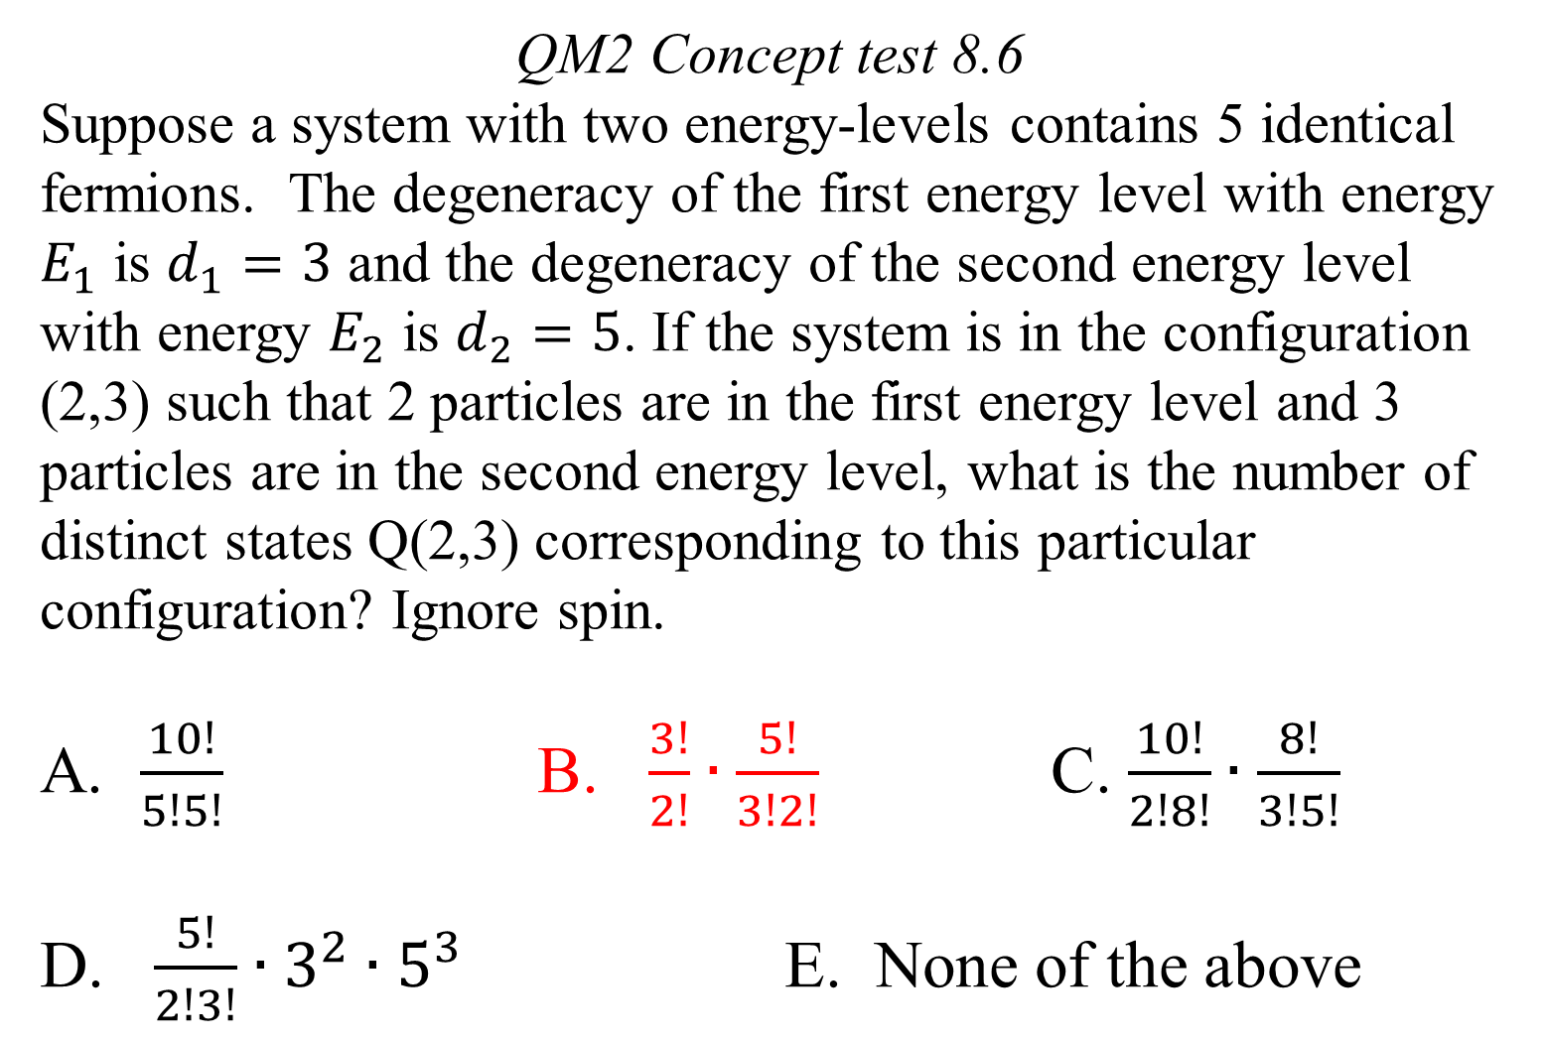
QM2 Concept test 8.6
Suppose a system with two energy-levels contains 5 identical fermions. The degeneracy of the first energy level with energy $E_{1}$ is $d_{1}=3$ and the degeneracy of the second energy level with energy $E_{2}$ is $d_{2}=5$. If the system is in the configuration (2,3) such that 2 particles are in the first energy level and 3 particles are in the second energy level, what is the number of distinct states Q(2,3) corresponding to this particular configuration? Ignore spin.
$\frac{10!}{5!5!}$ B. $\frac{3!}{2!}∙\frac{5!}{3!2!}$ C. $\frac{10!}{2!8!}∙\frac{8!}{3!5!}$
D. $\frac{5!}{2!3!}∙3^{2}∙5^{3}$ E. None of the above

Slide 7
QM2 Concept Test 8.7
Suppose 4 identical bosons occupy an energy level with energy $E_{1}$which has 3-fold degeneracy. How many distinct quantum states could this system with 4 bosons have?
$\frac{10!}{4!6!}∙3^{4}$
$\frac{6!}{4!2!}∙3^{4}$
$\frac{10!}{4!6!}$
$\frac{6!}{4!}$
$\frac{6!}{4!2!}$

