Slide 1
QM2 Concept Test 13.1
Choose all of the following statements that are correct about a hydrogen atom in the presence of an electromagnetic radiation if the wavelength of the electromagnetic radiation is long compared to the size of the atom.
The atom responds primarily to the oscillating electric field $\left|\vec{E}\right|=E_{0}\cos\left(ωt\right)$.
The perturbing Hamiltonian is ${\hat{H}}^{′}=−qE_{0}z\cos\left(ωt\right)$, where $q$ is the charge of the electron. Assume the electric field is polarized along the $z$-direction.
The off diagonal matrix elements $\left\langle Ψ_{a} | {\hat{H}}^{′} | Ψ_{b}\right\rangle$of the perturbation ${\hat{H}}^{′}=−qE_{0}z\cos\left(ωt\right)$ are zero between two unperturbed states.
3 only B. 1 and 2 only C. 1 and 3 only D. 2 and 3 only E. All of the above

Slide 2
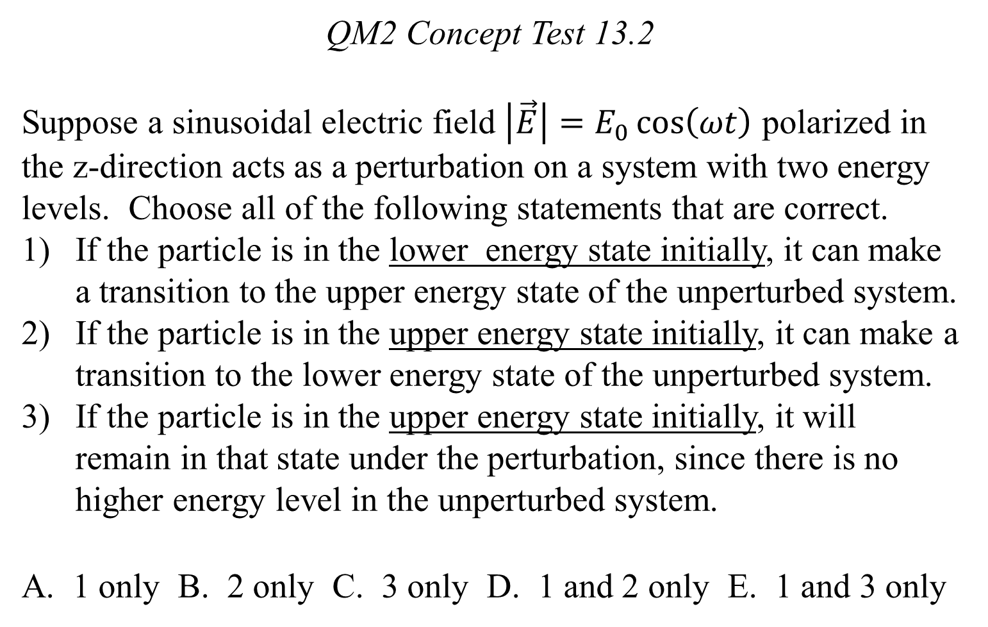
QM2 Concept Test 13.2
Suppose a sinusoidal electric field $\left|\vec{E}\right|=E_{0}\cos\left(ωt\right)$ polarized in the z-direction acts as a perturbation on a system with two energy levels. Choose all of the following statements that are correct.
If the particle is in the lower energy state initially, it can make a transition to the upper energy state of the unperturbed system.
If the particle is in the upper energy state initially, it can make a transition to the lower energy state of the unperturbed system.
If the particle is in the upper energy state initially, it will remain in that state under the perturbation, since there is no higher energy level in the unperturbed system.
A. 1 only B. 2 only C. 3 only D. 1 and 2 only E. 1 and 3 only

Slide 3
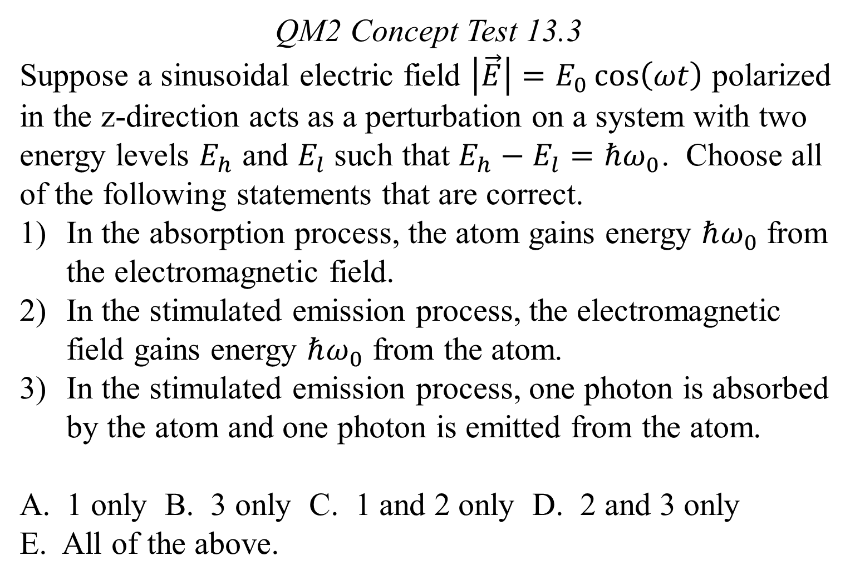
QM2 Concept Test 13.3
Suppose a sinusoidal electric field $\left|\vec{E}\right|=E_{0}\cos\left(ωt\right)$ polarized in the z-direction acts as a perturbation on a system with two energy levels $E_{h}$ and $E_{l}$ such that $E_{h}−E_{l}=ℏω_{0}$. Choose all of the following statements that are correct.
In the absorption process, the atom gains energy $ℏω_{0}$ from the electromagnetic field.
In the stimulated emission process, the electromagnetic field gains energy $ℏω_{0}$ from the atom.
In the stimulated emission process, one photon is absorbed by the atom and one photon is emitted from the atom.
1 only B. 3 only C. 1 and 2 only D. 2 and 3 only
E. All of the above.

Slide 4
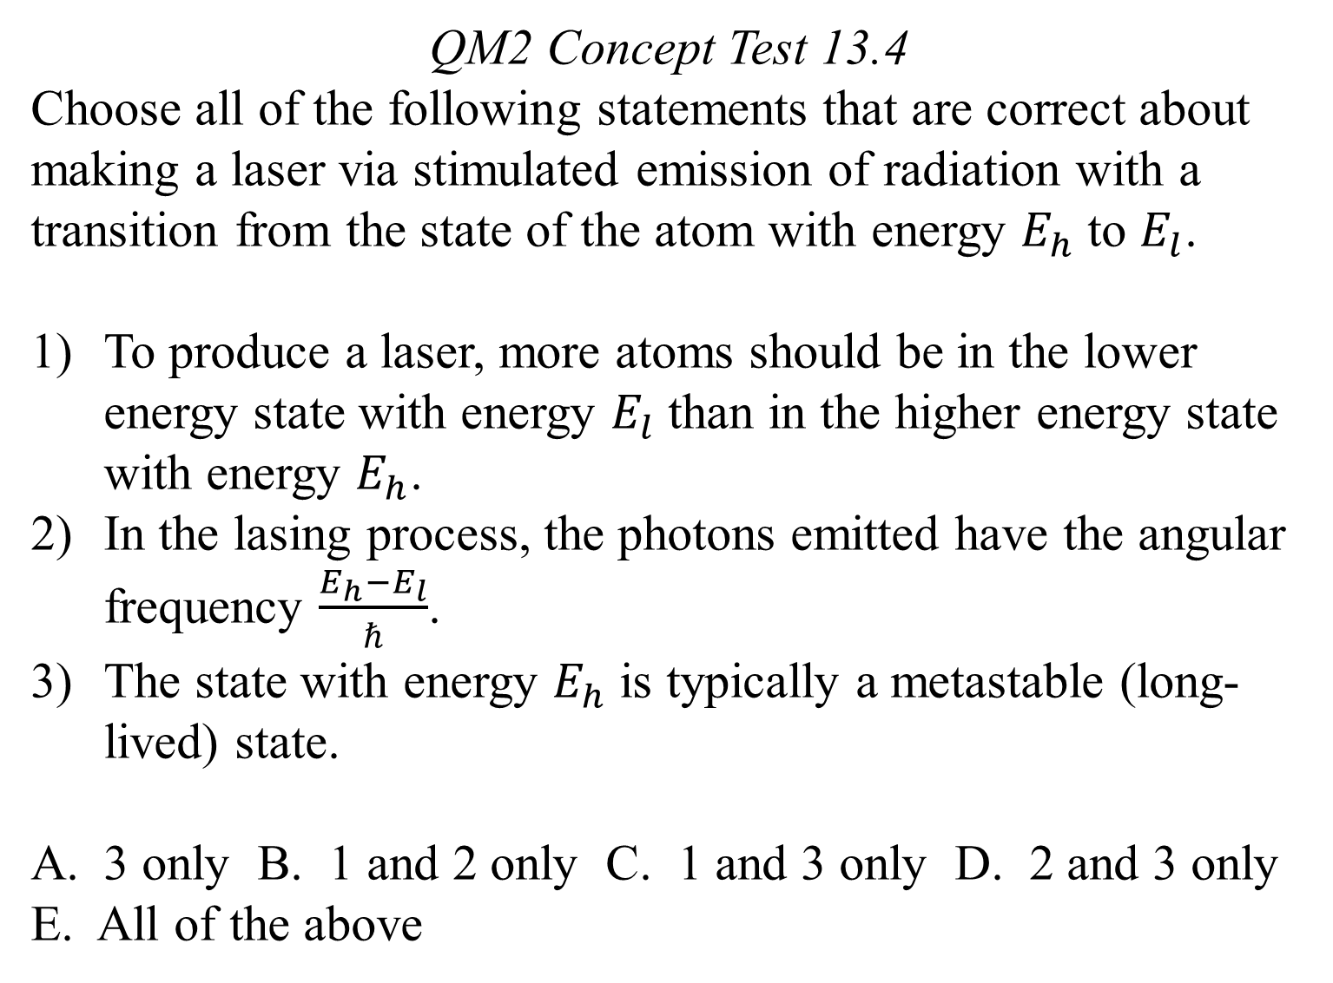
QM2 Concept Test 13.4
Choose all of the following statements that are correct about making a laser via stimulated emission of radiation with a transition from the state of the atom with energy $E_{h}$ to $E_{l}$.
To produce a laser, more atoms should be in the lower energy state with energy $E_{l}$ than in the higher energy state with energy $E_{h}$.
In the lasing process, the photons emitted have the angular frequency $\frac{E_{h}−E_{l}}{ℏ}$.
The state with energy $E_{h}$ is typically a metastable (long-lived) state.
3 only B. 1 and 2 only C. 1 and 3 only D. 2 and 3 only
E. All of the above

Slide 5
QM2 Concept Test 13.5
Choose all of the following statements that are correct about the spontaneous emission of electromagnetic radiation from a hydrogen atom.
If a hydrogen atom is in a stationary state, the system can make a transition to another stationary state via spontaneous emission.
A hydrogen atom can make an electric dipole transition via spontaneous emission even if there is negligible electromagnetic radiation of a particular frequency connecting the two states involved in transition.
According to quantum electrodynamics (QED), the electromagnetic field has a non-zero energy even at $T=0 K$.
2 only B. 3 only C. 1 and 3 only D. 2 and 3 only
E. All of the above.

Slide 6
QM2 Concept Test 13.6
Choose all of the following statements that are correct about electromagnetic radiation and transitions between two energy levels of an isolated atom.
In quantum electrodynamics, the ground state of the electromagnetic field has a non-zero energy called zero-point energy or vacuum energy.
An electron in a higher energy level can make transition to a lower energy level by emitting a photon even if there is negligible electromagnetic radiation of a particular frequency connecting the two states.
An electron in a lower energy level can make a transition to a higher level by absorbing a photon even if there is negligible electromagnetic radiation of a particular frequency connecting the two states.
A. 1 only B. 2 only C. 1 and 2 only D. 2 and 3 only E. All of the above.

Slide 7
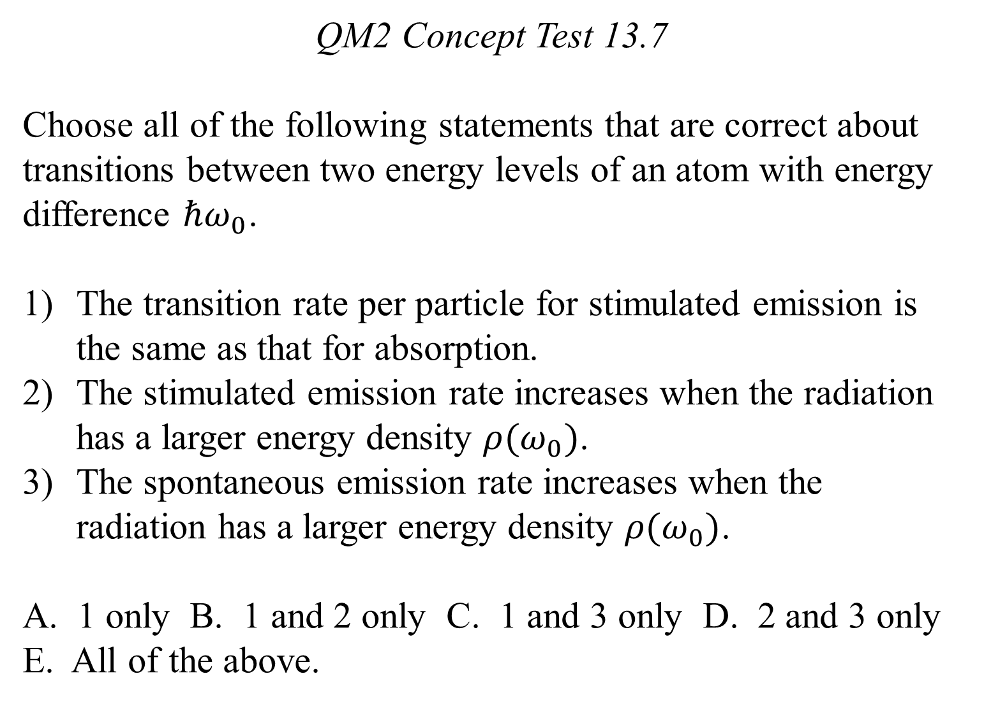
QM2 Concept Test 13.7
Choose all of the following statements that are correct about transitions between two energy levels of an atom with energy difference $ℏω_{0}$.
The transition rate per particle for stimulated emission is the same as that for absorption.
The stimulated emission rate increases when the radiation has a larger energy density $ρ(ω_{0})$.
The spontaneous emission rate increases when the radiation has a larger energy density $ρ(ω_{0})$.
A. 1 only B. 1 and 2 only C. 1 and 3 only D. 2 and 3 only E. All of the above.

