Slide 1
Framing the Active Learning Classroom
Clicker questions and slides to explain active learning to students

Slide 2
About this project
This is one items in a set of materials is compiled for instructors to draw upon in order to frame non-traditional modes of classroom teaching. Our hope is that these materials can enhance student enthusiasm for and reduce student resistance to such techniques, thus improving the experience of instructors and students and supporting student learning. These materials are not research-tested; rather, they represent the wisdom and experience of practitioners who are using research-based instructional techniques. These materials have been shared by members of the science education community, primarily in physics. If you re-use these materials, please be sure to attribute the author (see License, previous slide).
You can find the rest of these materials (slides, activities, etc.) at http://colorado.edu/sei/fac-resources.

Slide 3

This presentation is copyrighted under the Creative Commons License
Attribution Non-Commercial Share-Alike
That means: Please watch it, share it, and use it in your presentations. Just give us credit, don’t make money from it, and use the same kind of license on the works that you create from it.
More information about Creative Commons licenses here:
http://creativecommons.org/licenses/
Credit should be given to the author as indicated on each slide set.
For more information, contact Stephanie Chasteen, stephanie.chasteen@colorado.edu.
http://colorado.edu/sei

Slide 5
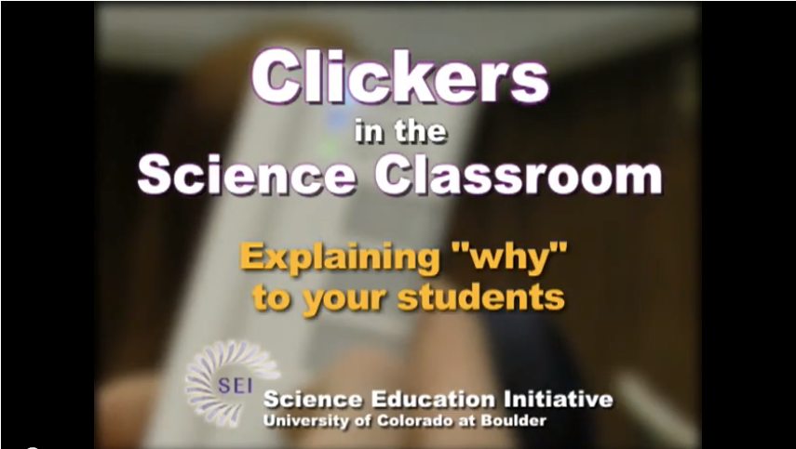
Tell your students why you’re using clickers
For an example of a first-day speech to students, and discussion of student buy-in, see video at https://www.youtube.com/watch?v=NGx7EzDQ-lY

Slide 6
Beth Simon “Intro to PI”
The following slides were created by Beth Simon, Computer Science and Engineering, Director of the Center for Teaching Development, UCSD)
An example script is given in the notes, and a video walk-through of the slides is at http://www.youtube.com/watch?v=UYS5ofDCn4Q
More materials online at http://www.peerinstruction4cs.org/general-pi-tips/

Slide 7
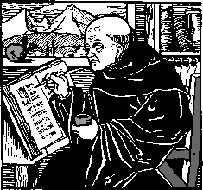

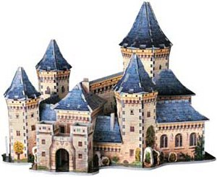
Why do we have lecture?
Draw mountains
Draw picture of ampitheatre
Show diffusion of knowledge
Beth Simon, UCSD
Notes:
In the world of Western civilization, back in medieval times, before the printing press. Scholars were specialized people (maybe monks), there’s weren’t many of them, and they were relatively wealthy.
If a scholar heard that over here in some castle far away, someone had learned something NEW, they had some new knowledge, if he wanted to get access to it he would mount an expedition, putting life and limb at risk and trek across possibly dangerous terrain to go to where this new knowledge was.
Once he was there, he’d study very hard, talk to the person with the new knowledge and maybe take a few notes down on some paper (it was very expensive before there were books…)

Slide 8
Why do we have lecture?
Draw mountains
Draw picture of ampitheatre
Show diffusion of knowledge
Beth Simon, UCSD
Notes:
Then he’d trudge back across the mountains, back to where he came from, and people would want to know about the new things he’d learned.
So they’d gather around him and he’s try to explain to them the things he learned, and because there were no cheap books, people would have to come in person to listen to him explain, as best he could…

Slide 9
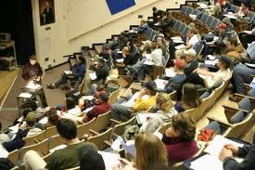
Why do we have lecture?
Draw mountains
Draw picture of ampitheatre
Show diffusion of knowledge
Beth Simon, UCSD
Notes:
And here we are! In a “lecture hall”!

Slide 10

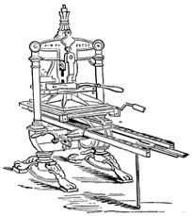


GREAT Innovations:
The printing press, The web
You don’t have the trust the monk!
  Read it and analyze for YOURSELF!
  If I rephrase it for you, what purpose does that serve?
Traditional class structures often look like:
You get very little opportunity for “expert” feedback
Lecture
Textbook
Homework
Exam
First
Exposure
Read Hard Stuff
See if You
Know Hard Stuff
Show Knowledge
Mastery
Beth Simon, UCSD
Notes:
Since then, there have been some great innovations. First, we had the printing press, so that knowledge could be encoded in books. And then we had Amazon, where you can now purchase “knowledge” and have it delivered to your door in 2 days!
What comes out of this is that you don’t have to take someone’s word on it, alone. You can read books which explain important information. You can read and analyze it yourself. If all that happens in lecture is that I summarize or re-phrase what is said in the book, what purpose does that serve?
But this is often what we are used to. In many college courses, the standard model goes something like this <<NOTE modify this diagram as needed, perhaps including lab>>.
Come to lecture, and get your first exposure to the materials, writing down notes on what the professor said. Maybe really try to figure out what might be hard.
Then, later, maybe you go back and open the textbook and use it to try to figure out the things you think are hard or you might not understand.
Even later, perhaps there’s some homework, which allows you to practice for yourself and see if you know the material and can “do it”.
Finally, you will show off your mastery on an exam.
The problem is, you get very little opportunity for “expert feedback”. In lecture, when the “expert” is there with you, you aren’t ready to interact, and the times where you might get stuck – working on hard stuff in the book or on homework, the expert isn’t with you.

Slide 11

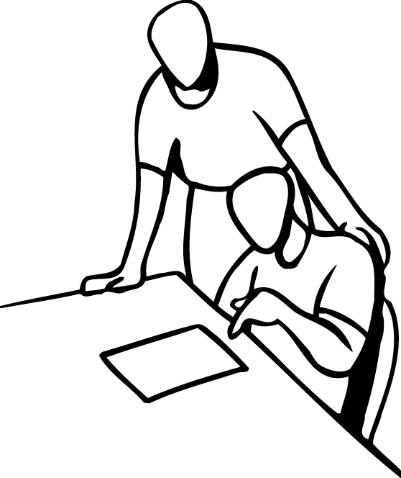


Peer Instruction-Based Design
Homework
Lecture
Lab
Exam
Q
U
I
Z
First Exposure:
With resources and
Feedback
Learn Hard Stuff:
With teacher and
discussion
Practice
Knowledge
Mastery
Show Knowledge
Mastery
Greater opportunity for expert feedback!
Research on how people learn:
  Everyone constructs their own understanding
    I can’t dump understanding into your brain
  To learn YOU must actively work with a problem and construct your own understanding of it
Beth Simon, UCSD
Notes:
In this class, we will be changing the “design” of the learning process with the goal of giving you much greater opportunity to get feedback on your learning from the “expert” – the professors.
Since you are intelligent, and you can buy access to the basics of the knowledge needed for this class in the form of the textbook, we’ll ask you to get your first exposure to the material by reading the book (or other assigned resources) and getting the “basics” for yourself. To help guide you in this, we’ll provide a set of questions that give you the idea of the kind of things you should “get” after reading the textbook. At least 2 of these questions will be on the “quiz” that we’ll give (with clickers) at the beginning of lecture.
Why a quiz at the beginning of lecture? A few reasons: 1) it gives you an excuse to do the homework. You are busy people, and by giving you quiz points for doing the homework and preparing for lecture, we’re giving you the incentive to fit it into your schedule. 2) You should ACE every quiz. Quizzes are over the *basic* information from the textbook – getting all the questions on the quiz right let’s you know you learned enough from reading in order to be prepared to engage and learn in “lecture”.
During lecture, I’ll be presenting some of the “hard stuff” that I know that students often struggle with or that the book doesn’t explain particularly well. Sometimes I will “explain things” in a way that looks like lecture. But a lot of the time, I will be letting you TEST YOUR OWN UNDERSTANDING and deepen your understanding – by presenting a question for you to solve, and having your discuss it in a team of your peers to help you make sure you really do get it. This is where the clickers come in – you will vote on your answer with them, so I can adapt what we do in class to address issues you are not sure about.
Finally in lab, we’ll have you practice your mastery of the material <<TAKE THIS OUT IF YOU DON’T HAVE LAB, PERHAPS REPLACE WITH WHATEVER YOU DO>>. And then we’ll let you show us how much you have mastered on exams.
Again: This process is based around giving you the opportunity to get access to expert help and explanation, when you need it. Not leaving you alone at night when you are doing your homework…
This process is also based in research on “how people learn”. Researchers have shown that people each construct their own understanding – individually. It’s not possible for me to “dump” or transmit understanding into your brain. Each of you is a unique individual, and you will each need to work and construct your own understanding.

Slide 12
Lecture: Peer Instruction
Are you prepared? (quick quiz at beginning of class, using clickers)
Pose carefully designed question
  Solo vote: Think for yourself and select answer
  Discuss: Analyze problem in teams of 3
    Practice analyzing, talking about challenging concepts
    Reach consensus
    If you have questions, raise your hand and I or the TAs will come around
  Group vote: Everyone in group votes
    You must all vote the same to get your point
  Class wide discussion:
    Led by YOU (students) – tell us what you talked about in discussion that everyone should know!
Beth Simon, UCSD
Notes:
So what does this “peer instruction” mean lecture actually “looks like”?
Again, first we have a short 3-4 question quiz on the assigned reading. Just to help make sure you are ready to learn. We use clickers for this, but it’s very fast, no discussion.
In the main part of lecture, I’ll be helping you deepen and check your understanding by posing you a set of carefully crafted questions based on my expertise in the subject, and what I know that students usually struggle with. For each question, I’ll have you first try to solve it yourself and vote for an answer. This is important in that it helps your brain get prepared to learn. We’ll talk more about that later.
Next, I’ll ask you to analyze and discuss the question in an assigned group of 3 people. You’ll work with the same people all term, the syllabus explains how groups are assigned. The goal of this discussion is for you to get the chance to practice analyzing and talking about challenging concepts. In your group, you need to reach a consensus. <<If you don’t plan to circulate and answer questions, or have Tas do it, take this bullet out>>
Then I will call for a group vote and everyone in your group must individually vote – the decision your group reached. You must all in your group vote the same way to get your participation point.
Finally, we will have a class-wide discussion where I will start by asking some of you to share some of the discussion you had in your groups. I am particularly interested in your ability to explain why the WRONG answers are WRONG. I also want to hear the way your group thought about the problem and have you share that with others. Finally, if there’s any confusion left, I will model for you how I think about the question.

Slide 13
Giving out Candy
To people willing to
  Ask a question
  Share an explanation
  Summarize what their group talked about
Your explanations are CRITICALLY HELPFUL for fellow students’ learning
Beth Simon, UCSD
Notes:
It’s not normal to be expected to participate in most university lectures. I know this. But your participation, especially in the class-wide discussion is one of the most beneficial things both for your own learning and to support the learning of everyone in the class. So, if you volunteer to participate in the class-wide discussion and share your thinking, or ask a question, I will give you a piece of candy. It turns out that research shows that it’s easier for you to understand the explanations of your peers – those at your own level. Additionally, it is through your explanations that you help me understand if there’s something people are confused on or that I need to explain more clearly. So, I am asking you to please volunteer to speak int eh class wide discussions. Your words are very important.

Slide 14
2-Slide Sequence
Just the second slide can be used, if you just want to “say” the material from the first slide.
Good for reminding students why we are using peer instruction
Walk through of these slides is at end of video at http://www.youtube.com/watch?v=SKGsvi5OfN0
Beth Simon, UCSD

Slide 15
Couldn’t you PLEASE just tell it to me?
I know how to learn from lecture!
Can’t you just explain it?
Well, clickers were fun, but the professor made me learn it on my own! It would have been easier if he’d just lectured!
Beth Simon, UCSD
Notes:
<<This is good to use sometime in the 4th – 5th class meeting. Although many of your students may love PI, it’s still not what they are used to form the past 12+ years of their educational experience. Especially for those very grade focused or concerned, they may be worried that their techniques for succeeding in a class won’t work in your “new” format>>
Today, I did want to briefly address some concerns that some of you might be having about the design of our learning experience in this class. I’ve mentioned before that I chose to utilize Peer Instruction as the technique to use to support your learning because RESEARCH shows that it will increase your learning. However, this is a very different learning approach than most of you are used to. You’ve been involved in the educational system for a long time, and to have gotten where you are here today, you’ve been very successful!
But the techniques you use to study, monitor your progress, etc. in traditionally formatted classes are hard to use here. Specifically, it is common for some students in peer instruction classes to say “I just wish the professor would just EXPLAIN IT TO ME” or “Well, clickers were fun, but the professor made me learn it on my own! It would have been easier if he’d just lectured!”
These are not unreasonable thoughts to have.

Slide 16
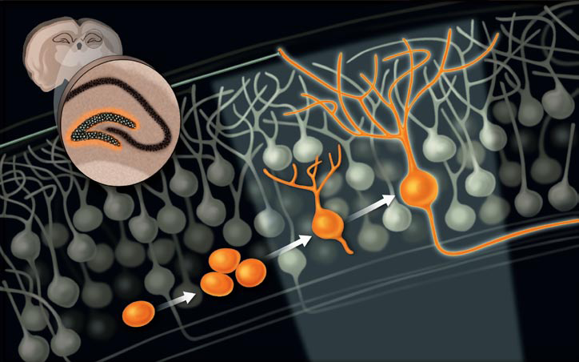
Learning Requires Your Effort
I can’t do the learning for you
Higher-level learning = brain development
It’s like muscle development!
Strenuous, repeated effort ->
New Muscle Cells
Strenuous, repeated effort ->
New Neurons, Links!
Development of new neurons in response to difficult learning task
T. Shors, Sci. Amer. Mar 09
Beth Simon, UCSD
Notes:
However, I want to remind you that, even though you have experience and comfort with “listening to lecture” and you may even feel like you learn from it, research shows that learning is not a passive process. Learning actually involves developing your brain, building new proteins, neurons, and connections in your brain. It’s a very PHYSICAL process. And one of the keys to this physical process is that it requires WORK on the part of the learner, for these physical changes to take place.
In fact, a lot like a training program for improving your physical, muscular abilities, where you would expect to need to put in repeated effort, going to the gym and working hard to build new muscle… to learn you have to YOURSELF put in repeated, strenuous effort in order to build new support in your brain for the new knowledge. So unfortunately, I can’t do the learning for you. You do have to do it yourself, and it takes serious effort. The reason we use Peer Instruction is to support you in efficient ways of accomplishing this learning

Slide 17
Cynthia Bailey Lee
Attribute to Cynthia Bailey Lee, Computer Science and Engineering, UCSD
Peer Instruction

Slide 18
What do you do in class?
(before class, you prepared yourself by reading the textbook and preparing for the in-class reading quiz)
I ask a question
You first answer it by yourself
Then discuss in assigned groups of 3-4 students
  Like a jury, you must come to a unanimous decision
  Answer the question a second time
I will ask groups to share their insights, and I will provide additional clarification as needed
The ideas, not your neighbors
Cynthia Bailey Lee, UCSD

Slide 19
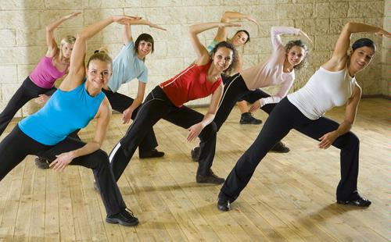
“But Prof. Lee, wouldn’t it be more efficient if you just taught us the right answer to begin with?”
Have you ever heard of an aerobics class where the instructor did all the exercises at the front of class, while the class just sat and watched attentively?
Me neither.
To learn, you must do the work with your own muscle (your brain).
Cynthia Bailey Lee, UCSD

Slide 20
What do you do in this course?
Prepare your brain for maximum in-class learning
  Reading, reading quizzes
In class: engage with your neighbors and the class, engage with the ideas
  Turn them upside down and sideways, think about what common errors or misconceptions might be
Seek help and seek to help others
  In class, moodle forums, office hours, discussion section
  I expect each class member to contribute to an environment of mutual aid and cooperation
The ideas, not your neighbors
Cynthia Bailey Lee, UCSD

Slide 21
Tips for a good group discussion
Take turns being the first one to talk
Once you all agree on the answer, don’t stop!
  Always go over each wrong answer and explain why it is wrong
    Also interesting and useful to think about why somebody might be tempted to choose it—how was Dr. Lee hoping to “trick” somebody by including that wrong answer?
  Even if your group-mate has said something very clearly and correctly, it’s a good idea to repeat it yourself
    “So, what I think you said was, …”
    Might seem pointless, but your brain will remember better if YOU say it too
Cynthia Bailey Lee, UCSD

Slide 22
Edward Price
Attribute to Edward Price, Department of Physics, CSU San Marcos
Peer Instruction Introduction

Slide 23
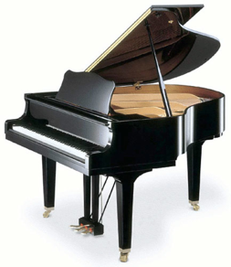
Expectations
This material is challenging, and involves more than just memorizing…
You will be expected to think and analyze new situations
To be good at this, you need practice and feedback, which is exactly how we will spend class time
Edward Price, CSU San Marcos

Slide 24
Expectations
Most students are capable of succeeding in this class – this means you!
I will try to create a course that facilitates your learning; you need to participate
If you would like to do better, ask “Am I…
  Coming to class (w/ clicker and workbook) and actively participating?
  Reviewing your class notes?
  Doing all HW on time?
  Trying to understand the material, not just ‘get it done’?
  Asking questions when confused
Edward Price, CSU San Marcos

Slide 25
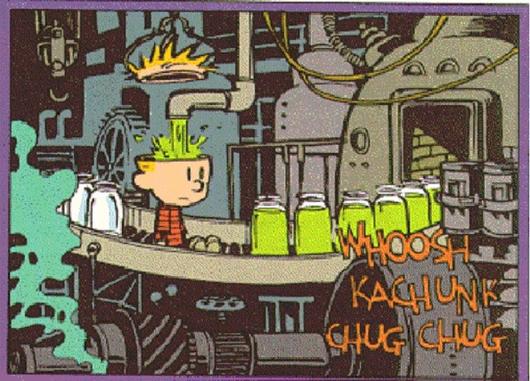

Course components: class
Expect active involvement
  Bring workbook to class
  Bring your clicker (credit for participation)
Edward Price, CSU San Marcos
Notes:
Convey expectations for class, these may be different from what students expect or are used to. Acknowledge this difference.
Unfortunately, we cannot pour knowledge directly into your head – hence the reason for this approach.

Slide 26
Do you have a clicker?
Yes
No
Not sure
Edward Price, CSU San Marcos

Slide 27
Meet your neighbor
Do you know your neighbor’s name?
yes
Find another neighbor
no
Say, “My name is ___. What’s yours?”
Edward Price, CSU San Marcos
Notes:
This is a joke, but many students are a little shy about talking in class. This acknowledges the awkwardness and gives them an excuse to start talking.

Slide 28
Noah Finkelstien
Attribute to Noah Finkelstein, University of Colorado Boulder
Modern Physics for Engineers course

Slide 29

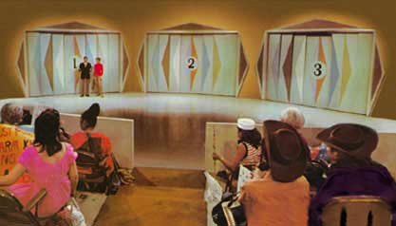
Interpretation and Probability
You’re on a game show:
There are 3 Doors (envelopes).
Two doors have goats (empty)
One door has a car (half-fast sandwich)
Notes:
SKIP
Monty Hall Problem

Slide 30
Interpretation and Probability
Audience Member -- -Pick Door (don’t open it)
Monty Hall (me?)
opens a different door & reveals goat
Audience member:
Do you switch doors and why?
A = yes, but don’t improve chances
B = yes, because better chances
C = no, it doesn’t improve chances
D= no, I don’t deserve to win
E= it really really doesn’t matter
Notes:
SKIP

Slide 31
Interpretation and Probability
Who knows what, when.
Monty Hall (I) know where the car is the whole time
He would not reveal the car (tear up the gift certif).
He can always show the goat
A = yes, but don’t improve chances
B = yes, because better chances
C = no, it doesn’t improve chances
D= no, I don’t deserve to win
E= it really really doesn’t matter
Notes:
SKIP

Slide 32
Interpretation and Probability
Who knows what, when.
All Possible Scenarios
Door
1 = you choose
2 = my door
3 = my door
A B C
Car
Goat
Goat
Goat
Car
Goat
Goat
Goat
Car
Switch
lose
win
win
REMEMBER:
I would never tear up the sandwich (reveal the car)
That’s why it’s not 50/50
Notes:
In one of 3 possible worlds… (annimate).

Slide 33
Some take-home messages
We can make rational choices
It depends on understanding probabilities
& interpretations
You should be engaged (you’ll learn more)
This class will provide you plenty of opportunities -- but you have to play
Some additional possible interpretations:
  Life is like a game-show
  Don’t contradict the Professor

Slide 34
Guiding principles: (basis for how course is run)
1. People understand concepts by seeing, discussing, and applying them, not by passively listening to explanations.
2. Understanding physics (& solving problems that develop understanding)
is a learned skill, like golf or playing basketball or violin.
Takes time, effort, and practice. Research says better retention if sustained effort rather than cramming.
3. People learn best by sharing and getting feedback on their thinking-- Student-student more often than student faculty.
4. Students learn most when they take the responsibility for what is learned.
Physics is not collection of facts
(it’s magic )
((just kidding… it’s better than magic))
It is way of thinking. Only you can teach yourself to think!
Analyzing, applying concepts, solving problems.

Slide 35
Attitudes and Beliefs*
Assessing the “hidden curriculum” - beliefs about physics and learning physics
Examples:
• “I study physics to learn knowledge that will be useful in life.”
• “To learn physics, I only need to memorize solutions to sample problems”
*Adams et al, (2006). Physical Review: Spec. Topics: PER, 0201010
Notes:
NOT AFFECT

Slide 36
CLASS categories
Shift (%) (“reformed” class)
-6
-8
-12
-11
-10
-7
-17
+5
(All ±2%)
Real world connect...
Personal interest........
Sense making/effort...
Conceptual................
Math understanding...
Problem Solving........
Confidence................
Nature of science.......
Notes:
Do we have any chaance of affecting student attitudes /beliefs:
good news: yes
Bad news worse

Slide 37
Teach by actively engaging students… based on what they know . . .

Slide 38
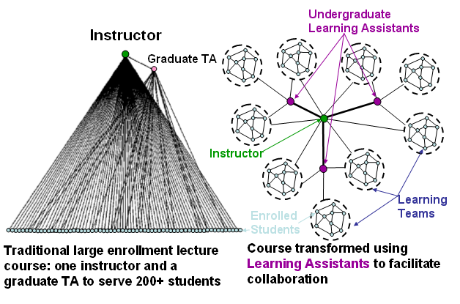
Course Transformation with LAs
Otero et al, Science 2006
Notes:
38

Slide 39
Engagement Improves Learning
traditional lecture
interactive engagement
<g> = ^{post-pre}
^{100-pre}
CU - IE &
trad recitations
CU - IE &
Tutorials
learning gain
Pollock & Finkelstein, Physical Review, 4, 010101 (2008).
Notes:
39

Slide 40
Course Goal:
Every student learn everything!
If not important to learn, we took it out.

Slide 41
Expectations
Most students are capable of succeeding in this class – this means you!
I will try to create a course that facilitates your learning; you need to participate
If you would like to do better, ask “Am I…
  Coming to class (w/ clicker and workbook) and actively participating?
  Reviewing your class notes?
  Doing all HW on time?
  Trying to understand the material, not just ‘get it done’?
  Asking questions when confused

Slide 42

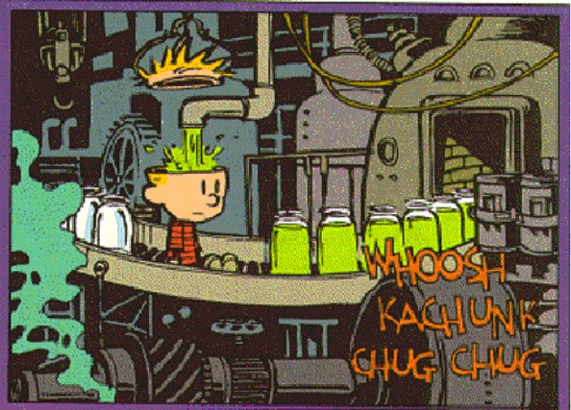
Course components: class
Expect active involvement
  Bring prelecture notes to class…
  Bring your clicker (credit for participation)
Notes:
Convey expectations for class, these may be different from what students expect or are used to. Acknowledge this difference.
Unfortunately, we cannot pour knowledge directly into your head – hence the reason for this approach.

Slide 43
We provide you with opportunities to help you learn.
Content, problems, simulations, guidance, organization.
Reward activities and efforts conducive to your learning
(grade)
Learning only comes as result of your effort!
Model for learning 2130
1. Reading before class- introduce ideas and terms.
2. Analysis and discussion in class- explore, develop
basic ideas and understanding.
3. Master and retain ideas through use in
extensive HW (4-6 hrs/wk)
(collaboration good, but submit own work)
Notes:
ADD DATA ON REFORMS.. Benefits from talking to folks,

Slide 44
Physics 2130 website, source of all knowledge!
http://www.colorado.edu/physics/phys2130
Home Page
Syllabus (Complete)
Weekly Reading Assignments
Weekly Homework Assignments
(Your Feedback)
Course Calendar
*Lecture Notes
Problem Solving Schedule
Homework Solutions
Exam Reviews and Answers
Department of Physics Home Page
Physics links/downloads
Sections
20.1-20.6
For Friday
(quiz)
read!!
Weekly: with HW Tues midnite
Posted by Fri
Due Tues/Wed
Posted before & after class
Start next Week
Mon 2-5
Tues 2-5
Important class rules:
No cell phones on, or newspapers in class.
Lots of physics discussion during clicker questions

Slide 45
Content survey (15 minutes)
Learn how much you know about modern physics already (hopefully not much)
Purposes:
  Find out what ideas you already know, so don’t repeat.
  What areas to focus on / emphasize
  Find out how much you learn during the semester.

Slide 46
Ian Beatty
Attribute to Ian Beatty, UNC Greensboro
See also Ian’s many clicker questions for meta-communication with students, in the clicker question files.

Slide 47
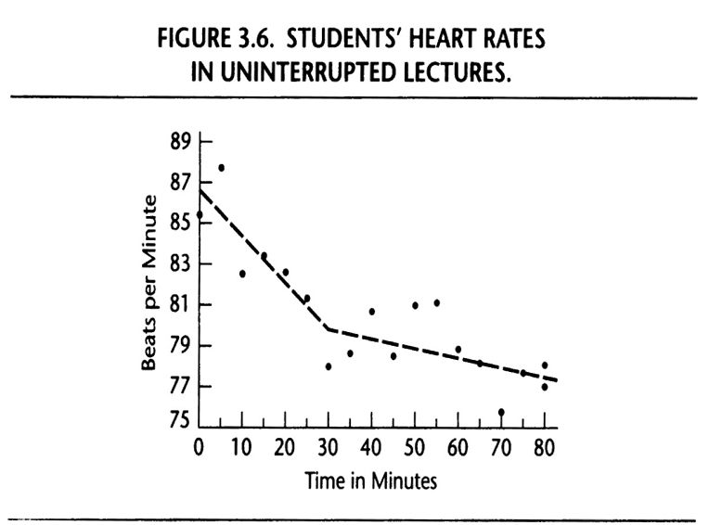
Bligh, 2000, What’s the Use of Lectures? 2000, p.51; Hartley & Davies, 1978, Programmed Learning and Educational Technology:15:207-224.
Courtesy of Ian Beatty, UNC Greensboro
Notes:
Not a question, but something to motivate a meta-discussion about active learning. (Good joke: point out that if I lecture long enough, this graph suggests that I’ll kill them all.)

Slide 48
Last Serny, Flingledobe and Pribin were in the Berdlink treppering gloopy caples and cleaming burly greps. Suddenly, a ditty strezzle boofed into Flingledobe’s tresk. Pribin glaped. “Oh Flingledobe,” he chifed, “that ditty strezzle is tunning in your grep!”
Courtesy of Ian Beatty, UNC Greensboro. Originally from Todd Zakrajsek of UNC-CH
Notes:
This final passage and set of questions isn’t for clickers, but I ask Ss to yell out the answers to each. It’s fun and they generally play along. The point, which they get and we meta-discuss at the end, is that one can answer a great many questions about something without really understanding it; being able to answer memory-type or pattern-recognition questions doesn’t really signify much of anything.
[I got these from a presentation that Todd Zakrajsek of UNC-CH gave at the Lilly Conference on Teaching & Learning one year. As far as I know, he created them…]

Slide 49
Last Serny, Flingledobe and Pribin were in the Berdlink treppering gloopy caples and cleaming burly greps. Suddenly, a ditty strezzle boofed into Flingledobe’s tresk. Pribin glaped. “Oh Flingledobe,” he chifed, “that ditty strezzle is tunning in your grep!”
When did Flingedobe and Pribin treppen?
Courtesy of Ian Beatty, UNC Greensboro. Originally from Todd Zakrajsek of UNC-CH

Slide 50
Last Serny, Flingledobe and Pribin were in the Berdlink treppering gloopy caples and cleaming burly greps. Suddenly, a ditty strezzle boofed into Flingledobe’s tresk. Pribin glaped. “Oh Flingledobe,” he chifed, “that ditty strezzle is tunning in your grep!”
What kind of caples did Flingledobe and Pribin treppen?
Courtesy of Ian Beatty, UNC Greensboro. Originally from Todd Zakrajsek of UNC-CH

Slide 51
Last Serny, Flingledobe and Pribin were in the Berdlink treppering gloopy caples and cleaming burly greps. Suddenly, a ditty strezzle boofed into Flingledobe’s tresk. Pribin glaped. “Oh Flingledobe,” he chifed, “that ditty strezzle is tunning in your grep!”
What did the ditty strezzle do to Flingledobe’s tresk?
Courtesy of Ian Beatty, UNC Greensboro. Originally from Todd Zakrajsek of UNC-CH

Slide 52
Last Serny, Flingledobe and Pribin were in the Berdlink treppering gloopy caples and cleaming burly greps. Suddenly, a ditty strezzle boofed into Flingledobe’s tresk. Pribin glaped. “Oh Flingledobe,” he chifed, “that ditty strezzle is tunning in your grep!”
What was Pribin’s reaction?
Courtesy of Ian Beatty, UNC Greensboro. Originally from Todd Zakrajsek of UNC-CH

Slide 53
Last Serny, Flingledobe and Pribin were in the Berdlink treppering gloopy caples and cleaming burly greps. Suddenly, a ditty strezzle boofed into Flingledobe’s tresk. Pribin glaped. “Oh Flingledobe,” he chifed, “that ditty strezzle is tunning in your grep!”
What do you imagine happened next?
Courtesy of Ian Beatty, UNC Greensboro. Originally from Todd Zakrajsek of UNC-CH

Slide 54
Last Serny, Flingledobe and Pribin were in the Berdlink treppering gloopy caples and cleaming burly greps. Suddenly, a ditty strezzle boofed into Flingledobe’s tresk. Pribin glaped. “Oh Flingledobe,” he chifed, “that ditty strezzle is tunning in your grep!”
Based on the incidents in the story, why do you think Flingledobe and Pribin went to Berdlink? Are they likely to return? Why or why not?
Courtesy of Ian Beatty, UNC Greensboro. Originally from Todd Zakrajsek of UNC-CH
Notes:
The point: Being able to answer quiz-type questions doesn't mean you "understand" the material.

Slide 55
Douglas Duncan
Attribute to Douglas Duncan, Astronomy, University of Colorado at Boulder
My class is a science class for NON-science students.
That is why I spend time motivating the usefulness of their studying astronomy and science more generally
You can contact Doug with questions at Douglas K Duncan <dduncan@colorado.edu>

Slide 56

How many of you are taking this class just because you love science?
Notes:
How many are holding up your hand just to please me?

Slide 57
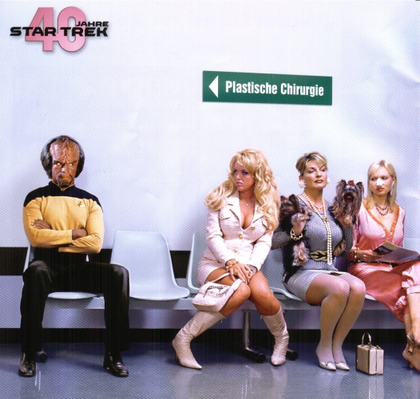
A paradox!
Notes:
The subject is interesting, even if your past science classes were not… so this class will be different.

Slide 58





In this class you’ll come to understand some of the most amazing things in the universe! ….
Black holes…newly discovered planets… why the sky is blue…and more

Slide 59
Scientific questions affect your life…
Is climate change a serious problem?
Will there still be skiing in Colorado when you’re my age?
Could the evolution of viruses cause many healthy college-age people to die?
What sources of energy are the best choices?
Notes:
Whether or not you are a scientist…

Slide 60
The most important scientific questions many people deal with involve medicine, life, and death.
This class will improve your judgment to make
good decisions on scientific topics. In life, outside the book.

Slide 61
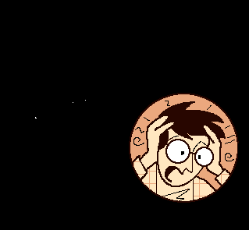
This class has less memorizing, but more thinking, than many science classes.
We encourage creativity as much as possible.

Slide 62
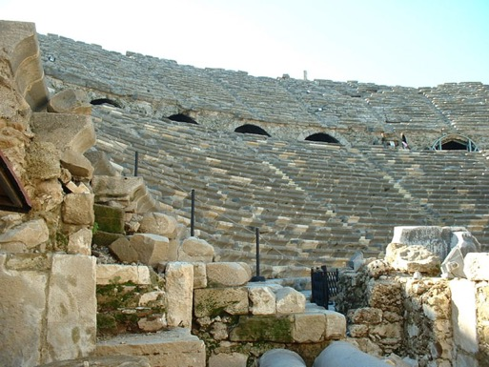
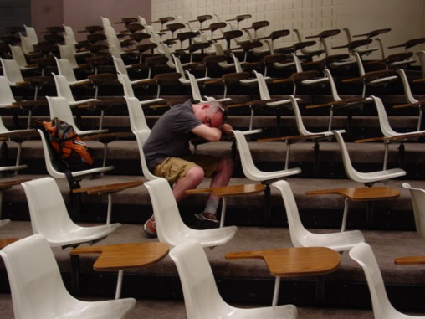
Why do I teach this class the way I do, less lecture, more student discussion ?
We’ve been teaching the same way for a long time…
2000 years ago
Today
How effective is pure lecture ?!

Slide 63
In a lecture class with an interesting, clear, engaging teacher, what fraction of the material presented during the semester does a student typically learn well? (well enough to explain to someone else)
90%
70%
50%
25%
15%

Slide 64
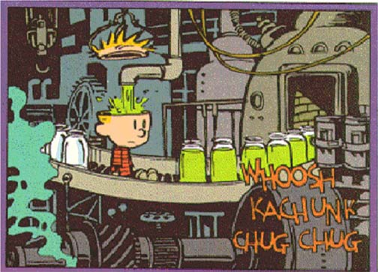
Traditional Model of Education
Individual
Instruction via
transmission
Content
Your mind must be active to learn!
Is false!

Slide 65
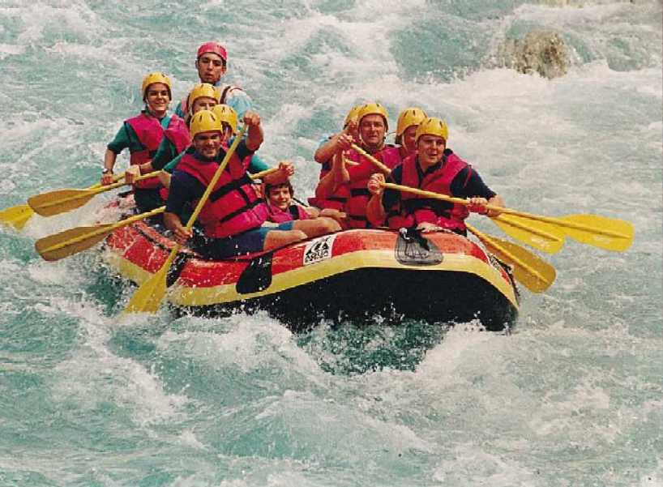
If you don’t plan to paddle,
don’t get in the boat.
Notes:
Take a more traditional course.

Slide 66
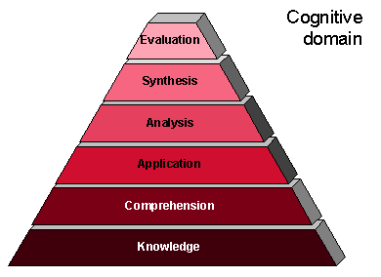
Bloom’s Taxonomy

Slide 67
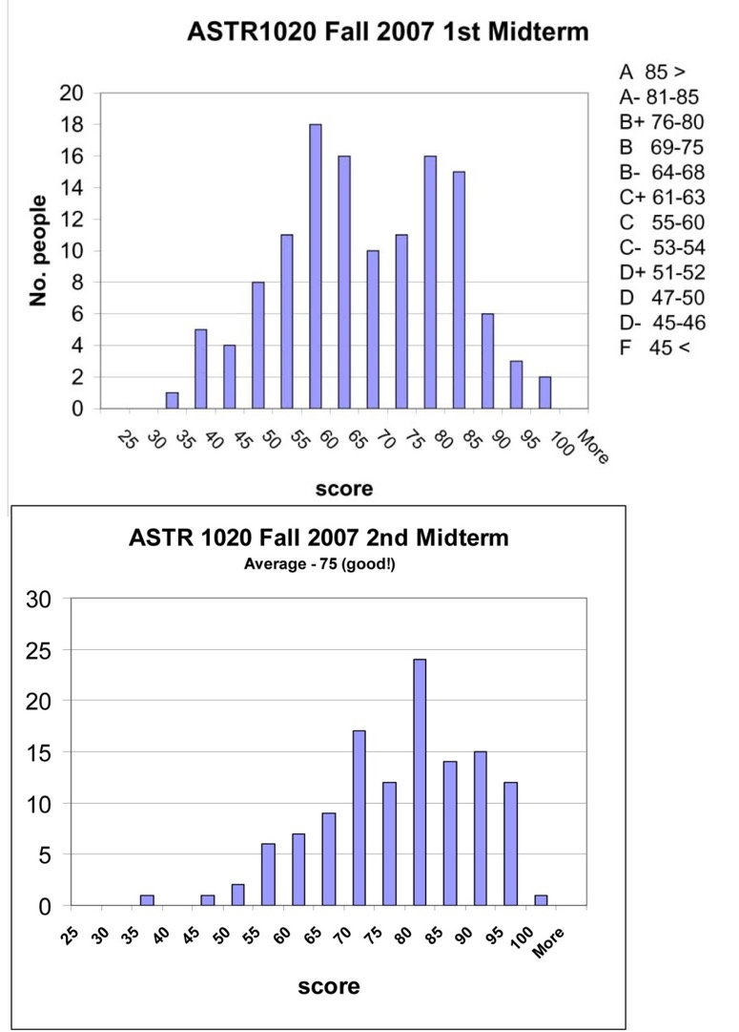
Notice my grading scale!
What’s with all the D’s and F’s ??
Save $10,000 now! Buy a DVD…
Notes:
Students learn not to skip class, and to PARTICIPATE in clicker discussions. Their grades rise!
If the class and group don’t add to your learning, why are you paying tuition? Buy a DVD from the Teaching Company.

Slide 68

If there was a magic switch you could push that would raise your grade half a letter grade, would you push it?
There is, and this is what it looks like…
Notes:
One more hint to get a good grade…

Slide 69
Notes:
Down down down goes your grade when you use a phone.

Slide 70
In other words …
Students who use report using their cell phones in class score nearly half a letter grade lower, on average, than students who report never using their phones.

Slide 71
Phone policy: to use a phone, go out into the hall.
Laptop policy: sit in the front row, only use for the class.
Otherwise I will ask you to leave class.
The CU code of conduct prohibits interfering with another student’s learning.
Notes:
And we know from interviews that “off topic” use irritates many students and professors.

Slide 72
Pull out a piece of paper and write one thing you would like the course to cover….

Slide 73
Catherine Crouch
Note that we have a video of Catherine’s first day, using these slides, in the “video” portion of the archives.
Attribute to Catherine Crouch, Swarthmore college

Slide 74
Course goals
Master basic physics both qualitatively and quantitatively
Build problem-solving skills
Learn relevance to biology and medicine, chemistry, engineering

Slide 75
Learning physics
Gaining not just information, but expertise
Develop new ways of thinking!
Notes:
Before we get into the details of the content, let me say a few things about how we’re going to spend class time, and how you should think about your study time.

Slide 76
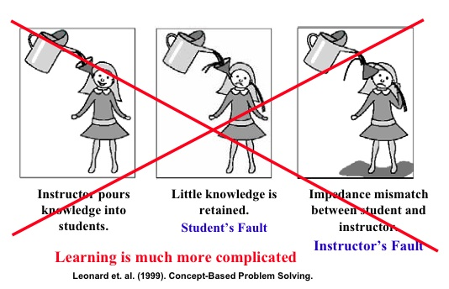
How not to learn physics
Notes:
My job is not to just pour information into your head as fast as I can, and hope that it doesn’t overflow!

Slide 77


Learning physics
My job:
(1) demonstrate these ways of thinking
(2) provide opportunities to try them out
(3) provide feedback
Your job:
(1) practice!
(2) help each other
Notes:
Research on learning high-level skills indicates that ….

Slide 78
Opportunities to practice
Reading follow-up assignments
Questions in class
Tutorials and questions in lab
Mistakes are part of learning!

Slide 79
Course logistics: highlights
Read syllabus carefully; note evening exams
Explore course web site: records of questions asked and my notes from class, all handouts; Phys 4 S06 exams with solutions
“Self-test” homework problems
One “free late” problem set: arrange in advance
Labs begin next week
Lab sectioning —email Adam Neat
Lab-related problems will be on the exams!

Slide 80
Andrew Boudreaux
Please Credit to Andrew Boudreaux, Western Washington University

Slide 81
Some features of this course:
Focus is on your thinking
(rather than my presentation of the ideas)
Focus is on concepts and reasoning
(rather than just equations)
Explicit attention to the process of learning

Slide 82
Focus on your thinking, not my presentation
Learning beyond surface level memorization requires active exertion . . .
. . . you will be doing the hard work, I am here to help.

Slide 83
Focus on your thinking, not my presentation
Most importantly:
I will take the lead in creating a safe learning environment, in which students are comfortable taking risks, offering their ideas to the group, and being respectfully critical of the ideas of others.
An environment in which mistakes are opportunities for learning and expansion, rather than opportunities for demonstrating “innate” physics talent.

Slide 84
I am your
PHYSICS COACH

Slide 85
Focus on your thinking, not my presentation
My role as physics coach:
Prompt you to evaluate your ideas and build class consensus
Provide frequent feedback
Teach by questioning rather than telling
Provide encouragement

Slide 86

Traditional set up:
Inclass presentation:
Big ideas, key results, main tools
Problem solving
Conceptual understanding
OUT OF CLASS WORK
Reasoning ability

Slide 87
Traditional set up:
Me talking . . .
Inclass presentation:
Big ideas, key results, main tools
Problem solving
Conceptual understanding
OUT OF CLASS WORK
You suffering . . .
Reasoning ability

Slide 88
Let’s turn it around!
Out of class preparation:
Big ideas, key results, main tools
Problem solving
Conceptual understanding
Reasoning ability
INCLASS PRACTICE AND FEEDBACK

Slide 89
Focus on your thinking, not my presentation
What about the “right answer?!”

Slide 90
Focus on your thinking, not my presentation
What about the “right answer?!”
Textbook, homework solutions, office hours . . .

Slide 91
Focus on your thinking, not my presentation
What about the “right answer?!”
Textbook, homework solutions, office hours . . .
but generally not during class.

Slide 92
Focus on your thinking, not my presentation
This approach may take getting used to.

Slide 93
WWU Mission Statement and Vision
“Western Washington University serves the people of the State of Washington, the nation, and the world by bringing together individuals of diverse backgrounds and perspectives in an inclusive, student-centered university that develops the potential of learners and the well-being of communities.”
“Western will build a stronger Washington by being an international leader in active learning, critical thinking, and societal problem solving.”

Slide 94
WWU Mission Statement and Vision
“Western Washington University serves the people of the State of Washington, the nation, and the world by bringing together individuals of diverse backgrounds and perspectives in an inclusive, student-centered university that develops the potential of learners and the well-being of communities.”
“Western will build a stronger Washington by being an international leader in active learning, critical thinking, and societal problem solving.”

Slide 95
WWU Mission Statement and Vision
“Western Washington University serves the people of the State of Washington, the nation, and the world by bringing together individuals of diverse backgrounds and perspectives in an inclusive, student-centered university that develops the potential of learners and the well-being of communities.”
“Western will build a stronger Washington by being an international leader in active learning, critical thinking, and societal problem solving.”

Slide 96
Final comment
Learning through
collaboration and consensus.

Slide 97
Problem Solving in Physics
        What is meant by “problem solving” anyway?

Slide 98
Problem Solving in Physics
        What is meant by “problem solving” anyway?
        The process of moving toward a goal when the path is uncertain.
        If you know how to do it, it is not a problem!

Slide 99
Here is an exercise:
Nina drops a watermelon from the top of a three-story building, 10 meters above the ground. How fast is the watermelon moving when it hits?

Slide 100
Here is an exercise:
Nina drops a watermelon from the top of a three-story building, 10 meters above the ground. How fast is the watermelon moving when it hits?
Why is this not a problem?
The situation and given information are so narrowly constrained that there is a single, fairly obvious path toward a solution. An efficient way to solve is to match equations to givens, without ever thinking about physics concepts!

Slide 101
“Traditional” physics problems
Can often be solved by manipulating equations
Do not require visualizing the physical situation
Do not require many decisions
Can often be solved without knowing physics!

Slide 102
A reasonable strategy for these kinds of “problems”:
read problem
categorize according to surface features (for example, “its an incline plane problem”)
recall memorized pattern of action and specific formulas for that type of problem
manipulate equations until solution obtained

Slide 103
Here is a problem:
On a weekend trip to Seattle you decide to take Amtrak. But you are late finishing your physics exam so you arrive late to the train station. You run as fast as you can, but just as you reach one end of the platform the train departs, 30 m ahead of you down the platform. You can run at a maximum speed of 8 m/s and the train is accelerating at 1 m/s per sec. You can run along the platform for 50 m before you run into a concrete barrier. Will you catch your train?

Slide 104
Problems you will encounter involve:
a “short story” in which you are the main character
a (somewhat) plausible motivation or reason for you to calculate something
objects that are real (or easily imaginable)
no pictures or diagrams. You must visualize by drawing on your own experience.
multi-step reasoning; no single single answers

Slide 105
This type of problem requires:
conceptual knowledge
ability to visualize situation and determine a goal
ability to choose applicable principles and relevant information
constructing a plan
  and also....
  Metacognitive Skills:
  Managing effort and monitoring your understanding and progress.

Slide 106
A strategic approach to problem solving:
Represent/Describe the problem
draw a specialized picture
draw a graph or other specialized physics diagram
define variables and state the goal
list knowns and unknowns
II. Make a plan and carry it out
choose the applicable principles
assemble the relevant equations
outline a computation strategy
work symbolically for as long as possible
III. Assess the result
Is this value reasonable?
Was the goal achieved? Are the units correct?
Is the answer consistent with any special cases or limiting cases?

Slide 107
These steps are a framework for helping you move forward even if you don’t initially see how to get to the answer.
The steps are not meant to be a straightjacket. You may go forward and backward through the steps, return to an earlier step, etc.

Slide 108
Barbara Demmig-Adams
Please Credit to Barbara Demmig-Adams, University of Colorado Boulder, and Alex Dutro-Maeda (illustrations)

Slide 109
[Fun family photo to introduce myself as not just a prof, but also a mom of students just like them)

Slide 110
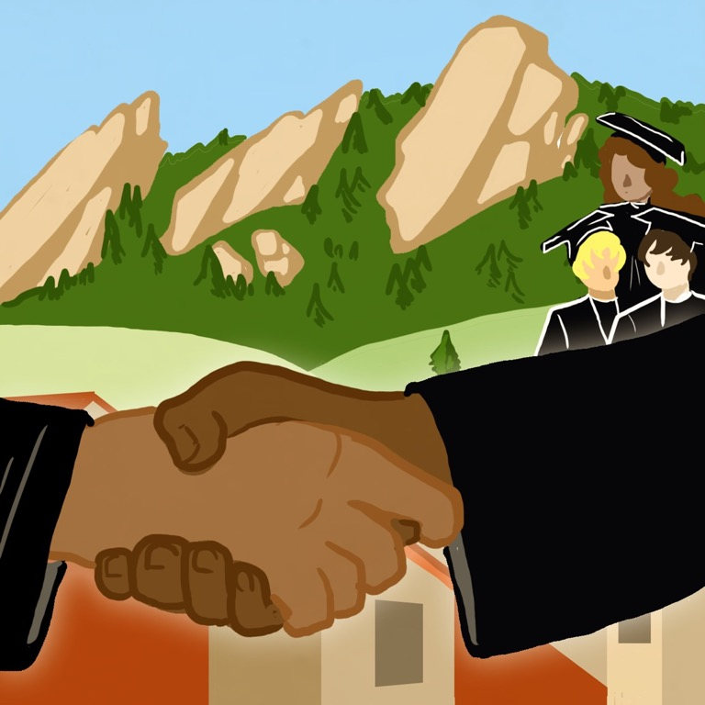
Illustration by Alex Dutro-Maeda
I pledge to work to
(1) provide the tools and transparency for your success in this class
(2) uphold standards to protect the long-term value of your degree from CU
e.g., Exam Topics

Slide 111
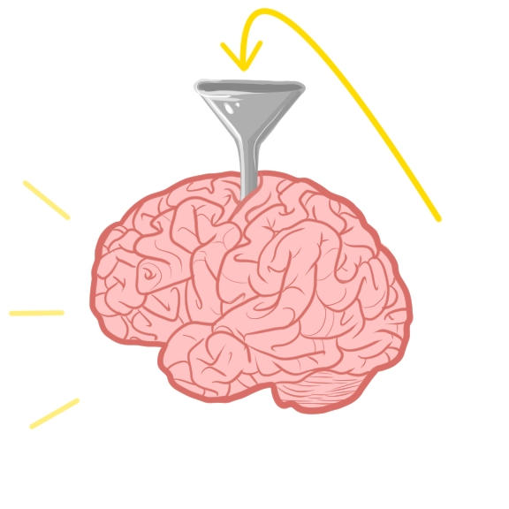
EBIO1210: General Goal
To practice critical thinking; to apply critical thinking skills to science
Illustration by Alex Dutro-Maeda

Slide 112
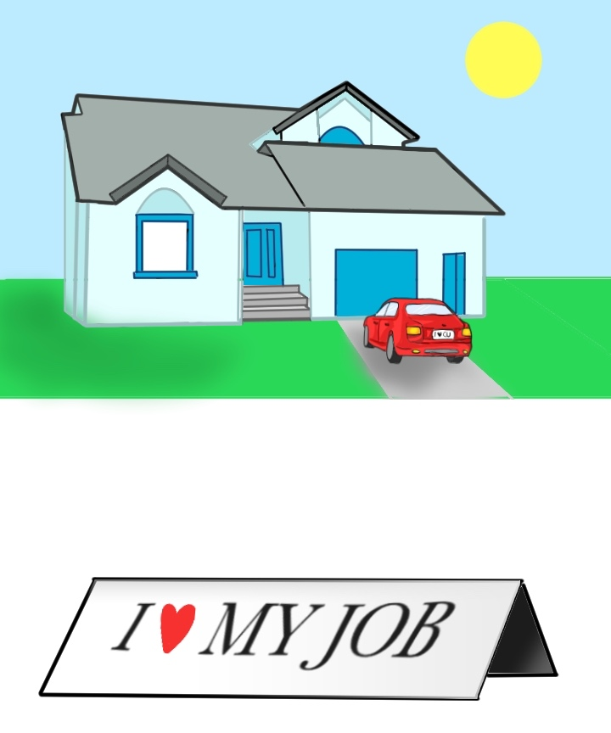
CU President Bruce Benson 2014:
Employers increasingly demand a workforce capable of critical thinking and analytical reasoning, effective communication, the ability to apply knowledge and skills in real-world settings, and teamwork.
Illustration by Alex Dutro-Maeda

Slide 113

First half of Fall EBIO1210:
Content-related Goals
1. To make connections between the
molecules of life
& their functions within organisms
and the interaction of organisms with the environment

Slide 114
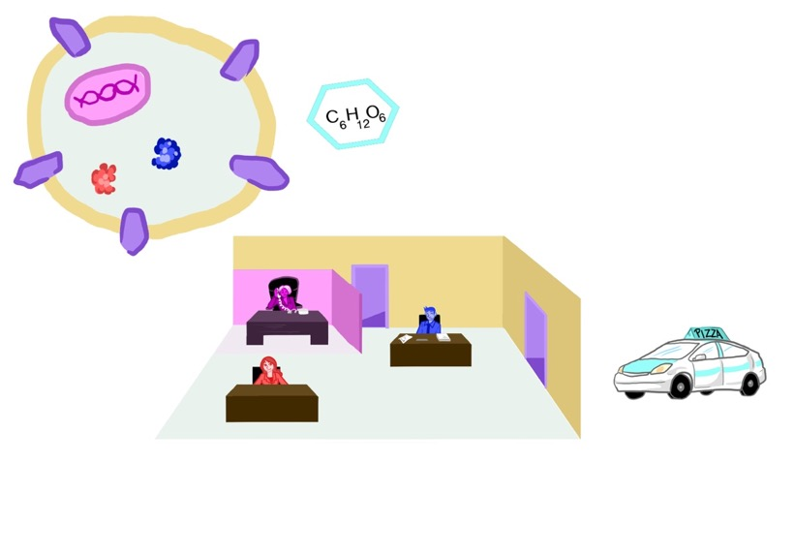
2. To follow information flow through biological cells; to identify indispensable cell features
3. To follow energy flow through biological systems
while making connections to human health & society
Illustration by Alex Dutro-Maeda

Slide 116
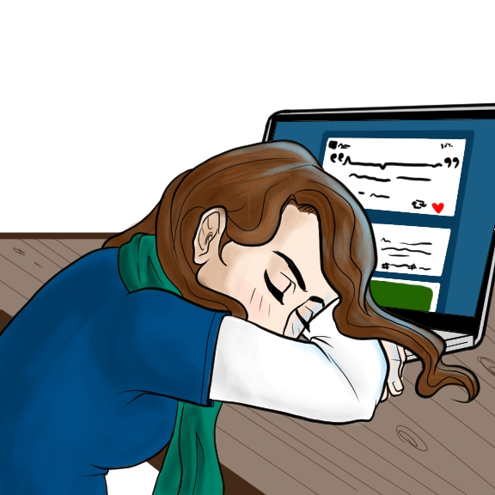
Strategy for success in this class
“Cramming” doesn’t work
Illustration by Alex Dutro-Maeda

Slide 117
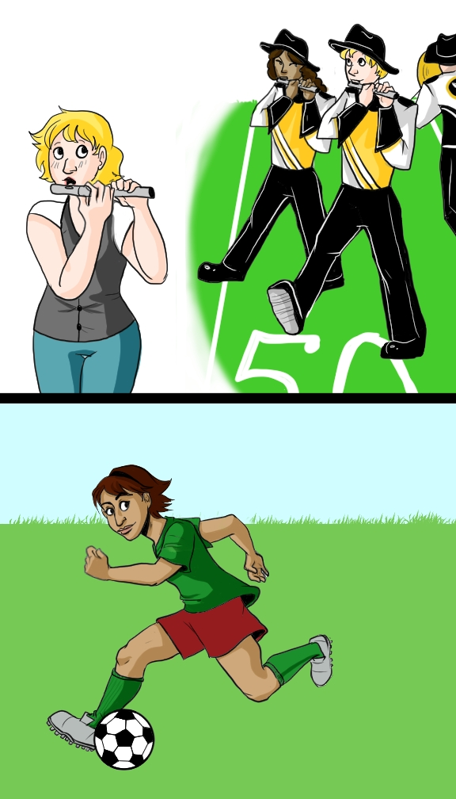
Just as with an instrument or a sport,
practicing several
times a week
works –
“cramming”
doesn’t
Illustration by Alex Dutro-Maeda

Slide 118
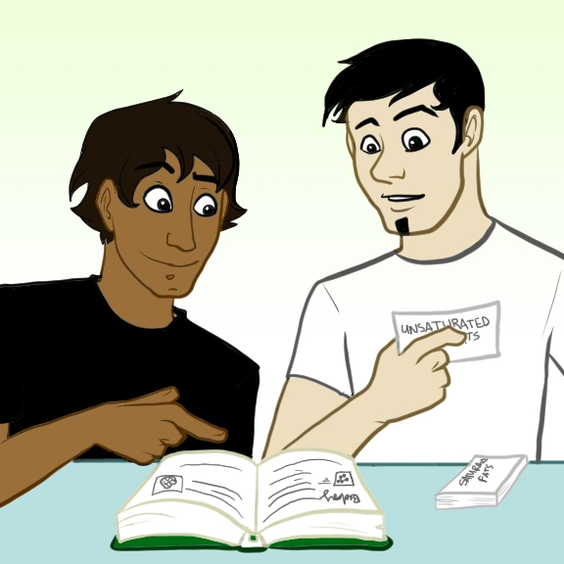
Illustration by Alex Dutro-Maeda
As is the case with a foreign language, understanding is easier than being able to say it yourself.
Say out loud what the reasons are why each answer option is correct or incorrect for all iClicker and homework questions.

Slide 119
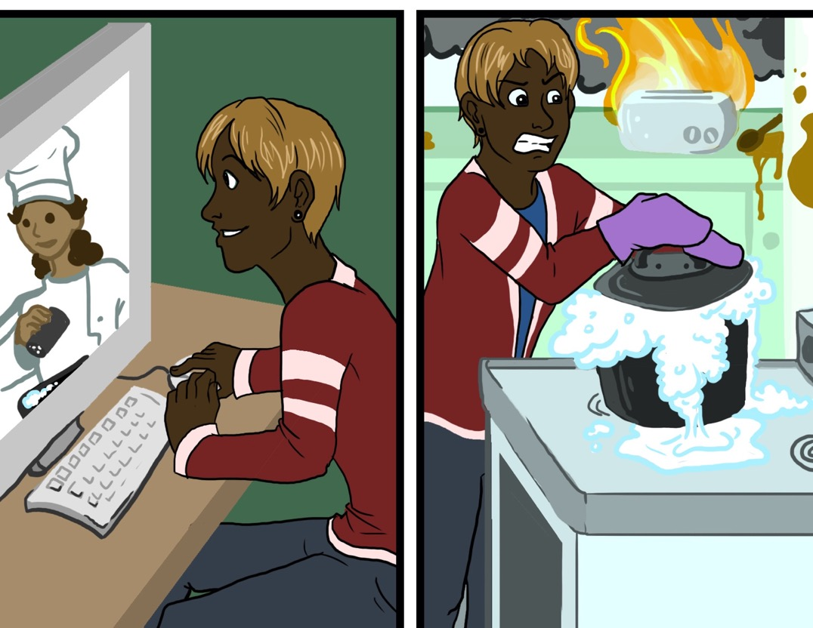
Understanding is easier than being able to do it yourself
Illustration by Alex Dutro-Maeda

Slide 120
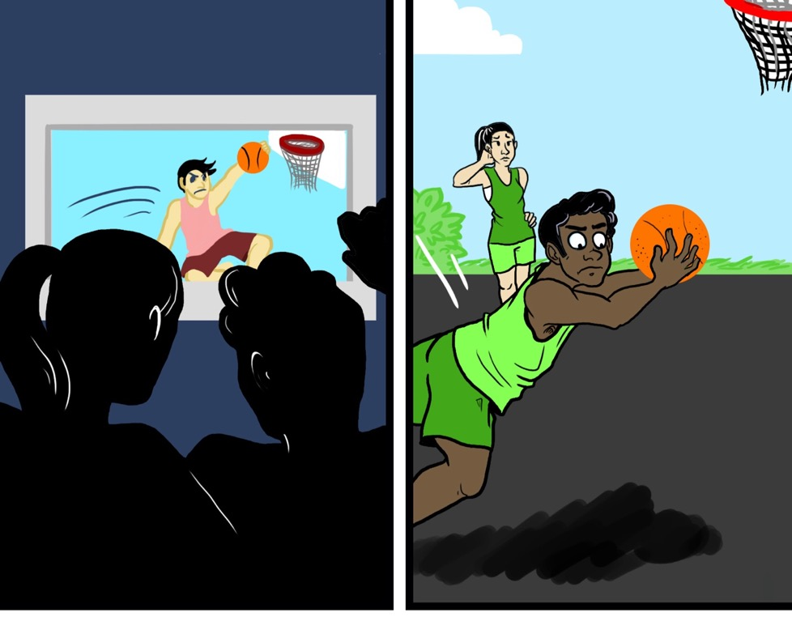
Understanding is easier than being able to do it yourself
Illustration by Alex Dutro-Maeda

Slide 121

Strategy for success in this class
All “Exam Topics” for Exam 1 are posted in D2L.
(1) BEFORE class: Download lecture files, read “Exam topics” and prepare for answering iClicker questions.
(2) To be able to COUNT the 150 min of class time per week as part of your exam prep, peruse the lecture PPT before coming to class.
(3) Use the MasteringBiology HOMEWORK to review LECTURE PPT.
(4) Go over material and SAY OUT LOUD what the reasons are WHY each answer option is correct or incorrect for all iClicker and homework questions.
Illustration by Alex Dutro-Maeda
Notes:
121

Slide 122
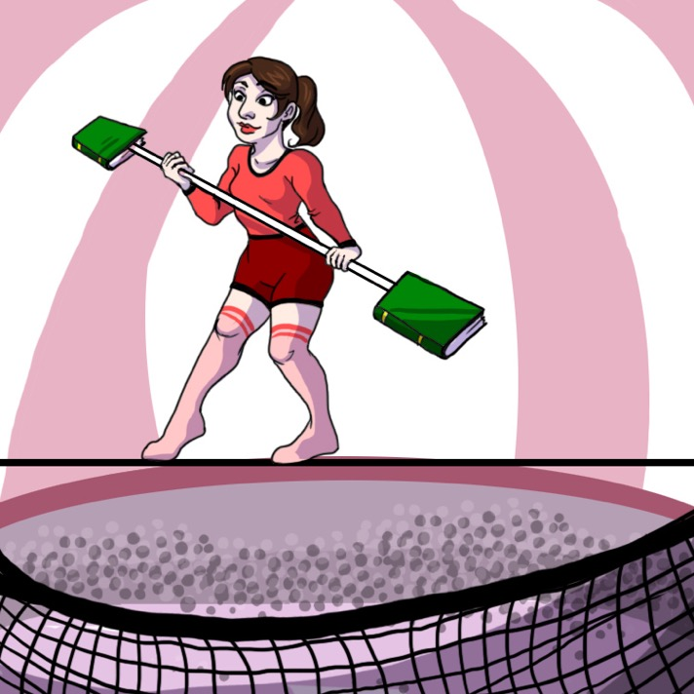
Strategy for success in this class
Build your safety net:
Work with ETs; match them up; anticipate connections; if something is fuzzy, don’t brush it aside since this will surely be on an exam; become immune to confusion and make your preparation solid enough to be able to select the correct answer no matter how the question is worded.
Illustration by Alex Dutro-Maeda

Slide 123
Other

Slide 124
Traxoline
It is very important that you learn about traxoline. Traxoline is a new form of zionter. It is monotilled in Ceristanna. The Ceristannians gristerlate large amounts of fervon and then bracter it to quasel traxoline. Traxoline may well be one of our most lukised protofoms in the future because of our zionter lescelidge.
What is traxoline?
Where is traxoline monotilled?
How is traxoline quaselled?
Why is it important to know about traxoline?
How is traxoline similar/different from table salt?
Don’t fool yourself about when you really understand
Attreibuted to Judy Lanier
Notes:
Similar to the “nonsense” passage from Ian Beatty, above, students can answer this “mini quiz” on this nonsense passage without difficulty, with the exception of questions 4 and 5, which get to the real “meaning” of the passage (of which, of course, there is none). The point is that we can answer factual recall questions without true understanding, and learning is not about memorizing terminology or reading/listening without understanding.
Note that Edward Prather (University of Arizona) tells his students, after this exercise, that if he ever says something in class that sounds like jargony gibberish, that they are to yell out “Traxoline!” to remind him to speak in everyday language.

Slide 125
Bio sketch
Got PhD in 2006 from Ohio State University
Masters in Atomic, Molecular and Optical Physics (worked on cold atoms, atomic beams, interactions of atoms and light and built lasers!)
Afterwards worked on Computational Particle Physics (the kind of thing they do to find theory for the Higgs Boson)
Worked at Oregon State for 5 years
Also work at the University of Cape Town, South Africa, helping to prepare students for graduate study in Astrophysics
Dancer?? (haha!) Martial Artist (be afraid!) and DJ (I might actually be getting good at that)”
Dedra Demaree, Oregon State University
Notes:
Because presentation of data resulted in student backlash, this instructor uses this short presentation to show that she can relate to a student learning physics for the first time.
“I used it to also say that I know am in charge of measuring the impact of the benefit to student learning from the changes we've made to the course, and to say that trying dance and martial arts puts me in the position of being a struggling student which I think helps me teach better since it's been 20 years since I took an introductory course but I can understand what it is like to be in their position.”
“Seems the most effective of anything that I have tried, and eliminated negative comments on evaluations (about wasting time in justifying instructional approaches). “
You can contact Dedra with questions at Dedra Demaree <demareed@science.oregonstate.edu>

